Slide 1
Natural Language Processing
Clinical Text Classification
Semester Project

Slide 2
Team Members
CB.EN.U4AIE19014 – ARUN PRAKASH J
CB.EN.U4AIE19016 – ASSWIN C R
CB.EN.U4AIE19024 – DHARSHAN KUMAR K S
CB.EN.U4AIE19028 – AVINASH DORA
CB.EN.U4AIE19014 – ARUN PRAKASH J
CB.EN.U4AIE19016 – ASSWIN C R
CB.EN.U4AIE19024 – DHARSHAN KUMAR K S
CB.EN.U4AIE19028 – AVINASH DORA

Slide 3
TABLE OF CONTENTS
01
DATASET
02
SEQUENCE MODELS
03
NON-SEQUENCE MODELS
04
RESULT
Problem Statement & Introduction
Sequence – LSTM, Transformers
Model Performance
Non Sequence – RF, LR, KNN

Slide 4
01
DATASET
Medical Transcriptions Dataset - Kaggle

Slide 5
Medical Transcription
Classifying Medical condition based on the transcription

Slide 6
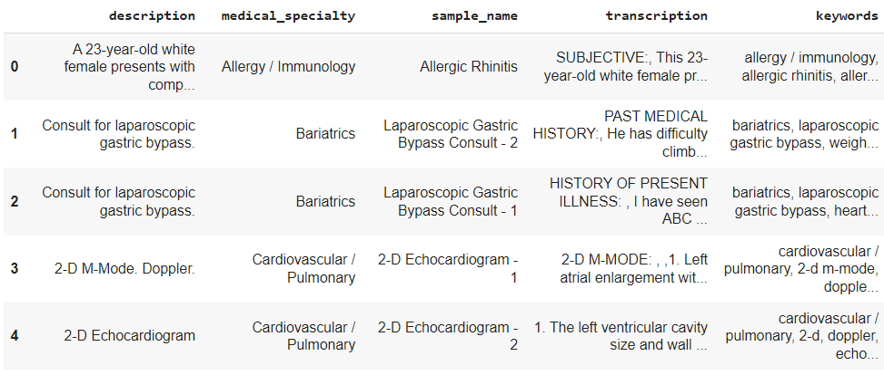
Medical Transcription
Total Samples - 4999

Slide 7
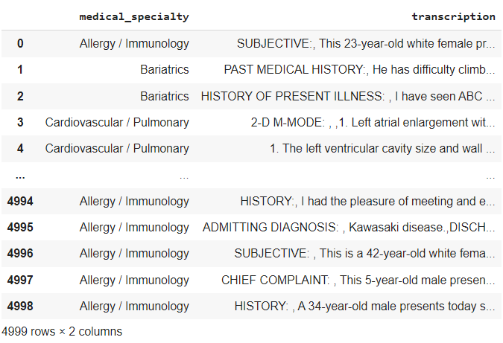
Medical Transcription
Total Samples - 4999
Train – Test split
75 : 25
Train data: 3159
Test data: 1053

Slide 8
Pre-Processing Labels
Pre-Processing Pipeline:
Labels
Remove
Unwanted Labels
Masking similar Labels
Filtering
( <100 )
Dropping NaN values

Slide 9
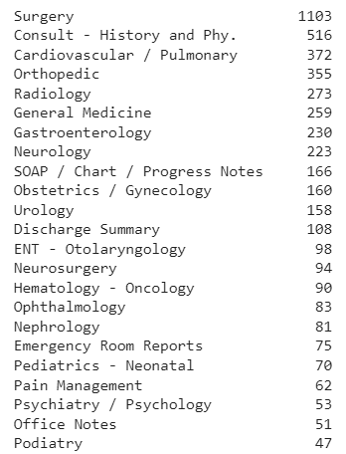
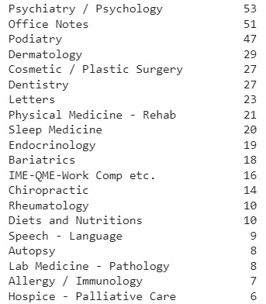
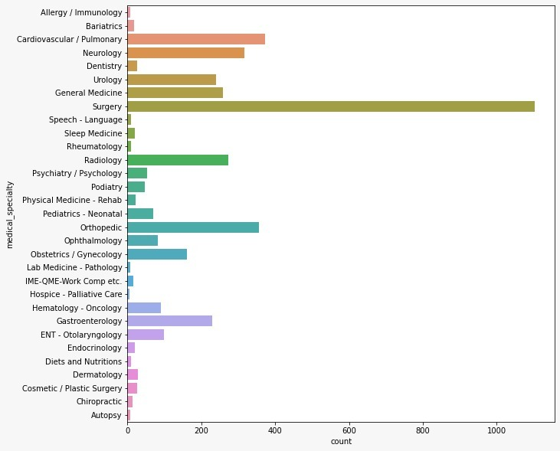
Class Labels
Before Pre-Processing

Slide 10
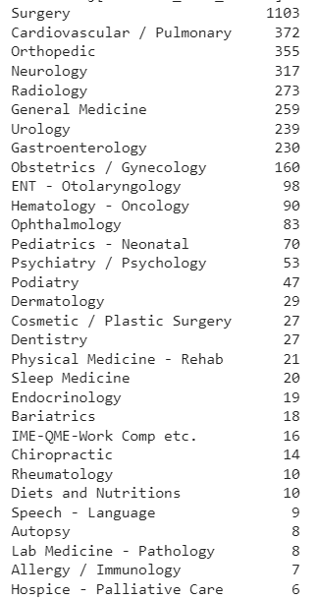
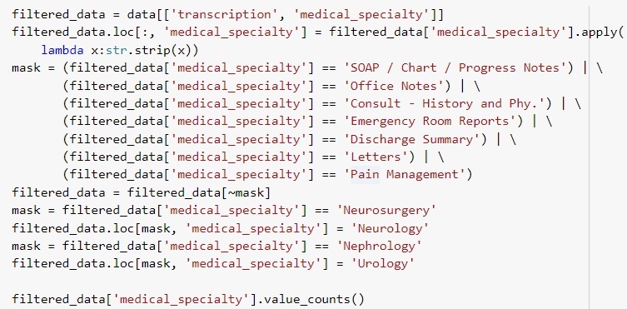
Class Labels
Removing Unwanted words & Masking Labels

Slide 11
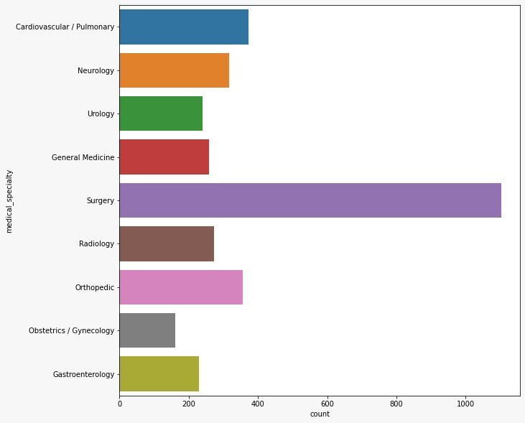

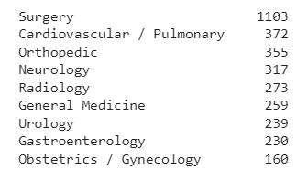


Class Labels
Filtering
~ 730 values are discarded

Slide 12
Sentence
‘The patient is suffering from stomach pain and itching. Mucus infection is also present in him’
NER
‘Abdominal skin nasal’
Tokenize
‘Abdominal’, ‘skin’, ‘nasal’
Remove stop words
‘Abdominal’, ‘skin’, ‘nasal’
Stemming
‘Abdomin’, ‘skin’, ‘nas’
Lemmatization
‘Abdomin’, ‘skin’, ‘nose’

Slide 13
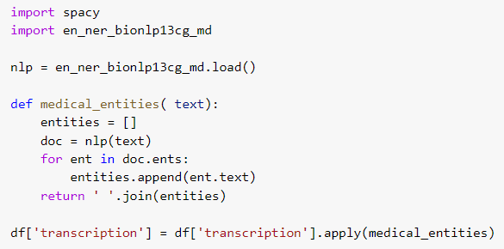
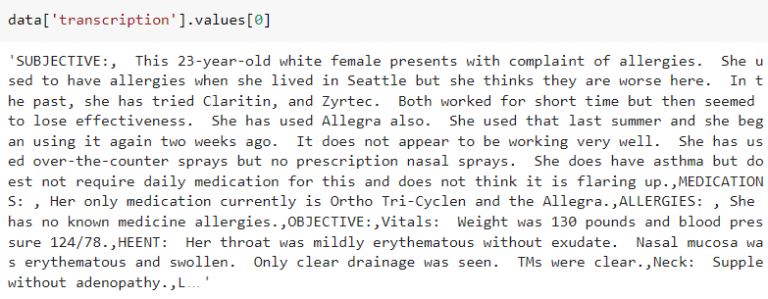
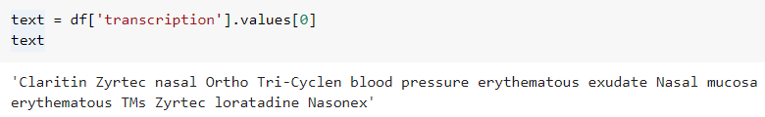
Data
NER

Slide 14
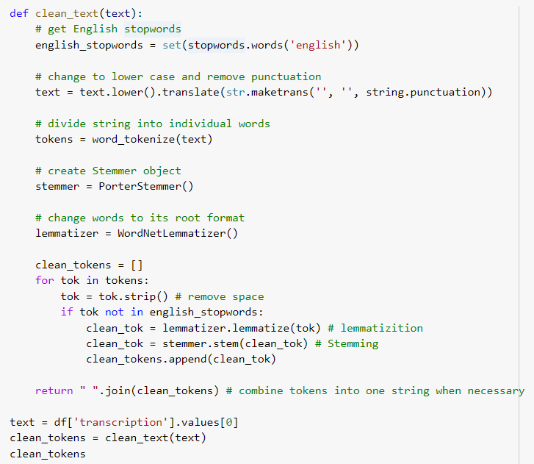
Data
Stop words removal, Stemming, Lemmatization

Slide 15

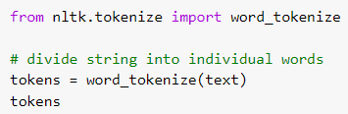
Data
Convert to Lowercase
Tokenize

Slide 16
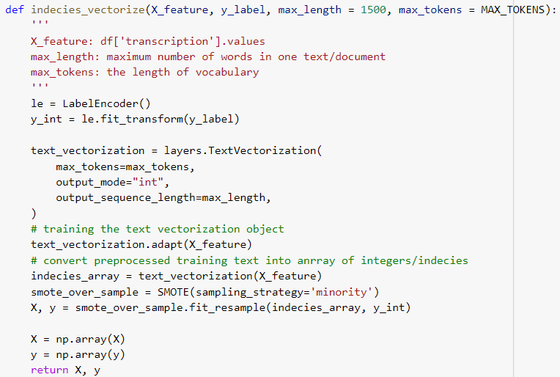
Label Encode
He is suffering from cold
1 2 3 4 5

Slide 17
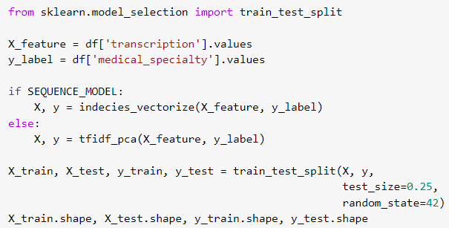
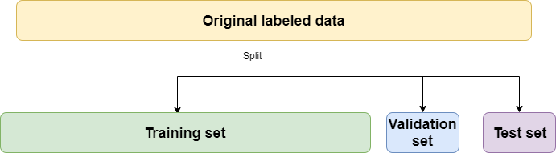

Train Test Split

Slide 18
Pipeline
Tokenised words
Non-Sequence Modelling
Sequence Modelling
TF-IDF
Word Embedding
PCA
VMD
LSTM
Positioning Embedding
SMOTE
Over Sampling
Transformer
Random Forest
Logistic Regression
Multi-Class KNN

Slide 19
02
Sequence Modelling
LSTM, Transformer

Slide 20
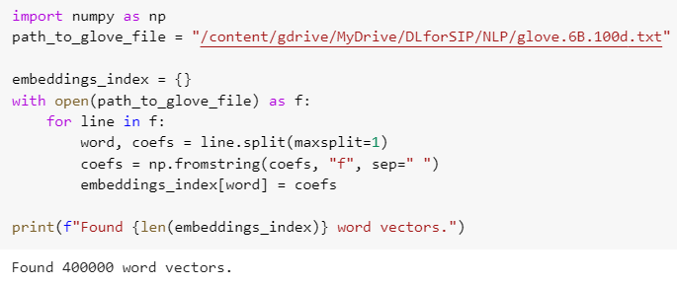
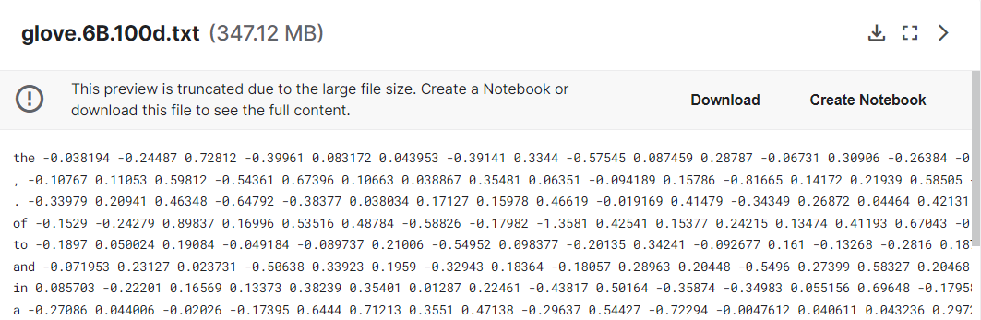
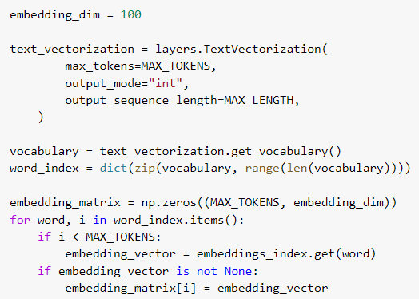
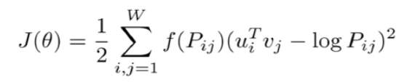
Pre-Trained Glove Model

Slide 21
LSTM

Slide 22
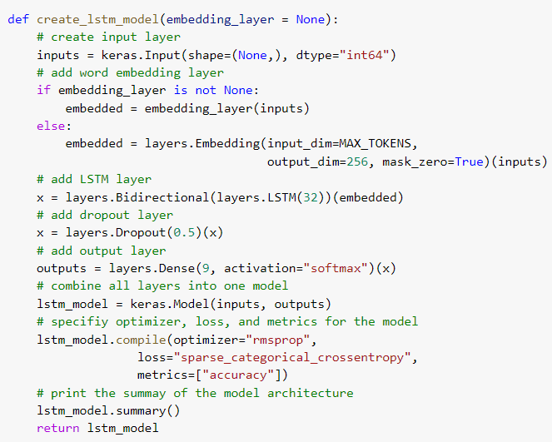
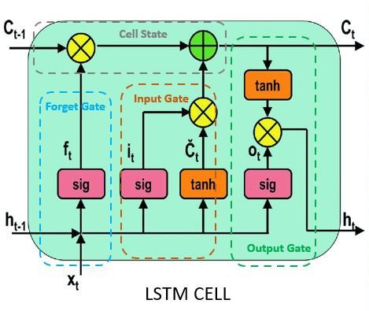
LSTM model

Slide 23
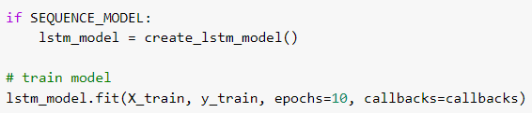
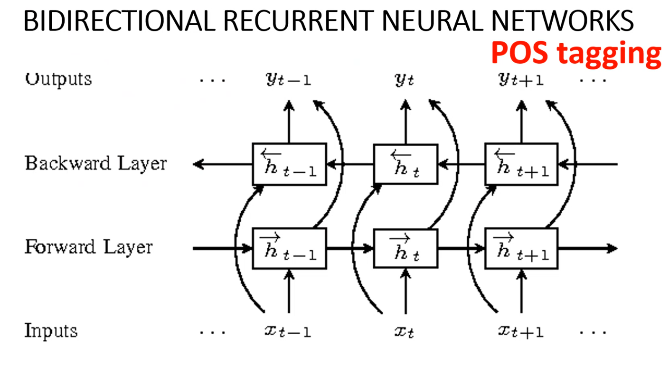
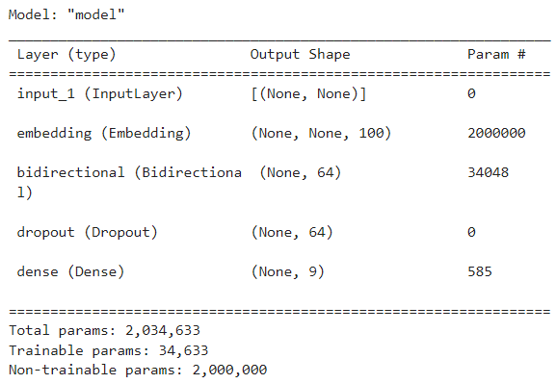
LSTM model

Slide 24
Transformer

Slide 25
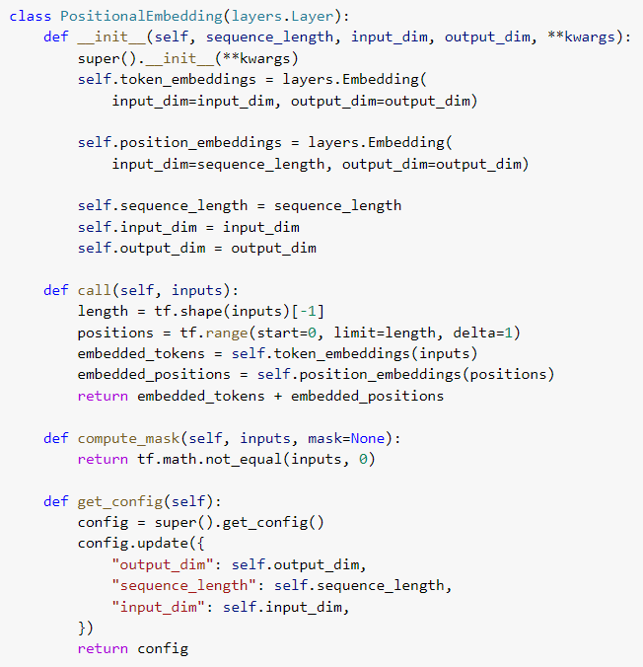
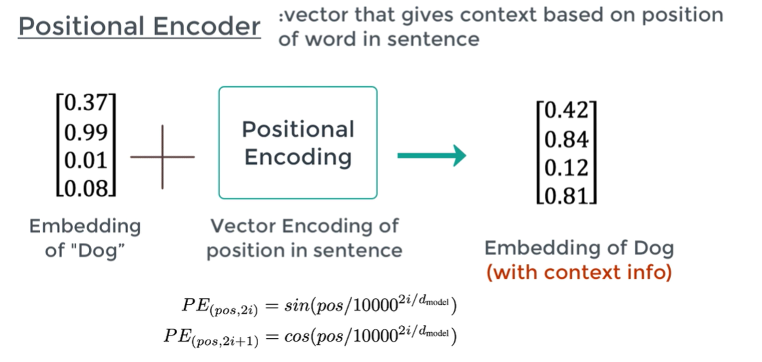
Positional Embedding

Slide 26
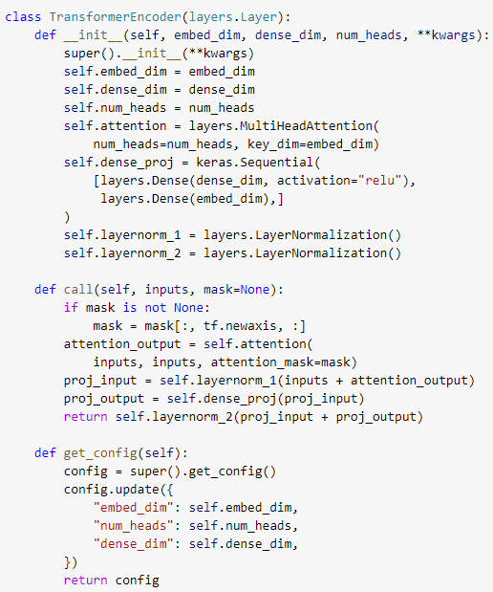
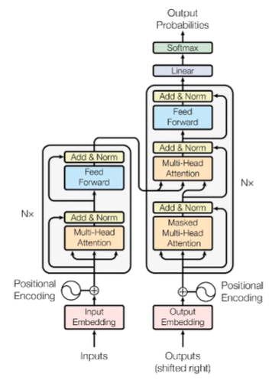
Transformer

Slide 27
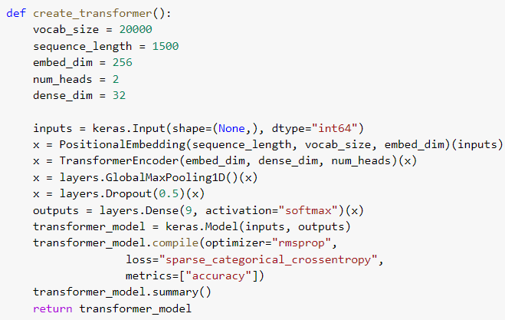
Transformer

Slide 28

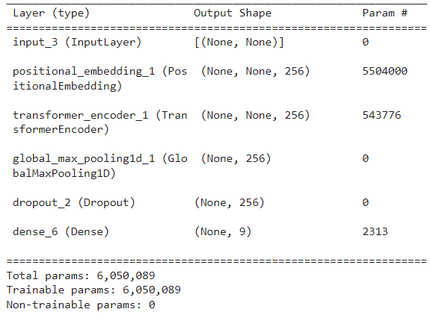
Transformer

Slide 29
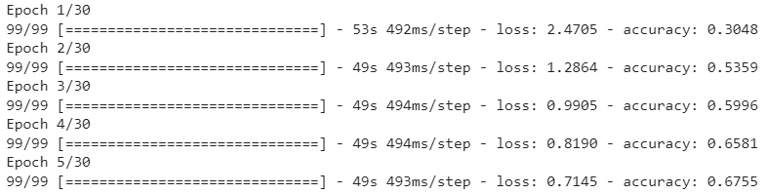
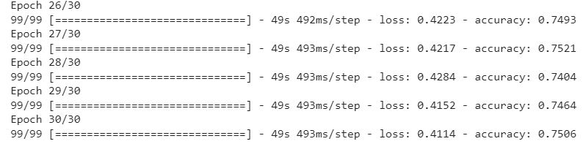
Transformer
. . .

Slide 30
03
Non-Sequence Modelling
Random Forest, Logistic Regression, Multi-class classifier

Slide 31
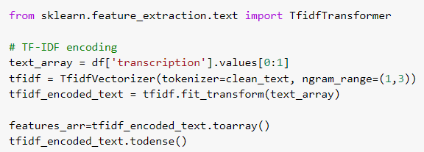
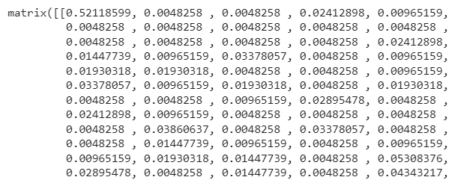
TF-IDF
TF(t) = (Number of times term t appears in a document) / (Total number of terms in the document)
IDF(t) = log e(Total number of documents / Number of documents with term t in it)

Slide 32
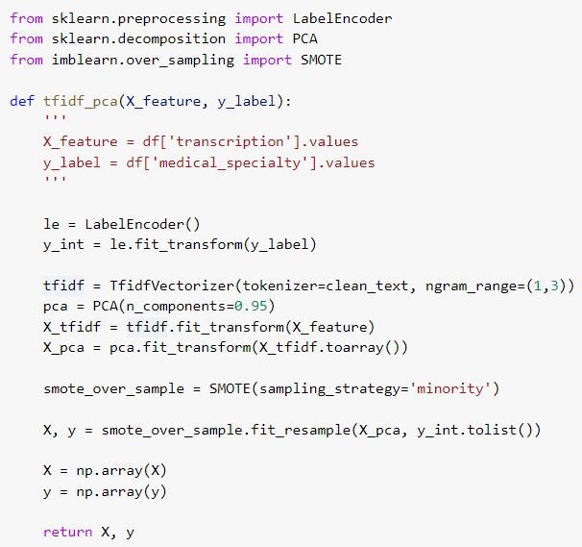
PCA
Aim: reduce the number of variables of a data set, while preserving as much information as possible.

Slide 33
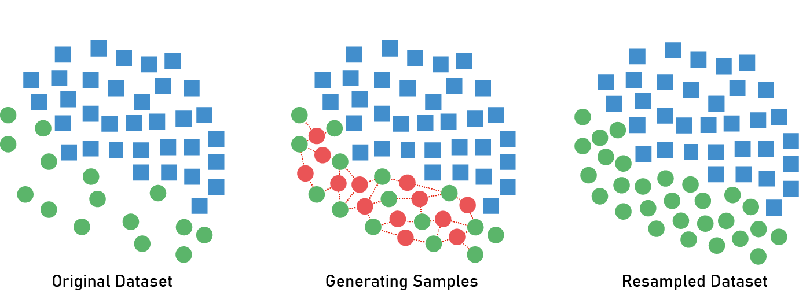
SMOTE
SMOTE is an over-sampling approach in which the minority class is over-sampled by creating “synthetic” examples rather than by over-sampling with replacement.
Difference of feature vector and nearest neighbor.
effectively forces the decision region of the minority class to become more general.

Slide 34
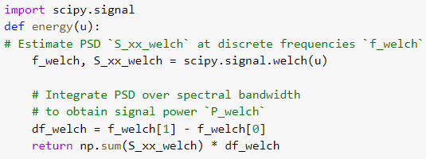
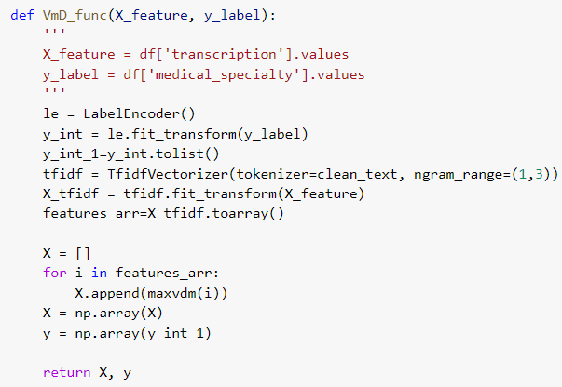
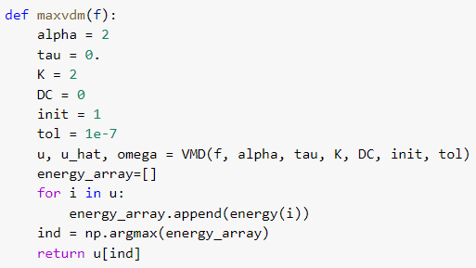
VMD

Slide 35
04
Result
Comparing results

Slide 36
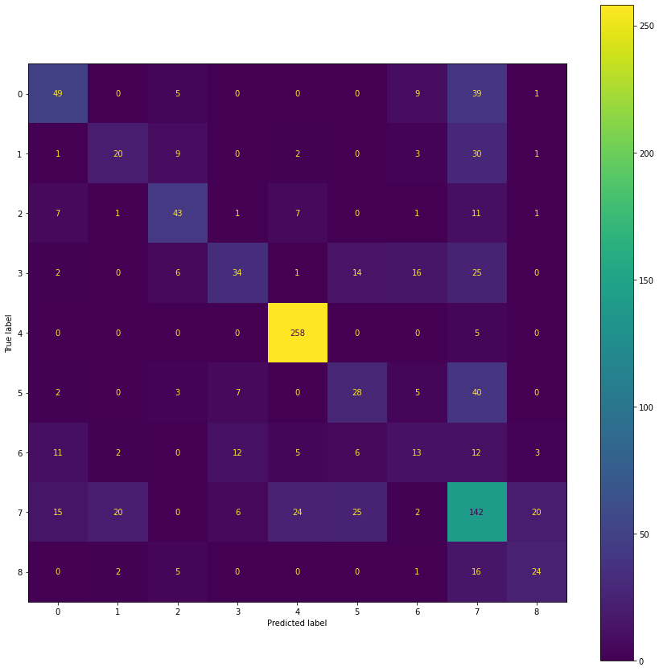
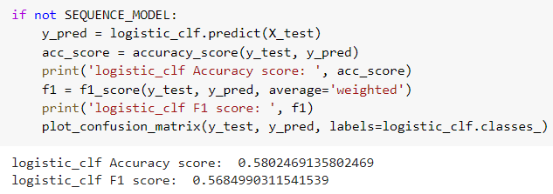
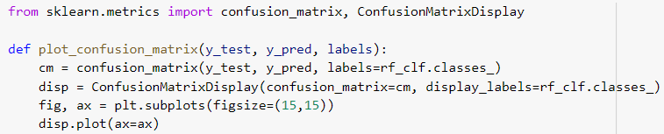
Logistic Regression
predicting the categorical dependent variable using a given set of independent variables

Slide 37
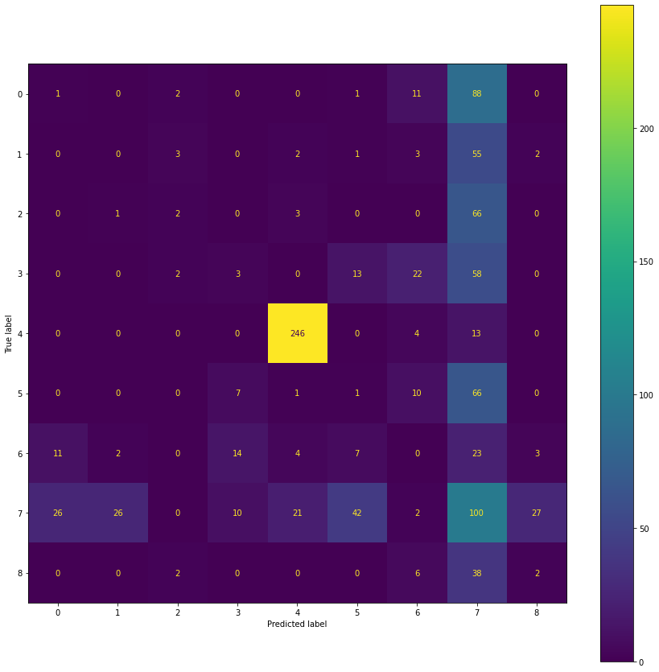
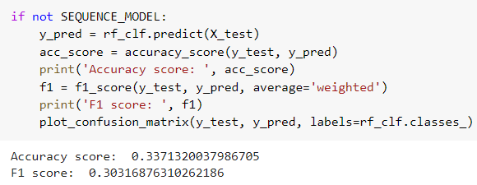
Random Forest

Slide 38
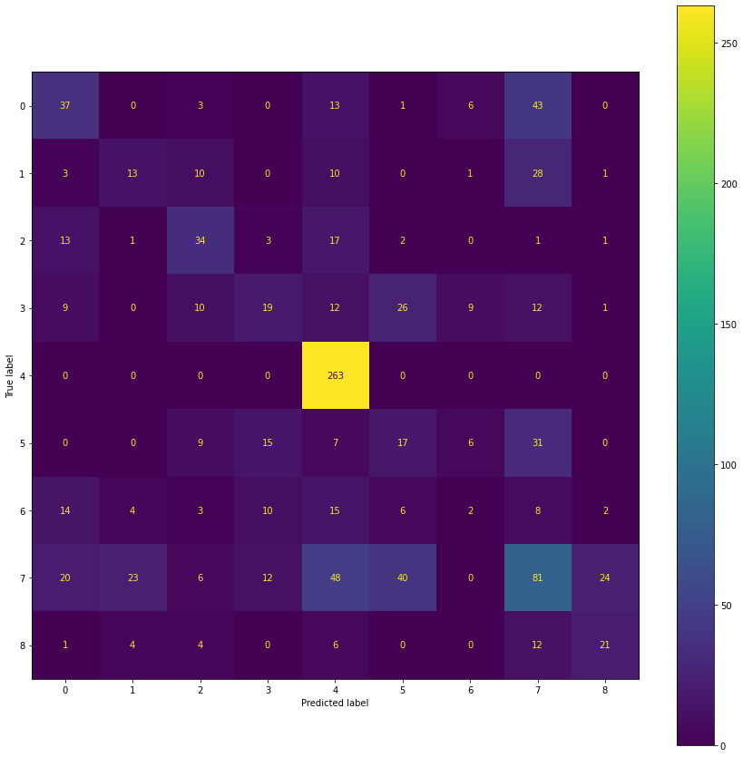
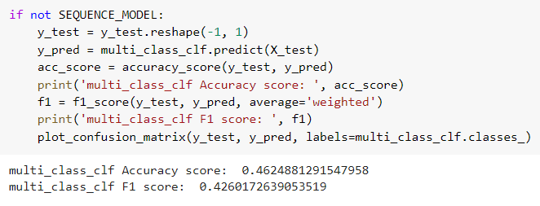
Multi-Class Classifier

Slide 39
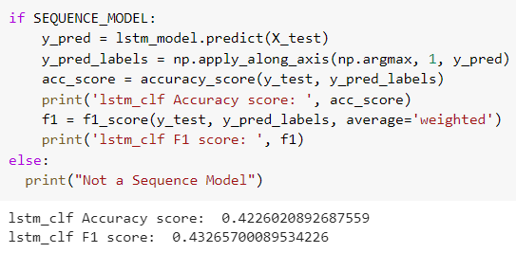
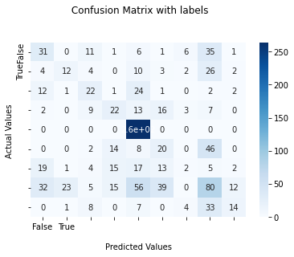
LSTM

Slide 40


Transformer

Slide 41


Non-Sequence Modelling-VMD

Slide 42





Slide 43

Accuracy Comparison

Slide 44
Team Members Contribution
CB.EN.U4AIE19014 – ARUN PRAKASH J
Pre-Processing
SMOTE
CB.EN.U4AIE19016 – ASSWIN C R
Implemented Non-Sequence Models
CB.EN.U4AIE19024 – DHARSHAN KUMAR K S
Implemented LSTM
CB.EN.U4AIE19028 – AVINASH DORA
Implemented Transformers

Slide 45


THANK YOU
Team 13

