Slide 1
Higher Order Data Driven Techniques for Financial Forecasting
21AIE461-FINANCIAL TIME SERIES ANALYSIS

Slide 2
TEAM-7
Arun Prakash - CB.EN.U4AIE19014
C.R.Asswin - CB.EN.U4AIE19016
Avinash Dora - CB.EN.U4AIE19028
Sai Ganesh - CB.EN.U4AIE19044
Siva Prakash - CB.EN.U4AIE19060

Slide 3
TABLE OF CONTENTS
1. INTRODUCTION
2. RELATED WORKS
3.THEORETICAL BACKGROUND
4. METHODOLOGY
5. RESULTS
6. FUTURE WORKS

Slide 4
PROBLEM STATEMENT
Compare the performance of ARIMA with DMD and HODMD on the forecast of stock price of a single company.
Check whether using the combination of different markets or combinations in the same market (Inter and Intra) improve the forecasting.
All comparisons are done based on the MAPE error metric.

Slide 5
1. Introduction

Slide 6
Analysis of stock prices :
Stock price prediction is a challenging problem as the market is quite unpredictable.
Technical Analysis :
Involves studying the past data to predict future prices.It uses statistical analysis to predict the price.
Fundamental Analysis :
Stock price predictions can be made by analyzing the current financial situations and by taking into account the financial statements of a company.

Slide 7
Limitations of other existing approaches :
Neural Network :
- Requires large training data
- Model has to be trained for new features, once the financial patterns change.
DFT :
- Cannot estimate growth and decay of the system.
Proper Orthogonal Decomposition(POD) :
- POD modes are orthogonal in space with multi-frequency time signals, whereas DMD modes are non-orthogonal in space with single frequency time signal.

Slide 8
2. Related works

Slide 9

Reference #1
DMD method to capture the temporal coherent structures in its sampling windows and provides a regression line for best fit.
Highlights on the use of an iterative refinement process to find the optimal sampling window.
Uses an iterative strategy to find the best forecast using combinations of sampling window and how far to predict in the future

Slide 10
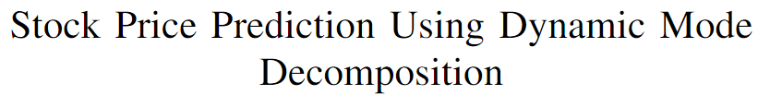
Reference #2
- Using stock market as a dynamic system.
- Mean Absolute error – to calculate the deviation of predicted and the actual price.
- Price prediction (3 ways)
· Sampled companies belonging to same sector to predict the future price.
· Sampled companies belonging to all sector to predict the future price.
[ Sampling and prediction window are fixed in above 2 cases ]
· 3rd- prediction until a threshold value.
- Comparing DMD with ARIMA MODEL.

Slide 11
Reference #3
Adapting the HODMD technique which is commonly used in fluid dynamics.
This method is a more robust and accurate version of classical DMD, and is suitable for analyzing complex signals and non dynamical systems.

Slide 12
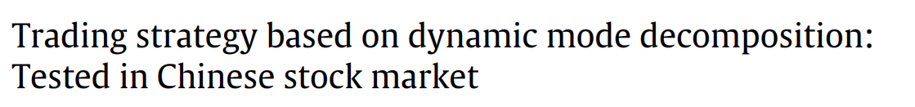
Reference #4
The authors propose a trading strategy considering the external factors in addition to the application of DMD for forecasting.
The trading is frozen when the success rate is less than 50%.

Slide 13
3. Theoretical Background

Slide 14

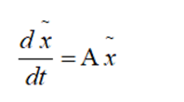
Dynamic Mode Decomposition
• The dynamic mode decomposition is a data processing algorithm that extracts spatial–temporal coherent structures in a given complex system( high dimensional data ) and gives a linear model which evolves over a period of time.
• A dynamic system is described using a governing set of differential equations.
• In DMD procedure, we construct an approximate linear evolution of the system.

Slide 15
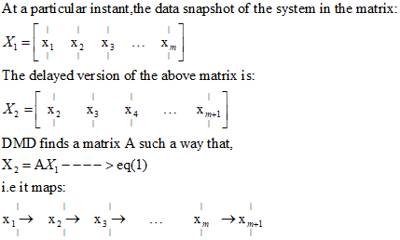
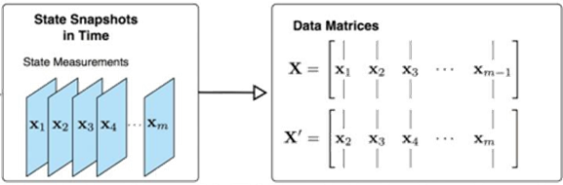
DMD ALGORITHM

Slide 16
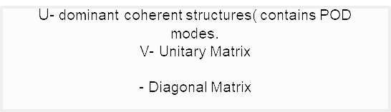
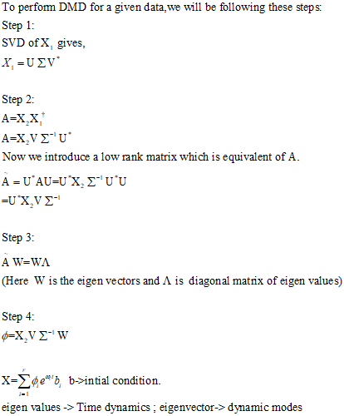
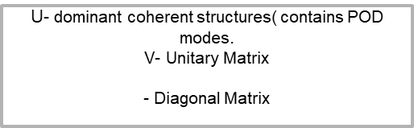
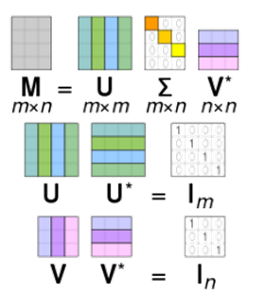

Slide 17
Conclusion based on Eigenvalues
If real part of eigenvalues are positive and greater than one, then it means a growing mode and growing money.
If eigenvalues are negative, then it means decaying modes and losing money.
The logarithmic values of DMD eigenvalues give us the frequencies.
Complex part of the eigen values represents oscillations in the time-series.

Slide 18
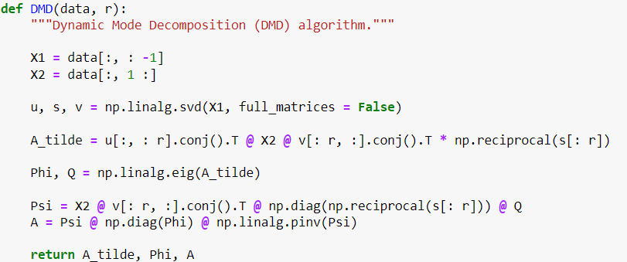
DMD - CODE

Slide 19
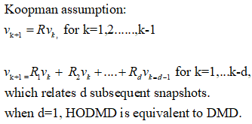
Higher Order DMD:
HODMD is an extension of the well known technique,Dynamic Mode Decomposition.
Hyperparameters involved :
- svd_rank : rank for truncation
- d : the new order for spatial dimension of the input snapshots

Slide 20
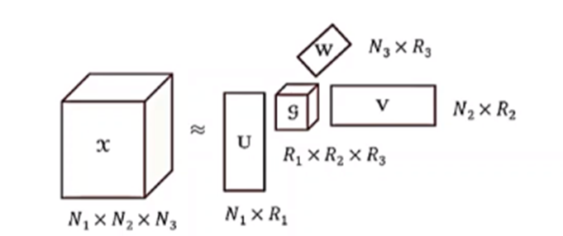
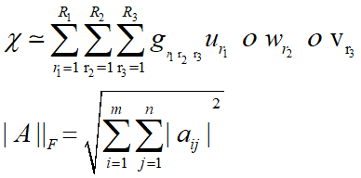
HOSVD
Orthogonality of the core tensor and the factor Matrices.

Slide 21

Mean Absolute Percentage Error
For comparing different time series, we cannot use scale dependent metrics like MSE or MAE.
MAPE is scale independent and can successfully help in comparing the forecast performance between different time series.
It is calculated by taking the mean or average of the absolute difference between the actual and predicted value, which is divided by the actual value.
Here At is the actual value and Ft is the predicted value.

Slide 22
4. Methodology

Slide 23
Method 1
Method 2
Use a single company’s stock prices by splitting the data into train and test data and then apply the 3 models :
Arima
DMD
HODMD
Compare ARIMA with DMD and HODMD by taking the MAPE values after forecasting.
Combine two different sectors, i.e., pharmacies and automobile sectors and then perform train test split. Apply DMD and forecast stock prices for a single pharmaceutical company (SunPharma).
If length of time series = a
If length of window = w
Then size of input matrix
d = (a-w+1,w)

Slide 24
5. Results

Slide 25
Single Stock Prediction
We compare the performance of ARIMA, DMD and HODMD algorithms for forecasting the price of a single stock. We compare the performance on the following 3 stocks:
Sun-Pharma
Tata Motors
Fintech
Performance is compared in terms of MAPE values. We check the performance both in the short term and long term.

Slide 26
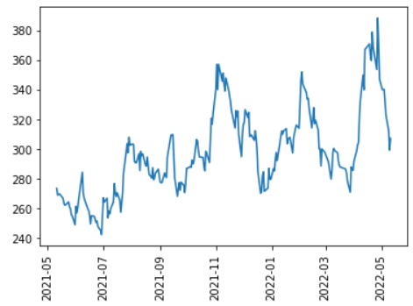
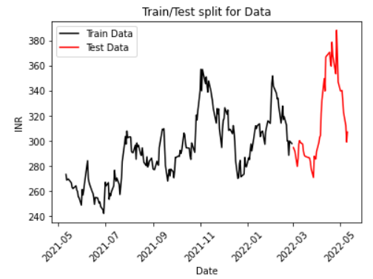
Fintech:
Time Series plot: Train-test Split:

Slide 27
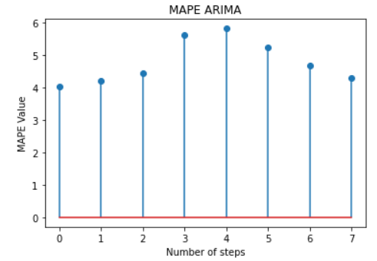
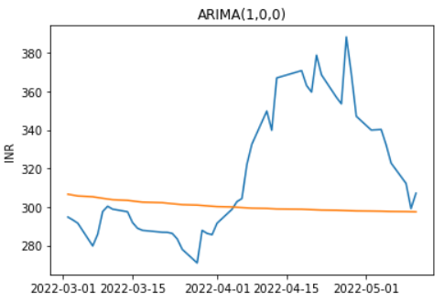

Fintech:
We fit the ARIMA(1,0,0) model on the data. The performance is given below:
Short-Term(7 days): Long-Term(49 days):

Slide 28
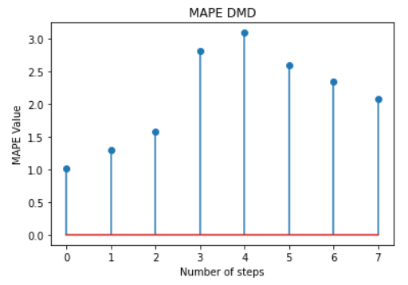
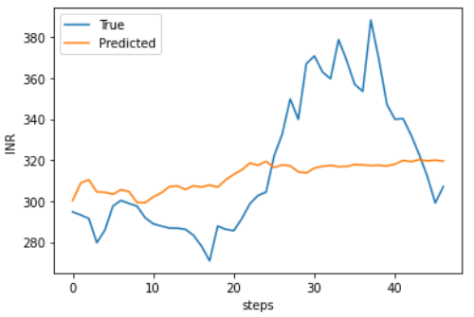
Fintech:
For DMD for a better Long term prediction we use a higher window size and for a better short term prediction we use a smaller window size.
Window = 5
Window = 30

Slide 29
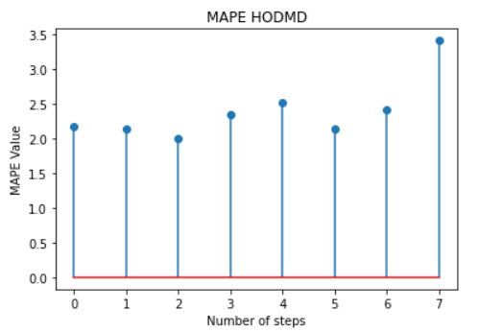
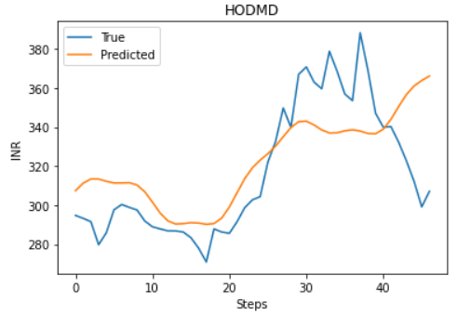
Fintech:
HODMD works better in the short term with a smaller window and better in the long term with a longer window. A higher dimensionality for both performs better
Window = 3
Window = 25

Slide 30
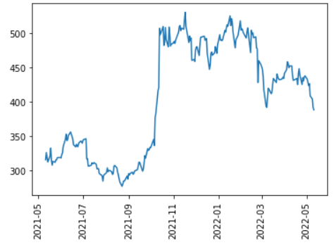
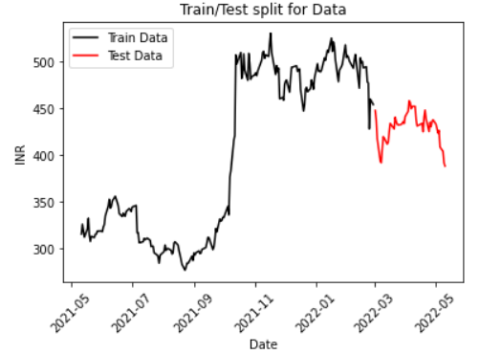
Tata Motors:
Time Series Plot: Train-test split:

Slide 31
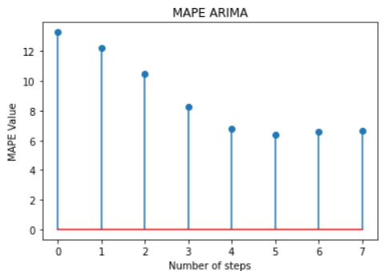
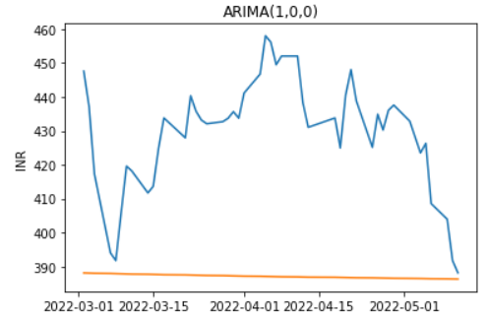
Tata Motors
We fit the ARIMA(1,0,0) model on the data. The performance is given below

Slide 32
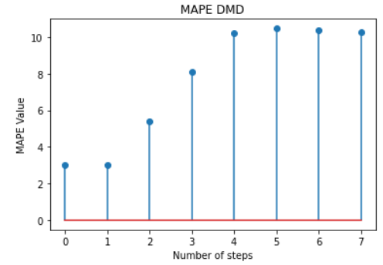
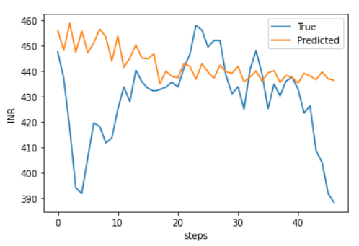

Tata Motors:
For DMD for a better Long term prediction we use a higher window size and for a better short term prediction we use a smaller window size.
Window = 10
Window = 25

Slide 33
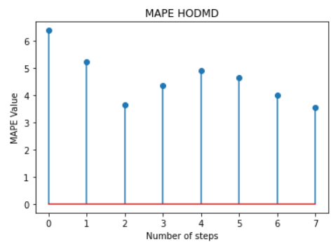
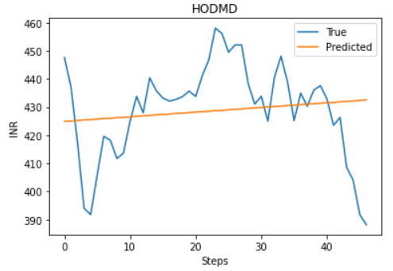
Tata Motors
HODMD works better in the short term with a smaller window and better in the long term with a longer window. A higher dimensionality for both performs better
Window = 3
Window = 25

Slide 34
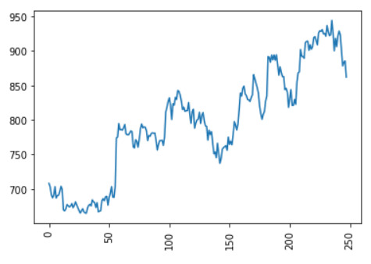
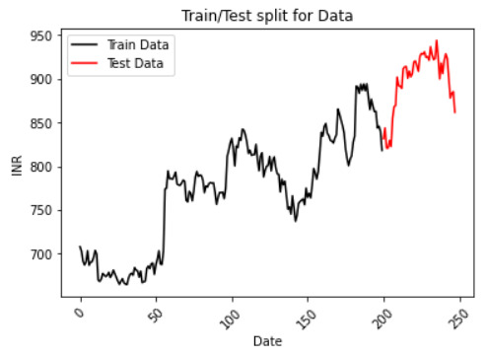


Sun Pharma:
Time Series Plot: Train-test split:

Slide 35
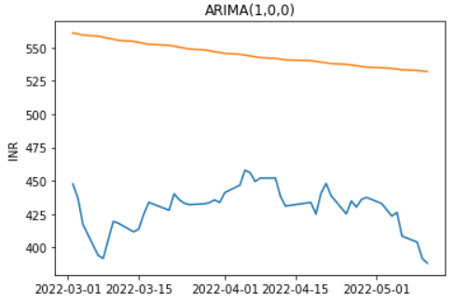
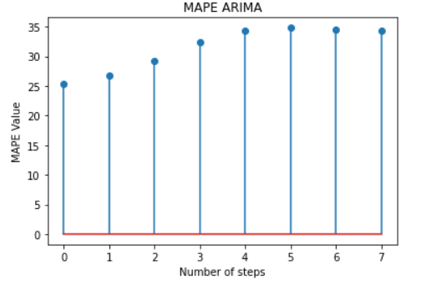
Sun Pharma
We fit the ARIMA(1,0,0) model on the data. The performance is given below

Slide 36
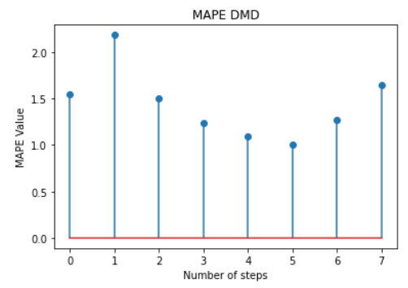
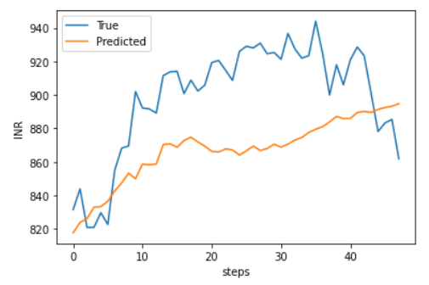

Sun Pharma
For DMD for a better Long term prediction we use a higher window size and for a better short term prediction we use a smaller window size.
Window = 10
Window = 30

Slide 37
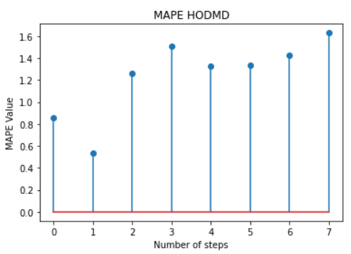
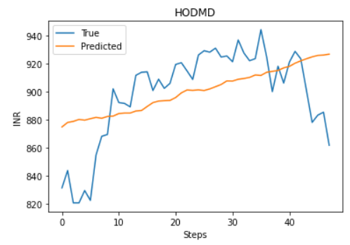

Sun Pharma
HODMD works better in the short term with a smaller window and better in the long term with a longer window. A higher dimensionality for both performs better
Window = 10
Window = 10

Slide 38
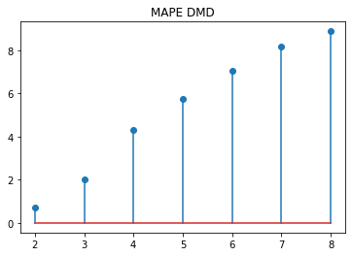
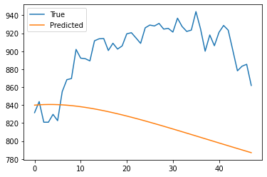
Sun Pharma (Combinations in same sector):
Based on experiments it is concluded that 5 modes are optimal for the next 49 days forecast.
MAPE : 8.96

Slide 39

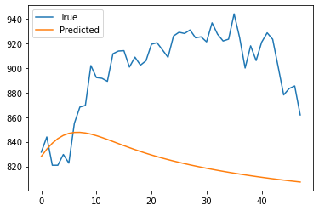
Sun Pharma (Combination of different sectors):
Based on experiments it is concluded that 14 modes are optimal for the next 49 days forecast. Sun Pharma with pharma sector and automobile sector gives a better forecast.
MAPE : 8.27

Slide 40
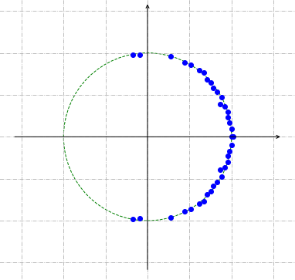
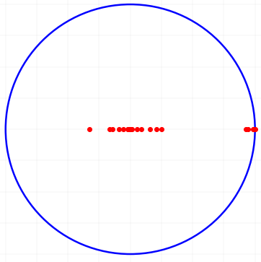
EigenValue Plots:
HODMD
DMD

Slide 41
6. Future Works

Slide 42
To explore other decomposition techniques such as Multi Resolution DMD.
Explore uses in other sectors.
Discover hotspots from the data using data driven techniques.

Slide 43
THANK YOU

