Slide 1




NEXT GEN EMPLOYABILITY PROGRAM
Creating a future-ready workforce
Team Members
College Name
Student Name: ARUN PRASATH VK
Student ID: au814721104008
SRM TRP ENGINEERING COLLEGE

Slide 2

CAPSTONE PROJECT SHOWCASE
Project Title
Notes Sharing Web Application using Django Framework
Abstract | Problem Statement | Project Overview | Proposed Solution | Technology Used | Modelling & Results | Conclusion

Slide 3
Abstract
MemoMatrix aims to develop a web application for sharing notes, built on the Django framework. Within this platform, users can effortlessly create, upload, view, and exchange notes with peers. By registering securely, users gain access to a personalized hub for managing their notes securely.
Emphasizing paramount importance on data security and privacy, the application implements robust authentication mechanisms, data encryption, and precise permission controls. This ensures user data remains safeguarded, fostering a trustworthy environment for collaboration.
In essence, MemoMatrix strives to offer a user-friendly, secure ecosystem for collaborative note management. It's a space where users can seamlessly exchange ideas, knowledge, and insights while efficiently organizing their notes.

Slide 4
Problem Statement
In the rapidly evolving digital landscape, individuals frequently confront obstacles in effectively managing and disseminating notes. Whether it's students collaborating on group assignments, professionals disseminating meeting insights, or enthusiasts sharing knowledge, there's a demand for a unified platform streamlining note creation, arrangement, and dissemination.
Fragmented Solutions: Users encounter challenges in locating a singular platform encompassing all essential features for creating, organizing, and distributing notes seamlessly.
Insufficient Security: Current offerings often fall short in implementing robust security protocols to safeguard user data, prompting apprehensions regarding privacy and confidentiality.

Slide 5
Project Overview
Within the realm of note-taking and collaboration, users frequently encounter obstacles that hinder their productivity and teamwork. These hurdles include:
Tool Fragmentation: Users often juggle multiple applications or tools for note-taking, organizing, and sharing, resulting in inefficiencies. This fragmented approach necessitates navigating various platforms with distinct interfaces and functionalities.
Security Risks: Numerous note-sharing platforms may overlook stringent security measures, leaving user data susceptible to breaches or unauthorized access. In the absence of robust encryption and authentication mechanisms, users may be reluctant to share sensitive information through these channels.

Slide 6
Proposed Solution
The Notes Sharing Web Application, constructed using the Django framework, presents a comprehensive solution to the challenges inherent in note-taking, organizing, and sharing. Here's how the application tackles each issue:
Centralization:
Users enjoy a singular hub where all note-related activities, from creation to sharing, are seamlessly executed. This eliminates the necessity of toggling between various tools or platforms, streamlining the user experience.
Security Protocols:
Stringent security protocols are ingrained within the application to safeguard user data and privacy. This encompasses encryption techniques applied to sensitive data, fortified authentication mechanisms like OAuth or JWT, and meticulous role-based access controls for efficient management of user permissions.

Slide 7


Technology Used
Front-end
Back-end

Slide 8
Modelling & Results
Modeling:
Database Design:
Utilizing Django's ORM, the application constructs a robust data model, outlining the configuration of database tables.
Search and Arrangement:
Empowered by an advanced search feature, users can effortlessly locate notes using various parameters such as keywords, titles, categories, or tags, enhancing organizational efficiency.
Outcomes:
The Notes Sharing Web Application, constructed on Django, offers a centralized arena for streamlined note creation, organization, and dissemination. Users benefit from seamless collaboration, version tracking, and real-time communication with collaborators, fostering enhanced productivity and collaboration.

Slide 9
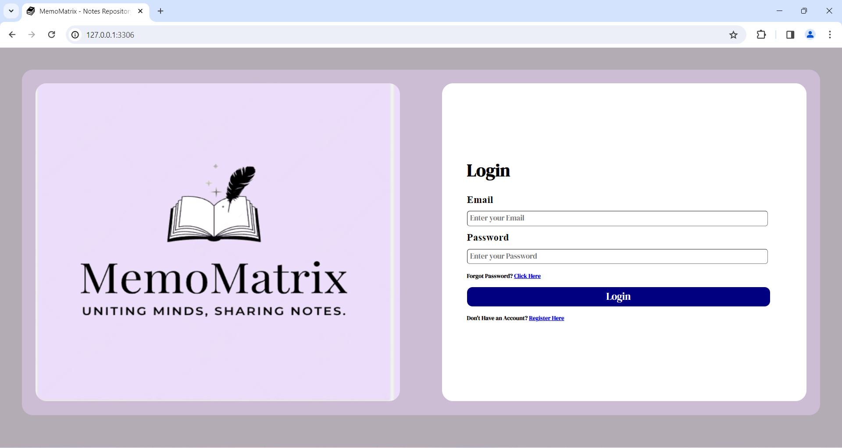
Login page

Slide 10
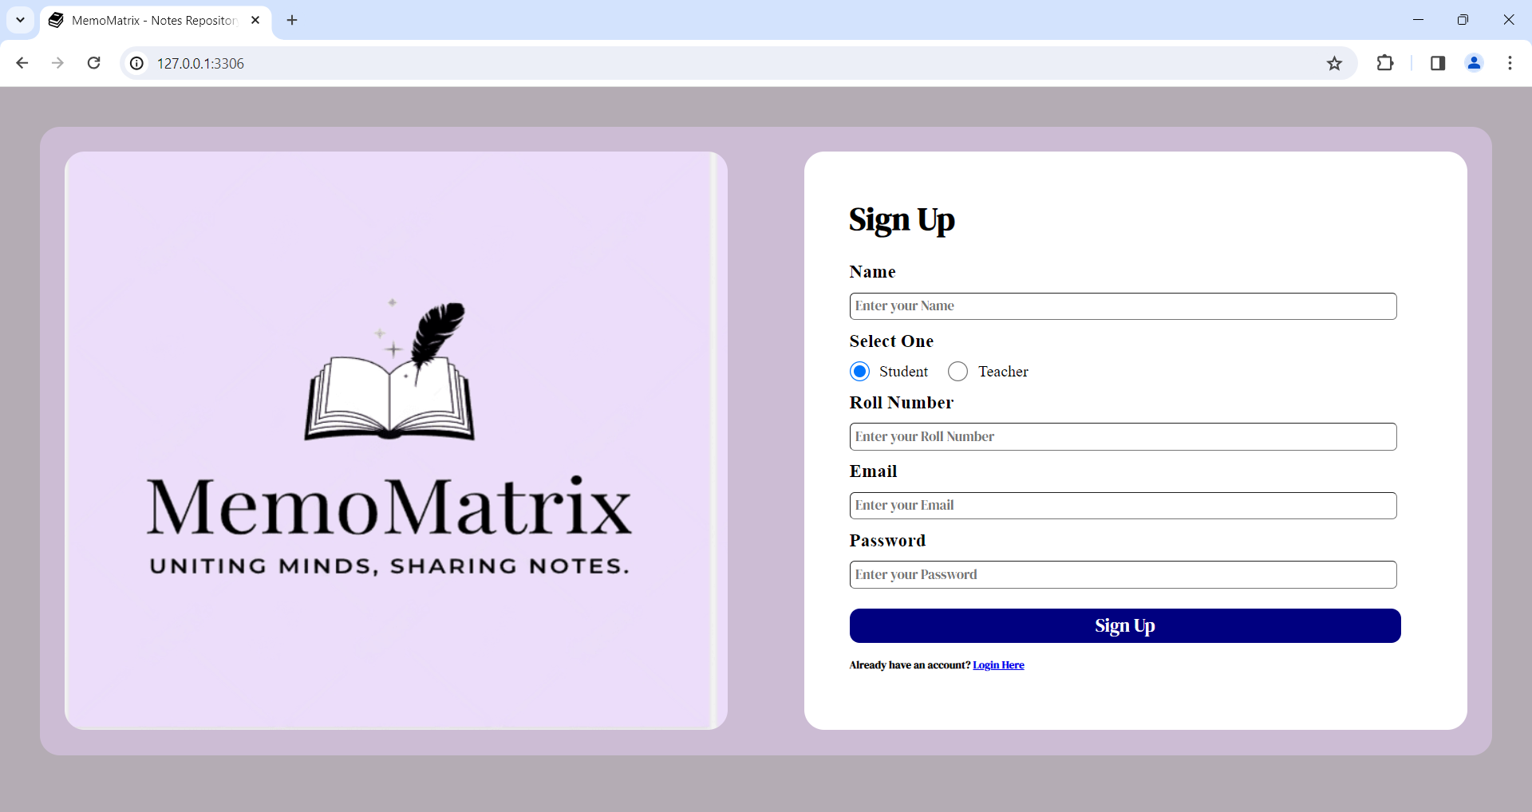
Student’s login

Slide 11
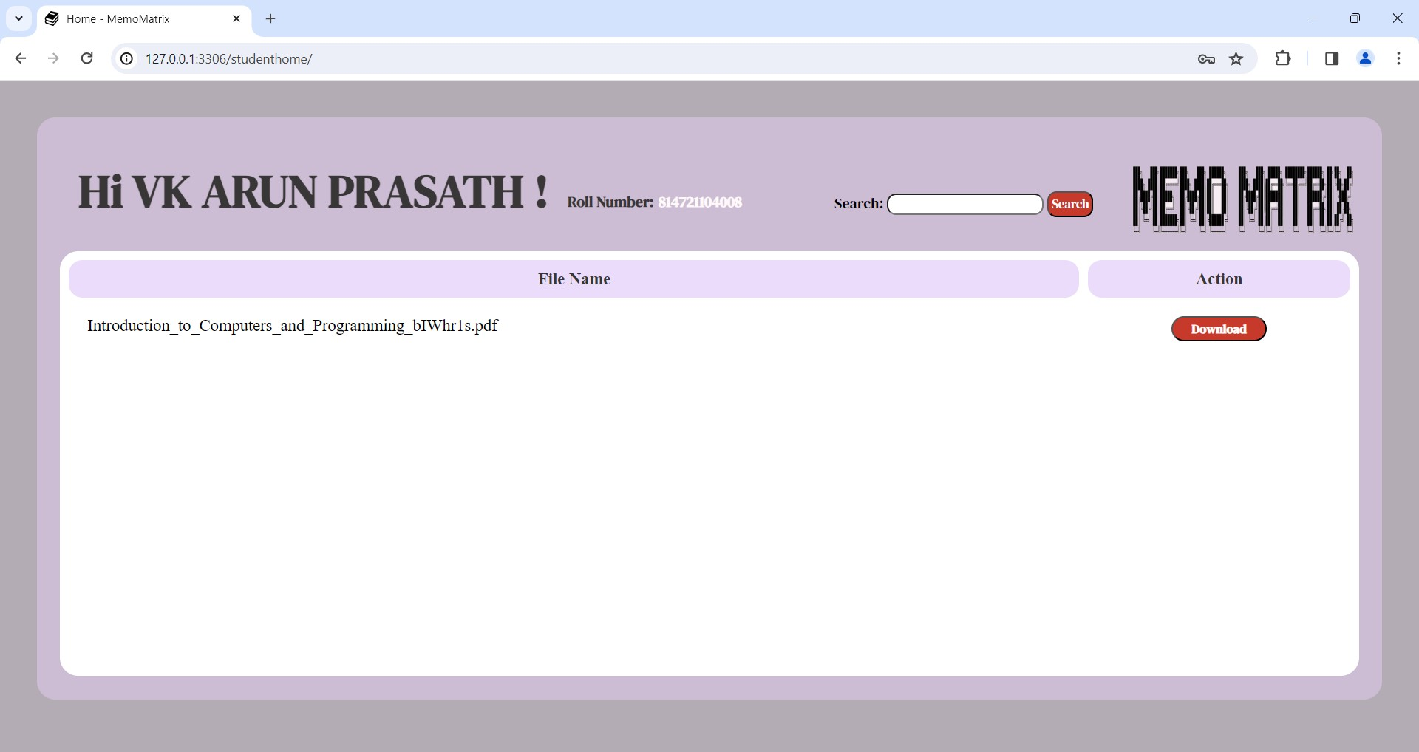
Student’s page

Slide 12
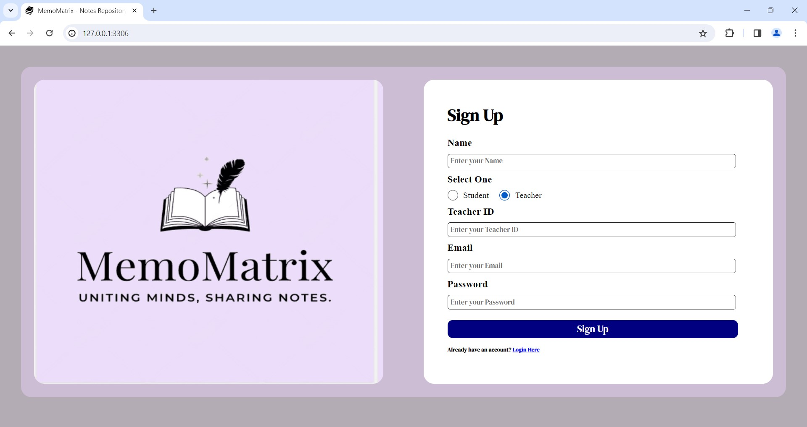
Teacher’s login

Slide 13
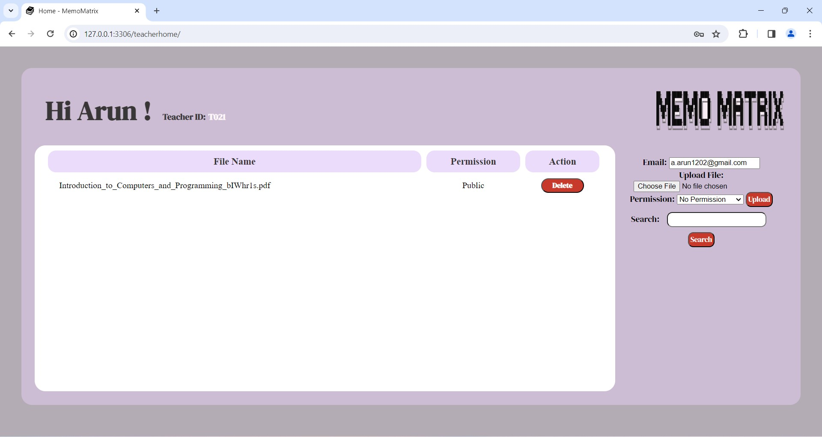
Teacher’s Page

Slide 14
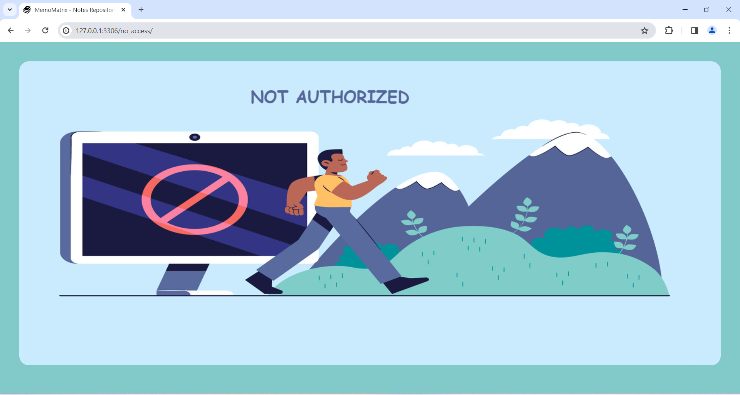
No access

Slide 15
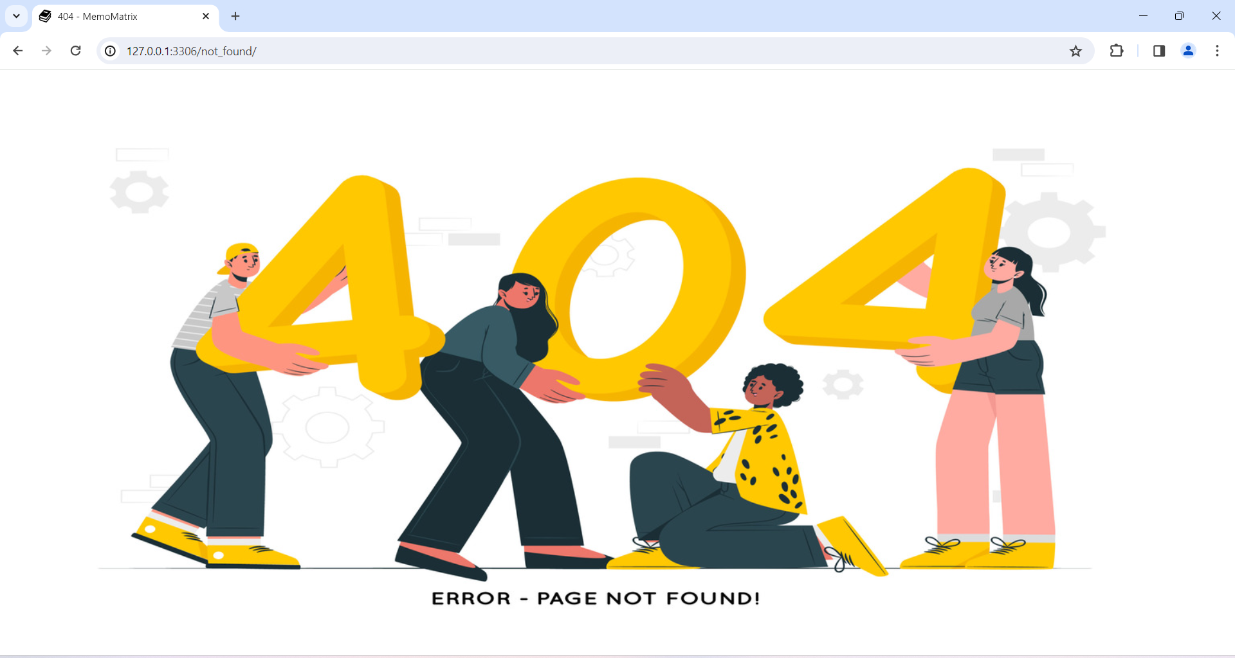
404 Error

Slide 16
Future Enhancements
Enhanced Collaboration: Introduce advanced collaboration functionalities to foster seamless teamwork.
External Tool Integration: Incorporate compatibility with external productivity tools for enhanced workflow integration.
Improved Security: Strengthen security measures to safeguard user data effectively.
Mobile App: Develop a mobile application counterpart to ensure accessibility and convenience.
Offline Access: Enable users to access and synchronize notes even without an internet connection.
Customizable Templates: Offer customizable templates and workflows to tailor note-taking experiences.
Analytics: Provide users with insights into usage patterns and productivity metrics.
Accessibility: Enhance accessibility features to accommodate diverse user needs.
Community Feedback: Integrate user feedback mechanisms to foster community engagement and refinement.

Slide 17
Conclusion
The MemoMatrix web application, constructed on Django, offers a comprehensive solution to the challenges encountered in note-taking, organization, and sharing. By establishing a centralized platform fortified with robust security measures, cutting-edge collaboration features, efficient organization tools, and an intuitive interface, the application aims to streamline workflows, boost productivity, and facilitate seamless knowledge exchange among users.
In essence, MemoMatrix stands as an invaluable tool for individuals, teams, and organizations seeking to streamline note-taking processes, foster effective collaboration, and harness the collective power of shared knowledge. Through ongoing refinement and innovation, MemoMatrix continues to evolve, remaining a cornerstone asset for users striving for excellence in productivity and collaboration.

Slide 18
Thank You!
Notes:
Thank You !!

