Slide 1
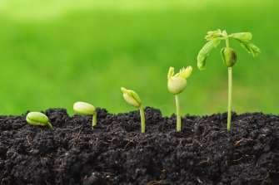

E - COMMERSE APPLICATION FOR FARMERS
GUIDE: Mr.N.Karthikeyan(AP/CSE)
Arun R ,Team Lead | (822720104006)
Ganesh S | (822720104303)
Mathiyazhagan A | (822720104020)
Mohamed Yashin M | (822720104022)

Slide 2
ABSTRACT
The vision of this project is to ensure the fair price to the farming community by making use of online market.
It serves as a platform for the movement of products agricultural from the farms directly to the consumers or retailers.
It makes all the available farm products easily accessible.
Despite the higher demands and opportunities, the agriculture sector in India has not proven to be very lucrative.
Bargaining power of farmers increases.

Slide 3
OBJECTIVE
Improve productivity: Agriculture applications can help farmers and agricultural businesses improve their productivity by providing tools and resources to help them manage their operations more efficiently. For example, applications can provide weather forecasts, crop growth tracking, and irrigation scheduling to help farmers optimize their crop yields.
Increase profitability: Agriculture applications can help farmers increase their profitability by reducing waste, minimizing input costs, and maximizing output prices. Applications can provide market information, price tracking, and yield forecasting to help farmers make informed decisions about their crops.
Enhance sustainability: Agriculture applications can help farmers and agricultural businesses adopt sustainable practices by providing information on soil health, water management, and pest control. By adopting sustainable practices, farmers can reduce their environmental impact and improve the long-term health of their land.
Improve food safety: Agriculture applications can help improve food safety by providing tools for tracking and monitoring food safety risks, such as potential contamination or disease outbreaks. Applications can also provide information on best practices for food safety and compliance with regulations.
Facilitate communication and collaboration: Agriculture applications can help farmers and agricultural businesses communicate and collaborate more effectively. Applications can provide platforms for sharing information and resources, connecting with suppliers and buyers, and building networks within the industry.

Slide 4
AGRRICULTURAL APPLICATION USED COUNTRIES
Overall, farmers applications are being used all over the world to support sustainable and profitable agricultural practices, while improving the livelihoods of farmers and rural communities.

Slide 5
1. INDIA
These applications provide information on
weather patterns
crop prices and
pest control measures.
The government also uses these applications to provide direct financial support to farmers.
The Indian government has developed several agriculture applications to support farmers in managing their crops and livestock.

Slide 6
2.UNITED STATES
These applications use
GPS technology to map fields
track crop growth
optimize irrigation and
fertilization schedules.
They also provide information on market trends and weather patterns.
In the US, farmers applications are widely used to support precision agriculture practices.

Slide 7
3.CHINA
In China, farmers applications are being used to support the use of precision agriculture technologies, such as drones and satellite imaging. These applications provide real-time data on crop growth and health, which can help farmers optimize their management practices and reduce input costs.

Slide 8
4.Kenya
In Kenya, mobile applications are being used to support small-scale farmers in accessing information on
soil health,
crop management
and market prices.
These applications also provide access to financial services, such as microloans and insurance, which can help farmers manage risk and improve profitability.

Slide 9
5.Brazil
These applications provide information on
soil health,
nutrient management,
and natural pest control measures.
In Brazil, farmers applications are being used to support sustainable farming practices, such as conservation agriculture and integrated pest management.

Slide 10
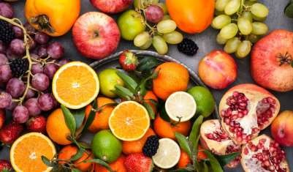
EXISTING WORK
Virtual Fruits Market(VFM) is an application for farmers. Farmers can specify the complete details of the products. A purchaser can select from the various products in the list. It show the road map to the farmer who has a particular crop within them with the distance and price.
DRAWBACKS :
VFM (virtual fruits market) only deals with fruits

Slide 11
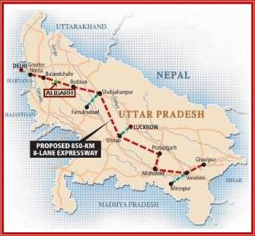
2. eMatch is the application finding the friends of your location. People can rate interest categories of their scale range of ten. Friends of the same categories are being tracked and viewed to users. They implement Dijkstra’s Algorithm to carry out the matching of one set of an interested person with the other and then connect each.
DRAWBACKS
eMatch application only shows the location where the nearest farmers are living/harvesting and it doesn’t deal with the selling and buying of goods.

Slide 12
PROPESED WORK
To improve better contact between farmer and consumer
To control the loss of short spam products
Affordable price for farmers for the products
To reduce the cost of transportation for the farmers
Provide farmers and customers with a seamless online shopping experience.
Improve farmers customer satisfaction by offering easy-to-use features.
Increase customer loyalty by providing personalized experiences.
Optimize the website for mobile devices.
Expand the customer base by reaching out to new demographics.
Simplify the checkout process to reduce cart abandonment.
Improve the search functionality to help customers find products more easily.
Offer a wide range of payment options to cater to different customer preferences.
Improve the site speed to reduce load times and improve user experience.
Increase brand visibility and recognition through digital marketing efforts.
Expand product offerings to cater to diverse customer needs.
Enhance the product descriptions to provide detailed information.
Provide high-quality product images to help customers make informed decisions.
Improve the overall user interface to enhance the shopping experience.

Slide 13





SOFTWARE REQUIREMENTS
FRONTEND
HTML
CSS
JAVA SCRIPT
BACKEND
p

Slide 14
THANK YOU

