Slide 1





ONLINE EXAMINATION SYSTEM
Team Members: Guide:Mrs.Uma Maheshwari
1) Arun R
2) Ganesh S
.

Slide 2
ONLINE EXAMINATION SYSTEM
OUTLINE
Abstract
Problem Statement
Aims, Objective
Proposed System/Solution
System Design/Architecture
Available Features
System Development Approach (Technology Used)
Conclusion
Future Scope
References
Video of the Project
Notes:
These are the list of chapters that we are going to cover in these foundation codes. Those are chapter one what are AI and ML? chapter 2 applied Python programming in AI, and chapter 3 is exploratory data analysis for ML.

Slide 3
Abstract This project aims to bridge the gap in traditional educational systems by proposing a comprehensive Exam Management System that caters to the evolving needs of teachers, students, and administrators. The education sector is rapidly evolving, and the integration of technology has become essential for efficient management and administration. This project addresses the need for a comprehensive Educational Management System that incorporates features for teachers, students, and administrators. The system aims to streamline processes related to course management, student-teacher interactions, examinations, and result dissemination.
ONLINE EXAMINATION SYSTEM

Slide 4
The traditional examination system involves a lot of manual work, which is time-consuming and error-prone. It requires significant resources in terms of invigilators, examination centers, and logistics. Manual processes for course management, examinations, and result handling are time-consuming and prone to errors. The need for a centralized and automated system to manage educational activities is crucial. The current online examination system lacks robustness, leading to issues such as frequent technical glitches, inadequate security measures, and an inefficient user interface, thereby compromising the overall integrity and user experience of the assessment process.This hampers the credibility of examination results and diminishes user trust. Addressing these issues is crucial to establish a reliable and seamless online examination system.
ONLINE EXAMINATION SYSTEM
Problem Statement

Slide 5
Aim and Objective
ONLINE EXAMINATION SYSTEM
The system will feature an intuitive and user-friendly interface for all teachers, students, and administrators. This interface will facilitate easy navigation and interaction, ensuring a positive user experience.
To ensure data security and privacy, the system will implement Role Based Access Control. Different user roles, such as teachers, students, and administrators, will have specific permissions and access levels, preventing unauthorized access to sensitive information.
Enable students to take exams from anywhere with internet access and Provide flexibility in terms of time and location, reducing the need for physical presence.

Slide 6
The proposed solution is an innovative and comprehensive Educational Management System designed to address the inherent challenges of traditional educational frameworks. This solution envisions a modular and scalable platform that seamlessly integrates technology to enhance the efficiency, transparency, and overall management of processes. By implementing this comprehensive Online Examination System, educational institutions can expect increased efficiency, transparency, and collaboration, ultimately contributing to an enriched learning experience for both students and educators.
ONLINE EXAMINATION SYSTEM
Proposed Solution

Slide 7
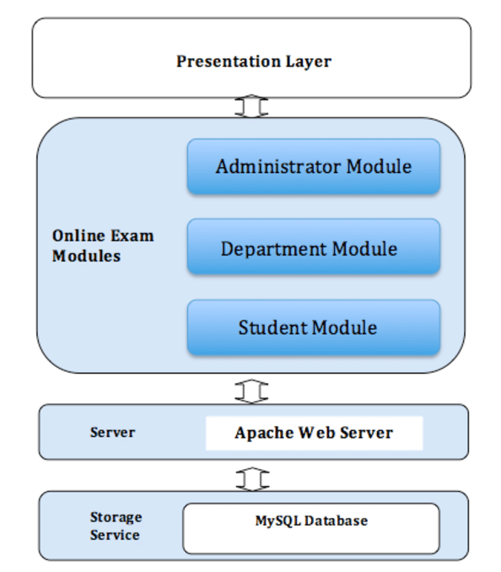
System Architecture
ONLINE EXAMINATION SYSTEM
Module Interaction

Slide 8
Available Features:
Admin Panel
Student Panel
MCQ based
Attend Examination
View Total Score
View Answers’ List
Update Profile
Manage Questions
Manage Registered Users

Slide 9
System Deployment Approach Front End: Back End:
ONLINE EXAMINATION SYSTEM
HTML
CSS
JAVASCRIPT
BOOTSTRAP
PHP
MySQL

Slide 10
The Educational Management System proposed in this project aims to revolutionize the education sector by providing an efficient and user-friendly platform. The integration of modern technologies ensures scalability, security, and reliability in managing educational processes. The emphasis on effective communication channels within the system underscores our commitment to fostering collaboration among teachers, students, and administrators. Through the integration of robust communication features, we envision a connected educational community that facilitates meaningful interactions and shared insights.
ONLINE EXAMINATION SYSTEM
Conclusion

Slide 11
Future Scope
ONLINE EXAMINATION SYSTEM
The proposed Educational Management System demonstrates immense potential for future advancements and enhancements in the ever-evolving landscape of education.
The modular architecture and advanced features lay the groundwork for a system that can readily adapt to emerging technologies. Future developments may involve seamless integration with Learning Management Systems to create a comprehensive educational platform.
This Examination System future lies in a dynamic cycle of user feedback, iterative updates, and a forward-thinking approach to educational technology, ensuring its sustained relevance and positive impact on the education sector.

Slide 12
ONLINE EXAMINATION SYSTEM
Reference
Chen Ying- ying , "The Design and Implementation of Online Examination System with Characteristics of Cloud Service [D]", Beijing University of Posts and Telecommunications, 2013.
Bai Yi- chen , "The Design and Implementation of the Online Examination System Based on MVC Model [D]", Shandong University, 2012.
Gui-ying Zhang, "Standardized Online Examination System Design and the Database Construction [J]", Journal of Inner Mongolia Agricultural University, vol. 33, no. 5–6, pp. 222-225, 2012.
Lu Chang and Xu Guang-ming, "Application Research of Web Examination System Based on College [J]", ELSERVER, 2012.
Notes:
Reference
These are the references for this session.
12

Slide 13
ONLINE EXAMINATION SYSTEM
VIDEO LINK: https://drive.google.com/file/d/1BQPb8bofiRPg57NONZx3nrdm3tXIj4wP/view?usp=sharing
GITHUB LINK:
https://github.com/ArunRGS/Online-Examination-System.git

Slide 14
ONLINE EXAMINATION SYSTEM
Thank you!
Notes:
thank you very much for joining this PPT, keep learning.
14

