Slide 1
SQL Introduction

Slide 2
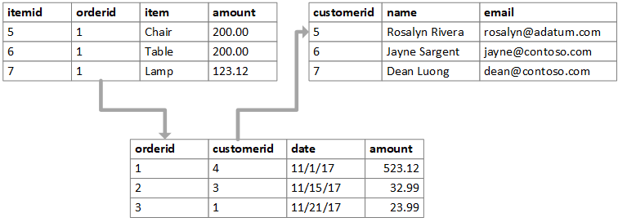
What is a Relational Database?
A relational database is a set of formally described tables from which data can be accessed or reassembled in many different ways without having to reorganize the database tables
Popular examples of relational databases include Microsoft SQL Server, Oracle Database, MySQL and IBM DB2

Slide 3
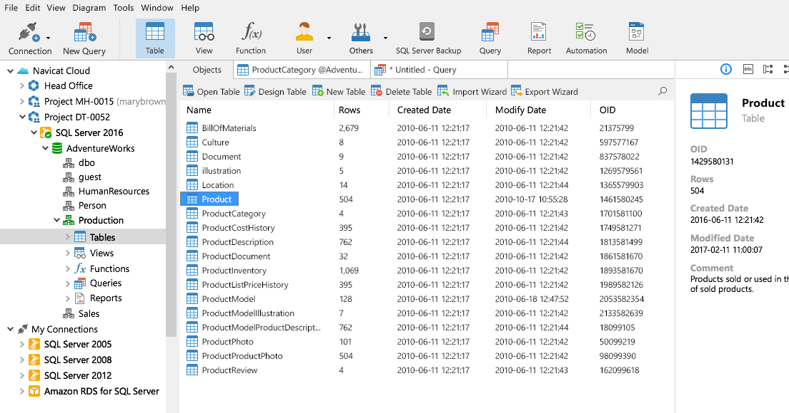
What is SQL?
SQL (Structured Query Language) is used to perform operations on the records stored in the database such as updating records, deleting records, creating and modifying tables, views, etc.
SQL is just a query language; it is not a database. To perform SQL queries, you need to install any database, for example, Oracle, MySQL, MongoDB, PostGre SQL, SQL Server, DB2, etc.

Slide 4
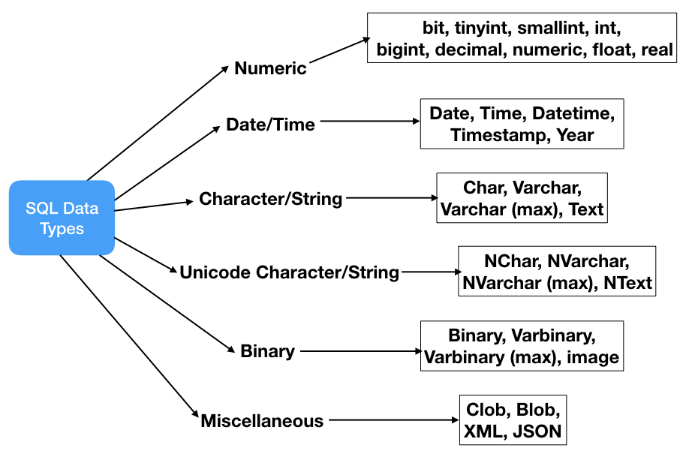
Datatypes in SQL

Slide 5
Types of SQL commands
SQL Categorizes its commands on the basis of functionalities performed by them. There are five types of SQL Commands which can be classified as: ◦
DDL(Data Definition Language) – Create, Alter, Rename, Drop, Truncate
DML(Data Manipulation Language) – Insert, Delete, Update
DQL(Data Query Language) - Select
DCL(Data Control Language) – Grant, Revoke
TCL(Transaction Control Language) – Roll back, Commit, Savepoint

Slide 6
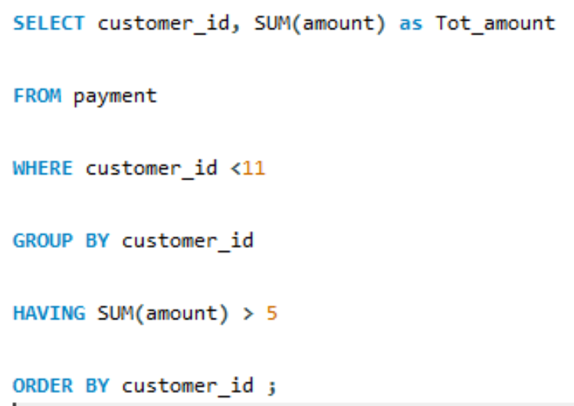
Structure of SQL Query
4
(S) Select fields
1
(F) Table used
2
(W) Condition applied
3
(G) Aggregation
5
(H) Condition on Aggregation
6
(O) Sorting of results

Slide 7
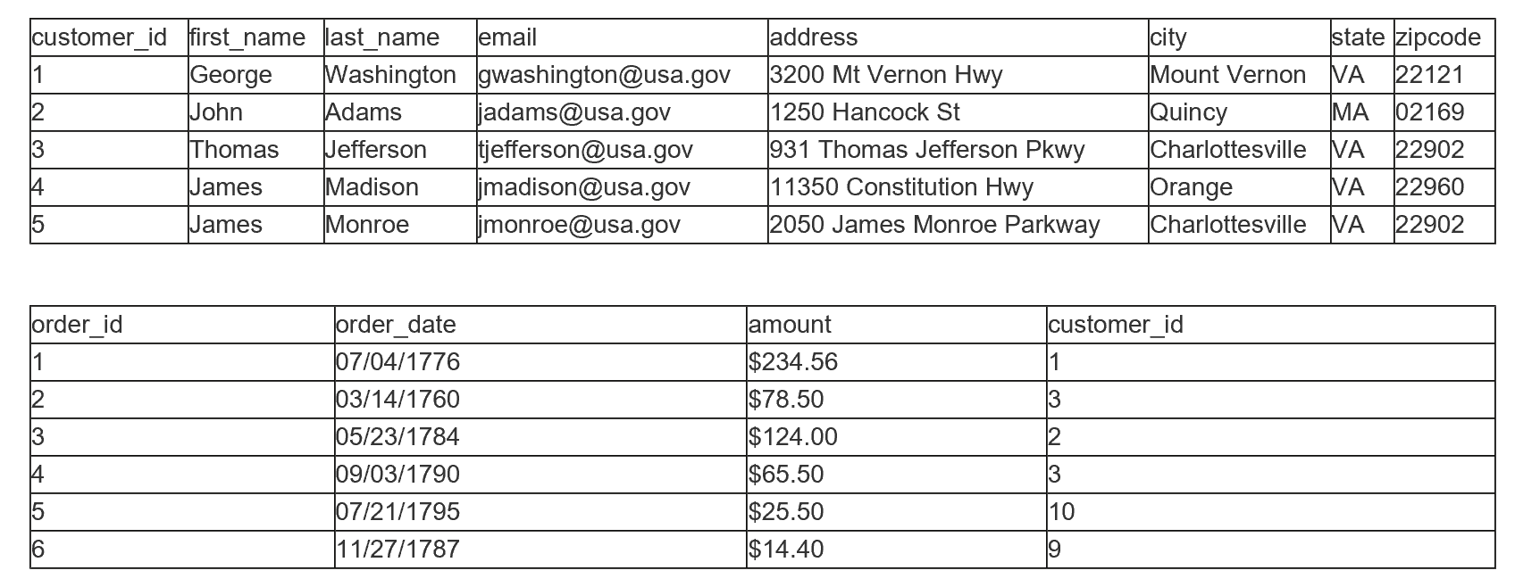
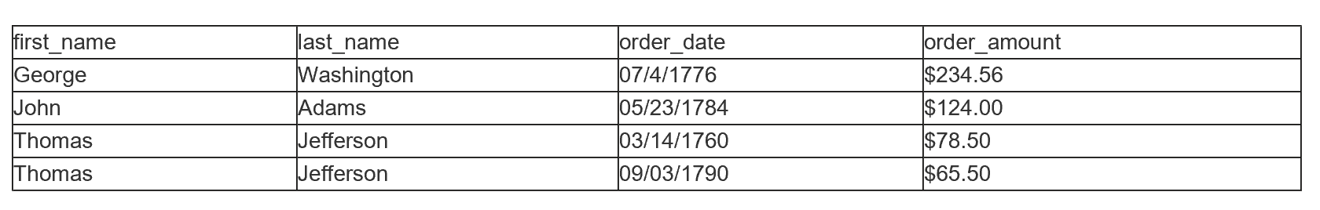
SQL Joins
A JOIN clause is used to combine data from two or more tables, based on a related column between them.

Slide 8
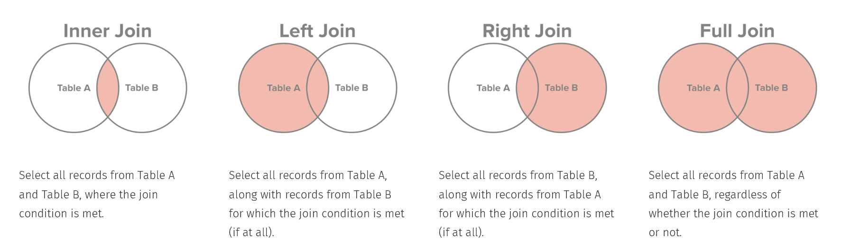
Types of SQL Joins
Types of SQL joins are –
(INNER) JOIN: Returns records that have matching values in both tables
LEFT (OUTER) JOIN: Returns all records from the left table, and the matched records from the right table
RIGHT (OUTER) JOIN: Returns all records from the right table, and the matched records from the left table
FULL (OUTER) JOIN: Returns all records when there is a match in either left or right table

Slide 9
Inner Join
Only Customer IDs 1, 2, & 3 will be included in the joined table as Inner join returns records that have matching values in both tables

Slide 10
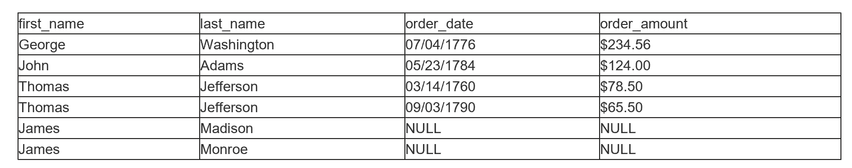
Left Join
All Customer IDs 1, 2, 3, 4 & 5 from the left table will be included in the joined table but since IDs 4 & 5 aren’t present in the right table, the Order date and amount (information fetched from the right table) will be NULL

Slide 11
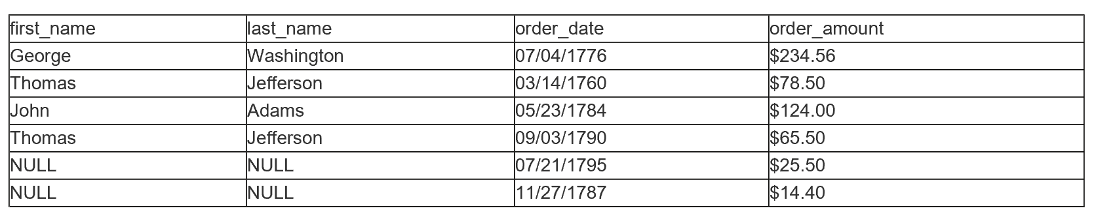
Right Join
All Customer IDs 1, 2, 3, 9 & 10 from the right table will be included in the joined table but since IDs 9 & 10 aren’t present in the left table, the First and Last name (information fetched from the left table) will be NULL

Slide 12
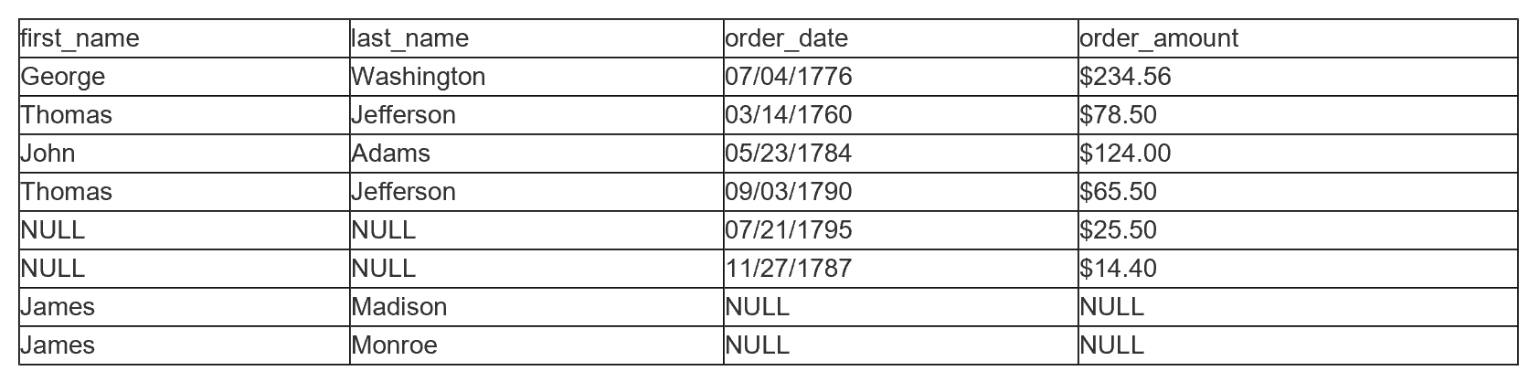
Full Join
All Customer IDs 1, 2, 3, 4, 5, 9 & 10 from both the tables will be included in the joined table as Full join returns all records when there is a match in either left or right table

Slide 13
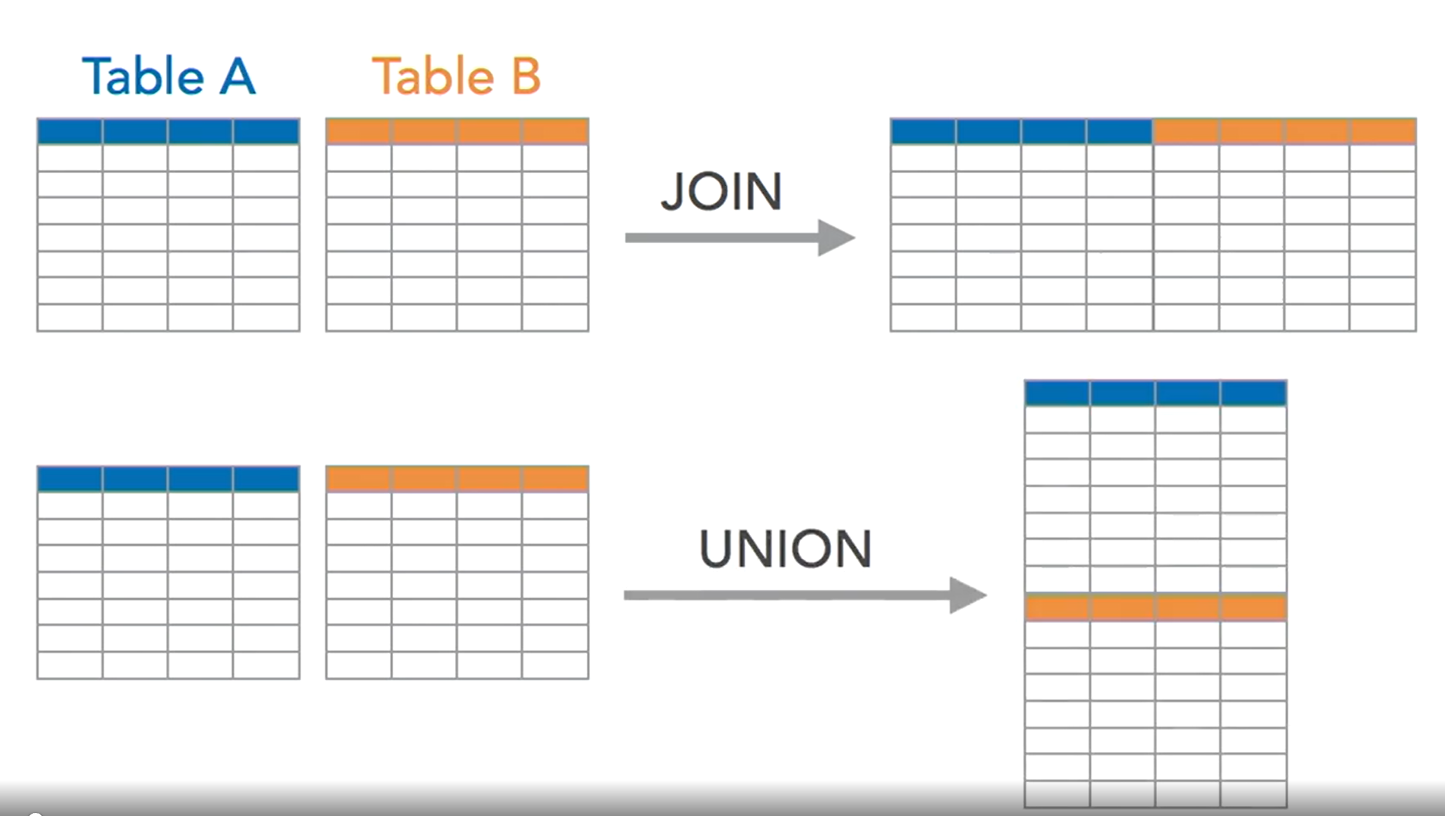
SQL Union
The UNION operator is used to combine the result-set of two or more SELECT statements.
Each SELECT statement within UNION must have the same number of columns
The columns must also have similar data types
The columns in each SELECT statement must also be in the same order

