Slide 1

21ECSC210
Exploratory Data Analysis Course Project
Polycystic Ovarian Syndrome
(PCOS)
Department of Computer Science and Engineering,
KLE Technological University’s Dr. M. S. Sheshgiri College of Engineering and Technology, Belagavi

Slide 2
Details of the Team
Div: |  | C (Group - 6)
Sl. No. | Name |  | SRN.
1 | Shruti Khannukar |  | 02FE23BCS401
2 | Divya Patil |  | 02FE23BCS409
3 | Appasab Kambale |  | 02FE23BCS418
4 | Arun Sadalgekar |  | 02FE23BCS411
Department of Computer Science and Engineering,
KLE Technological University’s Dr. M. S. Sheshgiri College of Engineering and Technology, Belagavi

Slide 3
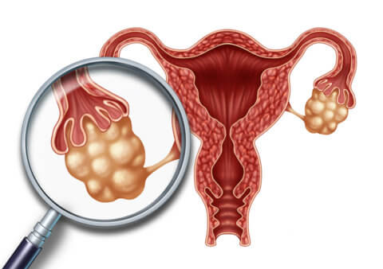
Course Project Problem Statement
Background
Polycystic Ovary Syndrome (PCOS), is a common endocrine disorder affecting women of reproductive age. It is characterized by irregular menstrual cycles, excessive androgen levels, and polycystic ovaries. PCOD can lead to various health issues, including infertility, metabolic syndrome, and an increased risk of type 2 diabetes and cardiovascular diseases. Understanding the factors associated with PCOD is crucial for early diagnosis and management.
Problem Statement
The primary goal of this project is to perform an Exploratory Data Analysis (EDA) on a dataset containing medical records of women, to identify significant factors associated with PCOD. This analysis will help in understanding the prevalence, demographic distribution, and potential risk factors of PCOD, which can further aid in developing targeted interventions and treatment plans.
Department of Computer Science and Engineering,
KLE Technological University’s Dr. M. S. Sheshgiri College of Engineering and Technology, Belagavi

Slide 4
SDG 3 target
Data Acquisition and Preparation:
Obtain a comprehensive dataset related to PCOS with at least 15 attributes and 8000 rows.
Clean the dataset by handling missing values, outliers, and inconsistencies to ensure data quality.
Descriptive Statistics and Data Summarization:
Calculate summary statistics (mean, median, mode, standard deviation) for continuous variables.
Summarize categorical variables by frequency counts and percentages.
Hypothesis Testing and Statistical Analysis:
Formulate hypotheses related to PCOS, such as the impact of BMI on PCOS prevalence or the correlation between insulin levels and PCOS.
Perform statistical tests (t-tests, chi-square tests, ANOVA) to validate or refute these hypotheses.
Exploration of Risk Factors and Demographics:
Analyze demographic variables (age, weight, height, BMI) to understand their association with PCOS.
Investigate lifestyle factors (fast food, physical activity) and their impact on PCOS prevalence and severity.
Department of Computer Science and Engineering,
KLE Technological University’s Dr. M. S. Sheshgiri College of Engineering and Technology, Belagavi

Slide 5
Introduction
Polycystic Ovary Syndrome (PCOS) is complex hormonal disorder affecting women of
reproductive age, characterized by an imbalance of reproductive hormones.
It affects 5-10% of women of reproductive age globally.
It's marked by symptoms like irregular menstrual cycles, excessive hair growth, acne, and
obesity, and can include multiple ovarian cysts.
Alternative Names: Also known as Polycystic Ovary Disease (PCOD), Stein-Leventhal
Syndrome.
Importance of Early Diagnosis:-
Early intervention can reduce symptoms and complications.
Improves quality of life for affected women.
Department of Computer Science and Engineering,
KLE Technological University’s Dr. M. S. Sheshgiri College of Engineering and Technology, Belagavi

Slide 6
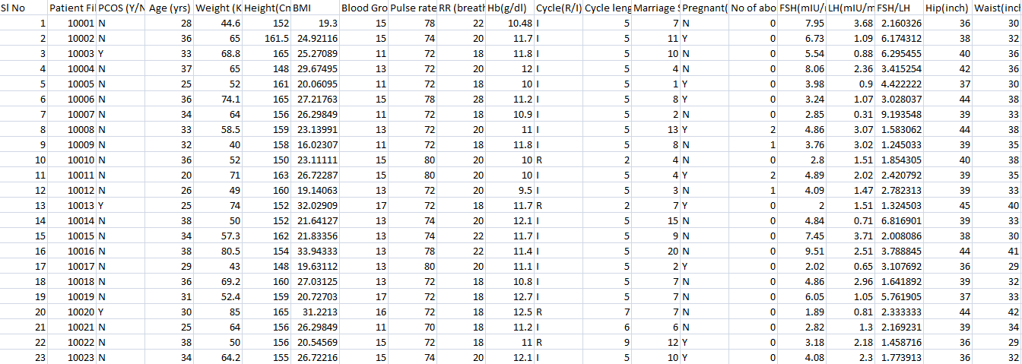
Dataset Description
The dataset consists of 1082 entries with 43 columns. Each entry represents a patient's medical record, containing both demographic and clinical information.
There are 1082 instances, Source URL : https://www.kaggle.com/datasets/vanditharai/polycysticovarysyndromepcod
https://www.kaggle.com/datasets/vanditharai/pcod123
Department of Computer Science and Engineering,
KLE Technological University’s Dr. M. S. Sheshgiri College of Engineering and Technology, Belagavi

Slide 7
Dataset attributes
There are 43 features in dataset :
Sl No - Serial number: A unique identifier for each patient in the dataset.
Patient File No - Patient file number: Another unique identifier for each patient, likely used in medical records.
PCOS (Y/N) - Indicates whether the patient has Polycystic Ovary Syndrome (PCOS). 'Y' means Yes, and 'N' means No.
Age (yrs) - Age of the patient in years.
Weight (Kg) - Weight of the patient in kilograms.
Height(Cm) - Height of the patient in centimeters.
BMI - Body Mass Index: A measure of body fat based on weight and height.
Blood Group - Blood group of the patient (e.g., A, B, AB, O).
Pulse rate(bpm) - Pulse rate in beats per minute.
RR (breaths/min) - Respiratory rate in breaths per minute.
Hb(g/dl) - Hemoglobin level in grams per deciliter, an indicator of the oxygen-carrying capacity of blood.
Cycle(R/I) - Menstrual cycle regularity: 'R' for Regular and 'I' for Irregular.
Department of Computer Science and Engineering,
KLE Technological University’s Dr. M. S. Sheshgiri College of Engineering and Technology, Belagavi

Slide 8
Cycle length(days) - Length of the menstrual cycle in days.
Marriage Status (Yrs) - Number of years the patient has been married.
Pregnant(Y/N) - Indicates whether the patient is currently pregnant. 'Y' means Yes, and 'N' means No.
No of abortions - Number of abortions the patient has had.
FSH(mIU/mL) - Follicle-stimulating hormone level in milli-international units per milliliter. FSH is involved in reproductive processes.
LH(mIU/mL) - Luteinizing hormone level in milli-international units per milliliter. LH is also involved in reproductive processes.
FSH/LH - Ratio of FSH to LH.
Hip(inch) - Hip circumference in inches.
Waist(inch) - Waist circumference in inches.
Waist/Hip Ratio - Waist to hip ratio: An indicator of body fat distribution.
TSH (mIU/L) - Thyroid-stimulating hormone level in milli-international units per liter. TSH regulates thyroid function.
AMH(ng/mL) - Anti-Müllerian hormone level in nanograms per milliliter. AMH is a marker of ovarian reserve.
PRL(ng/mL) - Prolactin level in nanograms per milliliter. Prolactin is involved in milk production and other functions.
Vit D3 (ng/mL) - Vitamin D3 level in nanograms per milliliter. Vitamin D3 is important for bone health and other functions.
Department of Computer Science and Engineering,
KLE Technological University’s Dr. M. S. Sheshgiri College of Engineering and Technology, Belagavi

Slide 9
PRG(ng/mL) - Progesterone level in nanograms per milliliter. Progesterone is involved in the menstrual cycle and pregnancy.
RBS(mg/dl) - Random blood sugar level in milligrams per deciliter. This is an indicator of glucose levels in the blood.
Weight gain(Y/N) - Indicates whether the patient has experienced weight gain. 'Y' means Yes, and 'N' means No.
hair growth(Y/N) - Indicates whether the patient has experienced abnormal hair growth. 'Y' means Yes, and 'N' means No.
Skin darkening (Y/N) - Indicates whether the patient has experienced skin darkening. 'Y' means Yes, and 'N' means No.
Hair loss(Y/N) - Indicates whether the patient has experienced hair loss. 'Y' means Yes, and 'N' means No.
Pimples(Y/N) - Indicates whether the patient has experienced pimples. 'Y' means Yes, and 'N' means No.
Fast food (Y/N) - Indicates whether the patient consumes fast food. 'Y' means Yes, and 'N' means No.
Reg Exercise(Y/N) - Indicates whether the patient engages in regular exercise. 'Y' means Yes, and 'N' means No.
Department of Computer Science and Engineering,
KLE Technological University’s Dr. M. S. Sheshgiri College of Engineering and Technology, Belagavi

Slide 10
BP Systolic (mmHg) - Systolic blood pressure in millimeters of mercury. This is the pressure in the arteries when the heart beats.
BP Diastolic (mmHg) - Diastolic blood pressure in millimeters of mercury. This is the pressure in the arteries when the heart is at rest between beats.
Follicle No (L) - Number of follicles in the left ovary.
Follicle No (R) - Number of follicles in the right ovary.
Avg F size (L) (mm) - Average follicle size in the left ovary in millimeters.
Avg F size (R) (mm) - Average follicle size in the right ovary in millimeters.
Insulin levels (U/ml) - Insulin levels in units per milliliter. Insulin is involved in glucose metabolism.
Endometrium (mm) - Endometrial thickness in millimeters. This is the thickness of the lining of the uterus.
Department of Computer Science and Engineering,
KLE Technological University’s Dr. M. S. Sheshgiri College of Engineering and Technology, Belagavi

Slide 11
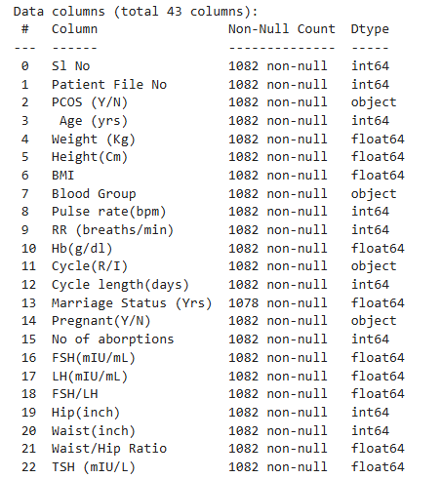
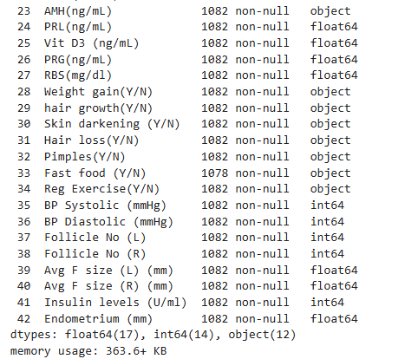
Feature Set Description
Department of Computer Science and Engineering,
KLE Technological University’s Dr. M. S. Sheshgiri College of Engineering and Technology, Belagavi

Slide 12
Domain understanding
Polycystic Ovary Syndrome (PCOS): A hormonal disorder common among women of reproductive age.
Common Symptoms -
Irregular Menstrual Cycles: Menstrual periods that are infrequent, irregular, or prolonged.
Abnormal hair : Excessive hair growth on the face, back.
Acne: Severe acne and skin issues.
Obesity: Weight gain and difficulty losing weight.
Ovarian Cysts: Presence of multiple small cysts on the ovaries.
Diagnosis -
Rotterdam Criteria: Diagnosis typically requires at least two of the following three criteria:
Irregular ovulation or anovulation.
Elevated androgen levels (clinical or biochemical signs).
Polycystic ovaries visible on an ultrasound.
Department of Computer Science and Engineering,
KLE Technological University’s Dr. M. S. Sheshgiri College of Engineering and Technology, Belagavi

Slide 13
Domain understanding
Causes and Risk Factors -
Genetic Factors
Family History: Strong genetic predisposition; PCOS often runs in families.
Environmental Factors -
Diet: High intake of unhealthy foods can exacerbate symptoms.
Physical Activity: Lack of regular exercise can contribute to the condition.
Endocrine-Disrupting Chemicals: Exposure to chemicals that interfere with hormonal functions.
Hormonal Imbalances -
Elevated Androgens: Higher levels of male hormones which can cause symptoms like hirsutism and acne.
Insulin Resistance: Insulin resistance and hyperinsulinemia, leading to higher insulin levels which can worsen PCOS symptoms.
Department of Computer Science and Engineering,
KLE Technological University’s Dr. M. S. Sheshgiri College of Engineering and Technology, Belagavi

Slide 14
Domain understanding
Treatment and Management -
Lifestyle Changes -
Diet: Eating a balanced diet rich in whole grains, lean proteins, and healthy fats.
Exercise: Regular physical activity to improve insulin sensitivity and help with weight management.
Medical Treatments -
Hormonal Contraceptives: Birth control pills to regulate menstrual cycles and reduce androgen levels.
Anti-androgens: Medications to reduce excessive hair growth and acne.
Metformin: A medication to improve insulin sensitivity and lower insulin levels.
Fertility Treatments -
Ovulation Induction: Medications like clomiphene citrate or letrozole to stimulate ovulation (Ovulation is the release of eggs from the ovaries).
Assisted Reproductive Technologies (ART): Options such as in vitro fertilization (IVF) for women who do not respond to other treatments.
Department of Computer Science and Engineering,
KLE Technological University’s Dr. M. S. Sheshgiri College of Engineering and Technology, Belagavi

Slide 15
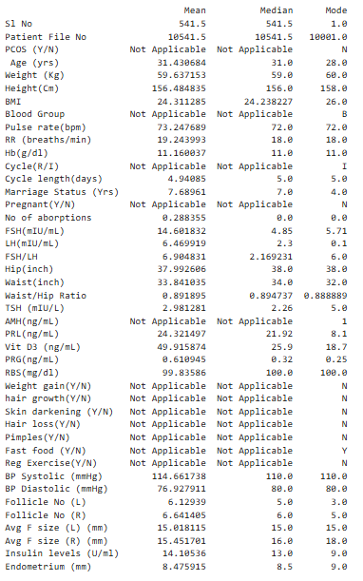
Data Cleaning and Preprocessing
1. Identifying Features:
Categorical Features:
Total: 12 features
Examples: PCOS (Y/N), Blood Group, Cycle (R/I), etc.
Numerical Features:
Total: 31 features
Examples: Age (yrs), Weight (Kg), Height (Cm), BMI, etc.
2. Calculating Statistics:
Numerical Features:
Mean: The average value of each numerical feature.
Median: The middle value of each numerical feature when sorted.
Mode: The most frequently occurring value of each numerical feature.
Categorical Features:
Mode: The most frequently occurring category in each categorical feature.
3. Handling Missing Values:
Initial Check: Identified missing values in several features.
Imputation: Missing values were handled by imputing them with the mode (most frequent value) and mean of the respective feature.
Post-imputation Check: Re-checked all features to ensure no missing values remain.
Department of Computer Science and Engineering,
KLE Technological University’s Dr. M. S. Sheshgiri College of Engineering and Technology, Belagavi

Slide 16
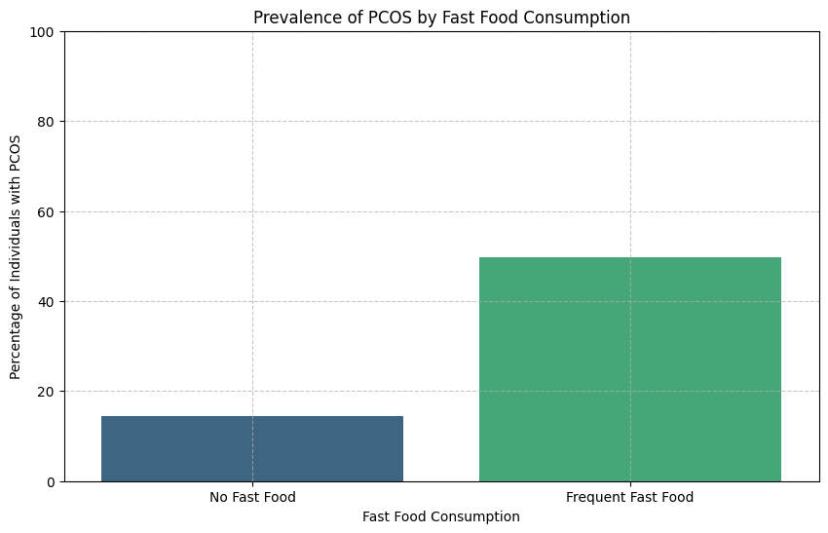
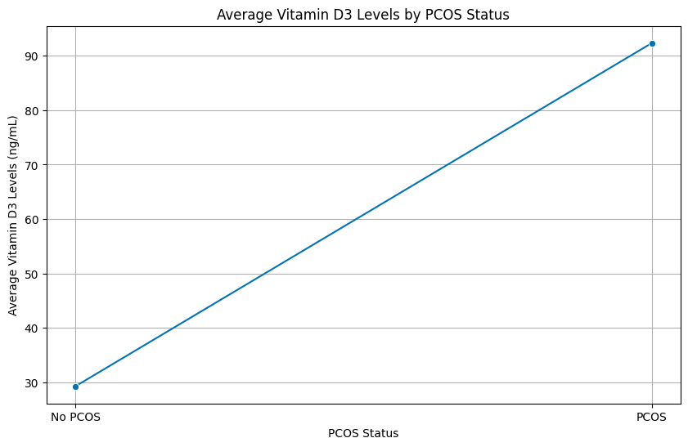
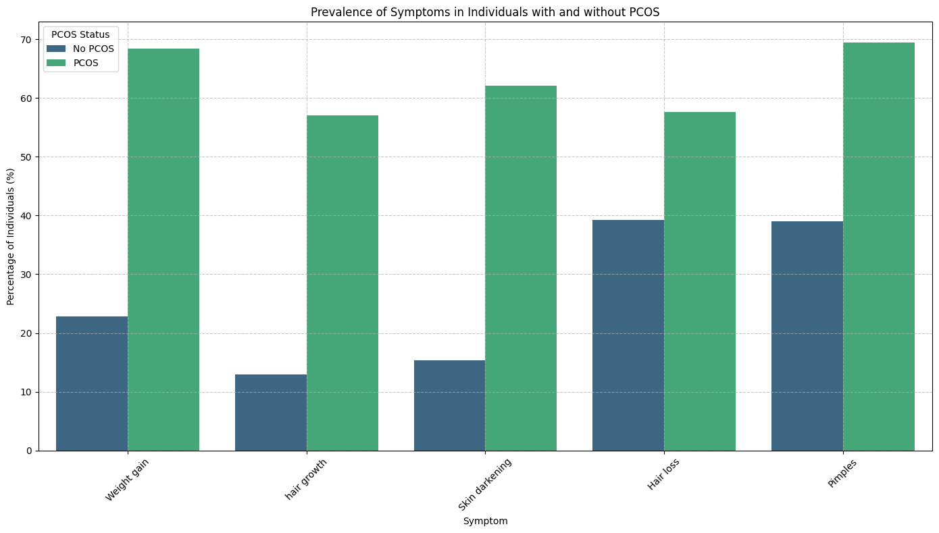
Hypothesis
1. How do Vitamin D3 levels vary between those with and without PCOS? (univariate)
3. Are symptoms like weight gain, excessive
hair growth, skin darkening, hair loss, and
Pimples more common in individuals with PCOS? (multivariate)
2. Is frequent consumption of fast food linked to a higher prevalence of PCOS? (univariate)
Department of Computer Science and Engineering,
KLE Technological University’s Dr. M. S. Sheshgiri College of Engineering and Technology, Belagavi

Slide 17
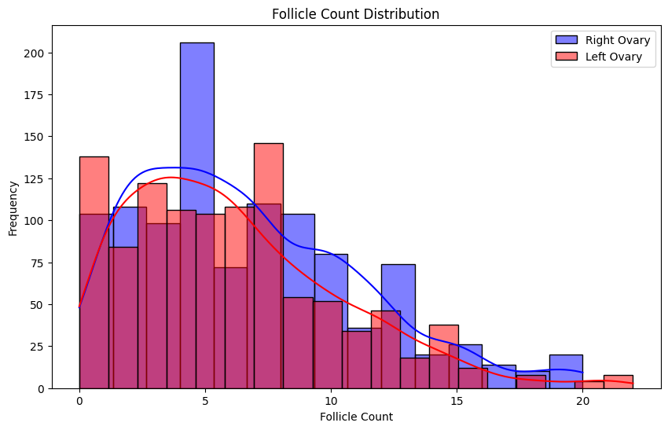
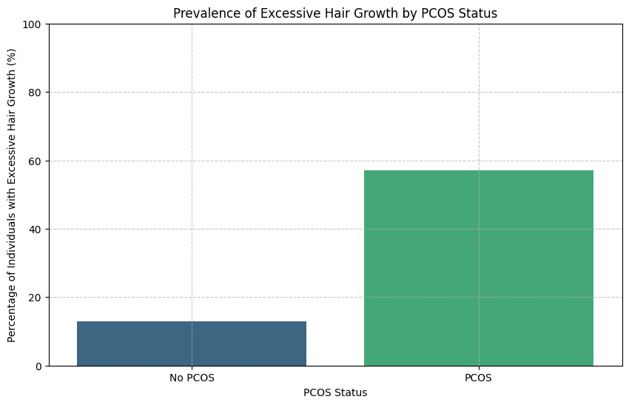
Hypothesis
5. The average number of follicle count on the right ovary is higher than on the left ovary. (bivariate)
4. Do individuals with PCOS have indicated by features like excessive hair growth ? (univariate)
Department of Computer Science and Engineering,
KLE Technological University’s Dr. M. S. Sheshgiri College of Engineering and Technology, Belagavi

Slide 18
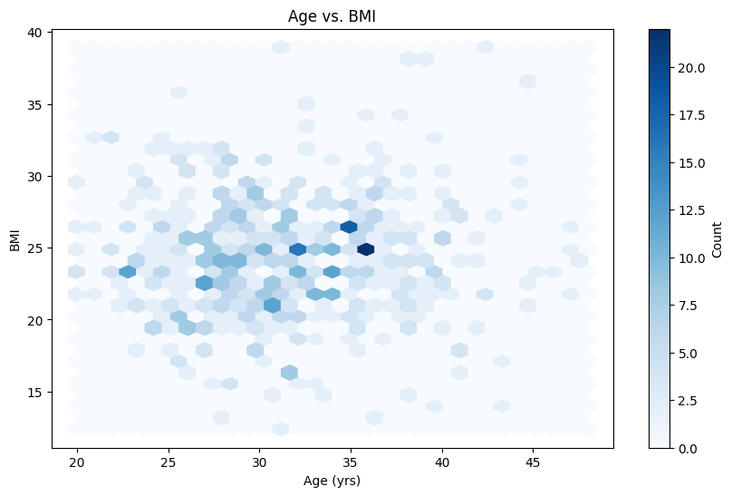
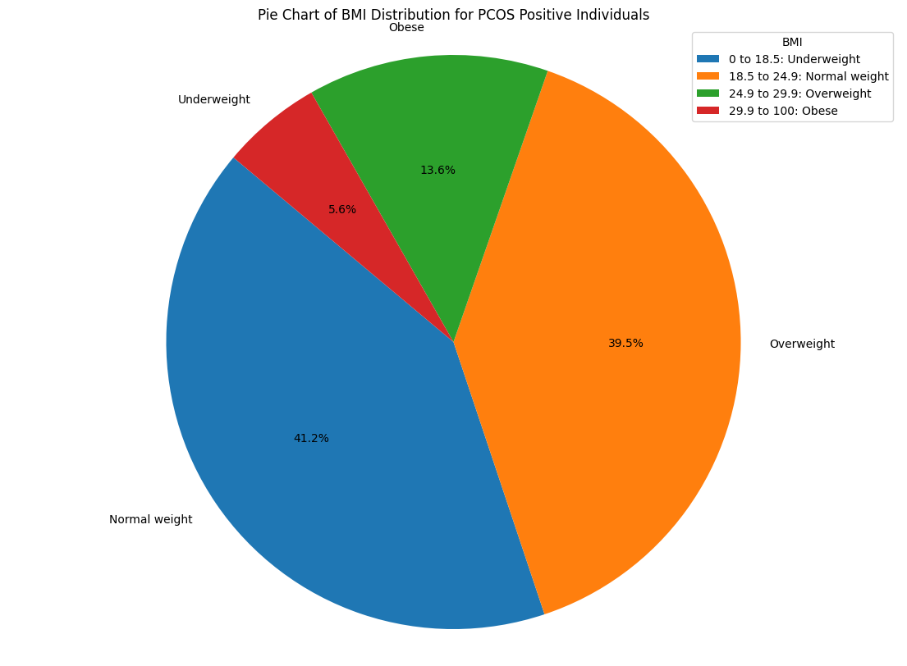
Hypothesis
7.Are BMI values significantly different between patients with PCOS? (Bivariate)
6. Is there a significant correlation between age and BMI? (Bivariate)
Department of Computer Science and Engineering,
KLE Technological University’s Dr. M. S. Sheshgiri College of Engineering and Technology, Belagavi

Slide 19
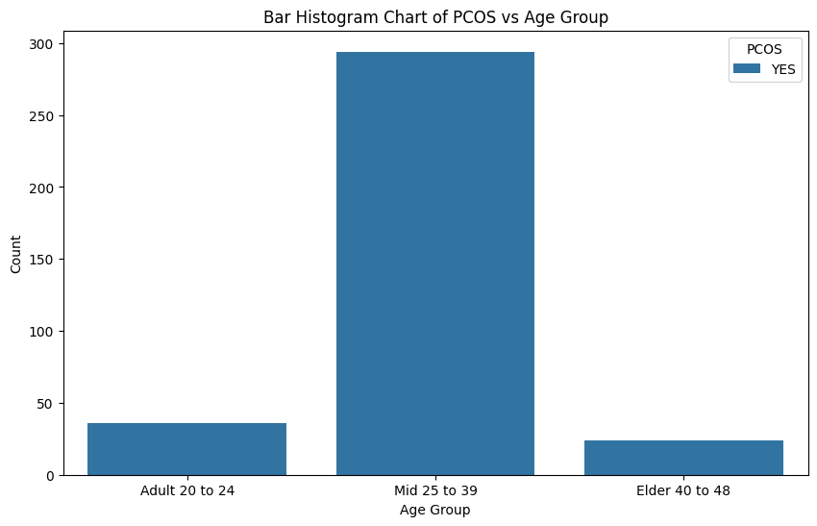
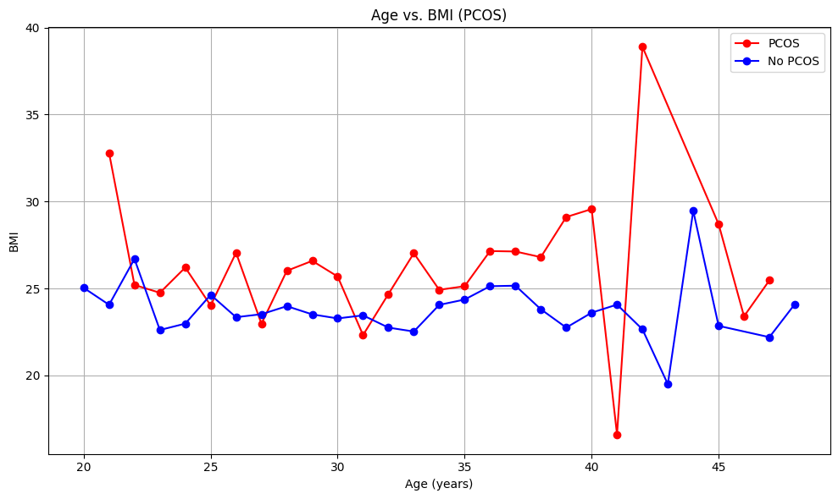
Hypothesis
9.Is there a significant difference in the Body Mass Index (BMI) across different age groups between women with PCOS and women without PCOS? (bivariate)
8. Does age play a significant role in the likelihood of being diagnosed with PCOS? (univariate)
Department of Computer Science and Engineering,
KLE Technological University’s Dr. M. S. Sheshgiri College of Engineering and Technology, Belagavi

Slide 20
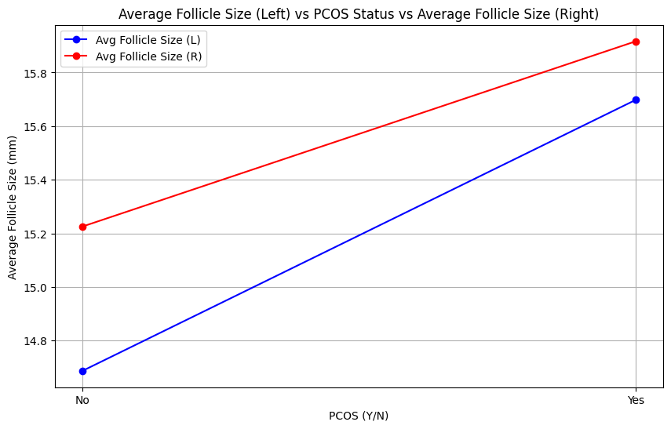
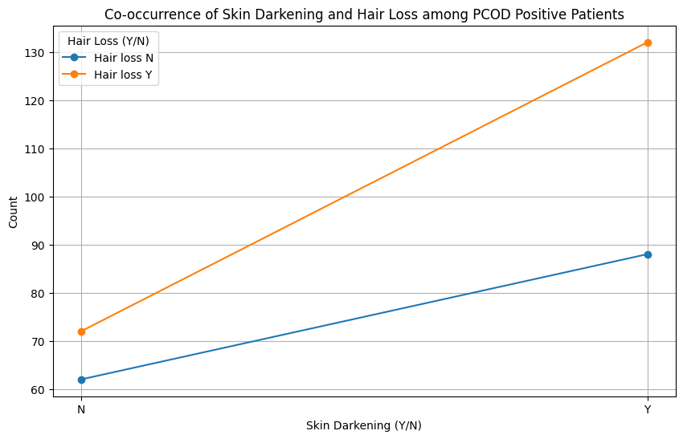
Hypothesis
11. Co-occurrence of Skin Darkening and Hair Loss among PCOD Positive Patients? (multivariant)
10. Is there a significant difference in the average follicle size in the left and right ovaries between women with PCOS and women without PCOS (multivariant)
Department of Computer Science and Engineering,
KLE Technological University’s Dr. M. S. Sheshgiri College of Engineering and Technology, Belagavi

Slide 21
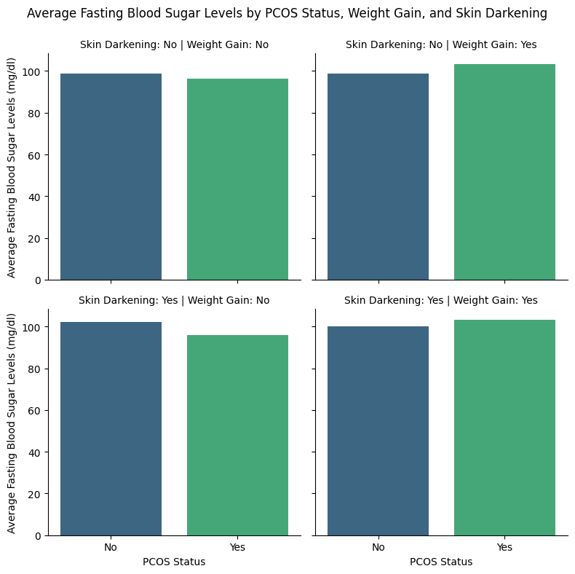
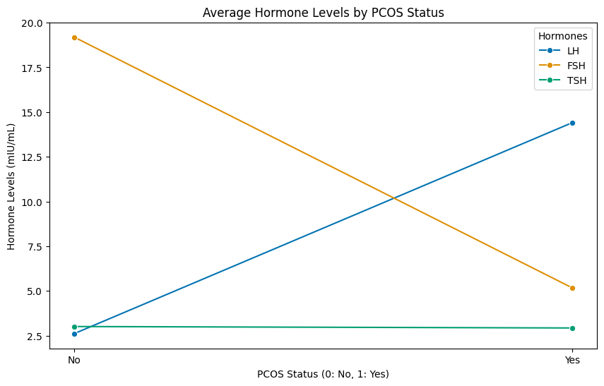
Hypothesis
13. Do average hormone levels differ significantly between individuals with and without PCOS? (multivariant)
12. Does a combination of skin darkening, weight gain, and fasting blood sugar levels significantly predict PCOS status? (multivariant)
Department of Computer Science and Engineering,
KLE Technological University’s Dr. M. S. Sheshgiri College of Engineering and Technology, Belagavi

Slide 22
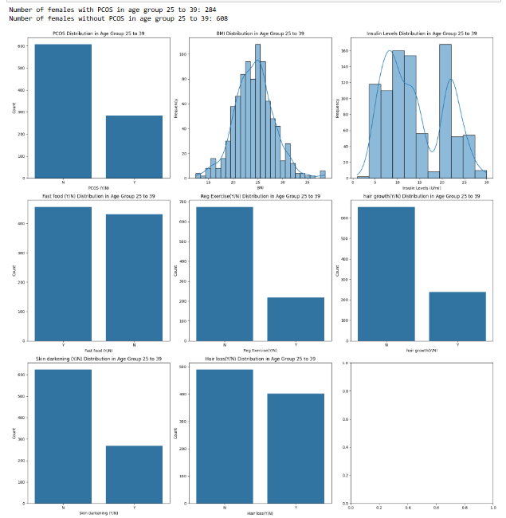
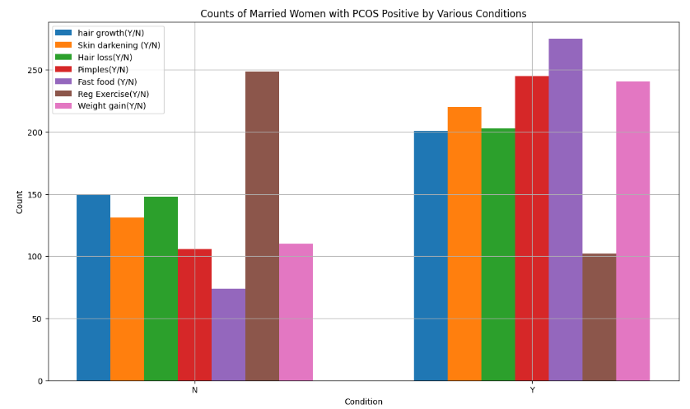
Hypothesis
15. Do symptoms like hair growth, skin darkening, hair loss, and pimples correlate with lifestyle factors such as fast food consumption, regular exercise, and weight gain in married women with PCOS? (multivariant) (external)
14. Is there a link between PCOS prevalence and lifestyle factors like BMI, insulin levels, and regular exercise among women aged 25 to 39?¶ (multivariant) (external)
Department of Computer Science and Engineering,
KLE Technological University’s Dr. M. S. Sheshgiri College of Engineering and Technology, Belagavi

Slide 23
MOOC Course Details
Team No. : EDA-6
Div: C
Sl. No. | Name | SRN. | Course Name | Course Link | Status
1 | Shruti Khannukar | 02FE23BCS401 | Python For Data Science | https://infyspringboard.onwingspan.com/web/en/app/toc/lex_auth_0126429312277463041725_shared/overview | Completed
2 | Divya Patil | 02FE23BCS410 | Python For Data Science | https://infyspringboard.onwingspan.com/web/en/app/toc/lex_auth_0126429312277463041725_shared/overview | Completed
3 | Appasab Kambale | 02FE23BCS418 | Python For Data Science | https://infyspringboard.onwingspan.com/web/en/app/toc/lex_auth_0126429312277463041725_shared/overview | Completed
4 | Arun Sadalgekar | 02FE23BCS411 | Python For Data Science | https://infyspringboard.onwingspan.com/web/en/app/toc/lex_auth_0126429312277463041725_shared/overview | Completed
Department of Computer Science and Engineering,
KLE Technological University’s Dr. M. S. Sheshgiri College of Engineering and Technology, Belagavi

Slide 24
Thank you !
Department of Computer Science and Engineering,
KLE Technological University’s Dr. M. S. Sheshgiri College of Engineering and Technology, Belagavi

