Slide 1
Robotic Vacuum Cleaner
Submitted by:
J Jawahar Babu 2451-18-735-131
J Arun Sai 2451-18-735-143
M Dharamveer 2451-18-735-160

Slide 2
List of Contents
Objective
Introduction
Proposed method
Working
Components required
Advantages
References

Slide 3
Objective
The objective of this project is to implement an octagon shaped robotic vacuum cleaner equipped with efficient scanning and vacuuming technologies which will automatically scan the area and vacuums in a time scheduled by the user.

Slide 4
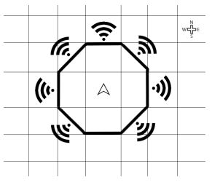
Introduction
The proposed system follows “grid mechanism” where the size of each grid depends on the dimensions of the body and the wheel.
In this project the length and width is 30x30 cm and the wheel radius is 1.5 cm

Slide 5
LITERATURE SURVEY:
AUTHOR | TITLE | YEAR OF PUBLICATION | DESCRIPTION
Kazi Mahmud Hasan, Adullah-Al-Nahid, Khondker Jahid Reza | Path Planning algorithm development for autonomous vacuum cleaner robots | 2014 [IEEE] | An Algorithm has been developed for Path Planning and Navigation that prevents the Robot from bumping into Walls and Obstacles by reversing or changing path accordingly.
P.B. Jarande, S.P. Murakar, N.S. Vast, N.P. Ubale, S.S Saraf | Robotic Vaccum Cleaner using Arduino with WiFi | 2018 [IEEE] | A fully Working Robotic Vaccum Cleaner was developed using Arduino UNO

Slide 6
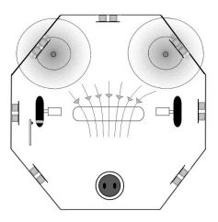
Proposed Method
The proposed model consists of 7 ultrasonic sensors for scanning border of the location that needs to be cleaned and compass sensor fixed facing the north direction.
Line tracking sensor fixed beside a wheel, along with relay module all the sensors are connected to raspberry pi.
The working can be be divided into 2 mechanisms
1. Scanning
2. Cleaning

Slide 7
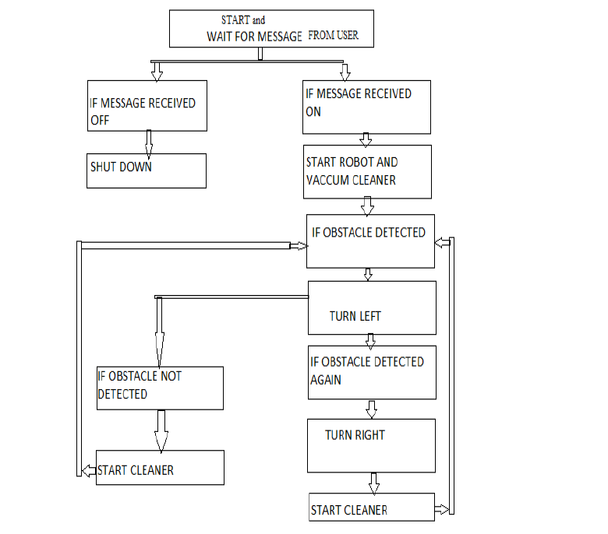
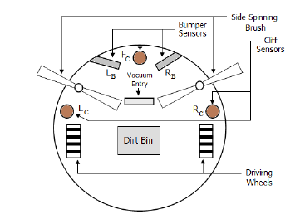

Slide 8


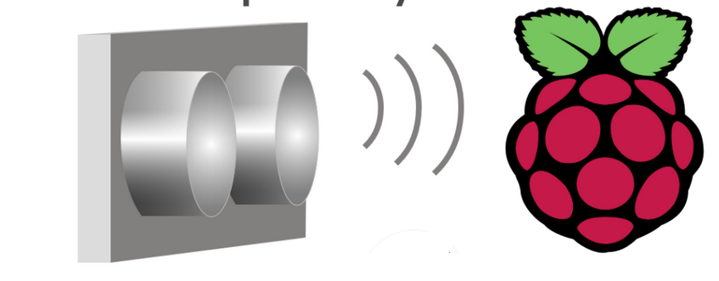

Working
Extra rows and columns are removed from the matrix
Return to the initial position after performing the cleaning process
A matrix is created and saved as .npy file
2
4
1
3
5
Uses the same .npy file for cleaning and makes a copy of the file that is already cleaned
Data scanned by ultrasonic sensors is processed into Raspberry pi

Slide 9
Components
Raspberry pi zero
Ultrasonic sensor
Compass sensor
Line tracking sensor
Micro gear motor
Motor driver
Relay module
DC motor
Lithium ion battery

Slide 10
Advantages:
Ease of Use
Hands-Free Operation
Saves Time and Energy
Improved Hygiene
Low Maintenance
Can handle tight spaces

Slide 11
References
P.B. Jarande, S.P. Murakar, N.S. Vast, N.P. Ubale, S.S Saraf, “Robotic Vaccum Cleaner using Arduino with WiFi ” published in 2018 Second International Conference on Inventive Communication and Computational Technologies.
Link : https://ieeexplore.ieee.org/abstract/document/8473256
Kazi Mahmud Hasan, Adullah-Al-Nahid, Khondker Jahid Reza, “Path Planning algorithm development for autonomous vacuum cleaner robots” published in 2014 International Conference on Informatics, Electronics and Vision (ICIEV).
Link : https://ieeexplore.ieee.org/abstract/document/6850799

