Slide 1
Basic Health Monitoring Station
Project Guide : Madam Karma Kelzang Eudon
External Guide : Mr Kinley Penjor
Date: 19/09/2025
Group 3 Members:
1.Arun Sanyasi
2.Tashi Chozom
3.Sherab Zangmo

Slide 2
Table of Contents
Introduction
Background
Problem Statement
Aim
Objectives
Literature Review
Methodology
Proposed system overview
System Flow Chart
Expected outcomes
Bill of Materials
Budget Calculation
Power Calculation
Work Plan

Slide 3

Introduction
Health monitoring is vital for early detection and prevention of diseases (World Health Organization, 2020). A Health Monitoring Station simplifies this by measuring key parameters and to display, it provides quick and reliable results, making healthcare more accessible and convenient (Kumar et al., 2022).

Slide 4
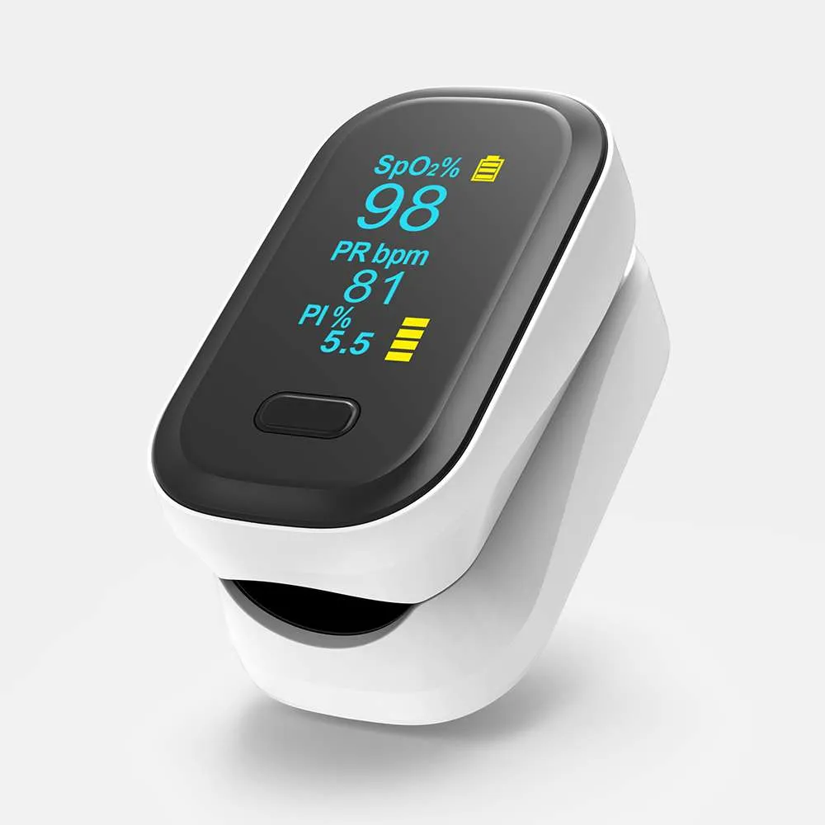
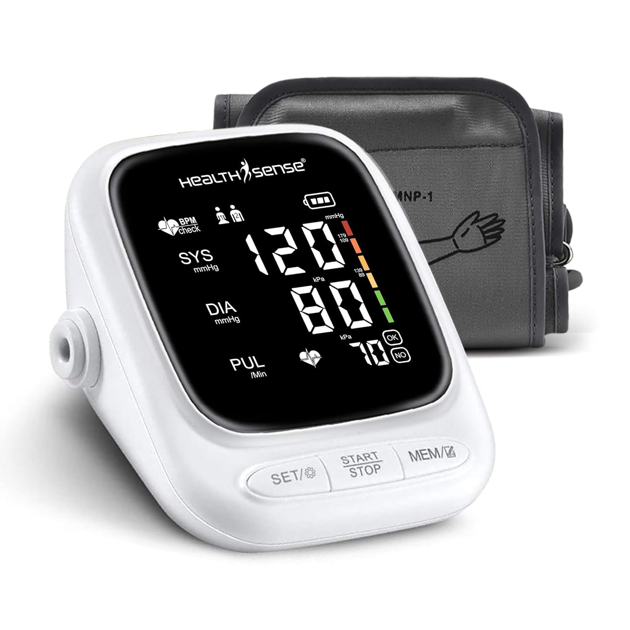
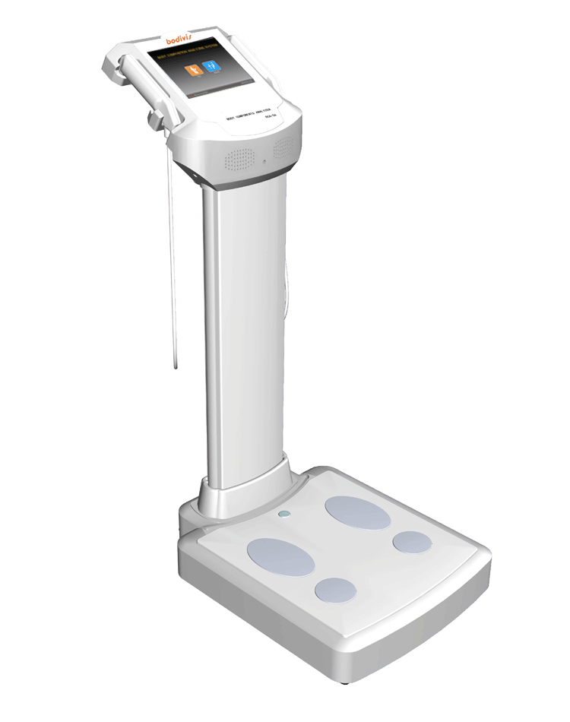
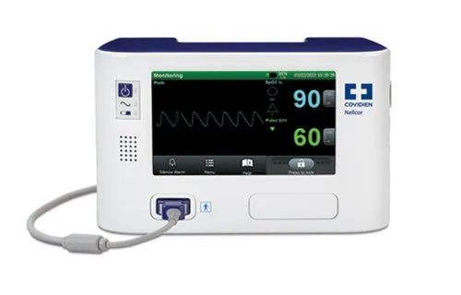
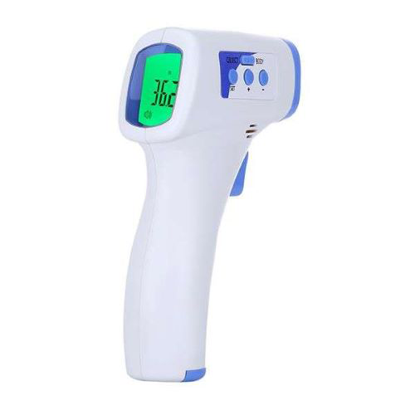
Background
Lifestyle diseases are increasing, while healthcare access is often limited (WHO, 2022). Measuring vitals like heart rate, SpO₂, temperature, and BMI traditionally required multiple devices. Advances in biomedical sensors and microcontrollers now enable these in one compact system (Sharma & Singh, 2021), supporting preventive care and monitoring (Chen et al., 2019).

Slide 5

Problem Statement
In our college, the Health Assistant currently uses separate devices to check vital signs. A single Health Monitoring Station that measures pulse rate, respiratory rate, SpO₂, temperature, and BMI in one system can speed up health check-ups. Before going to the Health Assistant, students and staff can use the station for pre-checks, which will help medical personnel quickly proceed with the necessary examinations.

Slide 6
Aim and Objectives
Aim:To design a health monitoring system that measures four vital signs and BMI for basic check up.
Objectives:
To design an integrated system for the measurement of pulse rate, respiratory rate, SpO₂, temperature, and BMI.
To publish vital signs and health insights using ESP32 and Raspberry Pi.
To install the system in the infirmary for quick and easy health check-ups.

Slide 7
Literature Review
Sl.No | Title | Authors/Institution | Features | Key findings | Limitations
. | Real-Time Vital Signs Monitoring System | Srishti Dhingra, Madhuri Sharma, Hitesh Arora, Anupam Misra, Surabhi Nayak Department of CSE, SRM-IST, NCR Campus, Modinagar | Measures heart rate, ECG, breathing, skin response, temperature LCD + web app for display and monitoring IoT-enabled data transfer | Provides Real-time and continuous monitoring Remote access by doctors through web app Low cost and portable | Limited parameters (no SpO₂, BP). Motion artifacts, calibration. No strong data security. Prototype stage
2. | Automated Body Mass Index Assessment Device | Horsfall, Otelemate M. Yaabari, Monday University of Port Harcourt | Used MHT1 load cell and HC-SR04 ultrasonic sensor Includes LCD display and alarm system for Obesity indication 12V adapter as backup power. | Provides accurate BMI measurements Automate the calculation User friendly | Tested on a small sample(10 people,age of 18-36) Device scope limited to BMI

Slide 8
Literature Review
Sl.No | Title | Authors/Institution | Features | Key findings | Limitations
3. | Development, Implementation and Usage of an Automated Body Mass Index System | Olajide Patrick O., Musiliyu Kazeem A., Alao Olumuyiwa A.,Owolabi I.E Afe Babalola University | Measurement of BMI Using 4-load cell Wheastone Bridge and PING/HC-SR04 Buzzer with driver circuit for feedback | Provides non-invasive, low-cost BMI measurement Results show strong correlation with manual measurement | Only BMI is measured Tested on 60 students
4. | Patient Assessment and Vital Signs Measurement and Documentation | American Association of Sleep Technologists (AAST) | Standardized methods for measuring/documenting vital signs; includes BMI, SpO₂, OSA risk tools, and questionnaires. | Accurate, consistent assessment improves sleep disorder diagnosis and safety; many external factors influence readings. | Tool accuracy may vary, some methods not suitable for all ages, requires adaptation to facility protocols.

Slide 9
Literature Review
Sl.No | Title | Authors/Institution | Features | Key findings | Limitations
5. | Study of Health Monitoring System | Megha Chavan, Prof. Prajakta Pardeshi, Dr. S.A. Khoje, Prof. Manasvi Patil – MIT College of Engineering (MITCOE), Pune | Reviews mobile, remote, and wearable health monitoring using IoT, RFID, Bluetooth, ZigBee, GPS for tracking vital signs. | Improves hospital/home monitoring, offers high accuracy and real-time data, reduces cost and workload. | Power use, data security, comfort issues, higher cost with advanced modules, false alarms.

Slide 10
Methodology
Start
Testing and Validation
Component Procurement
No
Topic Finalization
Working?
Literature Review
Breadboard Testing
Yes
Result and Analysis
Control Algorithm Development
System Design
Documentation
Component Selection
Fabrication and Integration
End

Slide 11
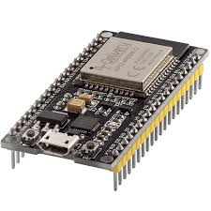
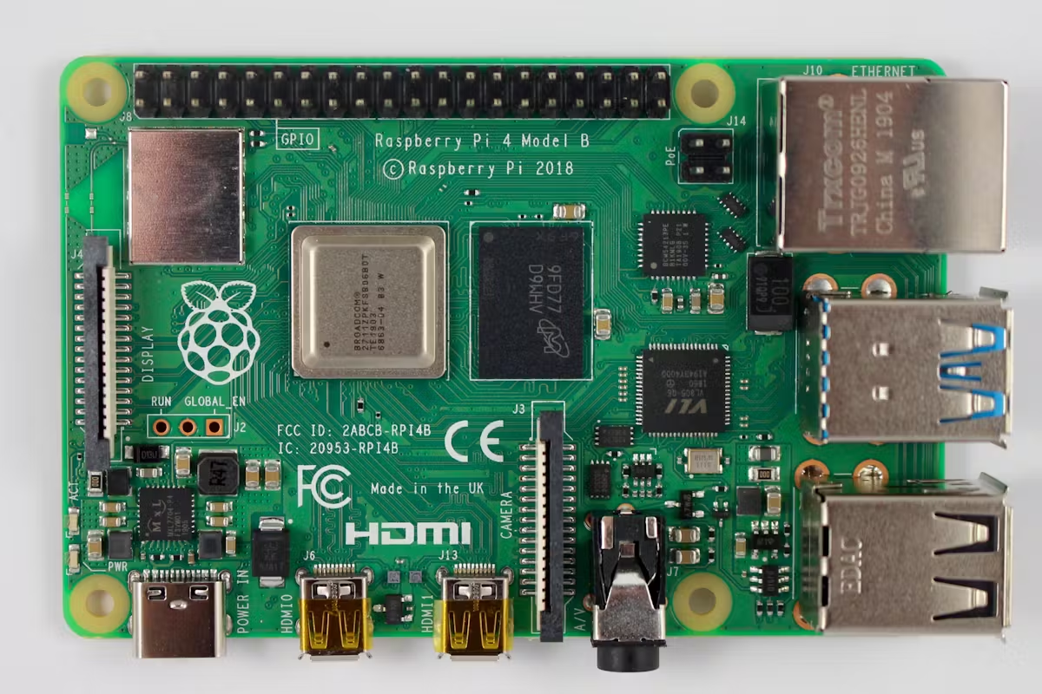
System Overview
SPO₂
ESP32
Raspberry
pi 4
Ultrasonic Sensor
Load cell
HMI Display
Pulse rate +
Respiratory rate
Temperature
sensor

Slide 12
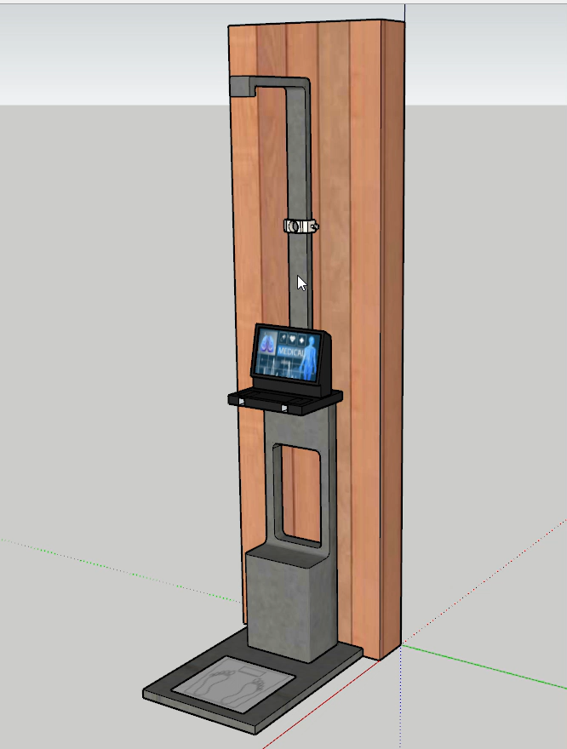
System Model

Slide 13
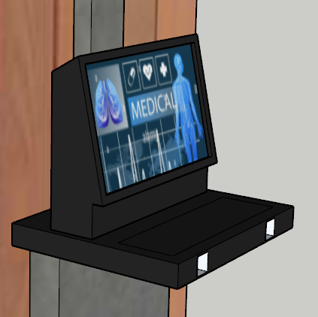
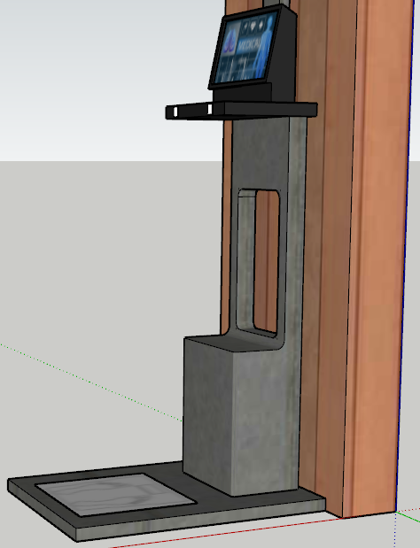
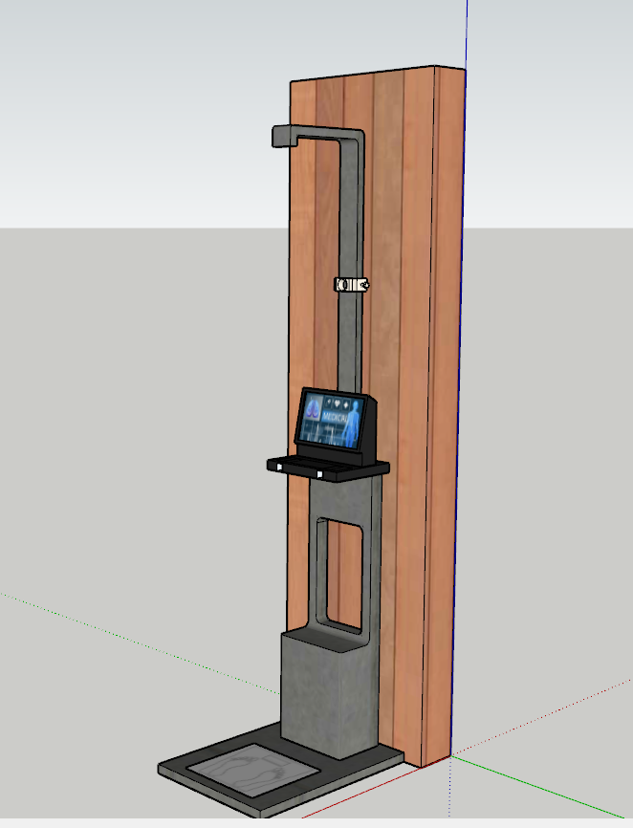
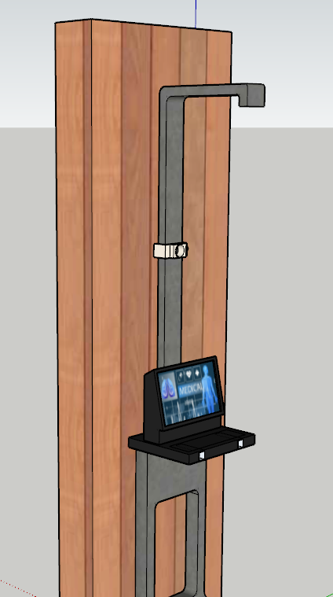
System Model
20CM
40CM
90CM
85CM
200CM
30CM
40CM

Slide 14
System Flow Chart
Data Collection in ESP32
Start
Processing in Raspberry Pi
System Initialization & Calibration “Raspberry Pi, ESP32, Sensors, Display”
Health Status
Regular Readings
Irregular Readings
Measure Height ‘HC-SR04 Ultrasonic’
Measure Weight ‘Load cell+HX711’
Pulse & Respiration ‘MAX30100’
Display Basic Health information on screen
Provide Recommendation
SpO₂ Measurement ‘MAX30102’
Temperature ‘MLX90614’
End

Slide 15
Process Flow Chart
START
Raspberry Pi 4B GUI, Data Processing
Patient
QR Code 'Detailed Report'
Touchscreen Display 'Basic Health Info'
Data from following sensors HC-SR04, Load Cell, MAX30100, MAX30102, MLX90614
END
ESP32 Real-time Data Acquisition

Slide 16
BMI= Weight(kg)/ [Height(m)]²
BMI | Category
＜18.5 | Underweight
18.5-24.9 | Normal weight
25-29.9 | Overweight
≥30 | Obese
(Tadi Chandrasekhar (BMI-for-age)), 2023)

Slide 17
Temperature
Average body temperature: 37 degree Celsius
Temperature | Category
(36.55 C - 37.27 C) | Normal Temperature
Higher than (38 C) | Fever
Below (35 C) | Hypothermia
(Kristin Mitchell), 2024.)

Slide 18
Pulse Rate
Age Group | Normal Range (bpm) | Below Normal (Bradycardia) | Above Normal (Tachycardia)
School Age (6–12 years) | 70 – 100 | < 70 | > 100
Adolescents (13–18 years) | 60 – 100 | < 60 | > 100
Adults (19–33 years) | 60 – 100 | < 60 | > 100
(Elizabeth Christman,2016)

Slide 19
Respiration Rate
Age Group | Normal Range (breaths/min) | Below Normal | Above Normal
19–33 yrs | 12–18 | Slow breathing (Bradypnea) | Fast breathing (Tachypnea)
(Cleveland Clinic, 2025)

Slide 20
Respiration Rate
Age Group | Normal Range (breaths/min) | Below Normal | Above Normal
19–33 yrs | 12–18 | Slow breathing (Bradypnea) | Fast breathing (Tachypnea)
(Cleveland Clinic, 2025)

Slide 21
SPO₂
Condition | SpO
Normal | 95% to 100% on both adults and children
Abnormal | 80% to 85%
Critical | Below 67%
(John P. Cunha,2019)

Slide 22
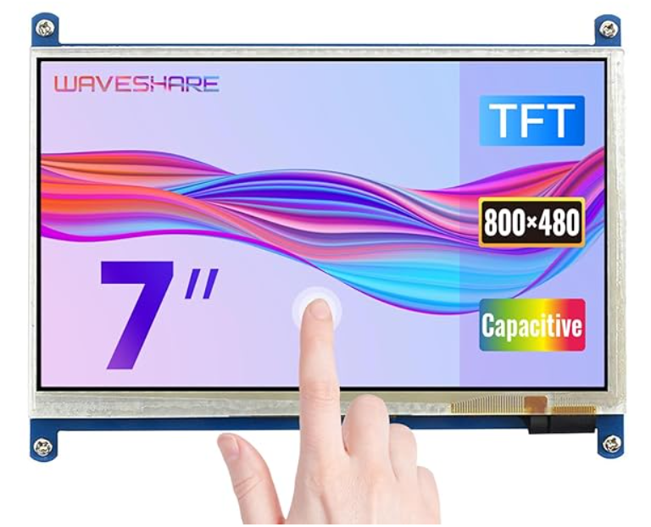
Bills of Material
Sl.No | Component | Specification | Component Image | Quantity | Rate (Nu.) | Total rate(Nu.) | Link
1 | Raspberry Pi 4B | Model Name:Raspberry Pi 4 RAM Memory Installed Size : 4 GB CPU Model : ARMv7 Product Dimensions‎ : 3 x 8 x 8 cm; 10 g |  | 1 | 5,759 | 5,759 | https://surl.li/hbretu
2 | Capacitive Touchscreen LCD Display | Product Dimensions : 18 x 10 x 9 cm; 406 g Item model number: ‎7inch (B) Processor Count: ‎1 Memory Clock Speed: 800 MHz |  | 1 | 5,679 | 5,679 | https://surl.lu/qubudb

Slide 23
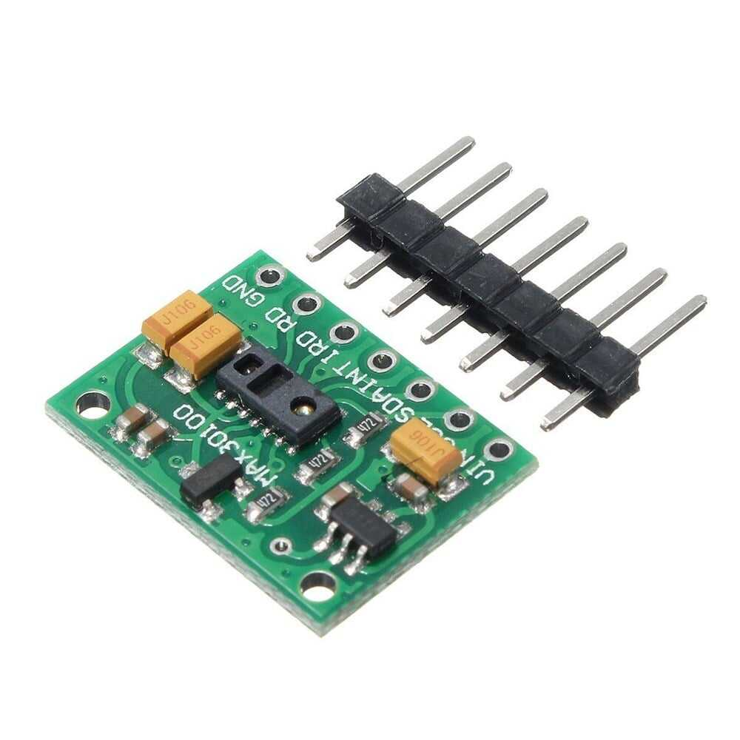
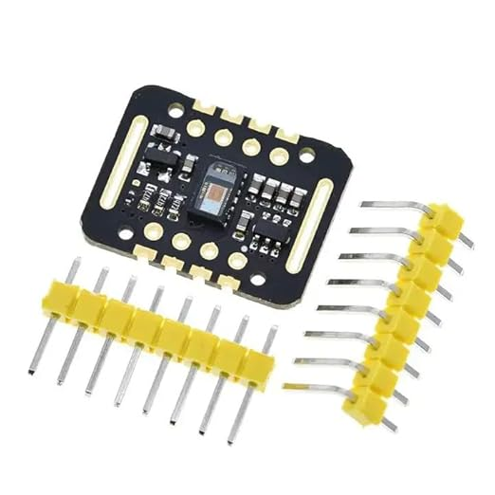
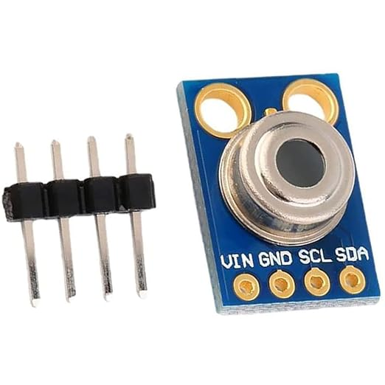
Sl.No | Component | Specification | Component Image | Quantity | Rate (Nu.) | Total rate(Nu.) | Link
3 | MAX30100 Heart Rate | Item Weight :‎2 g Product Dimensions: 8 x 4 x 10 cm; 2 g Item model number : BE-001758 |  | 1 | 253 | 253 | https://surl.li/wnprto
4 | Oximeter Sensor Module | Model number : SEN0159 No. of Memory Sticks: 1 Item model number :I‎SEN0159 |  | 1 | 335 | 335 | https://surli.cc/tcwcih
5 | Contactless Temperature sensor | Product Dimensions ‎: 2.9 x 11.7 x 30.1 cm; 400 g Item model no. ‎RC-A-41273 |  | 1 | 1,549 | 1,549 | https://surl.li/owcjpp

Slide 24
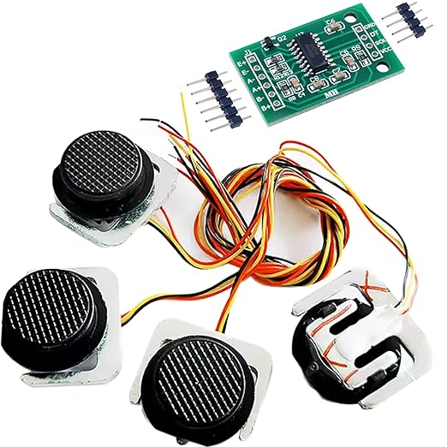
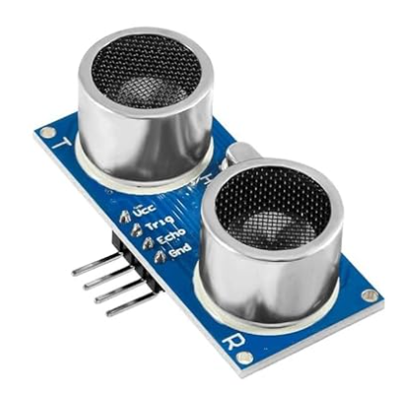
Sl.No | Component | Specification | Component Image | Quantity | Rate (Nu.) | Total rate(Nu.) | Link
6 | 4PCS 50KG Load Cell | Colour:‎4 sensor 1 module No. of Memory Sticks :1 Item Weight : ‎0.06 g Item model no. : FZ6096 |  | 1 | 2,220 | 2,220 | https://surl.li/dvbena
7 | Ultrasonic Distance Sensor | Item Weight: ‎12 g Product Dimensions: 4 x 2 x 1 cm; 12 g Item model no.HC-SR04 |  | 1 | 245 | 245 | https://surl.li/wvbkel
8 | ESP32 WROOM-32 | RAM Memory Installed Size :520 KB Memory Storage Capacity :4 MB CPU Model : Dual-Core |  | 1 | 589 | 589 | https://surl.li/eblppn

Slide 25
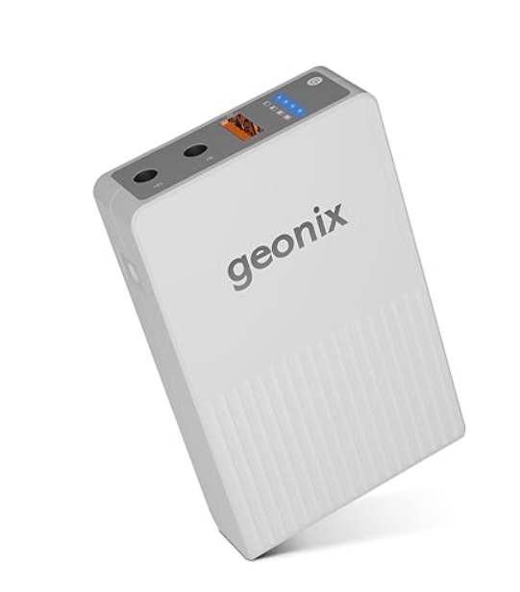
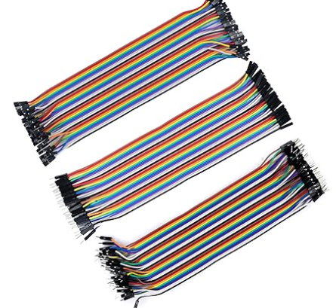
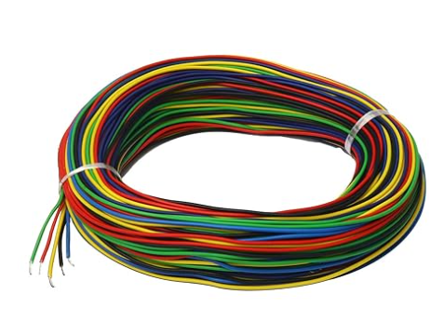
Sl.No | Component | Specification | Component Image | Quantity | Rate (Nu.) | Total rate(Nu.) | Link
9 | Mini UPS Power Bank | Voltage:‎12 Volts Power Source : Corded Electric Batteries Included Lithium Battery : Energy Content 14.8 Watt Hours |  | 1 | 899 | 899 | https://url-shortener.me/55GE
10 | Jumper Wires | Product Dimensions: 4.8 x 12 x 14.6 cm; 80 g |  | 1 | 189 | 189 | https://surl.li/envhfy
11 | Long electronic wire. | Material : ‎Silicone |  | 1 | 325 | 325 | https://surl.li/etvykg

Slide 26
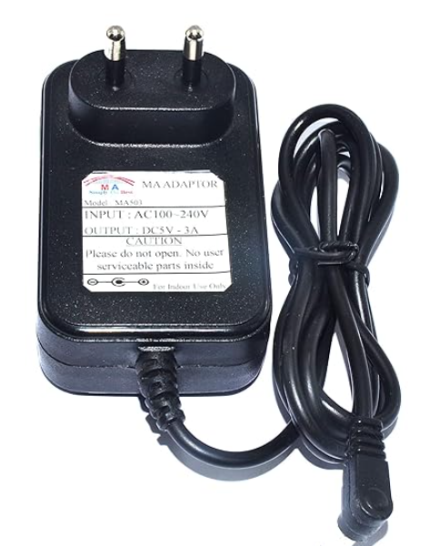
Sl.No | Component | Specification | Component Image | Quantity | Rate (Nu.) | Total rate(Nu.) | Link
12 | Mini UPS Power Bank | Pure 5V 3A Output with right angle DC connector. 1.5 Mtr. Long dc Dc output cord. |  | 1 | 578 | 578 | https://l1nq.com/sPi9F

Slide 27
Total budget Calculation
Total cost of component :Nu. 17,970.
Fabrication Cost : Nu. 1,500.
Total Project Cost : Nu .19,470.

Slide 28
Power Consumption Table
Component | Qty | Operating Voltage | Current Draw (Approx.) | Power = V x I(W) | Notes
Raspberry Pi 4B (4GB) | 1 | 5V | 600 mA (idle) → 1.2 A (full load with display) | ~6.0 W | Main computer, GUI, QR code, logging
Waveshare 7" HDMI Display (Capacitive Touch) | 1 | 5V | ~500 mA | ~2.5 W | Touchscreen & display
ESP32 DevKit | 1 | 3.3V / 5V | ~160 mA (WiFi active peak) | ~0.8 W | Sensor hub & communication
MAX30100 (Pulse + Respiration) | 1 | 1.8V–5V | ~600 µA (active mode) | ~0.003 W | Very low power

Slide 29
Power Consumption Table
Component | Qty | Operating Voltage | Current Draw (Approx.) | Power = V x I(W) | Notes
MAX30102 (SpO₂) | 1 | 1.8V–5V | ~1 mA (active mode) | ~0.005 W | Very low power
MLX90614 (Temp) | 1 | 3.3V–5V | ~1.5 mA | ~0.008 W | I²C, negligible load
Load Cell (50 kg ×4) + HX711 | 1 set | 5V | ~1.5 mA | ~0.008 W | Active only during reading
HC-SR04 Ultrasonic | 1 | 5V | ~15 mA | ~0.075 W | Short pulses during measurement
Battery Backup Pack (5V, 20,000 mAh typical) | 1 | 5V | Output up to 2.1–3A | Provides ~37 Wh | Powers Pi, display, ESP32, sensors

Slide 30
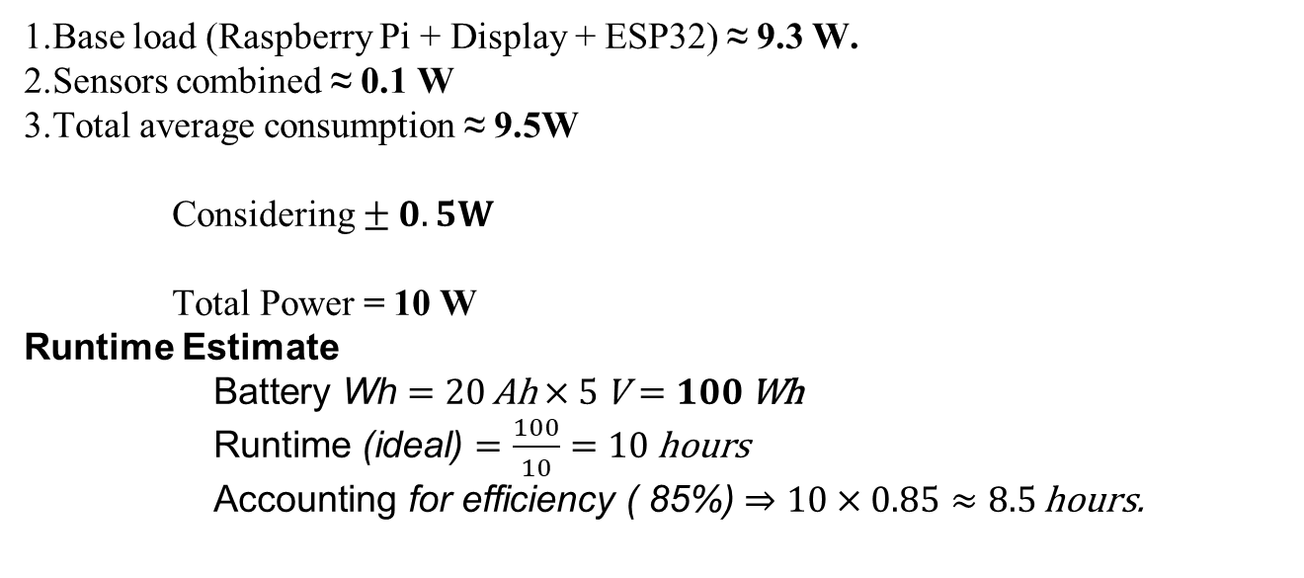
Total Power Requirement
1.Base load (Raspberry Pi + Display + ESP32) ≈ 9.3 W.
2.Sensors combined ≈ 0.1 W
3.Total average consumption ≈ 9.5W
Considering $± 0.5W$
Total Power = 10 W
Runtime Estimate
$\text{Battery} \text{Wh}=20 \text{Ah}×5 \text{V}=100 \text{Wh}$
$\text{Runtime}\text{ (}\text{ideal}\text{)}=\frac{100}{10}=10 \text{hours}$
$\text{Accounting} \text{for} \text{efficiency}\text{ ( }\text{85}\text{\%)}⇒10×0.85≈8.5 \text{hours}\text{.}$

Slide 31
Expected Outcomes
Measures BMI, pulse rate, SpO₂, respiratory rate, and temperature.
Provides accessible, real-time readings with user-friendly interface.
Generates a simple health index.

Slide 32
Work Plan (7th Semester)
Activity | Aug |  |  |  | Sep |  |  |  | Oct |  |  |  | Nov |  |  |  | Dec
 | 1 | 2 | 3 | 4 | 1 | 2 | 3 | 4 | 1 | 2 | 3 | 4 | 1 | 2 | 3 | 4 | 1 | 2 | 3 | 4
Topic Finalization
Literature Review
Proposal Presentation
System Design
First Review
Components Procurement
Control Algorithm Development

Slide 33
Work Plan (8th Semester)
Activity | Jan |  |  |  | Feb |  |  |  | Mar |  |  |  | Apr |  |  |  | May |  |  |  | Jun
 | 1 | 2 | 3 | 4 | 1 | 2 | 3 | 4 | 1 | 2 | 3 | 4 | 1 | 2 | 3 | 4 | 1 | 2 | 3 | 4 | 1 | 2 | 3 | 4
Fabrication and Integration
Second Review
Prototype Designing
Model Testing
Third Review
Report Writing
Report Draft Submission
Final Documentation
Final Presentation
Final Report Submission

Slide 34
Reference
Dhingra1, S., & Sharma2, M. (2019). Real-Time Vital Signs Monitoring System. International Journal of Engineering Research & Technology (IJERT), 8(2278–018). https://www.ijert.org/research/real-time-vital-signs-monitoring-system-IJERTV8IS060475.pdf
Patient Assessment and Vital Signs Measurement and Documentation. (2022). AAST Technical Guideline, 10. https://aastweb.org/wp-content/uploads/2025/03/13.-Patient-Assessment-and-Vital-Signs-Measurement-and-Documentation.pdf
Patrick O, O., & Kazeem A, M. (2020). Development, Implementation and Usage of an Automated Body Mass Index (ABMI) System. Global Scientific Journals, 8(2320–9186). https://www.globalscientificjournal.com/researchpaper/Development_Implementation_and_Usage_of_an_Automated_Body_Mass_Index_ABMI_System.pdf
Professional, C. C. M. (2025, May 7). Vital signs. Cleveland Clinic. https://my.clevelandclinic.org/health/articles/10881-vital-signs
What is a good oxygen rate by age? Causes, symptoms & chart. (2021, October 26). eMedicineHealth. https://www.emedicinehealth.com/what_is_a_good_oxygen_rate_by_age/article_em.htm

Slide 35
Thank You

