Slide 1


MARK GEN
First Review
(01.02.2017)
SUPERVISED BY
Mr. Prakash P
COMPLETED BY
Arun M (1313007)
Prabakaran P (1313081)
PraveenKumar M (1313084)
Vigneshwaran N (1313124)

Slide 2
ABSTRACT
Mark Generation is a system to speed up the process of generating internal marks of student and delivering the reports through electronic message. It allows faculties to generate reports in a predefined letter format with appropriate address and marks details for each student. Faculties can also send instant messages to students / parents through SMS. Mark Generation project digitalizes the mark generation process used currently.

Slide 3
PROPOSED SYSTEM
Proposed mark generation system is a web based application which can be accessed by faculties anywhere in the college network.
All details regarding students marks are updated to the central database.
Only authorized persons can update database.
Advisors can send reports to students / parents through SMS.
Advisors can also generate letters in a defined format automatically.(No need of mail-merge)
Faculties can also share necessary information's to students through short code messages.
Auto generation of internal marks based on regulation and formula.

Slide 4
SURVEY REPORT
<Times New Roman SIZE : 18>

Slide 5
ADVANTAGE OF PROPOSED SYSTEM
A central database is maintained.
No duplicate data.
No data mismatch as authorized persons only can update database.
Lesser the amount of man power than existing system.
Low cost because reports are delivered through messages.
Any information can be passed to students through messages at any time.

Slide 6
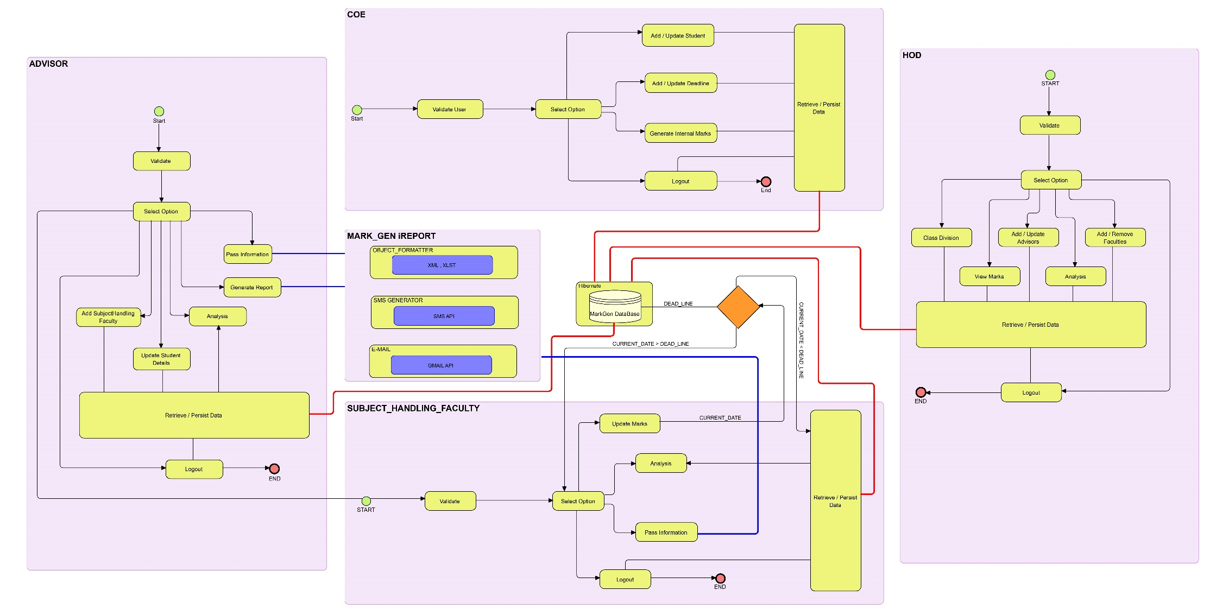
OVERALL SYSTEM ARCHITECTUERE

Slide 7
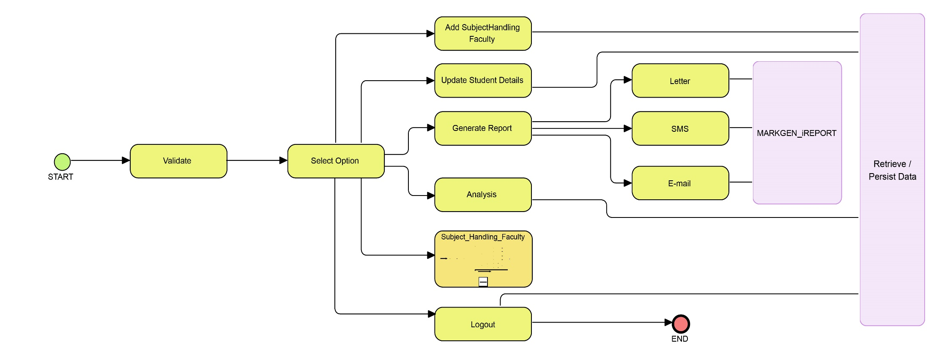
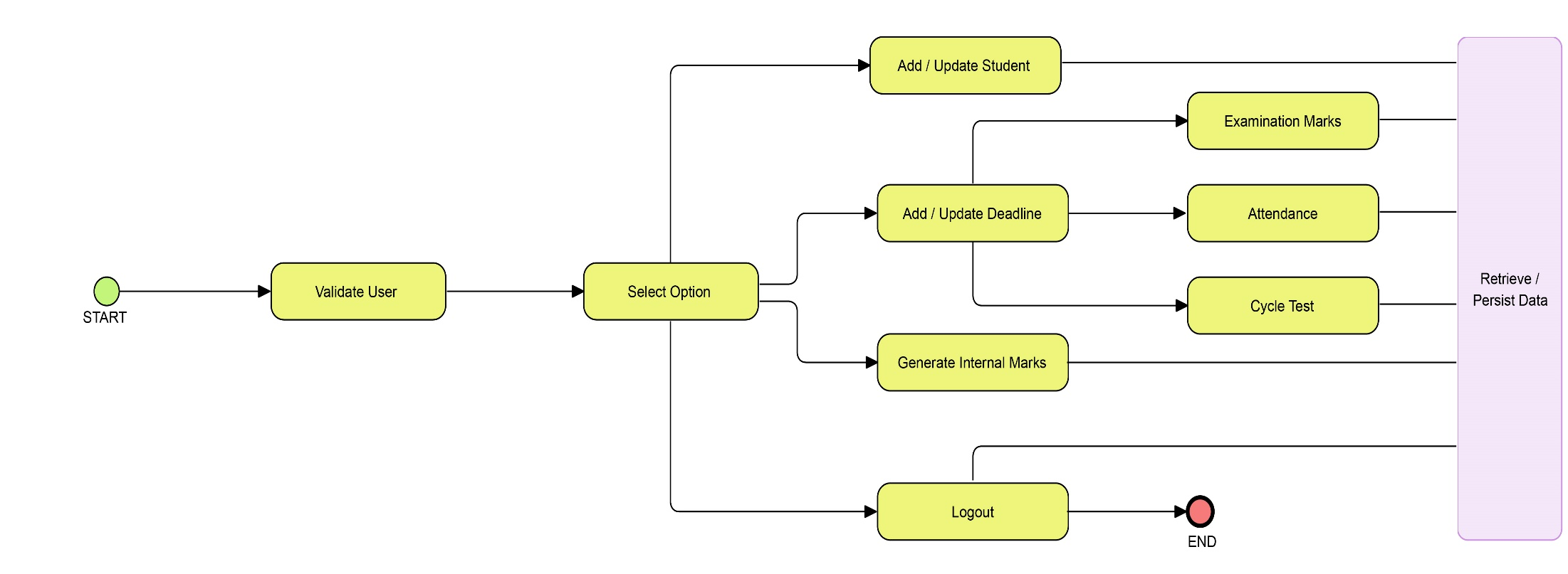
MODULES USED
ADVISORS
COE

Slide 8
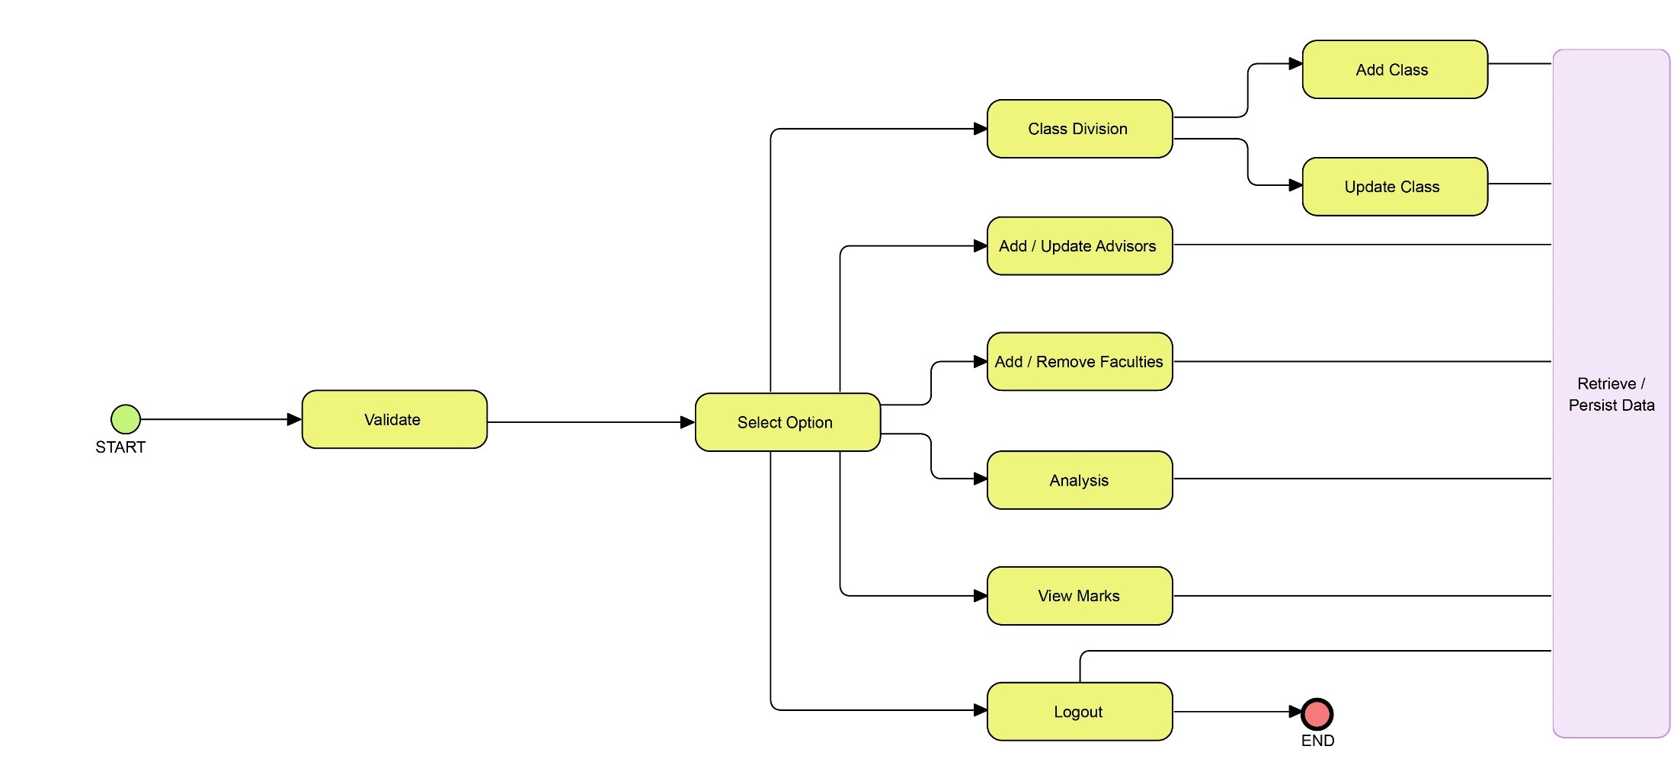
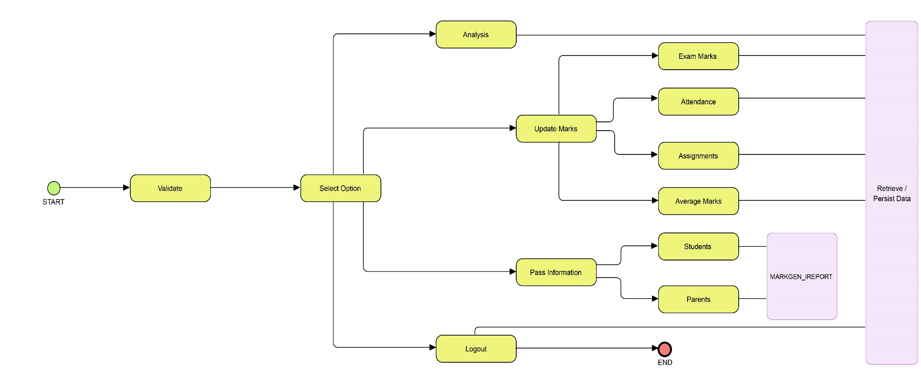
MODULES USED
HOD MODULE
SUBJECT_HANDLING_FACULTY MODULE

Slide 9
COE MODULE - EXPLANATION
COE adds list of students and their departments information into the MarkGen system.
For each examinations COE adds deadline, before which the marks are to be updated by staff (SUBJECT_HANDLING_FACULTY).
After all necessary details ( EXAMINATION_MARKS ,ASSIGNMENTS , ATTENDANCE ) are gathered from staff, COE can generate internal marks.
Deadline can be extended / modified for students whose tests are rescheduled.

Slide 10
HOD MODULE - EXPLANATION
HOD can group students into classes and update it into MarkGen database.
HOD can add / remove faculties into / from MarkGen database.
HOD can allocate advisors for all available classes.
HOD can view students marks at any time.
HOD can analyze students marks in forms of graph / chart.

Slide 11
ADVISOR MODULE - EXPLANATION
Advisors can add subject handling faculties for their class.
Only added faculties can update marks for their subjects.
Advisors can update students personal details.
If the advisor is also a subject handling faculty , he / she also can update marks for their handling class.
Advisors can generate report in the preferred way.
Advisors can also analyze marks of students.

Slide 12
SUBJECT_HANDLING_FACULTY MODULE
Subject handling faculties can update marks for their handling class.
Subject handling faculties can analyse marks for their handled subjects to view overall progress.
Subject handling faculties can pass information if any to students in the given way.

Slide 13
REFFERENCES
https://en.wikipedia.org/wiki/Requirements_analysis
https://www.tutorialspoint.com/uml/uml_standard_diagrams.htm
Book: Object Oriented Analysis and Design by Booch Jackson Rumbaugh.

