Slide 1
CERVICAL CANCER EPIDEMIOLOGY
Insights into Hormonal Contraceptives, IUD, Smoking and Age

Slide 2
GROUP-8
TEAM MEMBERS:
Kalepu Srinath
Veronica Angelina Itta
Adarsh Viswanath
Mahitha Vontimitta
Arun Kumar Soora
Ritheesh Miridoodi
GUIDED BY:
JOHN BURNS

Slide 3
INTRODUCTION
Every year, cervical cancer is diagnosed in over half a million women, and the disease leads to more than 300,000 fatalities globally (Cohen et al., 2019).
As per the latest data, cervical cancer holds the fourteenth position among all cancer types and is the fourth most prevalent cancer among women worldwide (Fowler et al., 2022).
The risk of cervical cancer is significantly influenced by factors such as early initiation of sexual activity and having multiple sexual partners. Additionally, variations in the incidence of cervical cancer among different countries can be attributed to the implementation of screening programs. While the overall trend suggests a reduction in both incidence and mortality, there are indications of an elevated risk of cervical cancer, likely associated with shifts in sexual behavior. Smoking and human papillomavirus (HPV) infection are currently recognized as significant factors in the multifaceted and progressive process of cervical carcinogenesis (Zhang et al., 2020).
Interventions for cervical cancer primarily center on primary and secondary prevention. The most effective approach to reduce the impact of cervical cancer and lower mortality rates is through primary prevention and regular screening (Fowler et al., 2022. We utilized this dataset to develop a model for the identification of individuals with a high risk of cervical cancer.

Slide 4
AIM:
The dataset titled "Cervical Cancer Epidemiology: Insights into Hormonal Contraceptives, IUD, Age, and Smoking" aims to provide important insights and support research on the connection between cervical cancer and four significant factors. By gathering and examining data related to these elements, the dataset seeks to offer a comprehensive understanding of cervical cancer epidemiology concerning hormonal contraceptives, IUD usage, and age. This valuable information can empower researchers and healthcare professionals to make informed decisions, develop effective prevention strategies, and enhance the quality of patient care.
PURPOSE:
The purpose of this project is to gain insights into cervical cancer patterns linked to age, number of sexual partners, number of pregnancies, smoking, hormonal contraceptives, IUD usage and STDs.
To correlate the above mentioned factors with cervical cancer using machine learning models to gain perspective on their role in the cervical cancer incidence.
RESEARCH QUESTION:
How do hormonal contraceptives, IUD usage, age, and smoking contribute to the epidemiology of cervical cancer? Specifically, what are the interconnections, correlations, or trends among these factors in relation to the occurrence and prevalence of cervical cancer?

Slide 5
HYPOTHESIS
Null Hypothesis: There is no significant interaction between age and the use of hormonal contraceptives in terms of their effect on cervical cancer risk, meaning that the impact of hormonal contraceptives on cervical cancer risk does not differ significantly between various age groups.
Alternative Hypothesis: An interaction effect exists between age and the use of hormonal contraceptives, leading to varying impacts of hormonal contraceptives on cervical cancer risk among different age groups.

Slide 6
METHODOLOGY
Data Collection:
The data for this study was obtained from Kaggle.
https://www.kaggle.com/datasets/ranzeet013/cervical-cancer-dataset/data
Data Cleaning and Extraction:
Removing null values
Converting subjective data to categorical data
Removing outliers
Developing models:
Logistic Regression
Support Vector Machine
Random Forest
Decision Tree
Statistical Analysis: It is the most critical part of the study. The Analysis will be performed using Python, which includes libraries like Scikit-Learn in Machine Learning and visualization libraries like Seaborn, Matplotlib, and Plotly for data visualization.

Slide 7
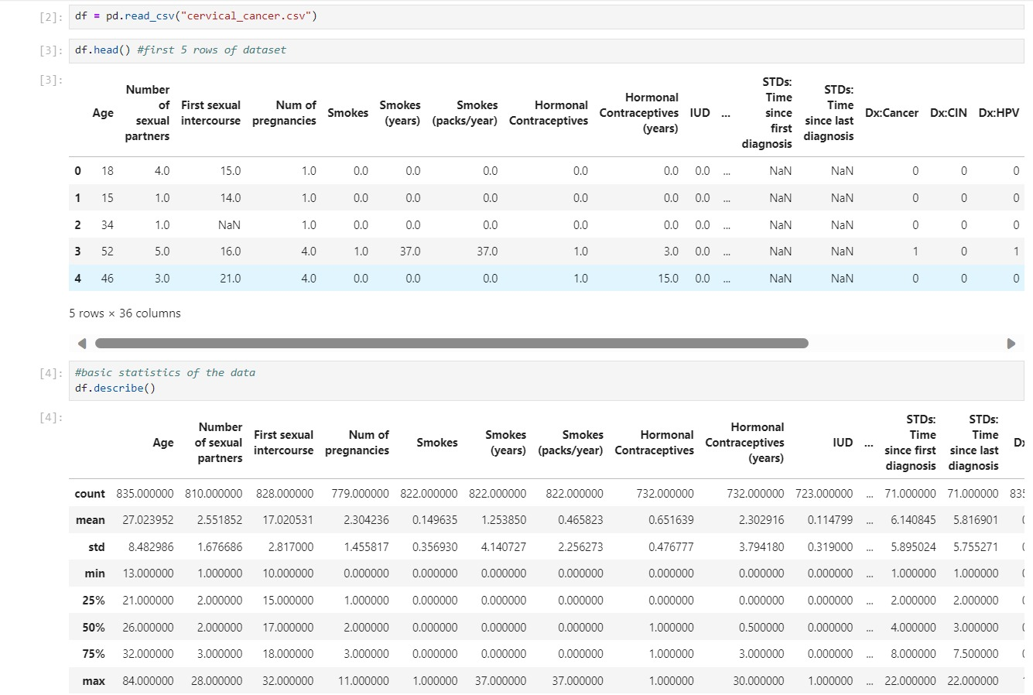
Reading the dataset

Slide 8
DATA CLEANING
Determine the null values in each column .
Imputed the missing values from the given data set.
We imputed the categorical values with 0 or 1 and continues variables with median values.
Checked for the null values
df.isnull().sum()

Slide 9
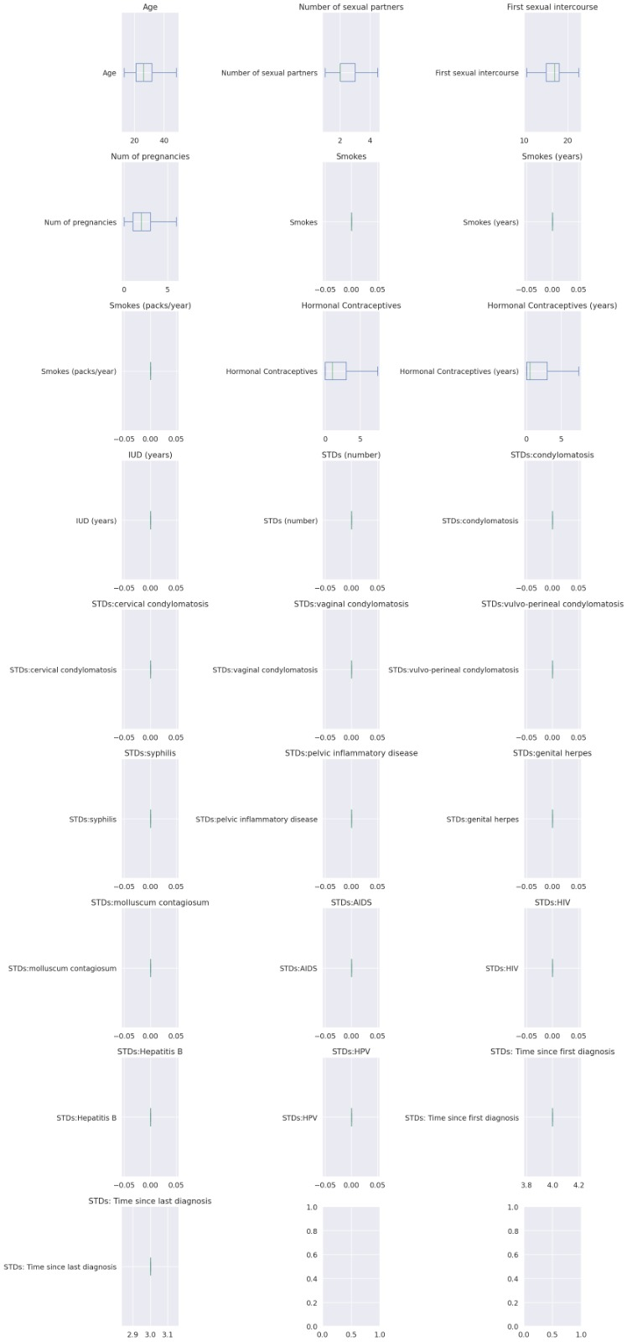
Outliers
AFTER CAPPING
Detected the outliers
Successfully capped the outliers

Slide 10
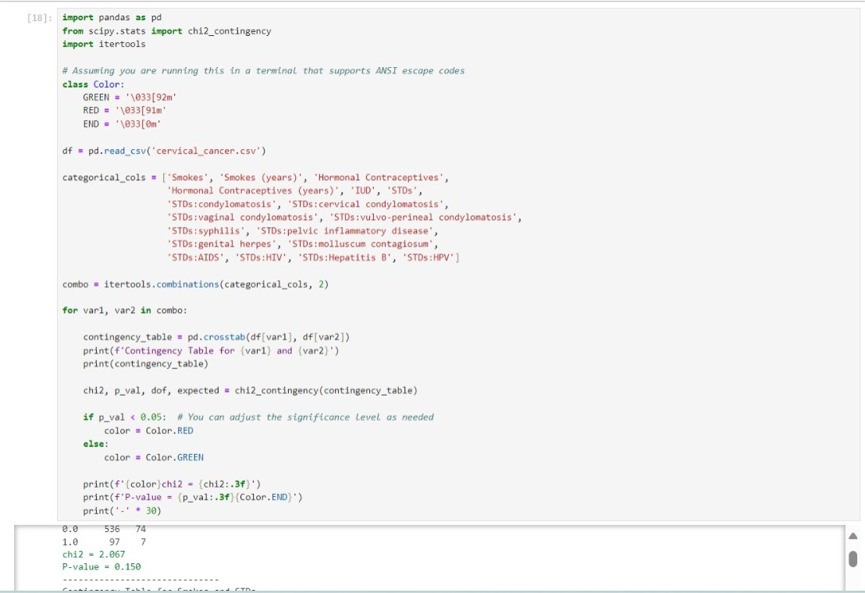
STATISTICAL TESTING
PERFORMED A CHI-SQUARE TEST

Slide 11
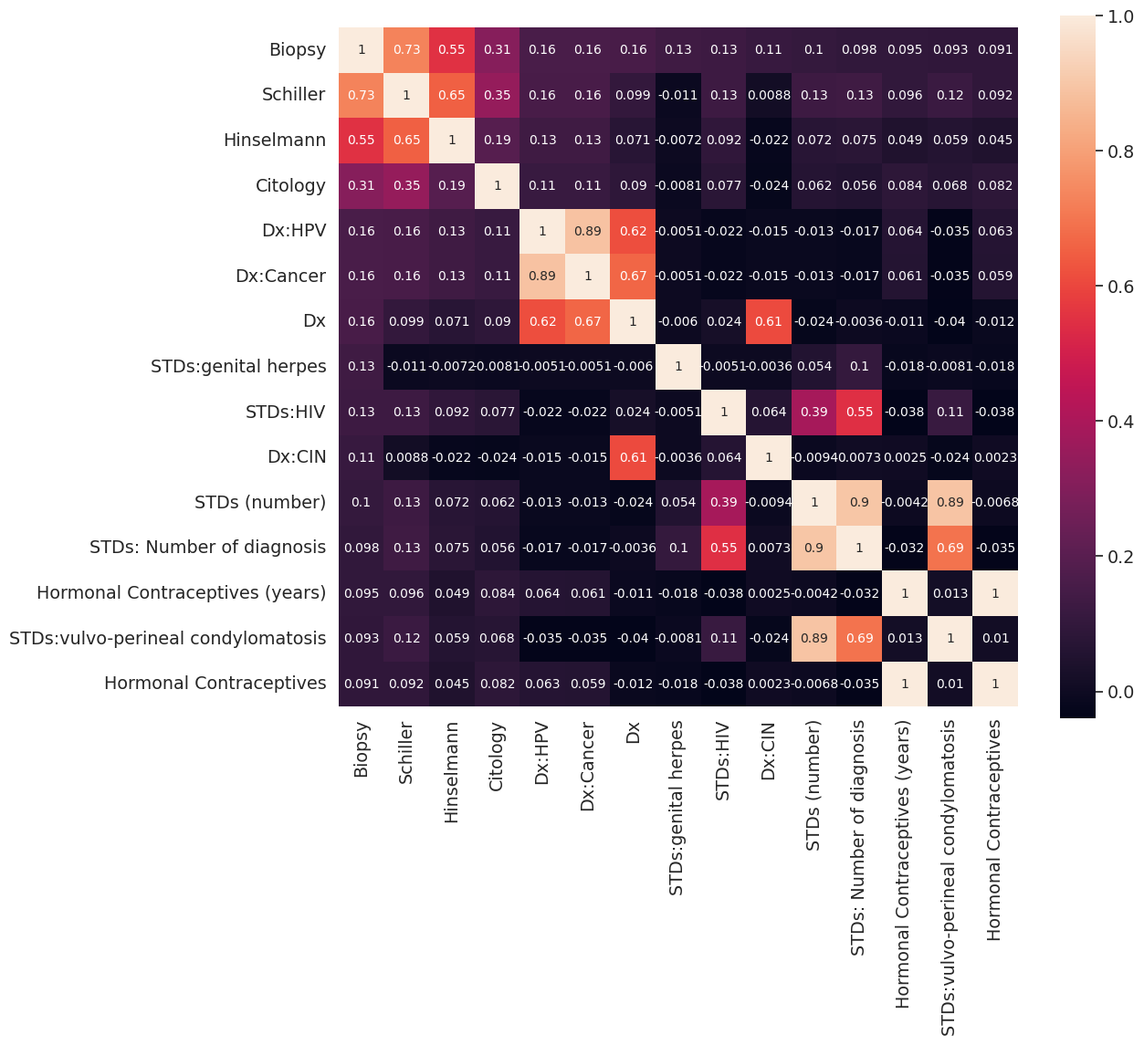
HEATMAP OF TOP CORRELATION AFTER IMPUTATION

Slide 12
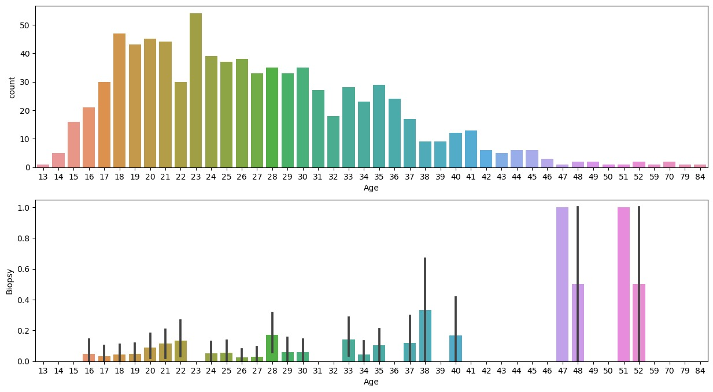
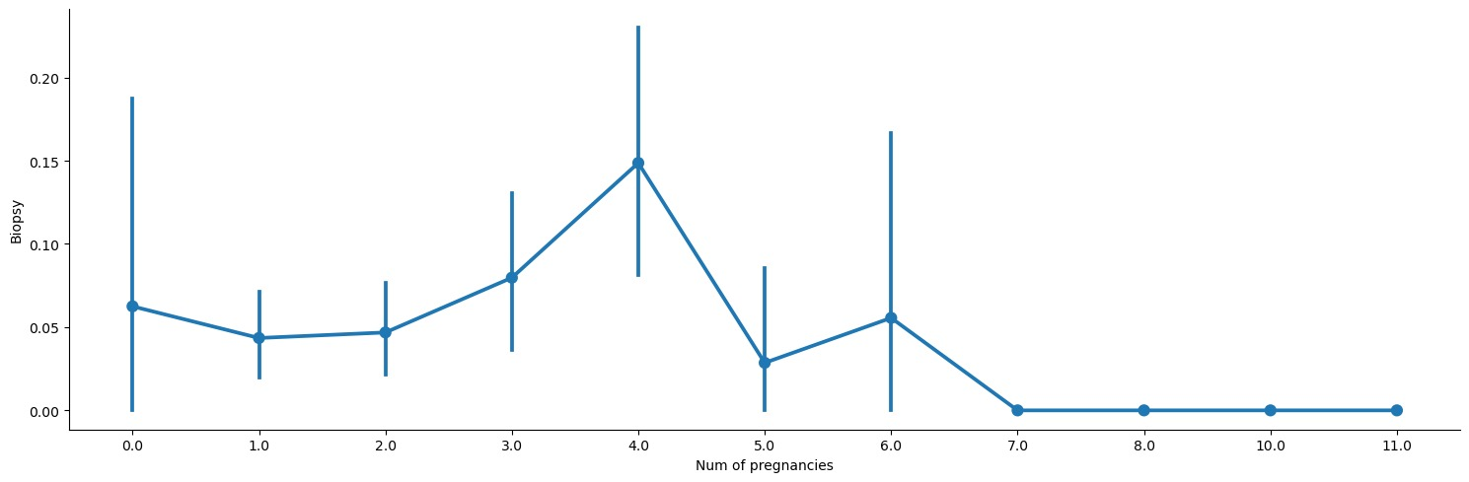
DATA VISUALIZATION
BIOPSY VS AGE
BIOPSY VS NO.OF PREGNANCIES WITH FACTOR PLOT

Slide 13
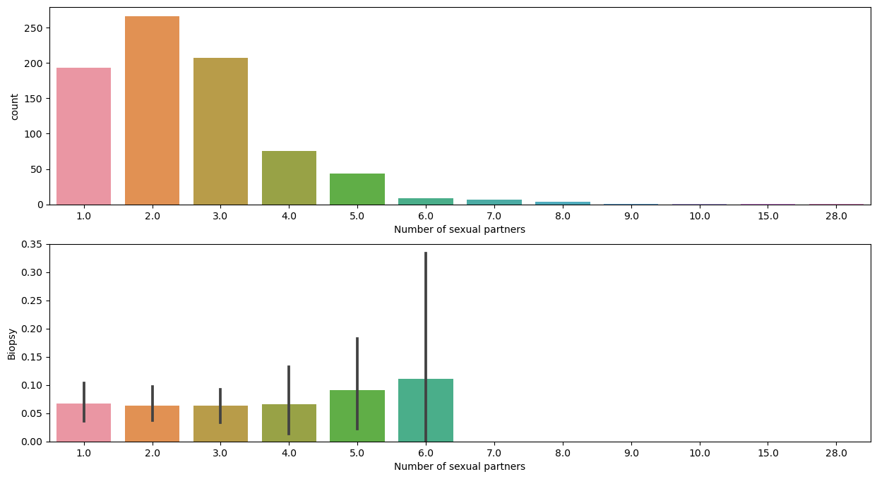

Slide 14
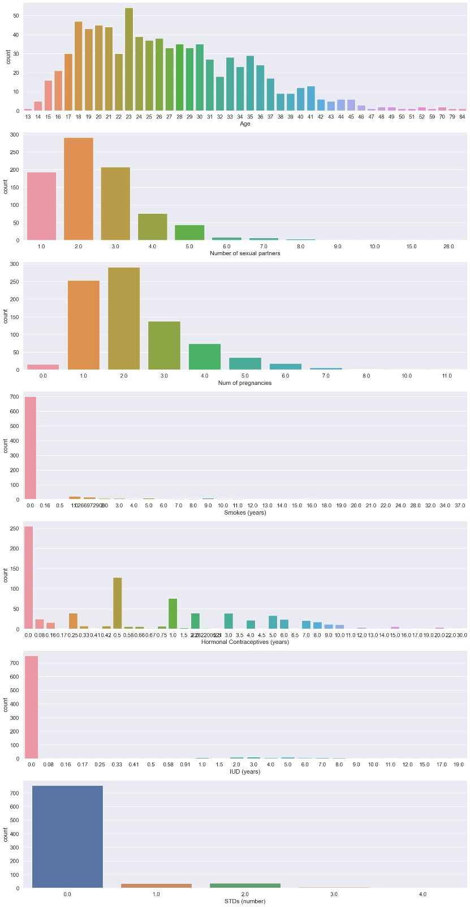
BAR PLOTS FOR AGE, SEXUAL PARTNERS, SMOKE, IUD, HORMONAL CONTRACEPTIVES AND STD’S

Slide 15
Machine learning models
LOGISTIC REGRESSION
SUPPORT VECTOR MACHINE
RANDOM FOREST
DECISION TREE

Slide 16
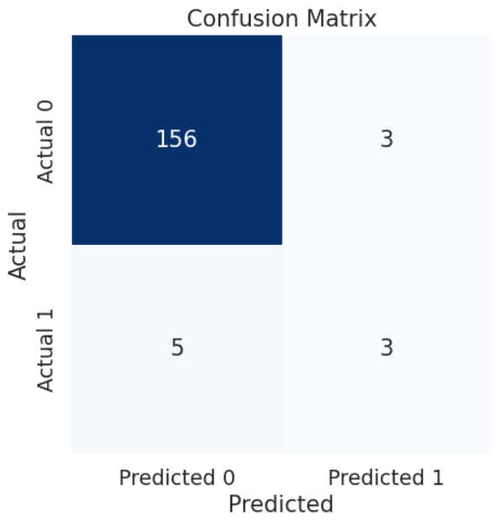
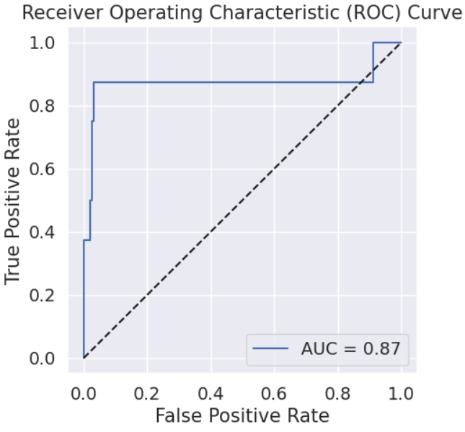
LOGISTIC REGRESSION TESTING ACCURACY:0.96 ACCURACY CURVE: 0.87
CONFUSION MATRIX
RECEIVER OPERATING CHARACTERISTIC (ROC) CURVE

Slide 17

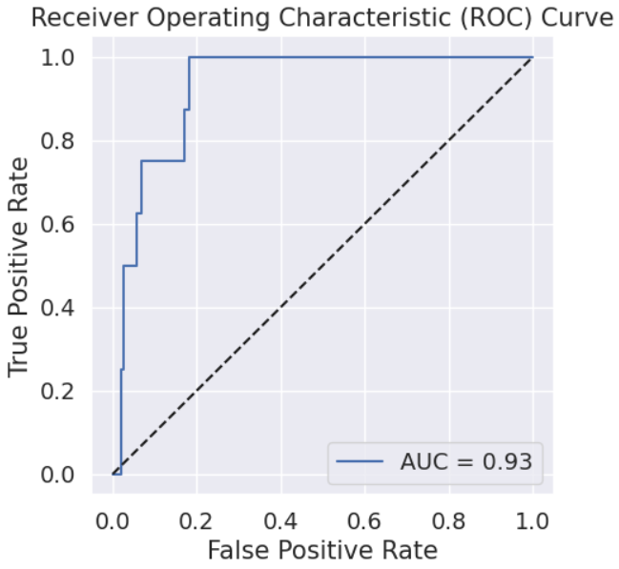
SUPPORT VECTOR MACHINE (SVM) TESTING ACCURACY:0.97 ACCURACY CURVE: 0.87
CONFUSION MATRIX
RECEIVER OPERATING CHARACTERISTIC (ROC) CURVE

Slide 18

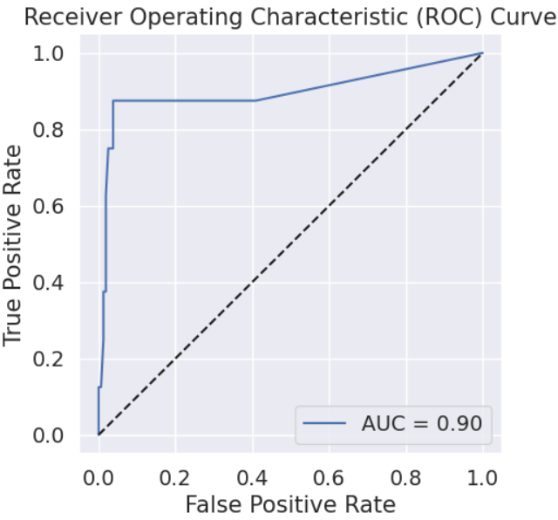
RANDOM FOREST TESTING ACCURACY:0.94 ACCURACY CURVE: 0.89
CONFUSION MATRIX
RECEIVER OPERATING CHARACTERISTIC (ROC) CURVE

Slide 19
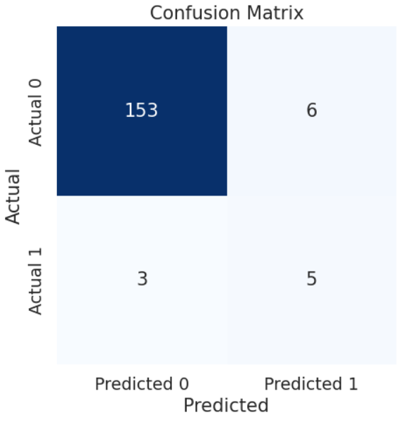
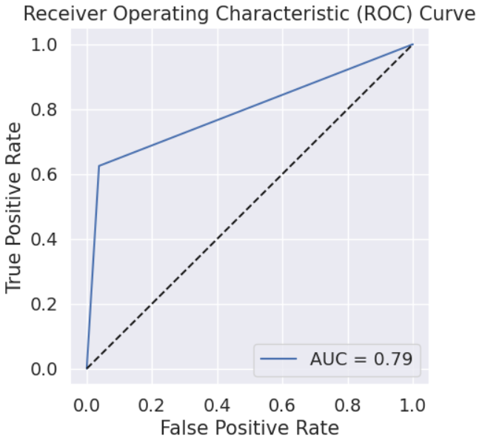
DECISION TREE TESTING ACCURACY:0.94 ACCURACY CURVE: 0.73
CONFUSION MATRIX
RECEIVER OPERATING CHARACTERISTIC (ROC) CURVE

Slide 20
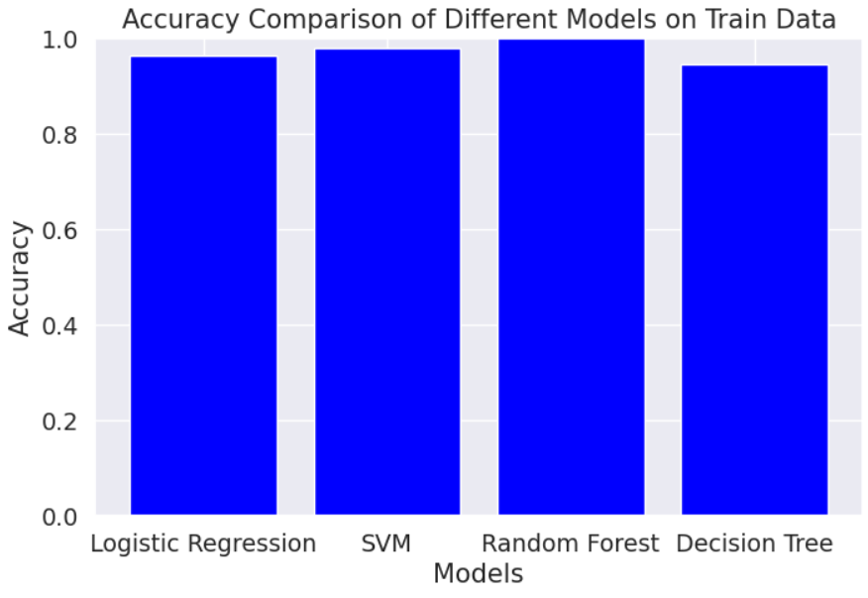
accuracy comparison of different moDELs on tRAIN data

Slide 21
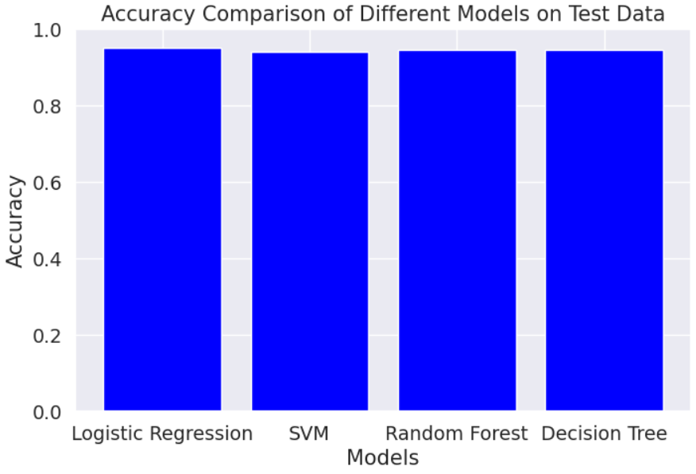
accuracy comparison of different modEls on test data

Slide 22
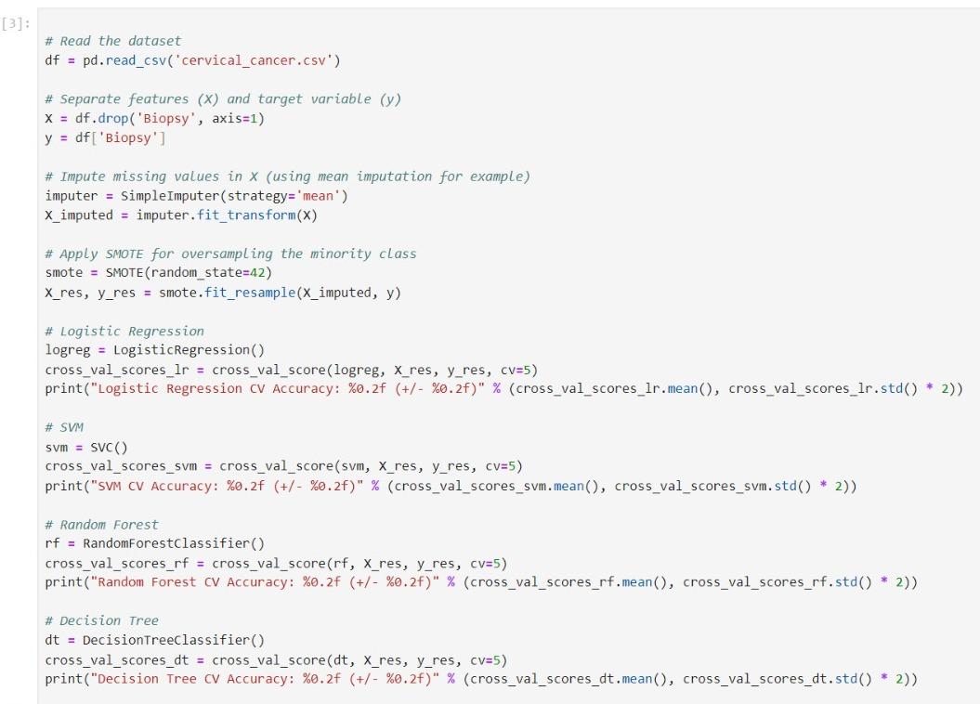
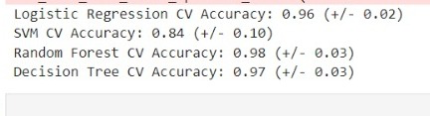
CROSS VALIDATION

Slide 23
CONCLUSION
In summary, we tried to predict the correlation between the factors and cervical cancer.
The online dataset was collected from Kaggle.
Data cleaning was done by replacing the placeholders with standard missing value representation(NaN), dropping the columns, converting the subjective data to categorical, removing the outliers of numerical variables and removing the outliers of numerical variables and removing the null values from the data.
Data visualization was done by plotting the histograms of the variables.
We developed the models including Logistic Regression, Support Vector Machine, Random Forest and Decision Tree
We compared the accuracy of different models on Train Data and Test Data.
We found that the Decision Tree has comparatively given the prediction better.
We have not observed enough accuracy to conclude that this dataset helps predict the correlation between those factors and cervical cancer incidence.
We are accepting the null hypothesis as the observed p-value is greater than 0.05.

