Slide 1

DFS Insights

Slide 2
Discovery Time and Finish Time
Discovery Time : Time when we first visited a vertex is the discovery time of that vertex.
Finish Time : Time when we have completely visited the sub-tree of a vertex is finish time of that vertex.

Slide 3
Discovery Time / Finish Time
9
11/
14
1/
2/
10
A
B
C
12/
13
D
E
F
3/
8
4/
5
G
6/
7

Slide 4
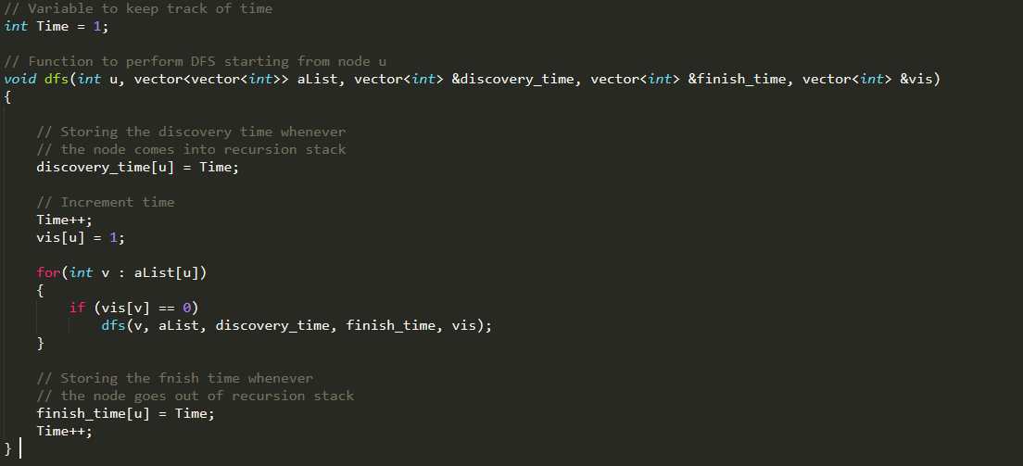
Code

Slide 5
1/10
2/9
11/14
A
B
C
TE
FE
BE
TE
CE
TE
D
E
F
12/13
TE
3/8
4/5
TE
G
6/7
Edges Classification:
Tree Edges (FE) – It is an edge which is present in the tree obtained after applying DFS on the graph.
Forward Edges (FE) – It is an edge (u, v) such that v is descendant but not part of the DFS tree.
Backward Edges or Back Edge (BE) – It is an edge (u, v) such that v is ancestor of node u but not part of DFS tree. Presence of back edge indicates a cycle in directed graph.
Cross Edges (CE) – It is a edge which connects two node such that they do not have any ancestor and a descendant relationship between them.

Slide 6
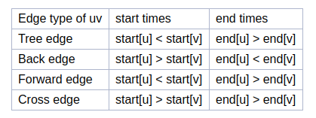
Classification of edges using relation between discovery (start) and finish (end) times

Slide 7
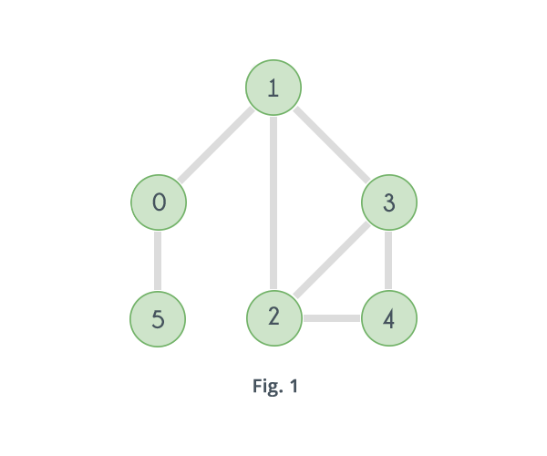
Articulation Point
Definition : In a graph, a vertex is called an articulation point if removing it and all the edges associated with it results in the increase of the number of connected components in the graph. For example consider the graph given in following figure.
For eg. In this graph nodes 1 and 0 are articulation points

Slide 8
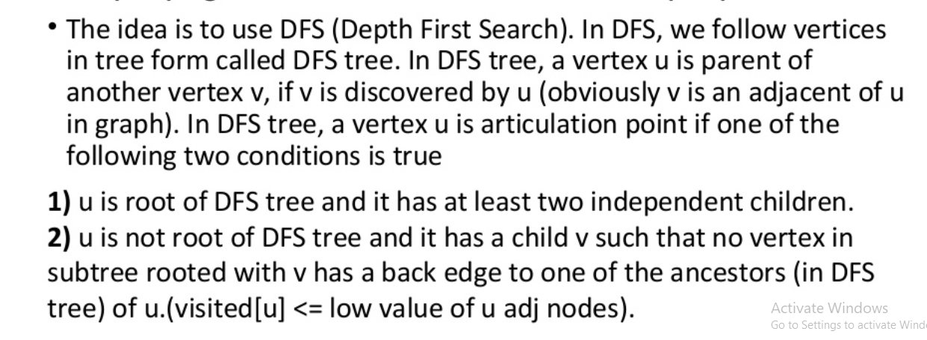
How to find Articulation Point ?
So, let disc[v] denote discovery time for node v. We introduce an array low which will let us check the fact for each vertex v. low[v] is the minimum of disc[v], the discovery times disc[p] for each node p that is connected to node v via a back-edge (v,p) and the values of low[T] for each vertex T which is a direct descendant of v in the DFS tree.
DiscTime[u]

Slide 9
Working
Node | Parent
1 | -1
2 | 1
3 | 2
4 | 3
0 | 1
5 | 0
1/
1
3/
3
min(4,2)
2/
4/
2

Slide 10
Working
Node | Parent
1 | -1
2 | 1
3 | 2
4 | 3
0 | 1
5 | 0
1/
1
3/
Min(2,1,3)
2
2/
4/
2

Slide 11
Working
Node | Parent
1 | -1
2 | 1
3 | 2
4 | 3
0 | 1
5 | 0
1/
1
3/
1
2
2/
4/
Min(2,1,2)

Slide 12
Working
Node | Parent
1 | -1
2 | 1
3 | 2
4 | 3
0 | 1
5 | 0
1/
min(1,5,1,1)
5/
5
3/
1
6/
6
2
2/
4/
1

Slide 13
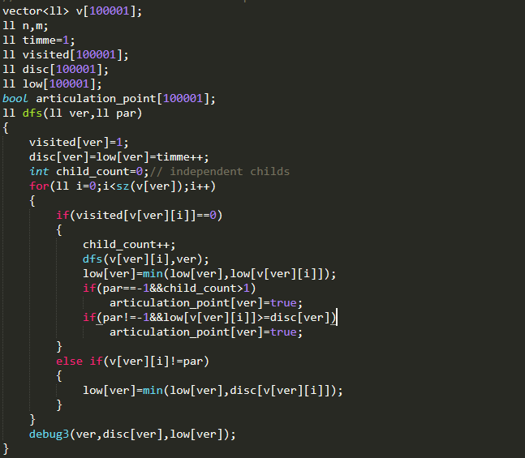
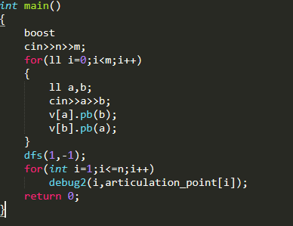
Code
Graph considered to be undirected here.

Slide 14
Bridge
An edge in a graph between vertices say u and v is called a Bridge, if after removing it, there will be no path left between u and v.
Refer Here - https://www.hackerearth.com/practice/algorithms/graphs/articulation-points-and-bridges/tutorial/

Slide 15
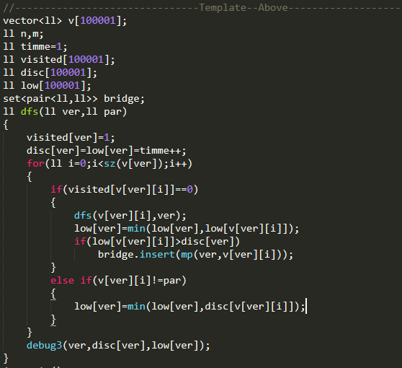
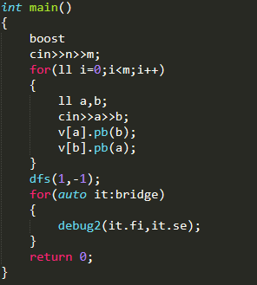
Bridge
Graph considered to be undirected here.

Slide 16
Question - Nearest Strong City (Insomnia 2020)
https://www.codechef.com/INSO2020/problems/INQU2005

Slide 17
Solution
Step 1 : Find bridges.
Step 2 : Remove bridges from graph.
Step 3 : Apply multisource BFS in new graph.
Editorial - https://discuss.codechef.com/problems/INQU2005

Slide 18

Sab Upper Se Chala Gaya?
Go through the class recording once more
Check out video lecture by Tushar Roy - https://www.youtube.com/watch?v=2kREIkF9UAs
Check out hackerearth tutorial - https://www.hackerearth.com/practice/algorithms/graphs/articulation-points-and-bridges/tutorial/
Contact seniors

