Slide 1
Disjoint Set Union

Slide 2
Motivation
We need to handle 2 type of queries-
Add edge between 2 nodes
Check if there is a path between two nodes. (Are 1 nodes connected)

Slide 3
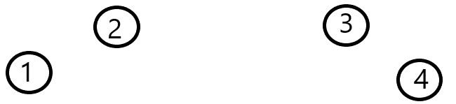
Add edges between 1-2, 2-3

Slide 4
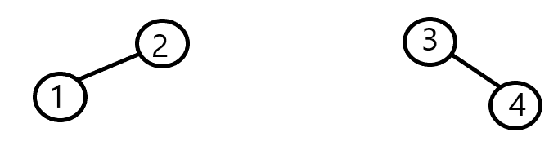
Check if path between 1 and 4 -> NO.
Now Add an edge between 2 and 3

Slide 5
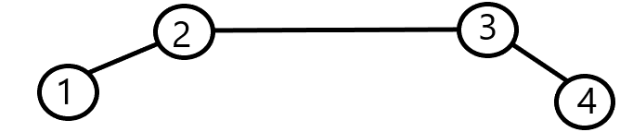
Check if path between 1 and 4-> YES

Slide 6
DSU...
Let say there are n Nodes…
Define an array Parent[]
Value of Parent of index i is ‘i’ initially

Slide 7
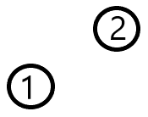
How to add edge between two elements?
Initially- Parent array - index 1 2 Parent [ ] 1 2

Slide 8
After adding an edge-
Now- Parent array - index 1 2 Parent [ ] 2 2
Change Parent of 1.
Now Parent is 2

Slide 9
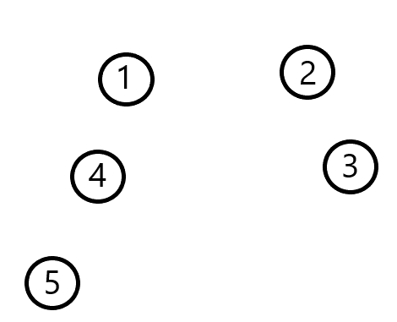
Index - 1 2 3 4 5
Parent- 1 2 3 4 5

Slide 10
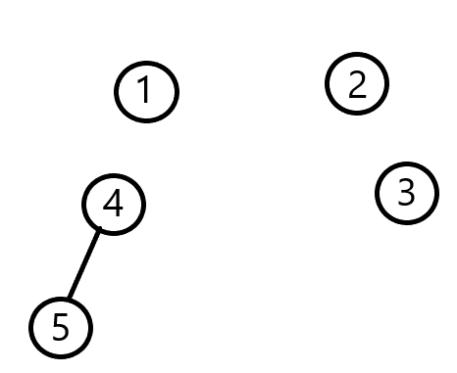
Add edge between 4-5
Index - 1 2 3 4 5
Parent- 1 2 3 4 4

Slide 11
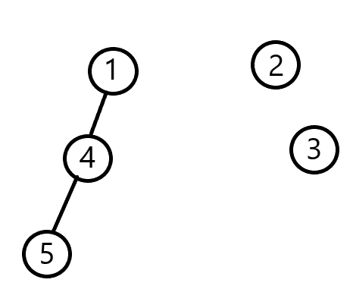
Add edge between 1-4
Index - 1 2 3 4 5
Parent- 1 2 3 1 4

Slide 12
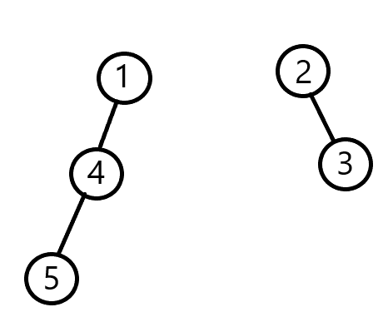
Add edge between 2-3
Index - 1 2 3 4 5
Parent- 1 2 2 1 4

Slide 13
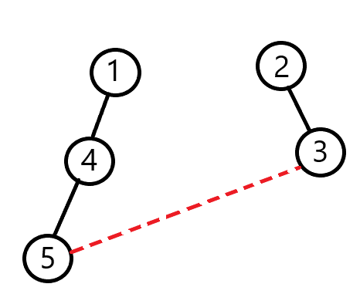
Add edge between 5 and 3
Index - 1 2 3 4 5
Parent- 1 2 2 1 4

Slide 14
5 calls 4 asking for his SUPER PARENT NODE.
1 is SUPER PARENT
4 calls 1 asking for his SUPER PARENT NODE.
Who is SUPER PARENT?
1 says I am SUPER PARENT. So it returns 1.
Returns 1
4 also returns value of 1
Who is SUPER PARENT?
Index - 1 2 3 4 5
Parent- 1 2 2 1 4
Returns 1

Slide 15
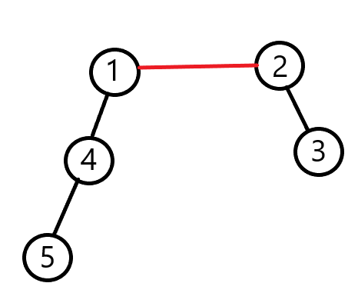
What we get is-
Super parent of 5 is 1
Super Parent of 3 is 2
NOW ADD EDGE BETWEEN 1-2
Index - 1 2 3 4 5
Parent- 1 1 2 1 4

Slide 16
We need 2 functions
Find (int node) -> to find the super parent of a node.
Union(int a,int b)-> to add edge between two nodes.

Slide 17
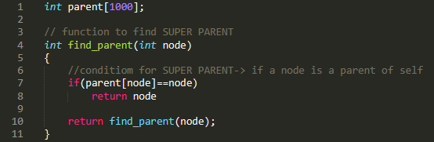
Find function

Slide 18
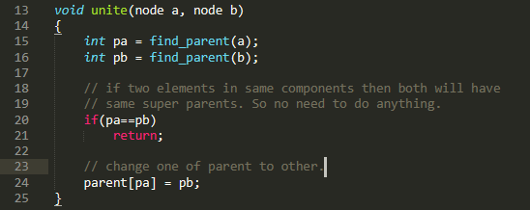
Union Function

Slide 19
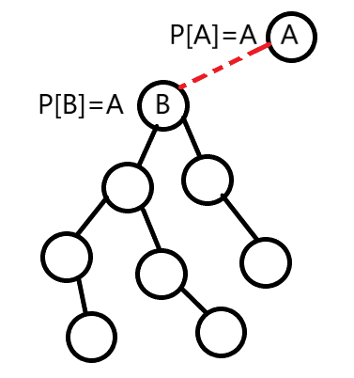
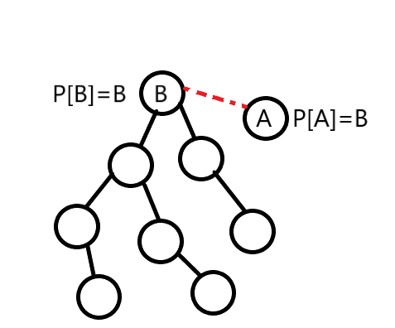
Optimisation 1

Slide 20
Solution- choose new super parent on basis of size of component.
Intially all nodes has size 1. Combine two nodes on basis of size only.

Slide 21
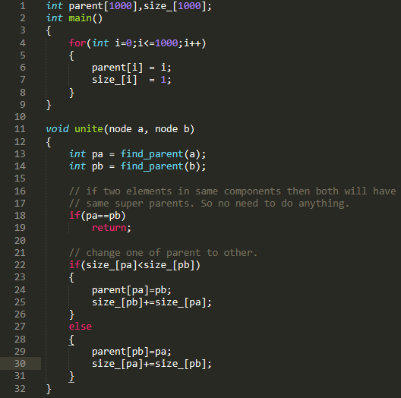
Initial conditon-
Every node is itself super parent
And size of component is 1.

Slide 22
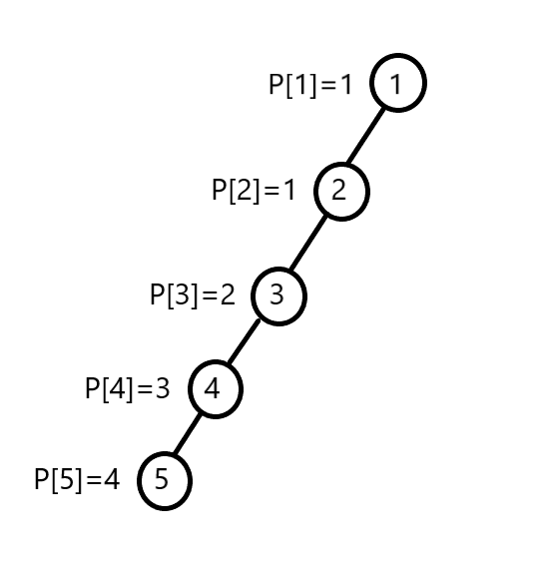
Optimisation 2- Path Compression
Returns 1
Why not all the nodes update themselves with
Parent [node] = 1 ???
Returns 1
Returns 1
Returns 1

Slide 23
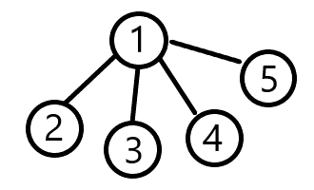
So finally it should look like this.
Index - 1 2 3 4 5
Parent- 1 1 1 1 1

Slide 24
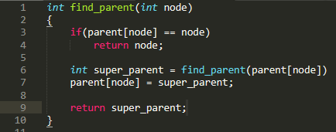

Slide 25
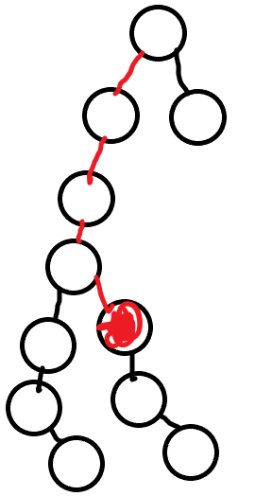
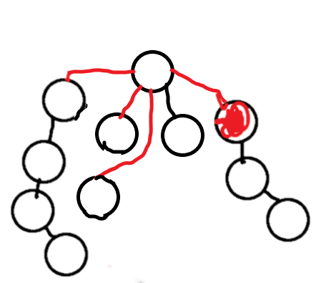
Complexity-
Complexity is O(n).
Because once u traversed over a unnecessary edge…. U will not go over it again.
In actual complexity is O(n*Alpha(n)) where Alpha(n) is reverse Ackermann function.

Slide 26
Qno.s
https://www.spoj.com/problems/NITTROAD/
https://codeforces.com/problemset/problem/371/D
https://www.spoj.com/problems/KOICOST/ (Do it urself)

Slide 27
First question-
Basically says to calculate no. of different connected components.
Now add all the edges.
Now check how many different super parents are there. As eac super Parent denotes its own Component.
(You can use for set for keeping unique entries or a simple array can also work).

Slide 28
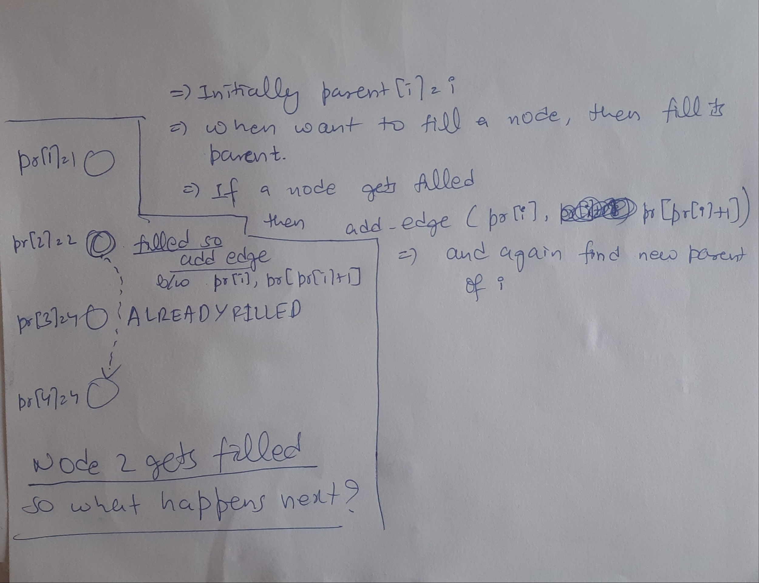
Second question

