Slide 1
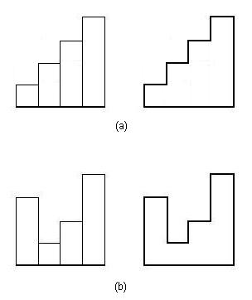
Question:
Given n rectangles each having different height and are 1 unit wide. Find the maximum perimeter of the histogram formed by using these n rectangles.
If heights are 1,2,3,4. Two possible histograms are shown in right.The maximum possible perimeter for heights 1,2,3,4 is 20.

Slide 2
Approach for the question
For every rectangle we calculate the contribution on the left side which is equal to absolute difference of the current rectangle and previous rectangle
curr
prev
prev
curr
(a)
(b)

Slide 3
The width of the histogram will remain same that is equal to number of rectangles so we can just add it in the end.
For starting rectangle we can consider the height of previous rectangle equal to 0 unit.
For last rectangle we will just add the height of the rectangle to answer.

Slide 4
Code using backtracking
int arr[20]; int maxPerimeter(int pre,int rectanglesCovered,int visited[],int n){ if(rectanglesCovered==n){ return arr[pre]; } int ans=0; for(int j=1; j<=n; j++){ if(visited[j]==-1){ visited[j]=1; ans=max(ans,abs(arr[pre]-arr[j])+maxPerimeter(j,rectanglesCovered+1,visited,n)); visited[j]=-1; } } return ans; }

Slide 5
Code using bitmasking
int arr[20]; int dp[100005][20]; int maxPerimeter(int mask,int pre,int n){ //number of rectangles covered int rectanglesCovered=__builtin_popcount(mask); if(rectanglesCovered==n){ return arr[pre]; } if(dp[mask][pre]!=-1) return dp[mask][pre]; int ans=0; // taking the rectngles which have not been considered till now for(int j=1; j<=n; j++){ if((mask&(1<<j))==0){ ans=max(ans,abs(arr[pre]-arr[j])+maxPerimeter((mask|(1<<j)),j,n)); } } return dp[mask][pre]=ans; }

Slide 6
Basic Observations
Bit masking takes exponential complexity, so generally if the constraints are around 15-20 we can think of bit masking.
While using left shift operator i.e. 1<<j prefer using 1LL<<j since it has a range equal to long long int.

Slide 7
HomeWork
There is an extension to this question, you have to find the maximum possible perimeter and also count the number of permutations having maximum perimeter.
https://www.spoj.com/problems/HIST2/

