Slide 1
Strongly Connected Components

Slide 2
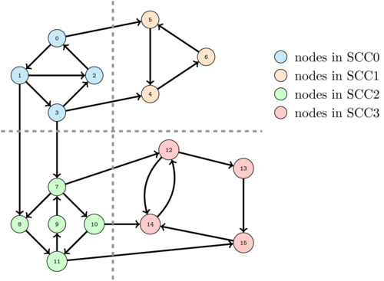
Example
Every node in a SCC is reachable from each other directly or indirectly.

Slide 3
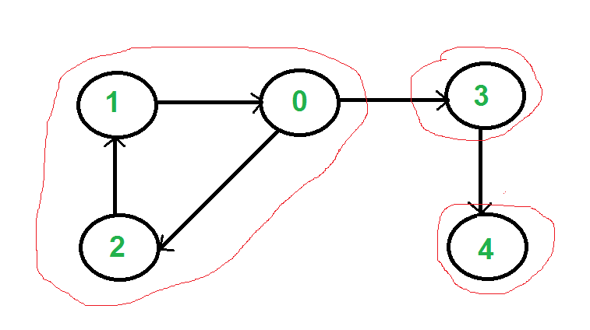
Step-by-step Procedure
1) Do DFS traversal of graph by starting from “ANY VERTEX” For a vertex v, call DFS for all its neghbour and then push this vertex in stack.
DFS ( Vertex V)
{
For Each Neighbour : X
DFS ( X )
PUSH VERTEX V IN STACK
}
0
3
4
STACK
2
1

Slide 4
What if we start from 3??
What are the values in stack?

Slide 5
That’s why easies way is to run a Loop for all the values and if any vertex is unvisited then just call DFS for it.
For ( int i=0;i<n;i++)
if( vertex i is unvisited)
dfs(i);

Slide 6
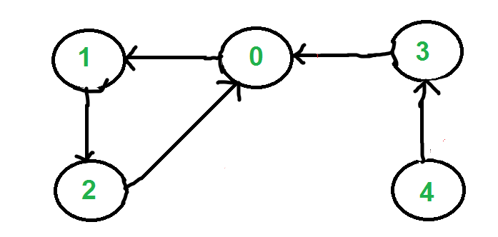
STEP 2- Reverse directions of all arcs to obtain the transpose graph.

Slide 7
STEP 3) One by one pop a vertex from S. Call DFS for this vertex, the DFS will print SCC containing this vertex only.
STACK -
Call DFS for 0 0,2,1 gets printed
Call DFS for 3 3 printed (0 was already visited)
Call DFS for 4 4 printed (3 was already visited)
2 Already visited so no call
1 Already visited so no call
0 3 4 2 1

Slide 8
Example Problem
https://www.spoj.com/problems/CAPCITY/
https://www.codechef.com/problems/SKIING

Slide 9
CAPCITY
Run Algorithm for SCC. The nodes in First SCC component we get is a candidate for this.
Take care of this case From any node of first SCC component run dfs and check if each node reachable

Slide 10
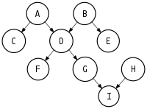
SKIING
Construct a graph- Add directed edges from current cell to neighbour cell if there height is <= this cell height. Run Algo for SCC.
Count no. of SCCs with in degree 0.

