Slide 1

E- Commerce
Developed using Spring Boot and Angular By
Aruna B

Slide 2
Project Overview
The e-commerce project is a web-based platform designed to provide a seamless online shopping experience. It allows users to browse products, add them to a cart, and place orders securely. The project focuses on delivering a responsive, user-friendly interface and robust backend to handle data management and business logic.
Purpose of the Project
Build an online shopping platform where users can explore products, manage their shopping carts, and complete purchases efficiently.
Simplify the online shopping experience with intuitive navigation and secure authentication.
Provide a scalable solution for businesses looking to establish an e-commerce presence.

Slide 3
Technologies Used:
Backend: Spring Boot for developing a RESTful API to manage business logic, data storage, and communication between the frontend and database.
Frontend: Angular for creating an interactive and responsive user interface.
Database: MySQL for storing and managing application data, including user details, products, orders, and cart information.
Tools Used
Eclipse Integrated development environment for writing and debugging backend code.
Postman For testing API endpoints during the development of the backend services.
Other Tools: Git For version control.

Slide 4
Features
1.Homepage
Attractive Banner:
Displays featured products, promotional offers, and trending items to capture user interest.
Navigation Bar:
Provides easy access to different sections such as Home, Products, Cart, Profile, and Login/Signup.
Responsive design ensures a seamless experience across devices (desktop, tablet, mobile).

Slide 5
2.Product Catalog
Browse Products:
View a comprehensive list of products categorized by type, price, or popularity.
Search Functionality:
Allows users to quickly find specific products using keywords or filters like price range and categories.
Product Details:
Displays detailed information such as product name, description, price, available discounts, and images.
Includes an "Add to Cart" button for quick actions.

Slide 6
3.Cart Management
Add/Remove Items:
Users can add products to their shopping cart with a single click.
Items can be removed or updated (e.g., quantity adjustments) directly from the cart.
Cart Summary: Provides a breakdown of all selected items, including individual and total costs, along with any discounts applied.
Proceed to Checkout: Guides users to finalize their purchase.

Slide 7
4.User Authentication
Login:
Secure access for existing users with validation for correct credentials.
Session management ensures secure and personalized interactions.
Signup:
New users can create an account by providing essential details such as email, username, and password.
Includes validation for unique email and strong password criteria.
Password Recovery:
Optional feature to reset forgotten passwords through email.

Slide 8
5. Order Management
Order History:
Users can view a list of past orders with details like product names, quantities, total amount, and date of
purchase.
Order Details:
Displays specific order information, including the shipping address, payment method, and order status
(e.g., pending, shipped, delivered).
Reorder Option:
Enables users to quickly reorder items from their history for convenience.

Slide 9
Backend Design
Entities The backend is structured with key entities to manage the core functionality of the e-commerce platform. Each entity represents a specific aspect of the system, ensuring modularity and scalability.
1.Product Entity This entity stores information about the products available on the platform.
Attributes: ID: A unique identifier for each product.
Name: The name of the product (e.g., “Ausu laptop“,Iphone).
Description: A detailed description of the product, including features and specifications.
Actual Price: The original price of the product.
Discounted Price: The price after applying discounts or offers.
Image URLs: Links to images that visually represent the product, supporting multiple image views.
Purpose: To facilitate product display, search, and management by admin users.

Slide 10
2.Auth Entity
Handles user authentication and authorization for secure platform access.
Attributes:
UserID: A unique identifier for each user.
Username: The user’s chosen name for login.
Email: User’s email address for communication and password recovery.
Password: Encrypted password for account security.
Roles: Defines user roles, such as "Admin" or "Customer."
Purpose:
Ensures that only authenticated users can access restricted features (e.g., placing orders, viewing profile).

Slide 11
3. Order Entity
Order Entity Manages the details of customer orders.
Attributes:
OrderID: A unique identifier for each order.
UserID: Links the order to a specific user.
Product Details: List of purchased products, including names, quantities, and prices.
Order Status: Tracks the progress of the order (e.g., "Pending," "Shipped," "Delivered").
Order Date: The date and time when the order was placed.
Purpose: Enables tracking and management of customer orders.

Slide 12
APIs
The backend provides secure and well-documented APIs for handling various functionalities. Each API endpoint is protected using authentication mechanisms like JSON Web Tokens (JWT).
1. Product Management APIs:
Create Product: Allows admin users to add new products to the catalog.
Retrieve Products: Provides product data for browsing, searching, and filtering.
Update Product: Enables updates to product details like price, description, or stock.
Delete Product: Removes a product from the catalog.
2. Authentication APIs:
User Registration: Endpoint for new users to create accounts.
User Login: Validates credentials and generates a secure JWT for session management.
Password Recovery: Optional API for resetting forgotten passwords.
3.Order Management APIs:
Place Order: Accepts user orders and stores order details in the database.
Retrieve Orders: Fetches a user's order history.
Update Order Status: Allows admins to modify order statuses (e.g., marking an order as "Shipped").
Delete Order: Cancels an order upon user request (if applicable).

Slide 13
Security Considerations
JWT Authentication: Ensures only authorized users can access protected endpoints.
Input Validation: Sanitizes user inputs to prevent SQL injection and other vulnerabilities.
Password Encryption: Uses hashing algorithms like bcrypt to securely store passwords.
Role-Based Access Control (RBAC): Restricts admin-level actions to authorized users only.

Slide 14
Frontend Design
The frontend of the e-commerce platform is developed using Angular, designed to provide a seamless, interactive, and visually appealing user experience. It consists of modular components, ensuring reusability and maintainability. Below is a detailed breakdown of the key components and their functionality.
Angular Components
1.Homepage
Displays an attractive banner showcasing featured products, promotions, and seasonal offers.
Includes a navigation bar with options like Home, Products, Cart, Profile, and Login/Signup.
Search bar for users to quickly find specific products.
Footer section with contact details, social media links, and policies (e.g., Privacy Policy, Terms & Conditions).
Purpose: Serves as the entry point for users, providing an overview of the platform and key features.

Slide 15
Product List & Details
Product List:
Displays a grid or list of products with thumbnails, names, and prices.
Supports filtering and sorting based on criteria like category, price, or ratings.
Pagination or infinite scrolling for a smooth browsing experience.
Product Details:
Shows detailed information about a selected product, including:
Multiple product images (gallery or carousel view).
Product description, specifications, and availability.
Price (actual and discounted) with offers or discounts highlighted.
"Add to Cart" button for quick actions.
Related products section to encourage upselling and cross-selling.

Slide 16
Cart
Features:
Displays a list of items added to the cart, including product name, quantity, price, and subtotal.
Allows users to:
Update quantities.
Remove items.
View the total amount (with discounts or taxes applied).
“Buy now" button for placing orders
Purpose: Provides users with a quick overview of their selected items and facilitates seamless navigation to the order process.
Login & Signup
Login:
Input fields for email/username and password.
"Remember Me" checkbox and "Forgot Password?" link for convenience.
Error handling for incorrect credentials with user-friendly messages.
Signup:
Form with fields for username, email, password, and confirm password.
Includes validation checks for unique email, strong password, and mandatory fields.
Optional feature: Captcha or OTP verification for additional security
Purpose: Ensures secure and easy access to the platform, with separate interfaces for new and returning users.

Slide 17
User Profile
Features:
Displays user details like name, email, and profile picture.
Options to:
Update profile information.
Change password.
View order history (list of past purchases with details like date, product name, price, and status).
Logout button for secure session termination.
Purpose: Provides users with a personalized area to manage their account and order history.
Responsive Design:
Key Features:
Device Compatibility
Touch-Friendly Design
Navigation Optimization
Testing Across Devices

Slide 18
Workflow Steps:
Homepage: Entry point with a navigation bar, banner, and product categories.
Authentication: User logs in or registers for access to cart and personalized features.
Product Browsing: Explore, filter, and view details of available products.
Cart & Checkout: Manage selected items, finalize the order, and make a secure payment.
Order Management: Track past orders and view detailed history in the profile.

Slide 19
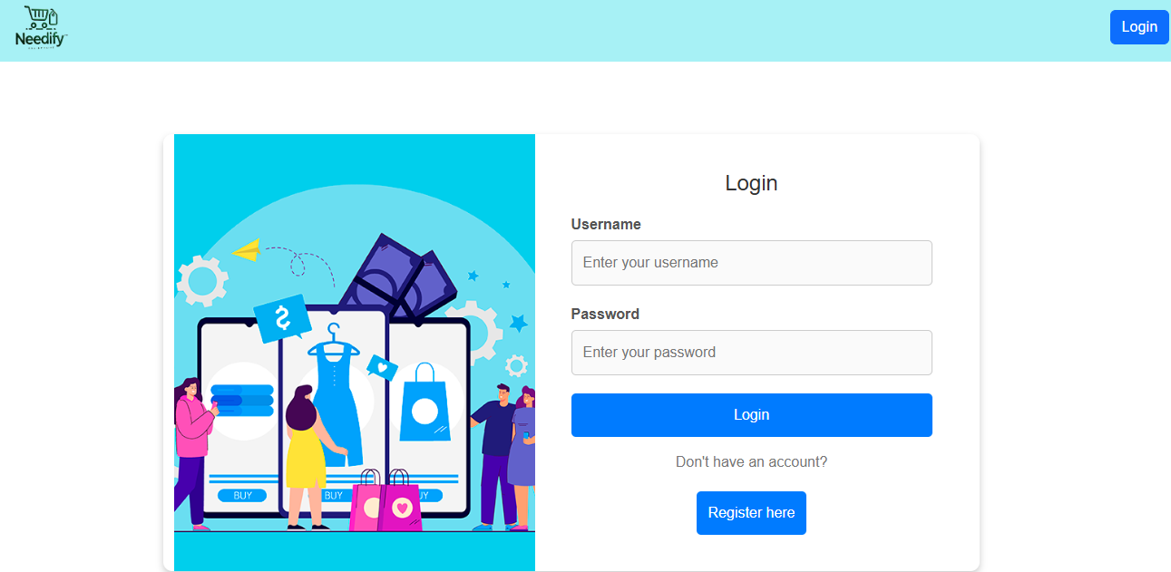
Login page

Slide 20
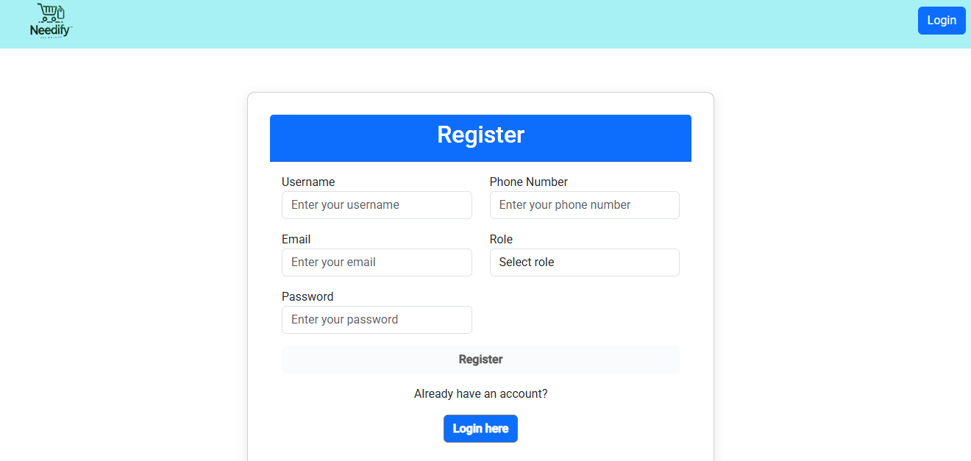
Registration page

Slide 21
Future Enhancements
Wishlist Feature: Save items for later.
Reviews and Ratings: Allow users to provide feedback.
Payment Gateway Integration: Secure online transactions.
Admin Dashboard: Manage products, orders, and users.

Slide 22
THANK YOU

