Slide 1


VR SIDDHARTHA ENGINEERING COLLEGE, VIJAYAWADA
Department of Computer Science and Engineering
HQC-Net: Hybrid Quantum-Classical Network for Leukemia Detection
20CS8551: B. Tech Major Project (Final Review )
April 28th, 2025
Batch No: 5
Batch Members
J. Aruna Bharathi (218W1A0519)
M. Rajyalakshmi (218W1A0534)
Under the Guidance of
Mr. BJL Narayana
Assistant Professor
1

Slide 2
Abstract
Acute Lymphoblastic Leukemia (ALL) is a severe blood cancer that affects both children and adults. Early and accurate detection is crucial for improving survival rates. Traditional diagnostic methods rely on manual microscopic examination, which is time-consuming and prone to human error. Deep learning-based approaches, particularly Convolutional Neural Networks (CNNs), have shown promise in automating leukemia classification. However, CNNs require large datasets and suffer from computational inefficiencies due to the high number of parameters in fully connected layers.To address these challenges, we propose HQC-Net, a Hybrid Quantum-Classical Network that integrates CNN-based feature extraction with Quantum Neural Networks (QNNs) for efficient leukemia classification. Unlike pure CNN models, which require extensive fully connected layers for classification, our approach utilizes QNNs to leverage quantum properties such as superposition and entanglement, reducing parameter count while maintaining high classification accuracy.We experiment with multiple CNN architectures, including Simple CNN and ResNet50, and optimize hyperparameters such as learning rate, qubit count, and training epochs. Our results demonstrate that HQC-Net achieves an accuracy of 94.35% on the leukemia dataset, with the potential for further improvements through quantum circuit optimization and dataset expansion.
Keywords- Quantum Computing, Convolutional NeuralNetworks, Quantum Neural Networks, Leukemia Detection,Medical Image Classification.
2

Slide 3
Presentation Outline
Aim and Motivation
Research Questions
Title Justification
Objectives
Scope
Introduction
Study on Existing Technologies
Gap Analysis
SDLC
Use Case Diagram
Data Collection
Data Preparation
Proposed Methodology
Result
Timeline
15.Summary
16.Publication status
References
3

Slide 4
1. Aim and Motivation
Aim:
To develop a Hybrid CNN-QNN model for early and accurate classification of Acute Lymphoblastic Leukemia (ALL) using blood smear images, integrating classical and quantum computing techniques.
Motivation:
ALL is a common blood cancer affecting both children and adults, with high mortality rates if not detected early.Manual diagnosis is slow and prone to errors, necessitating automated solutions.CNN-based leukemia classification, though effective, suffers from computational inefficiency and large parameter sizes.QNNs, leveraging quantum superposition and entanglement, offer efficient classification with fewer parameters.Quantum computing is advancing rapidly, making hybrid models a promising solution for medical imaging.
4

Slide 5
2. Research Questions
How can CNN and QNN be combined to improve leukemia classification efficiency?
What is the optimal number of qubits required for feature-based classification?
How does QNN compare to fully connected CNN layers in terms of performance and computational cost?
How can quantum computing be leveraged to improve small medical datasets' classification accuracy?
5

Slide 6
3. Title Justification
Hybrid CNN-QNN Model: Integrates CNN for feature extraction and QNN for classification.
Leukemia Detection: Focuses on detecting Acute Lymphoblastic Leukemia (ALL) from blood smear images.
Quantum Computing: Introduces quantum advantages for efficient classification.
6

Slide 7
4. Objectives
Collect and preprocess a dataset of blood smear images (ALL-positive & healthy cells).
Design and implement a CNN-based feature extractor to process images.
Integrate a Quantum Neural Network (QNN) classifier to improve classification accuracy.
Evaluate the model's performance against traditional CNN classification approaches.
Optimize the model for real-world applications with limited computational resources.
7

Slide 8
5. Scope
The dataset consists of BMP format blood smear images.
Focuses on binary classification (ALL-positive vs. healthy).
8

Slide 9
6. Introduction
Acute Lymphoblastic Leukemia (ALL) is a type of blood cancer that primarily affects white blood cells, leading to an overproduction of immature lymphoblasts in the bone marrow. If untreated, it can rapidly progress and become fatal.
History of ALL: First identified in the early 20th century, advances in medical imaging and treatment have improved survival rates, but early diagnosis remains crucial.
Blood Smear Images: A key diagnostic tool, these images are analyzed to detect abnormalities in white blood cells, helping in early leukemia detection.
Traditional Detection Methods: Manual examination of blood smear images by pathologists, which is time-consuming and subject to human error.
Deep Learning Approaches: CNNs have been used for automatic feature extraction and classification, but their reliance on fully connected layers makes them computationally expensive and prone to overfitting.
Quantum Neural Networks (QNNs): Utilize quantum computing principles to process data more efficiently, requiring fewer parameters than traditional fully connected CNN layers.
Hybrid CNN-QNN Approach: Combines the best of both worlds—CNN for robust feature extraction and QNN for efficient classification—aiming for improved accuracy and computational efficiency in leukemia diagnosis.
9

Slide 10
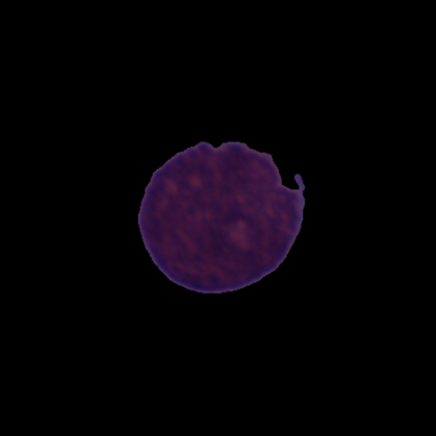
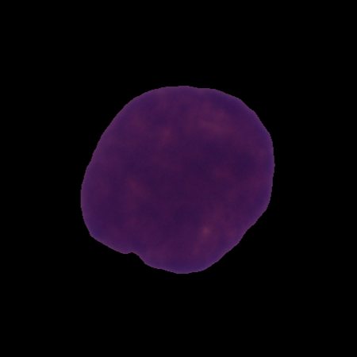
a)
b)
Fig. 1: (a) depicts healthy blood cell images
(b) depicts Leukemia diseased blood cell images
The two primary types of Acute Lymphoblastic Leukemia (ALL) are:
1️⃣ B-cell ALL – Affects B-cells, which produce antibodies to fight infections. It accounts for 75% to 80% of ALL cases.
2️⃣ T-cell ALL – Affects T-cells, which help eliminate pathogens and support immune function.
10

Slide 11
7.1 Study on Existing Technologies
Title: Ensemble learning using Gompertz function for leukemia classification
Journal Details: Biomedical Signal Processing and Control, 2025, Vol. 100, DOI: 10.1016/j.bspc.2024.106925
Dataset: 1,250 microscopic blood smear images
Methodology:
The research employed a CNN-based classification approach with transfer learning.
Image preprocessing included normalization and augmentation techniques to enhance model generalization.
VGG16 with a Squeeze-and-Excitation (SE) block was fine-tuned for improved feature extraction.
80% of the data was used for training, while 20% was reserved for testing.
The model was trained using Stochastic Gradient Descent with Momentum (SGDM).
Ensemble learning techniques such as Majority Voting, Weighted Average, and Fuzzy Rank-based Ensemble (using the Gompertz function) were compared.
Performance was evaluated using accuracy, precision, recall, F1-score, and MCC.
Advantages:
The proposed CNN achieved 88.80% accuracy, surpassing other ensemble techniques.
The SE block helped capture fine-grained features in blood smear images, enhancing classification.
Disadvantages:
Pre-trained models require careful fine-tuning to prevent overfitting on medical datasets..
11
The study focuses only on blood smear images, excluding other leukemia detection methods.

Slide 12
7.2 Study on Existing Technologies
Title: LEU3: An Attention Augmented-Based Model for Acute Lymphoblastic Leukemia Classification
Journal Details: IEEE Access, 2025, DOI: 10.1109/ACCESS.2025.3542609
Dataset: 484 peripheral blood smear (PBS) images.
Methodology:
A CNN-based classification model was developed with an attention mechanism.
Image preprocessing involved resizing to 224×224 pixels, normalization, and data augmentation (rotation, shifting, zooming, flipping).
The model LEU3 uses convolutional layers to extract spatial features and integrates an attention module to highlight crucial image areas.
The Adam optimizer was used for training with categorical cross-entropy loss.
Explainable AI (XAI) techniques like LIME and SHAP were incorporated to enhance interpretability.
Advantages:
Attention layers improved feature extraction for better leukemia detection.
LIME and SHAP provided insights into model decisions, enhancing transparency.
Disadvantages:
Requires high-quality augmented data for effective training.
Limited to PBS images, restricting generalization to other leukemia diagnosis methods.
12

Slide 13
7.3 Study on Existing Technologies
Title: Advanced Blast Identification in ALL Using Pivot-Growing Segmentation and U-Net PLR
Journal Details: SEEJPH Volume XXV, Vol. 27, No. 6, 2024.
Dataset: 15,135 microscopic images of pediatric Acute Lymphoblastic Leukemia (ALL) patients.
Methodology:
A CNN-based segmentation and classification model was developed.
Pivot-Growing Segmentation (PGS) was used to partition blood smear images into multiple regions based on pixel intensity similarity.
The segmentation process involved:
Selecting pivot points using K-medoids clustering.
Iteratively growing clusters based on squared Euclidean distance.
The U-Net PLR (Parametric Leaky ReLU) model was employed for classification, consisting of:
Encoder-decoder architecture with convolutional layers.
Skip connections to retain spatial details.
PLR activation to improve feature extraction.
The model was trained using EfficientNet-B3 with cross-validation.
Advantages:
PGS-based segmentation provided precise localization of blast cells.
The U-Net PLR model captured fine-grained features, enhancing classification.
Disadvantages:
The study is limited to microscopic images, not considering genetic or molecular biomarkers.
13

Slide 14
7.4 Study on Existing Technologies
Title: Secretary Bird Optimization Algorithm Based on Quantum Computing and Multiple Strategies Improvement for KELM Diabetes Classification
Journal Details: Scientific Reports, 2025, Vol. 13, DOI: 10.1038/s41598-025-87285-0
Dataset: Pima Indians Diabetes Dataset (PIDD)
Methodology:
The study introduced an improved Secretary Bird Optimization Algorithm (QHSBOA) to optimize the Kernel Extreme Learning Machine (KELM) for diabetes classification.
The Secretary Bird Optimization Algorithm (SBOA) was enhanced with:
A Particle Swarm Optimization (PSO) search mechanism for better exploration.
Dynamic boundary adjustment based on the best-performing individuals.
Quantum computing-based t-distribution variation for improved search diversity
QHSBOA was used to fine-tune the kernel penalty parameter (C) and bandwidth (c) of the KELM model.
Advantages:
Achieved higher classification accuracy compared to traditional KELM models.
Quantum computing-based optimization improved convergence speed and reduced the risk of local optima.
Disadvantages:
Requires fine-tuning of hyperparameters, making model training more complex.
Performance is dataset-dependent, limiting generalization to other medical datasets without adaptation.
14

Slide 15
7.5 Study on Existing Technologies
Title: Enhanced Multi-Label Ocular Disease Identification Using a Quantum Convolutional Neural Network Approach Based on Fundus Images.
Journal Details: Preprint (SSRN), 2024, Volume 9, DOI: 10.2139/ssrn.5139712
Dataset: OIA-ODIR dataset, which consists of 10,000 fundus images from 5,000 patients.
Methodology:
A Quantum Convolutional Neural Network (QCNN)-based classification model was developed.
Image preprocessing included circular border cropping, resizing, contrast enhancement, noise reduction, and augmentation
Quantum Convolutional Layers were integrated with CNN to extract quantum-enhanced features from fundus images.
The QCNN model used a combination of classical and quantum convolutional layers, leveraging entanglement-based quantum pooling for dimensionality reduction.
Feature extraction was performed using Anisotropic Diffusion Filtering and Wavelet Transform (WT) to enhance contrast.
Advantages:
The quantum convolutional layers improved feature extraction, leading to better classification of multiple ocular diseases.
Enhanced contrast filtering and wavelet transform reduced noise, improving diagnostic accuracy.
Disadvantages:
The model's performance is dependent on high-quality fundus images, limiting real-world applicability in noisy environments.
15

Slide 16
7.6 Study on Existing Technologies
Title: Pre-trained Quantum Convolutional Neural Network for COVID-19 Disease Classification Using Computed Tomography Images
Journal Details: PeerJ Computer Science, 2024, DOI: 10.7717/peerj-cs.2343
Dataset: SARS-CoV-2 CT dataset, consisting of 2,482 CT scan images collected from hospitals in São Paulo, Brazil.
Methodology:
A Pre-trained Quantum Convolutional Neural Network (QCNN)-based classification model was developed.
The model integrates VGG16, a classical CNN architecture, with a quantum computing layer to enhance feature extraction.
Image preprocessing included resizing, grayscale conversion, and data normalization.
Quantum Feature Encoding (ZZFeatureMap) and RealAmplitudes Ansatz circuits were applied to embed data into quantum space.
Advantages:
The quantum-enhanced feature extraction improved classification performance.
Achieved 96.78% accuracy, outperforming conventional CNN models.
Low computational complexity, making it suitable for real-world deployment.
Disadvantages:
Requires specialized quantum computing hardware, limiting accessibility.
The dataset is limited to CT scan images, reducing generalizability to other medical imaging modalities.
16

Slide 17
7.7 Study on Existing Technologies
Title: H-QNN: A Hybrid Quantum–Classical Neural Network for Improved Binary Image Classification
Journal Details: AI (MDPI), 2024, Volume 20-7s, Pages 1395-1405, DOI: 10.3390/ai5030070
Dataset: Three binary image classification datasets from Kaggle
Methodology:
A Hybrid Quantum–Classical Neural Network (H-QNN) was developed for binary image classification.
The model integrates a two-qubit quantum circuit with classical CNN architecture.
Image preprocessing included resizing images to 720×720 pixels, normalization, and augmentation.
The quantum circuit contained parameterized quantum gates (Hadamard and Ry gates) for feature transformation.
The hybrid module connected the classical CNN layers with the quantum circuit, using PyTorch's autograd function for backpropagation.
The model was trained using gradient-based optimization with the parameter-shift rule.
Advantages:
Quantum-enhanced feature extraction improved classification accuracy compared to CNN.
The model showed better generalization on small datasets, reducing overfitting.
Disadvantages:
The model requires quantum simulators or specialized quantum hardware.
Limited to binary classification, requiring modifications for multi-class tasks.
17

Slide 18
7.8 Study on Existing Technologies
Title: Hybrid Quantum–Classical Neural Networks for Efficient MNIST Binary Image Classification
Journal Details:, Mathematics (MDPI) ,2024, DOI: 10.3390/math12233684
Dataset: MNIST dataset, a widely recognized benchmark for handwritten digit classification.
Methodology:
A Hybrid Quantum–Classical Neural Network (H-QNN) was developed to enhance image classification performance.
Image preprocessing involved resizing, standardization, and quantum feature encoding.
The quantum layer utilized ZZFeature Map for data embedding and Real Amplitudes Ansatz circuits for quantum transformation.
The hybrid architecture combined classical CNN layers with quantum circuits containing parameterized rotation gates (RY) and CX entanglement gates.
The model was optimized using the Adam optimizer with gradient-based parameter tuning.
Advantages:
Quantum-enhanced feature mapping improved pattern recognition and reduced computational complexity.
Required fewer parameters compared to conventional CNNs, making it more resource-efficient.
Disadvantages:
Restricted to binary classification, requiring modifications for multi-class tasks.
18

Slide 19
Journal Name | Publisher | Year | Methodology | Advantages | Disadvantages | Dataset
Biomedical Signal Processing and Control |  | 2023 | The study utilized a CNN-based classification approach with transfer learning, incorporating VGG16 with a Squeeze-and-Excitation (SE) block for enhanced feature extraction. The model, trained with SGDM on an 80-20 data split, was evaluated using various ensemble learning techniques, including Majority Voting, Weighted Average, and Fuzzy Rank-based Ensemble, with performance assessed through accuracy, precision, recall, F1-score, and MCC. | The proposed CNN achieved 88.80% accuracy, outperforming other ensembles. The SE block enhanced fine-grained feature extraction in blood smear images. | Fine-tuning pre-trained models is crucial to avoid overfitting on medical data. The study is limited to blood smear images for leukemia detection. | 1,250 microscopic blood smear images
LEU3: An Attention Augmented-Based Model for Acute Lymphoblastic Leukemia Classification | IEEE Access | 2025 | A CNN-based model with an attention mechanism, LEU3, was developed for leukemia classification, incorporating image preprocessing and feature extraction. Trained with Adam and categorical cross-entropy, it utilized XAI techniques like LIME and SHAP for interpretability. | Attention layers improved feature extraction for better leukemia detection. LIME and SHAP provided insights into model decisions, enhancing transparency. | Requires high-quality augmented data for effective training. Limited to PBS images, restricting generalization to other leukemia diagnosis methods. | 484 peripheral blood smear (PBS) images
Advanced Blast Identification in ALL Using Pivot-Growing Segmentation and U-Net PLR |  | 2024 | A CNN-based model integrated Pivot-Growing Segmentation (PGS) for partitioning blood smear images, using K-medoids clustering and iterative growth. The U-Net PLR model with EfficientNet-B3 and cross-validation was employed for classification, leveraging skip connections and PLR activation for enhanced feature extraction. | PGS-based segmentation provided precise localization of blast cells. The U-Net PLR model captured fine-grained features, enhancing classification. | The study is limited to microscopic images, not considering genetic or molecular biomarkers | 15,135 microscopic images of pediatric Acute Lymphoblastic Leukemia (ALL) patients.

Slide 20
Journal Name | Publisher | Year | Methodology | Advantages | Disadvantages | Dataset
Secretary Bird Optimization Algorithm Based on Quantum Computing and Multiple Strategies Improvement for KELM Diabetes Classification |  | 2025 | The study proposed an enhanced Secretary Bird Optimization Algorithm (QHSBOA) to optimize KELM for diabetes classification. QHSBOA integrated a PSO-based search, dynamic boundary adjustment, and quantum t-distribution variation to fine-tune the kernel penalty and bandwidth parameters. | The quantum convolutional layers improved feature extraction, leading to better classification of multiple ocular diseases. Enhanced contrast filtering and wavelet transform reduced noise, improving diagnostic accuracy | Requires fine-tuning of hyperparameters, making model training more complex. Performance is dataset-dependent, limiting generalization to other medical datasets without adaptation | Pima Indians Diabetes Dataset (PIDD)
Enhanced Multi-Label Ocular Disease Identification Using a Quantum Convolutional Neural Network Approach Based on Fundus Images |  | 2024 | A QCNN-based classification model was developed, integrating quantum and classical convolutional layers for enhanced feature extraction from fundus images. Image preprocessing involved cropping, resizing, contrast enhancement, and noise reduction, while quantum pooling, Anisotropic Diffusion Filtering, and Wavelet Transform improved feature representation. | The quantum convolutional layers improved feature extraction, leading to better classification of multiple ocular diseases. Enhanced contrast filtering and wavelet transform reduced noise, improving diagnostic accuracy. | The model's performance is dependent on high-quality fundus images, limiting real-world applicability in noisy environments. | OIA-ODIR dataset, which consists of 10,000 fundus images from 5,000 patients
Pre-trained Quantum Convolutional Neural Network for COVID-19 Disease Classification Using Computed Tomography Images |  | 2024 | A pre-trained QCNN-based model combining VGG16 with quantum computing layers was developed for enhanced feature extraction. Image preprocessing involved resizing, grayscale conversion, and normalization, while Quantum Feature Encoding (ZZFeatureMap) and RealAmplitudes Ansatz circuits embedded data into quantum space. | Quantum-enhanced features boosted classification, achieving 96.78% accuracy with low computational complexity for real-world use. | Requires quantum hardware, limiting accessibility, and is tested only on CT scans, affecting generalizability. | SARS-CoV-2 CT dataset

Slide 21
Journal Name | Publisher | Year | Methodology | Advantages | Disadvantages | Dataset
H-QNN: A Hybrid Quantum–Classical Neural Network for Improved Binary Image Classification |  | 2024 | An H-QNN was developed for binary image classification, combining a two-qubit quantum circuit with a classical CNN. Image preprocessing included resizing, normalization, and augmentation, while parameterized quantum gates transformed features, and PyTorch’s autograd enabled gradient-based training with the parameter-shift rule. | Quantum features improved accuracy and enhanced generalization on small datasets, reducing overfitting. | Requires quantum simulators or hardware and is limited to binary classification, needing adjustments for multi-class tasks. | Three binary image classification datasets from Kaggle
Hybrid Quantum–Classical Neural Networks for Efficient MNIST Binary Image Classification |  | 2024 | An H-QNN was developed for improved image classification, integrating classical CNN layers with quantum circuits. Image preprocessing included resizing and standardization, while ZZFeature Map and Real Amplitudes Ansatz circuits enabled quantum transformation, optimized using Adam with gradient-based tuning. | Quantum-enhanced feature mapping improved pattern recognition and reduced computational complexity. Required fewer parameters compared to conventional CNNs, making it more resource-efficient. | Restricted to binary classification, requiring modifications for multi-class tasks. | MNIST dataset, a widely recognized benchmark for handwritten digit classification.
21

Slide 22
8. Gap Analysis
Limitations of Classical Models – Traditional CNNs require large datasets and high computational power, limiting efficiency.
Feature Extraction Challenges – Existing methods struggle to capture complex patterns in medical images, affecting accuracy.
QNN Potential – Pure QNNs offer quantum advantages but face hardware constraints for practical implementation.
Hybrid Approach Advantage – Combining CNNs with QNNs enhances feature extraction and classification accuracy efficiently.
22

Slide 23
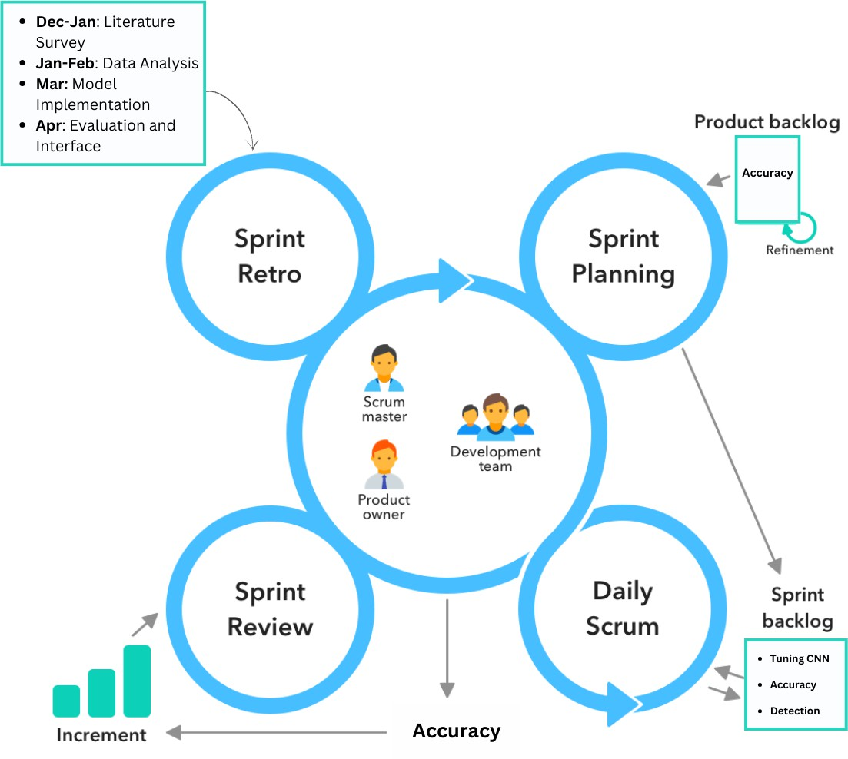
9. SDLC

Slide 24
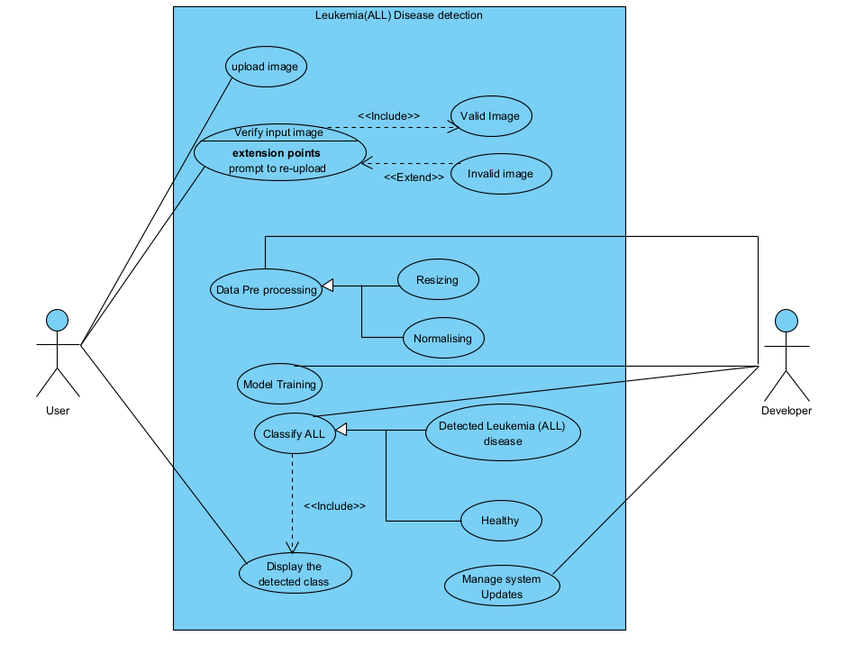
10.1 Use Case Diagram

Slide 25
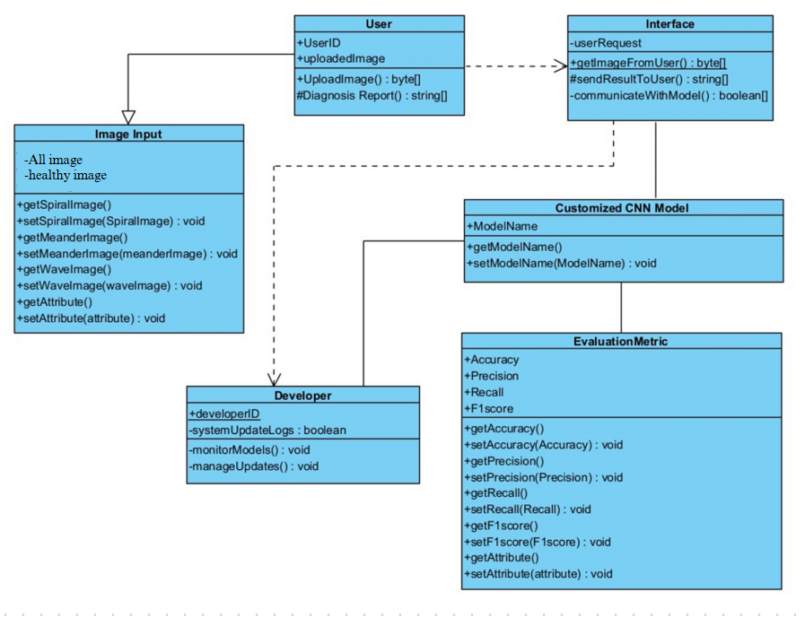
10.2 Class Diagram

Slide 26
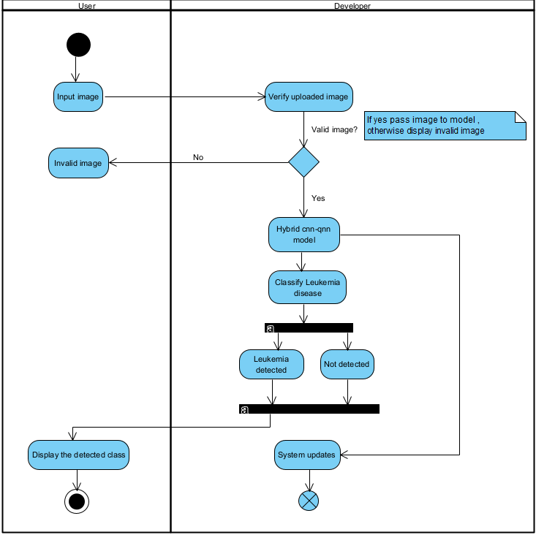
10.3 Activity Diagram

Slide 27
11. Data Collection
Acute lymphoblastic leukemia(ALL) disease dataset is collected and downloaded using below link
https://www.kaggle.com/datasets/andrewmvd/leukemia-classification
28

Slide 28
12. Data Preparation
The dataset consists of blood smear images categorized into Healthy and ALL-positive classes. The images were collected from publicly available sources such as Kaggle.
To ensure uniformity, all images were resized to 64×64 pixels and normalized to a [0,1] range to enhance model training.
For training and evaluation, the dataset was split into training (80%) and testing (20%) subsets. This ensures that the model generalizes well and is not biased towards the training data.

Slide 29
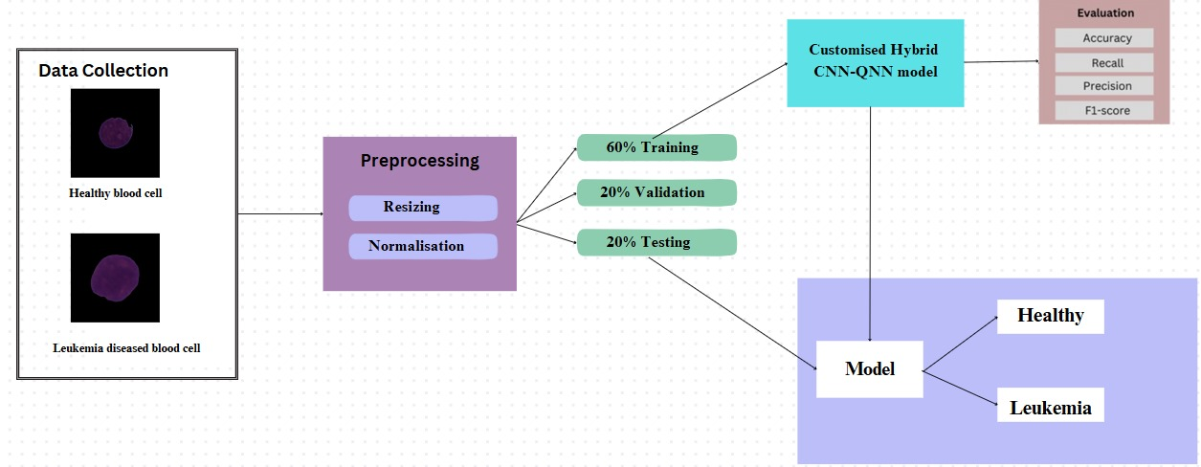
13.1 Proposed Architecture

Slide 30
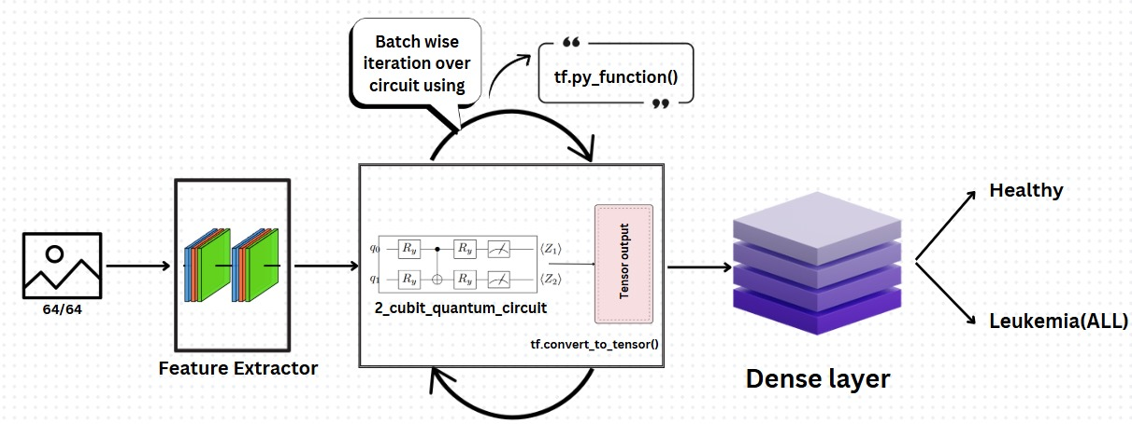
13.2 Proposed Methodology

Slide 31
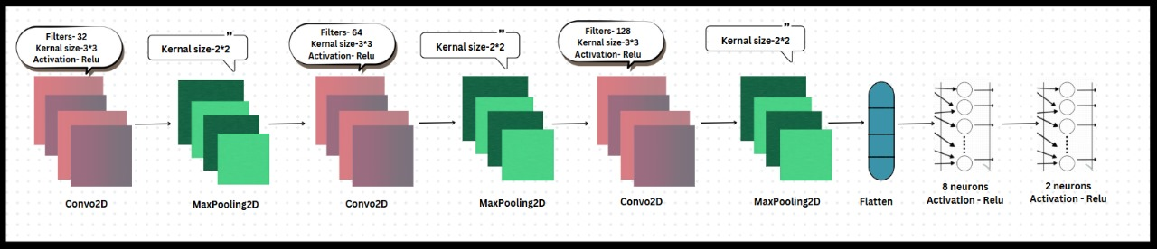
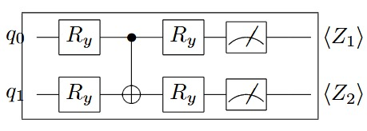
13.2 Proposed Methodology

Slide 32
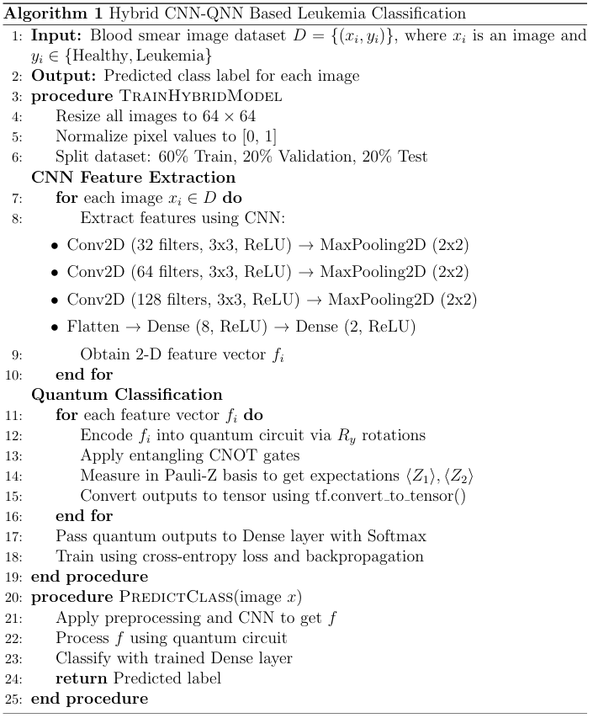
13.3 Algorithm

Slide 33
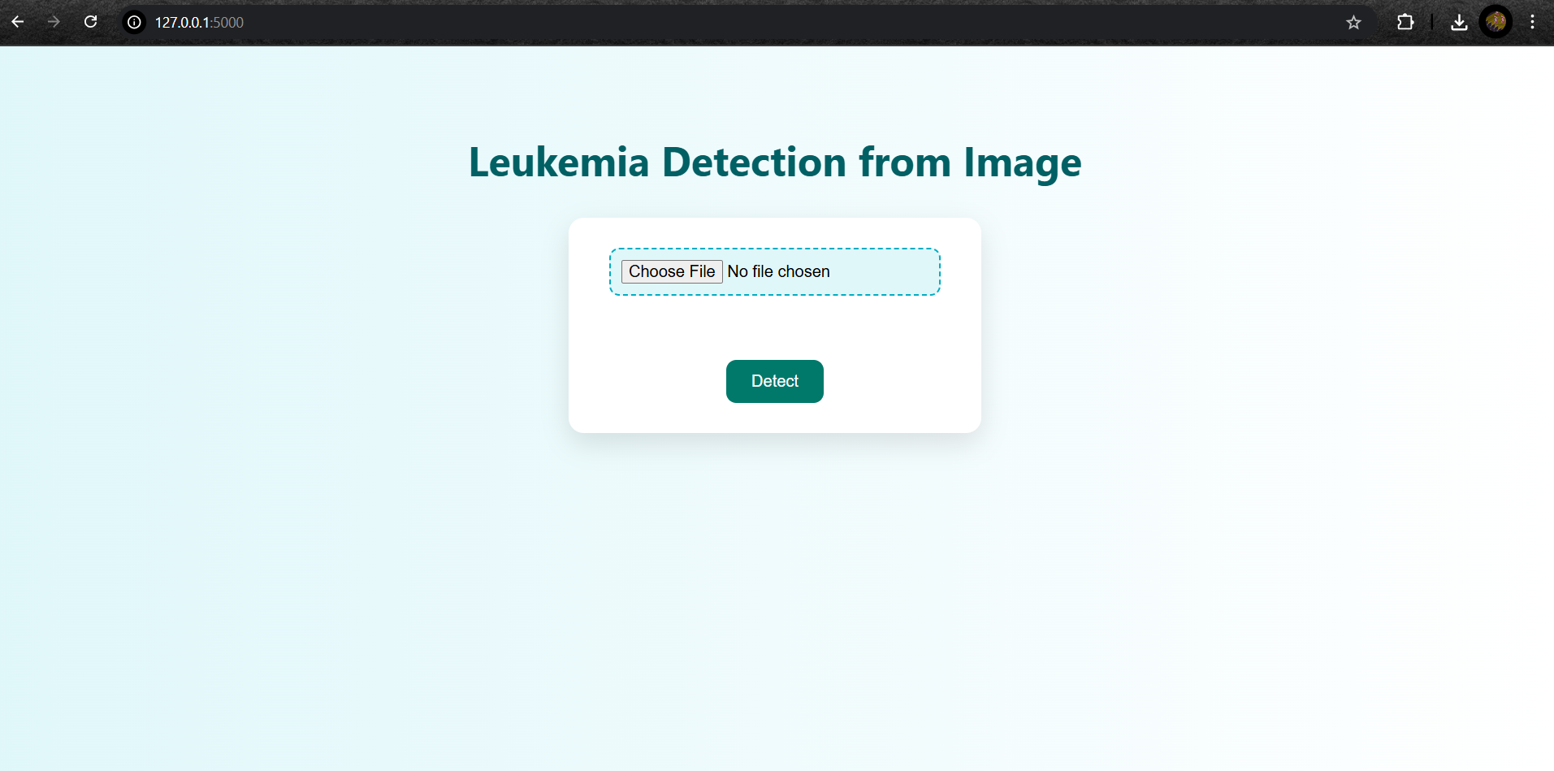
14 . Result

Slide 34
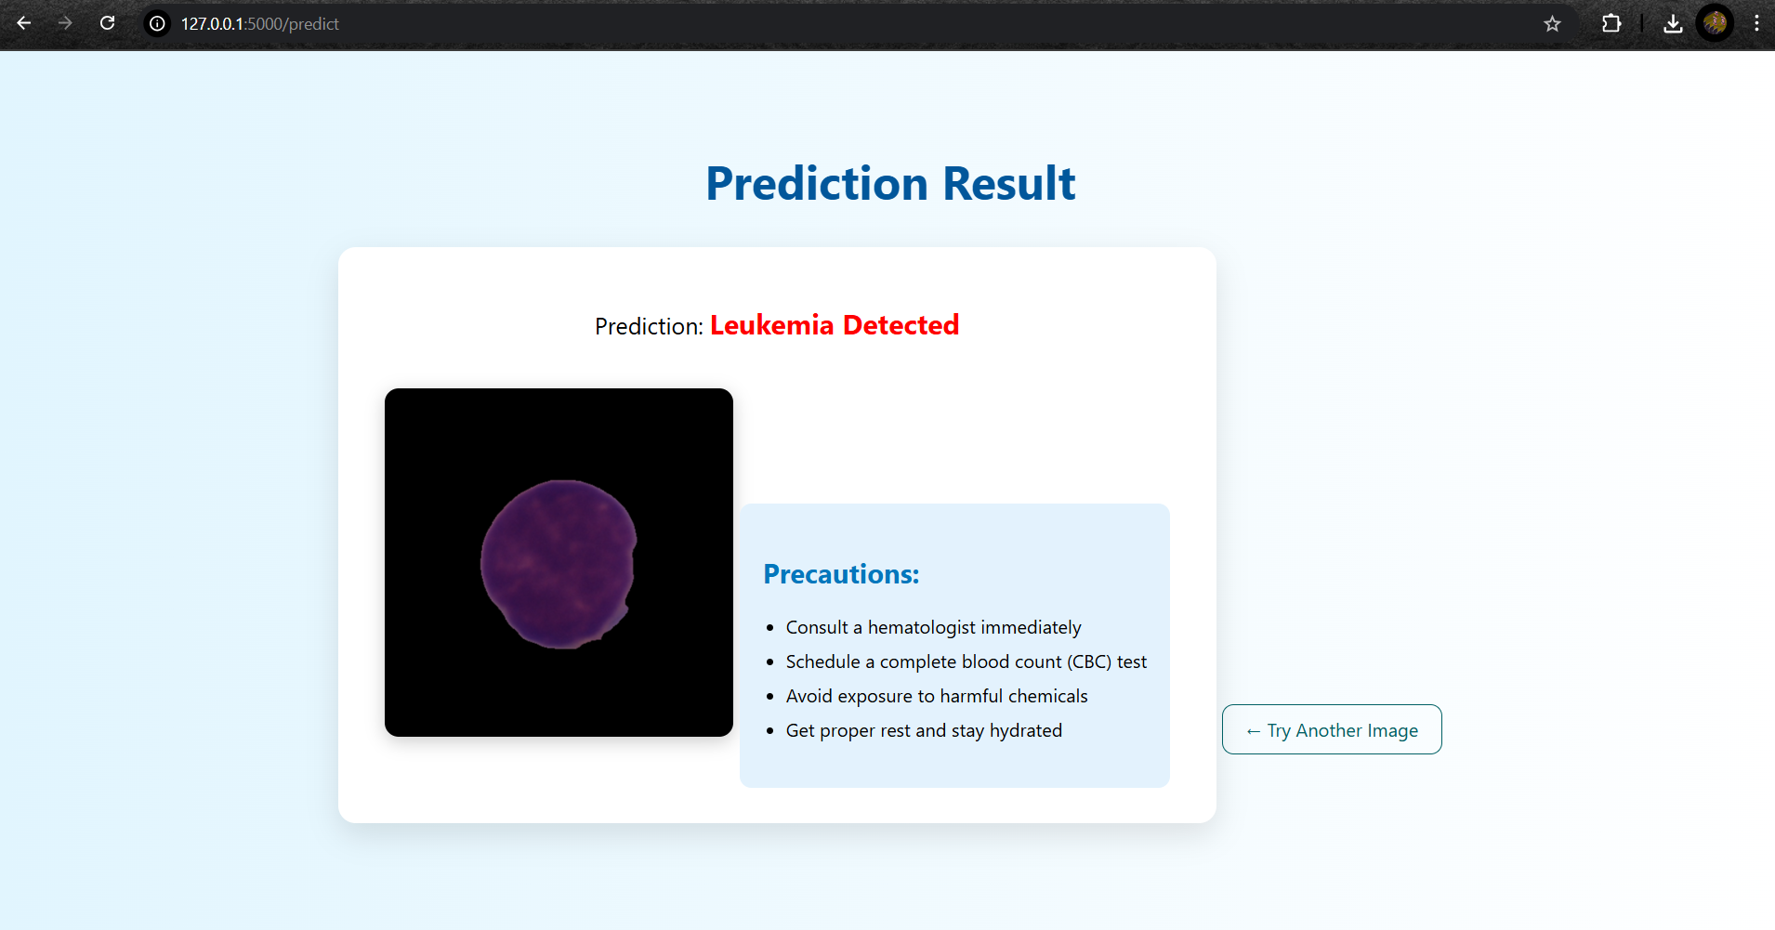
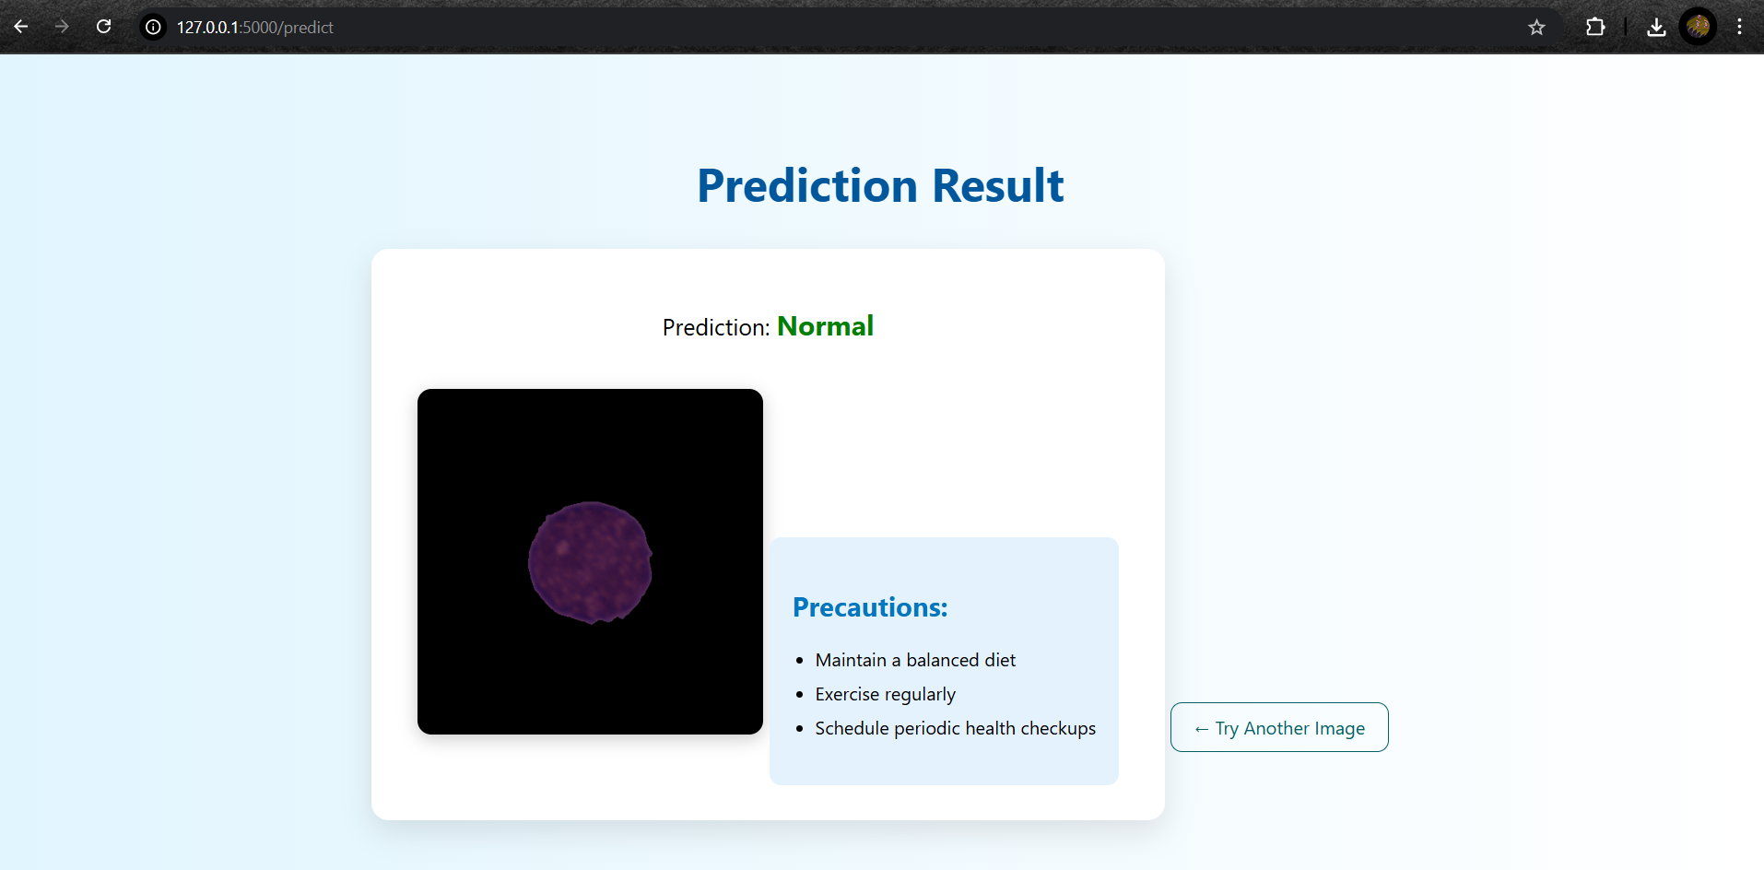
14 . Result

Slide 35
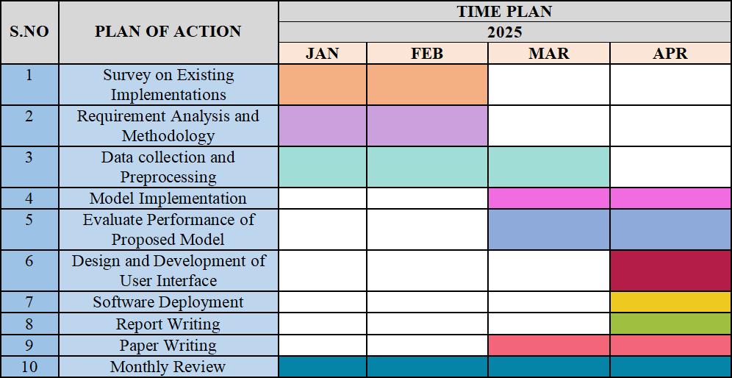
15. Timeline Chart
35

Slide 36
16. Summary
- Leverages blood smear image analysis to identify signs of acute lymphoblastic leukemia (ALL).
- Develops a hybrid CNN-QNN model to extract deep features from blood smear images for precise classification.
- Aims to create a efficient, and accessible diagnostic tool for leukemia detection.
- Enhances diagnostic accuracy and reduces dependency on manual microscopic examination of blood samples.
- Provides a scalable AI-driven solution to improve accessibility for early leukemia screening, aiding in better disease management.
36

Slide 37
16. Summary
- Leverages blood smear image analysis to identify signs of acute lymphoblastic leukemia (ALL).
- Develops a hybrid CNN-QNN model to extract deep features from blood smear images for precise classification.
- Aims to create a efficient, and accessible diagnostic tool for leukemia detection.
- Enhances diagnostic accuracy and reduces dependency on manual microscopic examination of blood samples.
- Provides a scalable AI-driven solution to improve accessibility for early leukemia screening, aiding in better disease management.
37

Slide 38

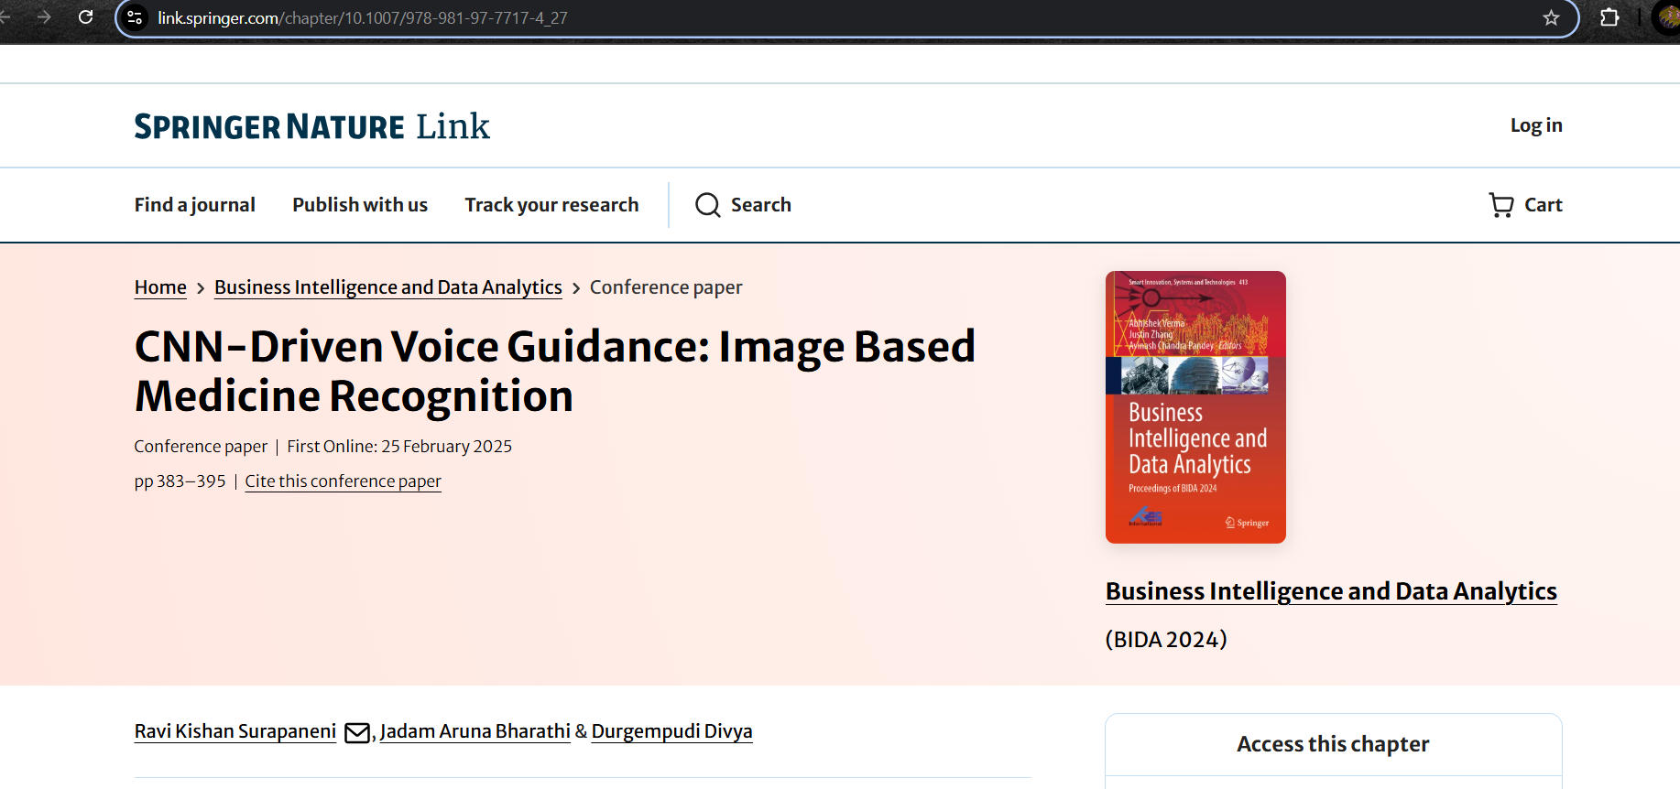
17. Publication status
Epics - published
38

Slide 39


17. Publication status
Mini-1 - Presented
39

Slide 40
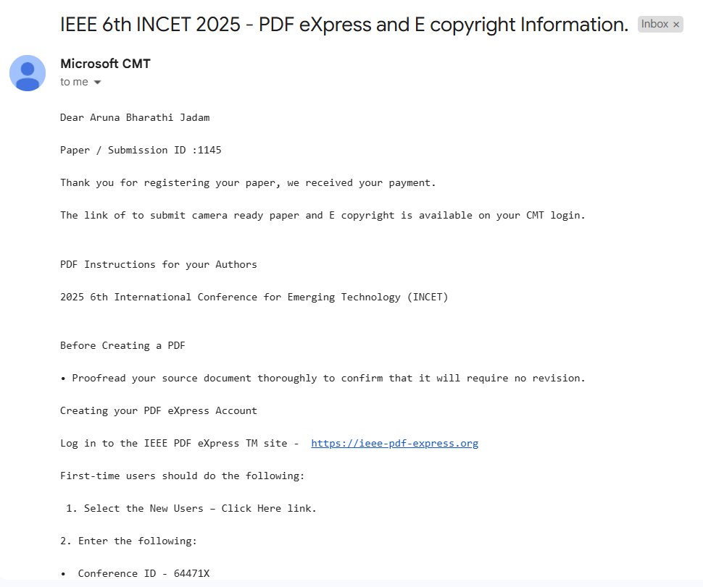
17. Publication status
Mini-2 – Registered
40

Slide 41
References
Abhishek, A., Deb, S. D., Jha, R. K., Sinha, R., & Jha, K. (2025). Ensemble learning using Gompertz function for leukemia classification. Biomedical Signal Processing and Control, 100, 106925.
Dutta, M., Mojumdar, M. U., Kabir, M. A., Chakraborty, N. R., Siddiquee, S. M. T., & Abdullah, S. (2025). LEU3: An Attention Augmented-based Model for Acute Lymphoblastic Leukemia Classification. IEEE Access.
Asaad, R. R., Almufti, S. M., Marqas, R. B., Hussein, C. S., & Majeed, D. A. U-NET PLR.
Zhu, Y., Zhang, M., Huang, Q., Wu, X., Wan, L., & Huang, J. (2025). Secretary bird optimization algorithm based on quantum computing and multiple strategies improvement for KELM diabetes classification. Scientific Reports, 15(1), 3774.
Alqassab, A. I. M., LUQUE-NIETO, M. A., & Mohammed, M. A. Enhanced Multi-Label Ocular Disease Identification Using a Quantum Convolutional Neural Network Approach Based on Fundus Images. Available at SSRN 5139712.
Asadoorian, N., Yaraghi, S., & Tahmasian, A. (2024). Pre-trained quantum convolutional neural network for COVID-19 disease classification using computed tomography images. PeerJ Computer Science, 10, e2343.
35

Slide 42
References
Hafeez, M. A., Munir, A., & Ullah, H. (2024). H-QNN: A Hybrid Quantum–Classical Neural Network for Improved Binary Image Classification. AI, 5(3), 1462-1481.
Ranga, D., Prajapat, S., Akhtar, Z., Kumar, P., & Vasilakos, A. V. (2024). Hybrid Quantum–Classical Neural Networks for Efficient MNIST Binary Image Classification. Mathematics, 12(23), 1-22.
36

Slide 43
Thank you

