Slide 1
TESLA STOCK PRICE PREDICTION USING REGRESSION MODEL
GUIDE NAME: Dr.K.SANGEETHA M.E ,PhD., Associate Professor BATCH NO: A4
ARUNA K (211419104020)
ASTALAKSHMI G (211419104028)
PREETHI B (211419104200)

Slide 2
ABSTRACT:
Stock prices are first determined by a company’s Initial Public Offering (IPO) when it first puts its shares into the market.
Investment firms use a variety of metrics, along with the total number of shares being offered, to determine what the stock price will be.
There are several reasons that will cause the share price to rise and fall, driven largely by the earnings that can be expected from the company. Traders use financial metrics constantly to determine the value of the company including its history of earnings, changes in the market, and the profit that it can reasonably be expected to bring in.
We propose a machine learning-based method to accurately predict the stock price. The analysis of dataset by supervised machine learning technique (SMLT) using uni-variate analysis, bi-variate and multi-variate analysis.

Slide 3
BASE PAPER:
TITLE: Pearson Correlation Coefficient-Based Performance Enhancement of Broad Learning System for Stock Price Prediction
AUTHOR: Guanzhi Li; Aining Zhang; Qizhi Zhang; Di Wu; Choujun Zhan
LINK: https://ieeexplore.ieee.org/document/9737295

Slide 4
LITERATURE SURVEY
Year | Title | Author | Methodologies | Merits | Demerits
2022 | Pearson Correlation Coefficient-Based Performance Enhancement of Broad Learning System for Stock Price Prediction | Guanzhi Li, Aining Zhang, Qizhi Zhang, Di Wu , and Choujun Zhan | Broad Learning System, Pearson Correlation Coefficient | Purpose of this brief is to help investors make reasonable trading decisions by accurately predicting stock price movements using machine learning methods. | Deployment is not implemented. It is very complex system as Shanghai Stock Exchange price is predicted (Chinese Yuan (CNY)).
Link | https://ieeexplore.ieee.org/document/9737295

Slide 5
LITERATURE SURVEY
Year | Title | Author | Methodologies | Merits | Demerits
2022 | Predicting Stock Price Changes Based on the Limit Order Book: A Survey | Ilia Zaznov Julian Kunkel | Long short-term memory(LSTM). | It is focused on the critical evaluation of the current studies in the subject area of stock price movement predictions based on LOB data. | The dataset suffers from a number of issues, such as dated information, inherently unbalanced distribution between three classes, five stocks comprising this dataset are indistinguishable, and etc.
Link | https://www.mdpi.com/2227-7390/10/8/1234

Slide 6
LITERATURE SURVEY
Year | Title | Author | Methodologies | Merits | Demerits
2021 | Stock Movement Prediction using Technical and Data | Dylan M. Crain | Gated recurrent unit(GRU) and Long short-term memory(LSTM). | Both technical and fundamental data is used. | It would be a useful alteration to include more than just one stock in the analysis.
Link | https://cs230.stanford.edu/projects_fall_2021/reports/103153267.pdf

Slide 7
LITERATURE SURVEY
Year | Title | Author | Methodologies | Merits | Demerits
2021 | Novel Stock Crisis Prediction Technique—A Study on Indian Stock Market | Nagaraj Naik, Biju R. Mohan | Log-Periodic Power Law(LPPL) | Proposed the Hybrid Feature Selection (HFS) algorithm to remove irrelevant stock financial parameters features. | Explored only a limited number of technical parameters of stock prices.
Link | https://ieeexplore.ieee.org/document/9453777

Slide 8
LITERATURE SURVEY
Year | Title | Author | Methodologies | Merits | Demerits
2020 | Predicting Stock Market Trends Using Machine Learning and Deep Learning Algorithms Via Continuous and Binary Data; a Comparative Analysis | Mojtaba Nabipour ,Pooyan Nayyeri, Hamed Jabani ,Shahab S, Amir Mosavi | Nine machine learning methods (Decision Tree, Random Forest, Adaboost, XGBoost, SVC, Naïve Bayes, KNN, Logistic Regression and ANN) and two deep learning algorithms (RNN and LSTM) are used. | The evaluation results indicate that for the continuous data, RNN and LSTM outperform other prediction models with a considerable difference. | Complexity and nonlinearity are two main challenges faced.
Link: | https://ieeexplore.ieee.org/document/9165760

Slide 9
LITERATURE SURVEY
Year | Title | Author | Methodologies | Merits | Demerits
2019 | Stock Price Prediction App using Machine Learning Models Optimized by Evolution | CHAU Tsun Man, SUEN Heung Ping | Recurrent Neural Network (RNN) ,Long short-term memory networks (LSTM) and Gated recurrent unit networks (GRU). | The project aims to provide retail investors with a third-party investment mobile application to navigate through the stock market. | Multiple approaches to framing the problems is not be explored in , such as predicting whether the stock price goes up or down (binary classification) based on the previous stock prices.
Link | https://www.cse.ust.hk/~rossiter/fyp/103_RO4_Final_201819.pdf

Slide 10
LITERATURE SURVEY
Year | Title | Author | Methodologies | Merits | Demerits
2019 | Stock Price Prediction: A Comparative Study between Traditional Statistical Approach and Machine Learning Approach | Indronil Bhattacharjee, Pryonti Bhattacharja | Predictions using statistical methods like Simple Moving Average, Weighted Moving Average, Exponential Smoothing, Naive approach, and machine learning methods are performed. | To predict the closing prices of stocks through comparative study between different traditional statistical approaches and machine learning Techniques. | Only the the neural network models are found to be the most accurate for stock price prediction.
Link | https://ieeexplore.ieee.org/document/9068850

Slide 11
LITERATURE SURVEY
Year | Title | Author | Methodologies | Merits | Demerits
2019 | Indian stock market prediction using artificial neural networks on tick data | Dharmaraja Selvamuthu ,Vineet Kumar & Abhishek Mishra | Support Vector Machines (SVM) and Artificial Neural Networks (ANN) | Easy and simple algorithms were used for prediction. | Recurrent Neural Networks may provide better predictions than the neural networks used in this study.
Link: | https://jfin-swufe.springeropen.com/articles/10.1186/s40854-019-0131-7

Slide 12
SUMMARY OF LITERATURE SURVEY
This high performance points to the utility and returns possible from utilizing both fundamental and technical data in stock prediction.
Most accurate to predict stock prices.
Mobile applications with better presentation of stock price predictions could be developed to help investors understand the implications of the stock price predictions.

Slide 13
PROBLEM STATEMENT
Accurate prediction of a stock price is a challenging task due to the complexity, financial systems, etc.
Stock prices are first determined by a company’s Initial Public Offering (IPO) when it first puts its shares into the market. Investment firms use a variety of metrics, along with the total number of shares being offered, to determine what the stock price will be.Hence, stock price prediction has become an important research area.
The aim is to propose a machine learning-based method to accurately predict the stock price. The analysis of dataset by supervised machine learning technique (SMLT) using uni-variate analysis, bi-variate and multi-variate analysis .
This suggestion is promising as data modeling and analysis tools, e.g., data mining, have the potential to generate a knowledge-rich environment which can help to significantly improve the quality of tesla stock price prediction.

Slide 14
PROPOSED SYSTEM
In proposed system, the Datasets from different sources would be combined to form a generalized dataset.
After the generalized dataset is prepared it is checked for cleanliness, and then trimmed dataset is analyzed.
The data set collected for predicting given data is split into Training set and Test set. Generally, 7:3 ratios are applied to split the Training set and Test set.
The Data Model which was created using machine learning algorithms are applied on the Training set and based on the test result accuracy, test set prediction is done.
In addition, we are going to compare the forecasting results with four machine learning methods, like Adaptive Boosting (Adaboost), Decision Tree, Ridge regression and Lasso regression . Among all algorithms used for testing, the algorithm that provides the best performance is finally used.
Then the system is deployed using django. For predicting the tesla stock problem, ML prediction model is effective because it is strong in preprocessing of data, irrelevant variables, and a mix of continuous, categorical and discrete variables.

Slide 15
Advantages:
Tesla stock price is predicted (in US dollars).
Performance metrics are compared.
Project will be deployed.

Slide 16
MODULES
Data Pre-processing
Data Visualization
Implementing Algorithm 1
Implementing Algorithm 2
Implementing Algorithm 3
Implementing Algorithm 4
Deployment

Slide 17
REGRESSION ALGORTIHM
Adaptive Boosting (Adaboost)
Ridge Regression
Lasso Regression
Decision Tree Regression

Slide 18
MODULE DESCRIPTION
DATA PRE-PROCESSING
Validation techniques in machine learning are used to get the error rate of the Machine Learning (ML) model, which can be considered as close to the true error rate of the dataset.
The type of missing data will influence how to deal with filling in the missing values and to detect missing values, and do some basic imputation and detailed statistical approach for dealing with missing data.
Given Input : Data
Expected Output: Removing noisy data

Slide 19
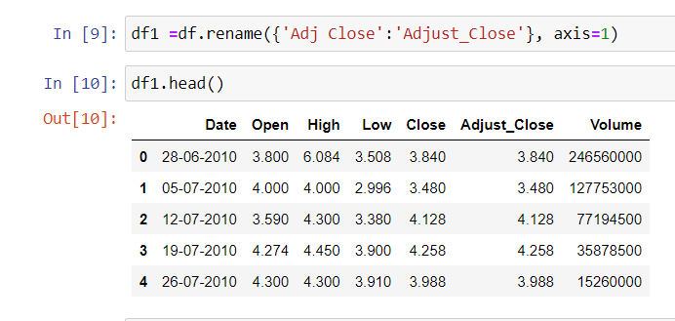
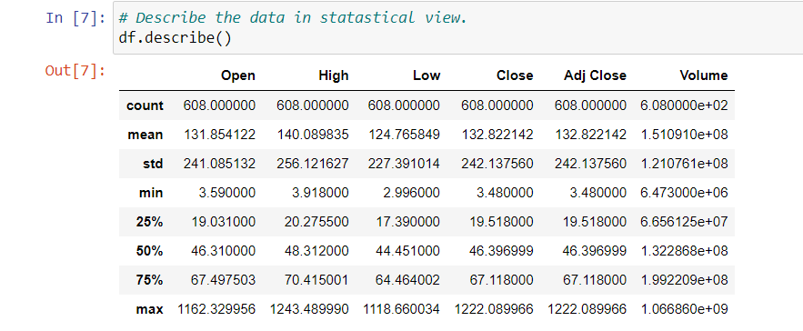
Example:
INPUT:
OUTPUT:
INPUT:

Slide 20
DATA VISUALIZATION
Data visualization is an important skill in applied statistics and machine learning. Statistics does indeed focus on quantitative descriptions and estimations of data
It will discover the many types of plots that you will need to know when visualizing data in Python and how to use them to better understand your own data.
How to chart time series data with line plots and categorical quantities with bar charts.
How to summarize data distributions with histograms and box plots.
Given Input : Data
Expected Output: visualized data

Slide 21
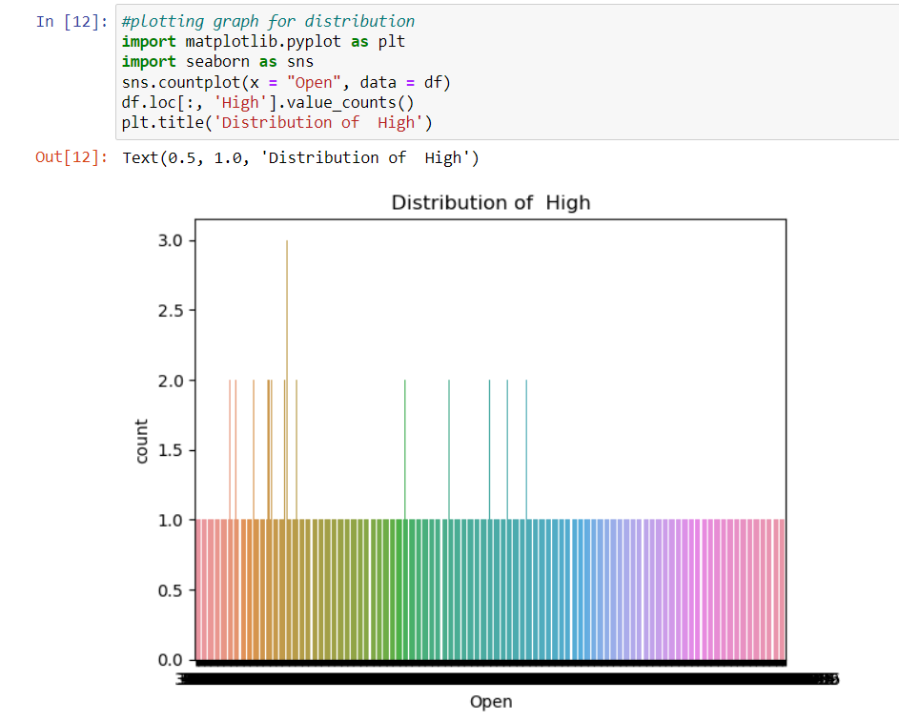
EXAMPLE:

Slide 22
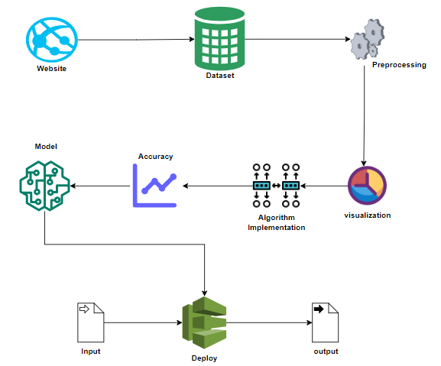
SYSTEM ARCHITECTURE

Slide 23
ALGORITHM IMPLEMENTATION
Algorithmic implementation is important to compare the performance of multiple different machine learning algorithms consistently and it will discover to create a test harness to compare multiple different machine learning algorithms in Python with scikit-learn.
Each model will have different performance characteristics
Use these estimates to choose one or two best models from the suite of models that you have created
The key to a fair comparison of machine learning algorithms is ensuring that each algorithm is evaluated in the same way on the same data and it can achieve this by forcing each algorithm to be evaluated on a consistent test harness.

Slide 24
ADABOOST ALGORITHM:
AdaBoost is adaptive in the sense that subsequent weak learners are tweaked in favor of those instances mis-regressor by previous regressors. In some problems it can be less susceptible to the overfitting problem than other learning algorithms. The individual learners can be weak, but as long as the performance of each one is slightly better than random guessing, the final model can be proven to converge to a strong learner.
Although AdaBoost is typically used to combine weak base learners (such as decision stumps), it has been shown that it can also effectively combine strong base learners (such as deep decision trees), producing an even more accurate model.

Slide 25
Advantages:
Ease of use and less parameter tweaking
Used for accuracy improvement of weak classifiers and cases in image/text classification.
Disadvantages:
High-quality data is needed
Very sensitive to outliers and noise in data
It is slower

Slide 26
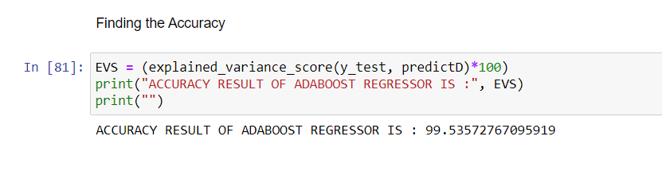
EXAMPLE:

Slide 27
LASSO REGRESSION:
Least Absolute Shrinkage and Selection Operator(LASSO) regression is a regularization technique. It is used over regression methods for a more accurate prediction. This model uses shrinkage. Shrinkage is where data values are shrunk towards a central point as the mean.
The lasso procedure encourages simple, sparse models (i.e. models with fewer parameters). This particular type of regression is well-suited for models showing high levels of multicollinearity or when you want to automate certain parts of model selection, like variable selection/parameter elimination.
Lasso Regression uses L1 regularization technique. It is used when we have more features because it automatically performs feature selection.

Slide 28
Advantages:
As any regularization method, it can avoid overfitting. It can be applied even when number of features is larger than number of data.
It can do feature selection.
It is fast in terms of inference and fitting.
Disadvantage:
The model selected by lasso is not stable. For example, on different bootstrapped data, the feature selected can be very different.
The model selection result is not intuitive to interpret: for example, why lasso select a feature?
When there are highly correlated features, lasso may randomly select one of them of part of them. The result depends on the implementation. To improve, people introduced elastic net.
Based on my experience, its prediction performance is usually worse than ridge regression in terms of mse.

Slide 29
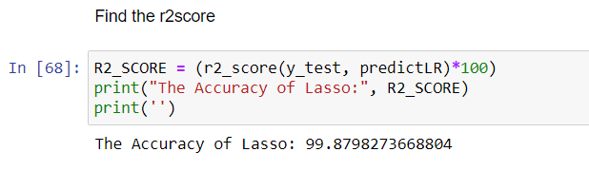
EXAMPLE:

Slide 30
DECISION TREE ALGORITHM:
Decision Tree is a Supervised learning technique that can be used for both classification and Regression problems. It is a tree-structured regressor, where internal nodes represent the features of a dataset, branches represent the decision rules and each leaf node represents the outcome.
In a Decision tree, there are two nodes, which are the Decision Node and Leaf Node. Decision nodes are used to make any decision and have multiple branches, whereas Leaf nodes are the output of those decisions and do not contain any further branches.

Slide 31
Advantages:
Compared to other algorithms decision trees requires less effort for data preparation during pre-processing.
It does not require normalization of data.
It does not require scaling of data as well.
A Decision tree model is very intuitive and easy to explain to technical teams as well as stakeholders.
Disadvantage:
A small change in the data can cause a large change in the structure of the decision tree causing instability.
For a Decision tree sometimes calculation can go far more complex compared to other algorithms.
Decision tree often involves higher time to train the model.
Decision tree training is relatively expensive as they are complex.

Slide 32
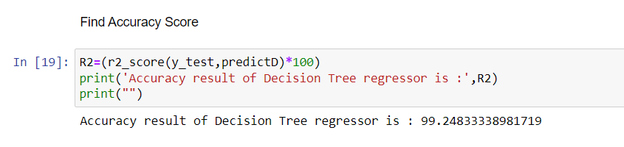
EXAMPLE:

Slide 33
RIDGE REGRESSION:
Ridge regression is a regularization technique, which is used to reduce the complexity of the model. It is also called as L2 regularization. In this technique, the cost function is altered by adding the penalty term to it. The amount of bias added to the model is called Ridge Regression penalty.
Ridge works well if there are many large parameters of about the same value.
Ridge regression aims at reducing the standard error by adding some bias in the estimates of the regression.

Slide 34
Advantages
Avoids overfitting a model.
They add just enough bias to make the estimates reasonably reliable approximations to true population values.
Disadvantages
They include all the predictors in the final model.
They are unable to perform feature selection.
They shrink the coefficients towards zero.
They trade the variance for bias.

Slide 35
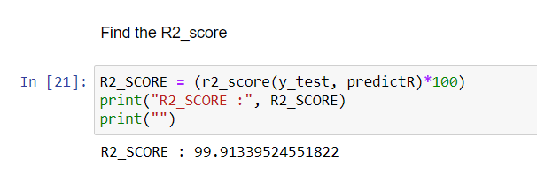
EXAMPLE:

Slide 36
DEPLOYMENT
In this module the trained machine learning model is converted into pickle data format file (.pkl file) which is then deployed in our django framework.

Slide 37
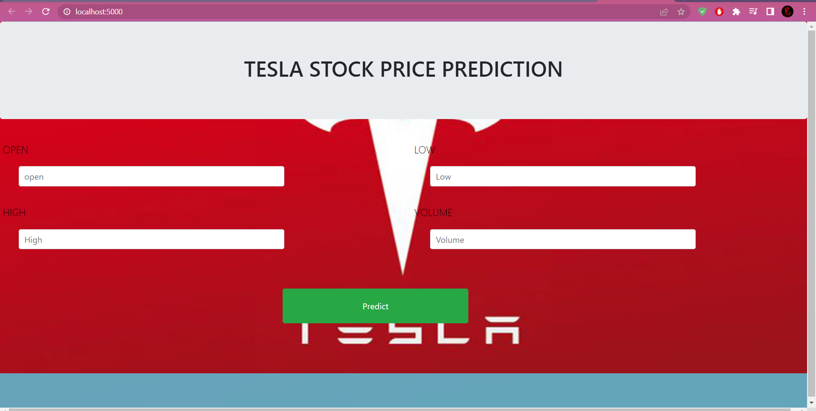

Slide 38
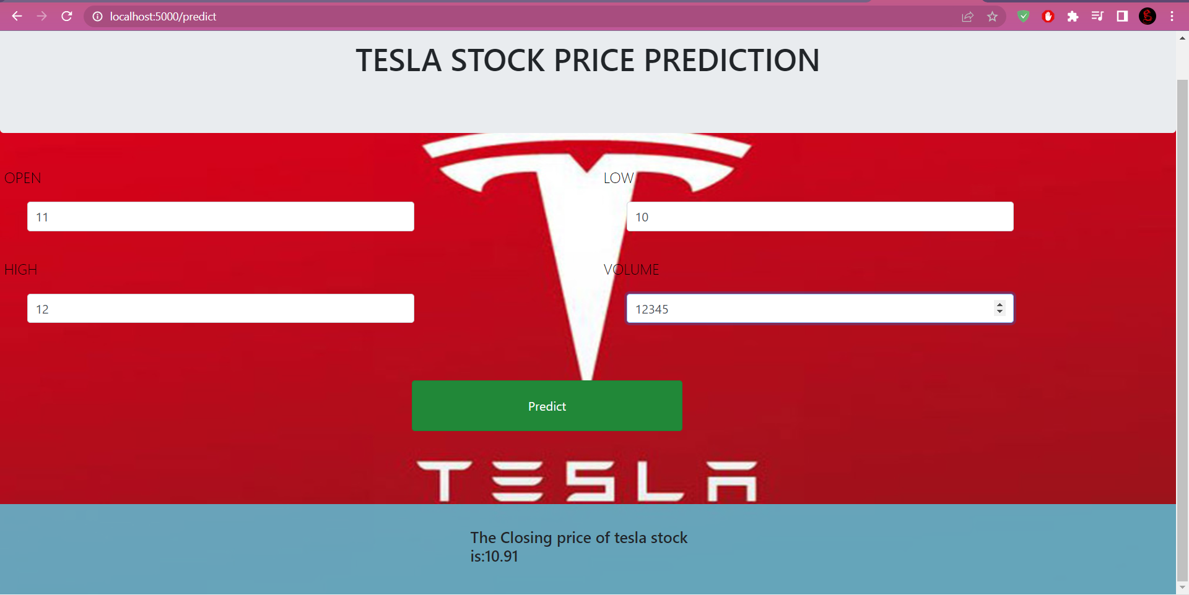

Slide 39
PERFORMANCE METRICS
 | Mean Absolute Error | Mean Absolute Percentage Error | Explained Variance Score | Mean Squared Error | Median Absolute Error | R2 score
Adaptive Boosting | 13.86 | 1.16 | 99.22 | 368.03 | 12.43 | 99.22
Ridge Regression | 3.42 | 0.04 | 99.79 | 98.20 | 0.68 | 99.79
Lasso Regression | 3.66 | 0.06 | 99.82 | 99.37 | 0.97 | 99.79
Decision Tree Regression | 6.71 | 0.04 | 99.53 | 209.76 | 1.00 | 99.73

Slide 40
Environmental Requirements:
Software Requirements:
Operating System : Windows
Tool : Anaconda with Jupyter Notebook
Hardware requirements:
Processor : Pentium IV/III
Hard disk : minimum 80 GB
RAM : minimum 2 GB

Slide 41
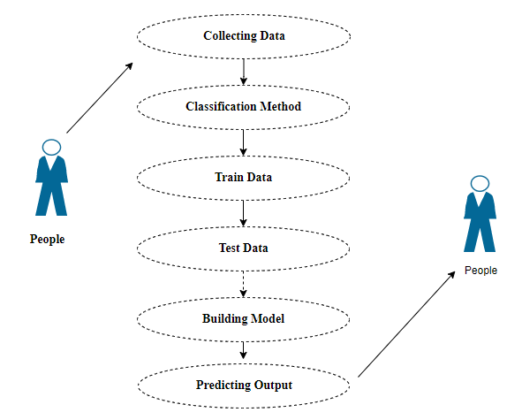
USE CASE DIAGRAM
UML DIAGRAMS

Slide 42
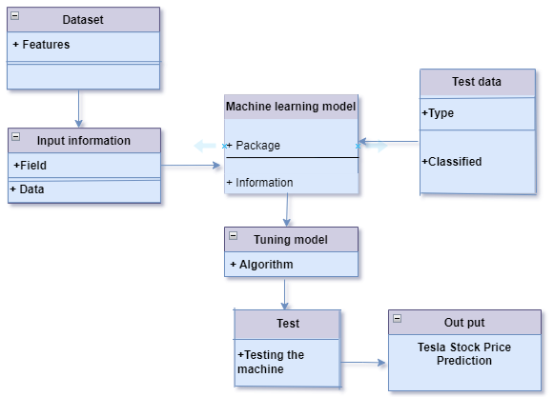
CLASS DIAGRAM

Slide 43
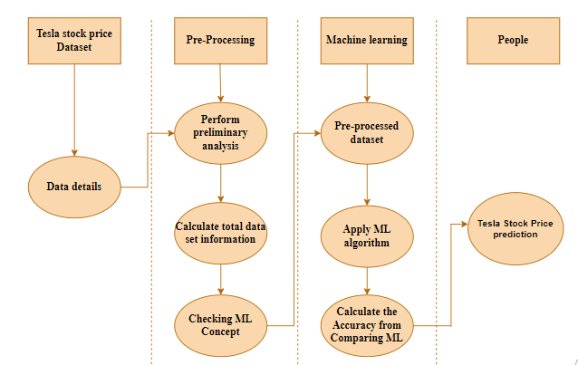
Activity Diagram

Slide 44
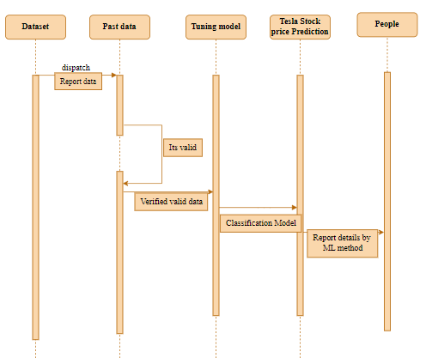
Sequence Diagram:

Slide 45
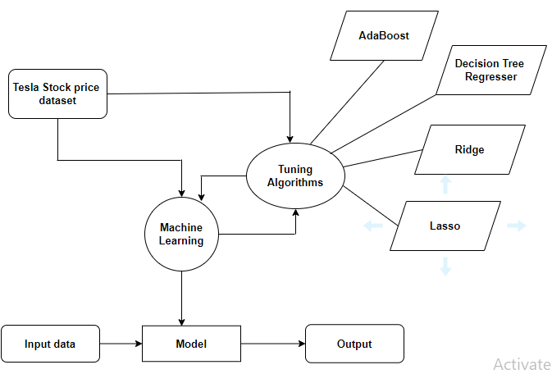
E-R DIAGRAM

Slide 46
Data Flow Diagram:
Dataset
Test dataset
Preprocessing
Training dataset
Prediction of Tesla Stock Price
Machine Learning Algorithm

Slide 47
REFERENCES
W. Lu, J. Li, J. Wang, and L. Qin, “A CNN-BiLSTM-AM method for stock price prediction,” Neural Comput. Appl., vol. 33, no. 10, pp. 4741–4753, 2021.
G. Chen, Y. Lou, and L. Wang, “A comparative study on controllability robustness of complex networks,” IEEE Trans. Circuits Syst. II, Exp. Briefs, vol. 66, no. 5, pp. 828–832, May 2019.
J. Dong, W. Dai, Y. Liu, L. Yu, and J. Wang, “Forecasting chinese stock market prices using baidu search index with a learning-based data collection method,” Int. J. Inf. Technol. Decis. Making, vol. 18, no. 5, pp. 1605–1629, 2019.
L. Bai, Y. Zhao, and X. Huang, “A CNN accelerator on FPGA using depthwise separable convolution,” IEEE Trans. Circuits Syst. II, Exp. Briefs, vol. 65, no. 10, pp. 1415–1419, Oct. 2018.
B. N. G. Koneru and V. Vasudevan, “Sparse artificial neural networks using a novel smoothed LASSO penalization,” IEEE Trans. Circuits Syst. II, Exp. Briefs, vol. 66, no. 5, pp. 848–852, May 2019.

Slide 48
REFERENCES
A. Thakkar, D. Patel, and P. Shah, “Pearson correlation coefficientbased performance enhancement of vanilla neural network for stock trend prediction,” Neural Comput. Appl., vol. 33, pp.
D. Liu, C. K. Tse, and X. Zhang, “Robustness assessment and enhancement of power grids from a complex network’s perspective using decision trees,” IEEE Trans. Circuits Syst. II, Exp. Briefs, vol. 66, no. 5, pp. 833–837, May 2019.
J. Yang, R. Rao, P. Hong, and P. Ding, “Ensemble model for stock price movement trend prediction on different investing periods,” in Proc. 12th Int. Conf. Comput. Intell. Security (CIS), 2016, pp. 358–361.
C. L. P. Chen and Z. Liu, “Broad Learning System: An effective and efficient incremental learning system without the need for deep architecture,” IEEE Trans. Neural Netw. Learn. Syst., vol. 29, no. 1, pp. 10–24, Jan. 2018.

Slide 49
REFERENCES
L.-P. Ni, Z.-W. Ni, and Y.-Z. Gao, “Stock trend prediction based on fractal feature selection and support vector machine,” Expert Syst. Appl., vol. 38, no. 5, pp. 5569–5576, 2011
Q. Li et al., “Integrating reinforcement learning and optimal power dispatch to enhance power grid resilience,” IEEE Trans. Circuits Syst. II, Exp. Briefs, vol. 69, no. 3, pp. 1402–1406, Mar. 2021.
Q. Zhuge, L. Xu, and G. Zhang, “LSTM neural network with emotional analysis for prediction of stock price,” Eng. Lett., vol. 25, no. 2, pp. 167–175, 2017.
J. Yang, R. Rao, P. Hong, and P. Ding, “Ensemble model for stock price movement trend prediction on different investing periods,” in Proc. 12th Int. Conf. Comput. Intell. Security (CIS), 2016, pp. 358–361

Slide 50
CONCLUSION
The analytical process started from data cleaning and processing, missing value, exploratory analysis and finally model building and evaluation. The best accuracy on public test set of higher accuracy score algorithm will be found. The founded one is used in the application which can help to find the tesla stock price.

