Slide 1


Job Portal Database System
INFO6210 – Database Management and Database Design
Project Team-6
Aruna Divi | Alivia Guin | Arundathi Balangowda Patil | Harika Reddy Gurram

Slide 2
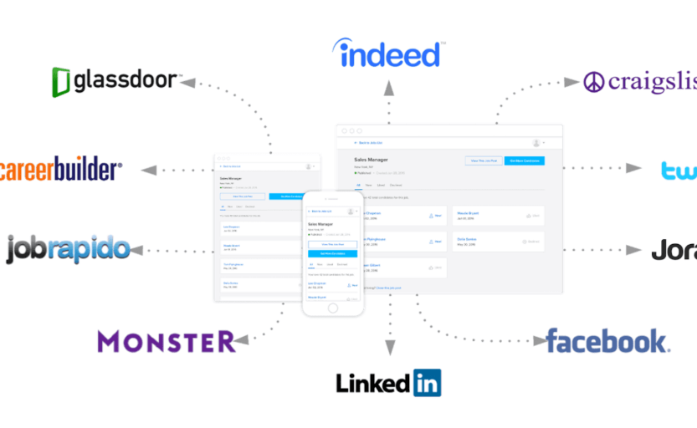
Objective
About the topic
Job portals are integral part of almost every hiring process and using them effectively will translate into qualified candidates
Goal
The purpose of the database is to serve jobseekers to find available job vacancies and employers to identify eligible candidates for the desired position

Slide 3

Business Problems Addressed
Allows jobseekers to find the postings
Permits recruiters to post the job
Feedback to the companies by job seekers

Slide 4
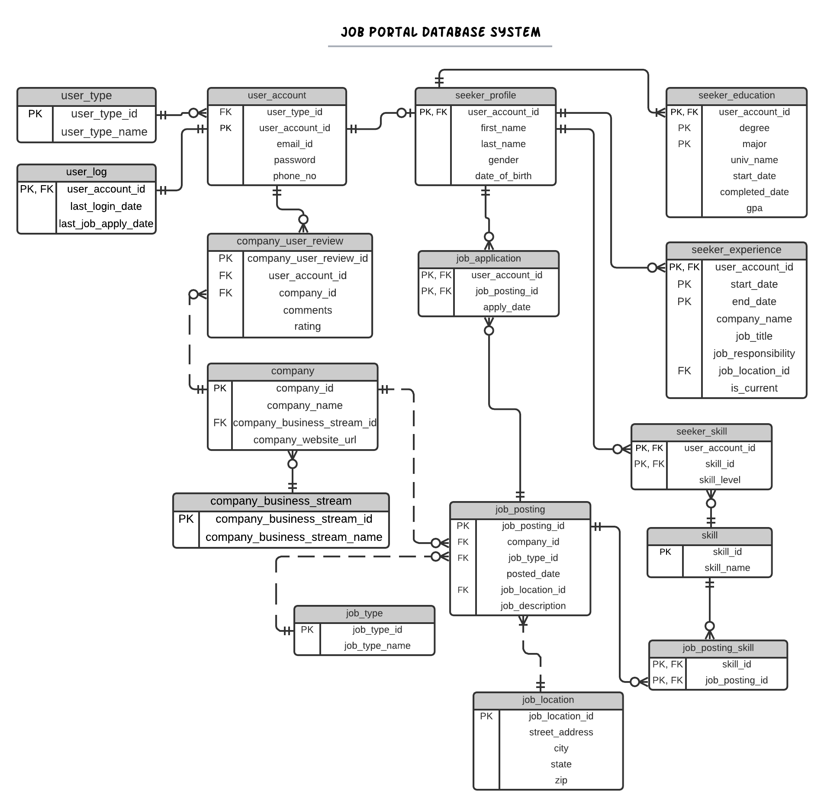
Entity-Relationship Diagram

Slide 5
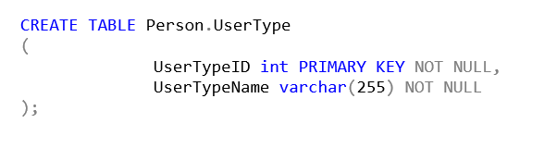
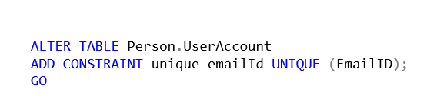
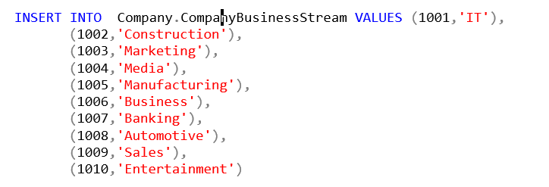
Implementation
DDL
Computed columns
Functions
Triggers

Slide 6
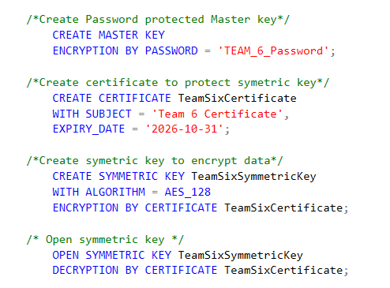
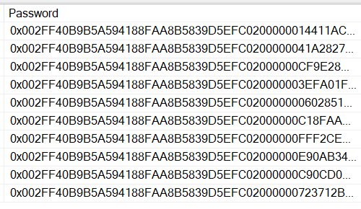
Encryption

Slide 7
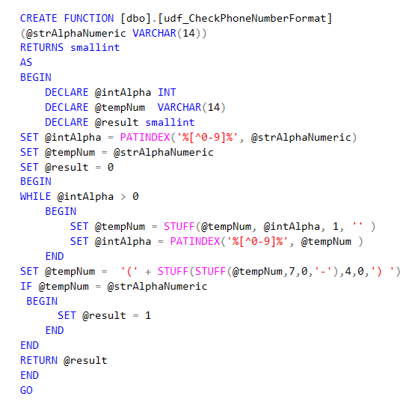
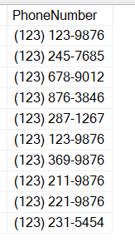
Functions- Table level Constraint

Slide 8
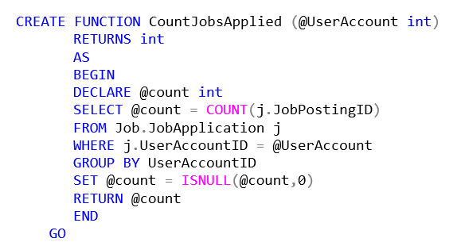
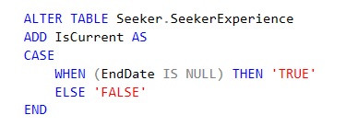
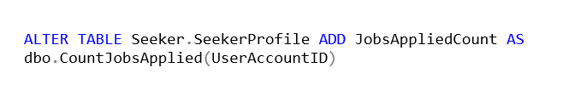
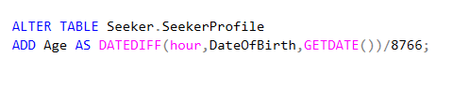
Computed Columns
Jobs Applied
Current Job
Age

Slide 9
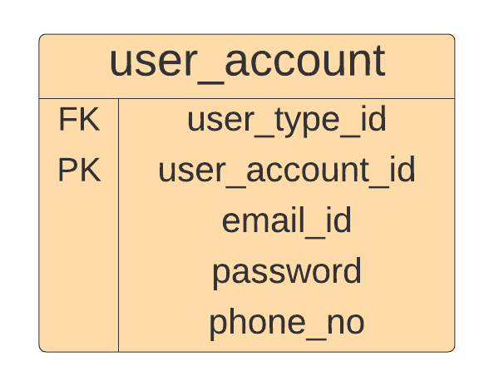
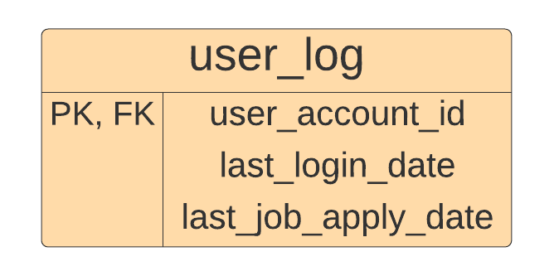
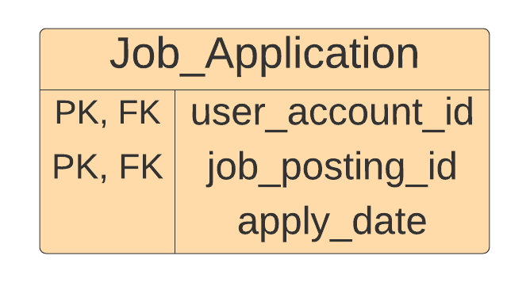
Triggers
Trigger – I
CREATE TRIGGER utrAddUserEntryInUserLogAfterUserCreation
ON Person.UserAccount
AFTER INSERT
AS
BEGIN
DECLARE @userAccountID INT;
SET @userAccountID = (SELECT UserAccountID FROM Inserted);
INSERT INTO Person.UserLog VALUES (@userAccountID, GETDATE(),NULL)
END
GO
Trigger – II
CREATE TRIGGER utrLASTJOBAPPLIEDDATE
ON Job.JobApplication
AFTER INSERT
AS
BEGIN
DECLARE @userAccountID INT;
SET @userAccountID = (SELECT UserAccountID FROM Inserted);
UPDATE Person.UserLog SET LastJobApplyDate = GETDATE()
WHERE UserAccountID = @userAccountID
END
GO

Slide 10
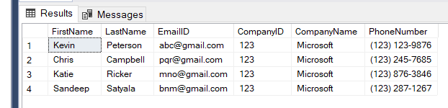
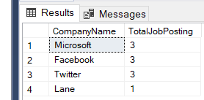
Views
View – I
CREATE VIEW vwSDEApplication
AS
SELECT sp.FirstName, sp.LastName, ua.EmailID, c.CompanyID, c.CompanyName, ua.PhoneNumber FROM Job.JobApplication ja
INNER JOIN Job.JobPosting jp ON ja.JobPostingID = jp.JobPostingID
INNER JOIN Company.Company c ON jp.CompanyID = c.CompanyID
INNER JOIN Seeker.SeekerProfile sp ON sp.UserAccountID = ja.UserAccountID
INNER JOIN Person.UserAccount ua ON ua.UserAccountID = ja.UserAccountID
WHERE jp.JobTypeID = 1 and jp.CompanyID = 123
GO
View – II
CREATE VIEW vwTotalJobPostingsByCompanyView
AS
SELECT c.CompanyName, COUNT(jp.JobPostingID) AS
TotalJobPosting
FROM Company.Company c
INNER JOIN Job.JobPosting jp ON
c.CompanyID = jp.CompanyID
GROUP BY c.CompanyID, c.CompanyName
GO

Slide 11
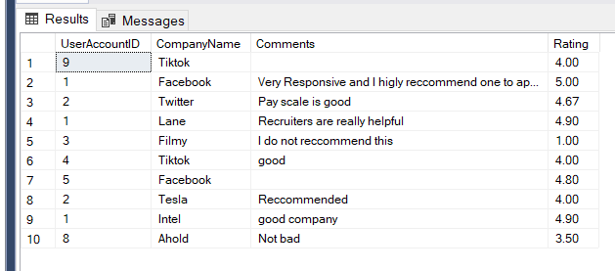
Views Continued..
View – III
CREATE VIEW userRating
AS
SELECT ua.UserAccountID, CompanyName, ur.Comments, ur.Rating
FROM Person.UserAccount ua
INNER JOIN Company.CompanyUserReview ur ON ur.UserAccountID = ua.UserAccountID
INNER JOIN Company.Company cc ON cc.CompanyID = ur.CompanyID
GO

Slide 12

Data Analysis

Slide 13
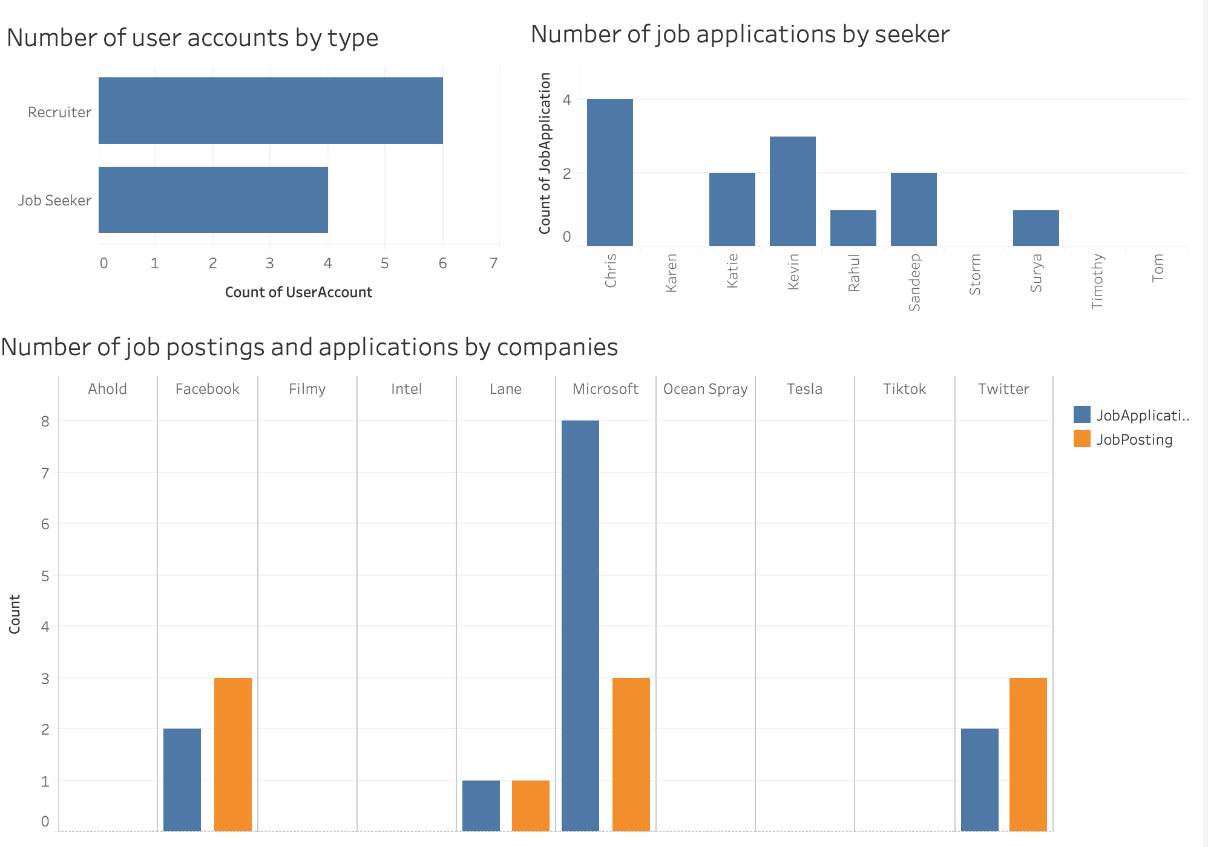

Slide 14
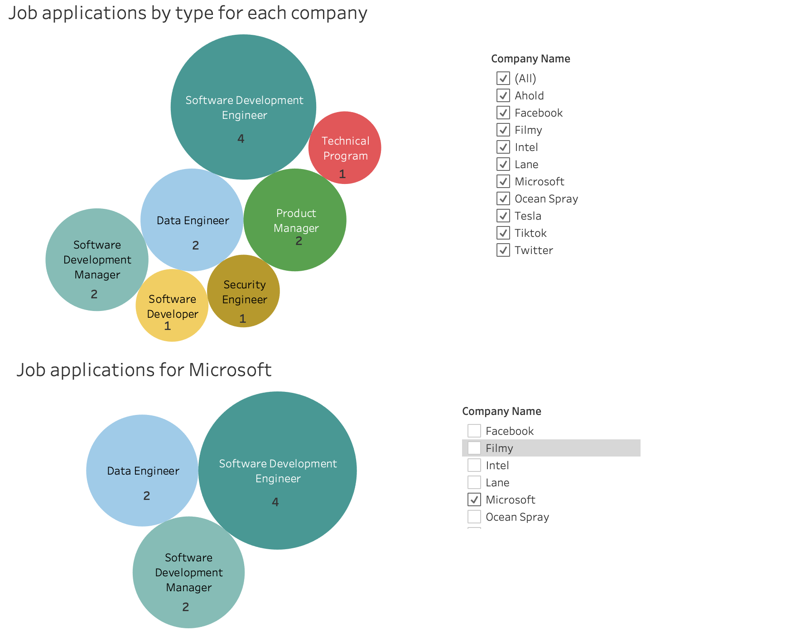

Slide 15
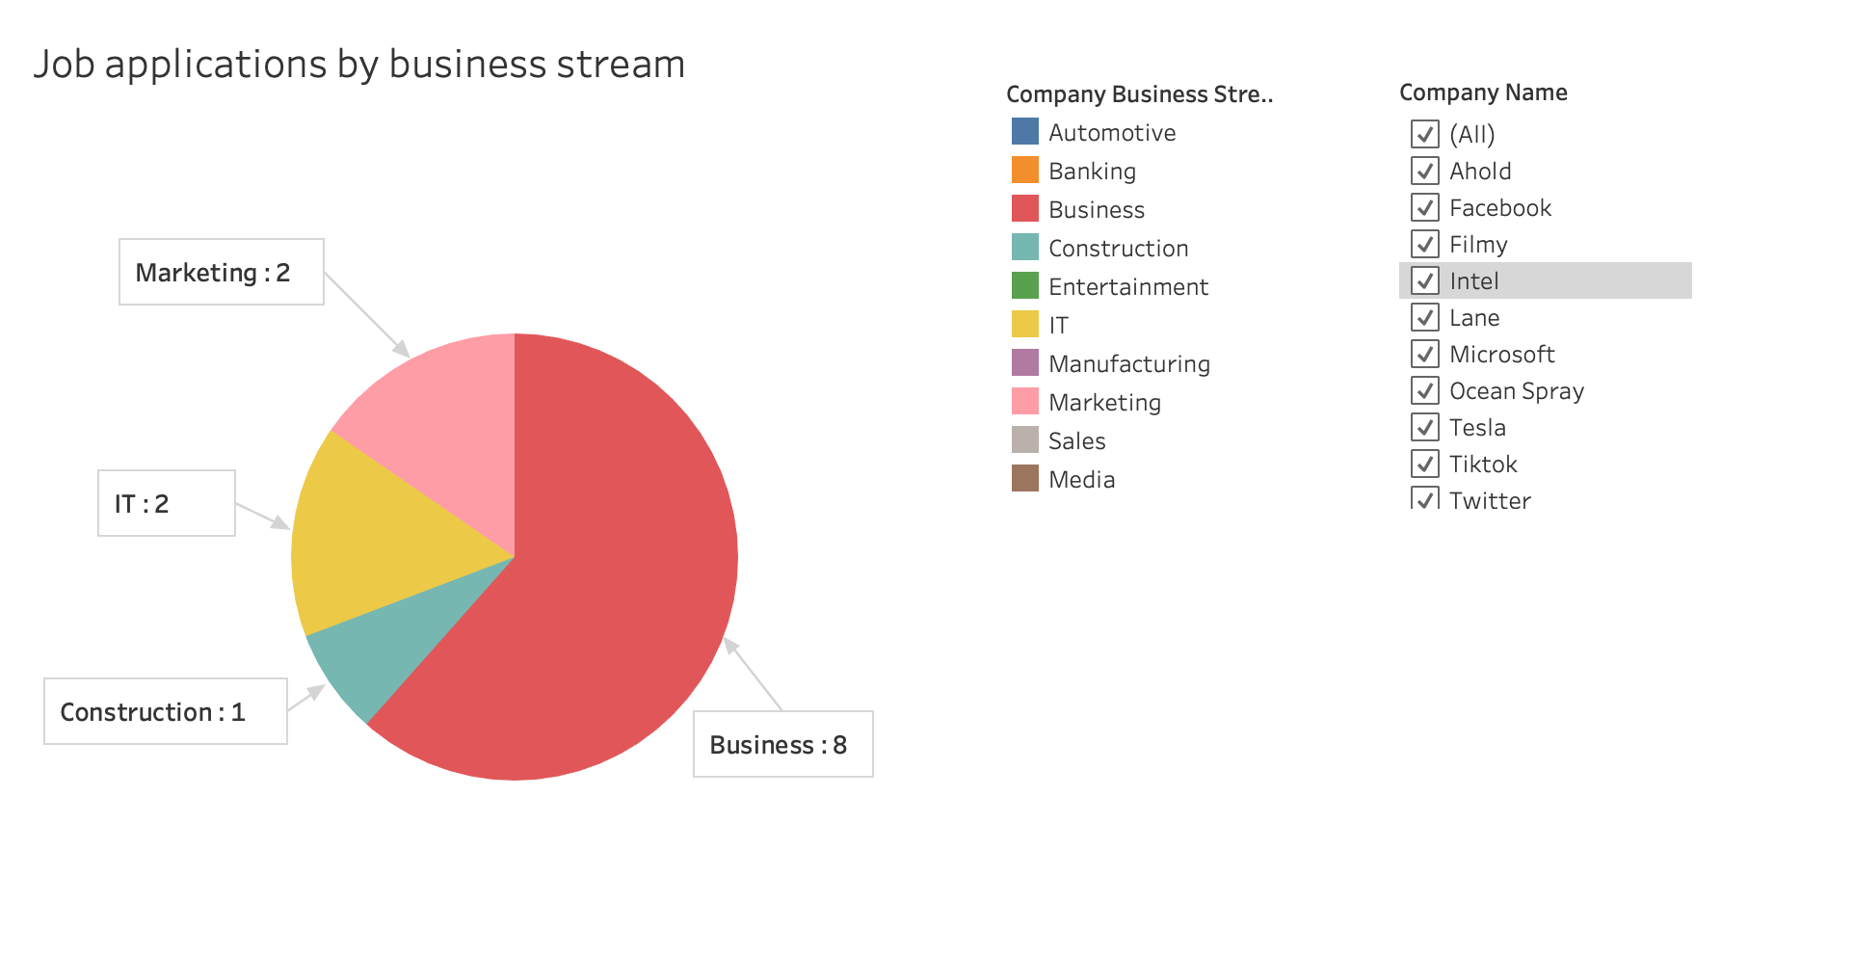

Slide 16



