Slide 1
SENTIMENT ANALYSIS IN MARKETING Phase 4(Development part 2)
NAME : ARUNACHALAM A
NM ID : au513521104005
EMAIL ID : arunpraveen0807@gmail.com
COLLEGE NAME : Annai Mira College of Engineering and Technology

Slide 2
INTRODUCTION
Visualising and counting sentiments of tweets for each airline.
Wordcloud plots for negative tweets to visualise most frequent words for each.
Wordcloud plots for positive tweets to visualise most frequent words for each.
Analysing the reasons for negative tweets for each airline.
Visualising negative tweet-sentiment relationship with dates.
A relationship between negative sentiments and date

Slide 3
Visualising and counting sentiments of tweets for each airline.
print("Total number of tweets for each airline \n ",df.groupby('airline')['airline_sentiment'].count().sort_values(ascending=False))
airlines= ['US Airways','United','American','Southwest','Delta','Virgin America']
plt.figure(1,figsize=(12,12))
for i in airlines:
indices= airlines.index(i)
plt.subplot(2,3,indices+1)
new_df=df[df['airline']==i]
count=new_df['airline_sentiment'].value_counts()
Index = [1,2,3]
plt.bar(Index,count, color=['blue', 'green', 'red'])
plt.xticks(Index,['negative','neutral','positive'])
plt.ylabel('Mood Count')
plt.xlabel('Mood')
plt.title('Count of Moods of '+i)
plt.show()

Slide 4
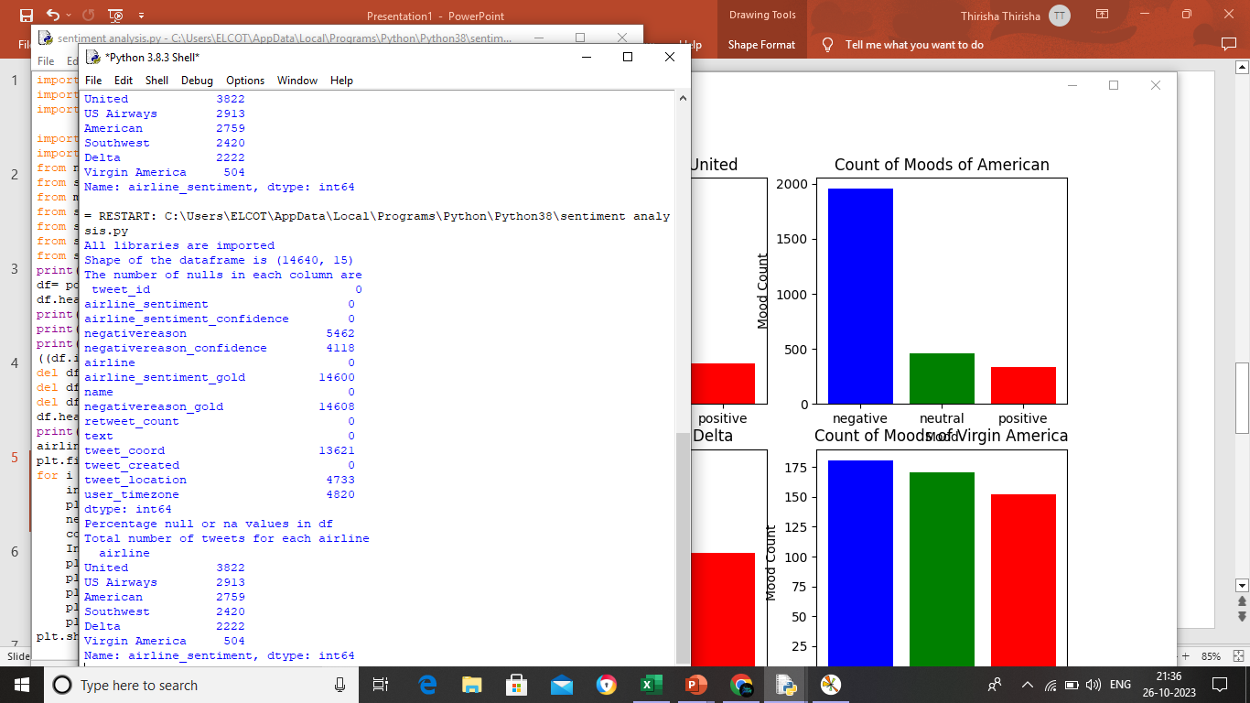
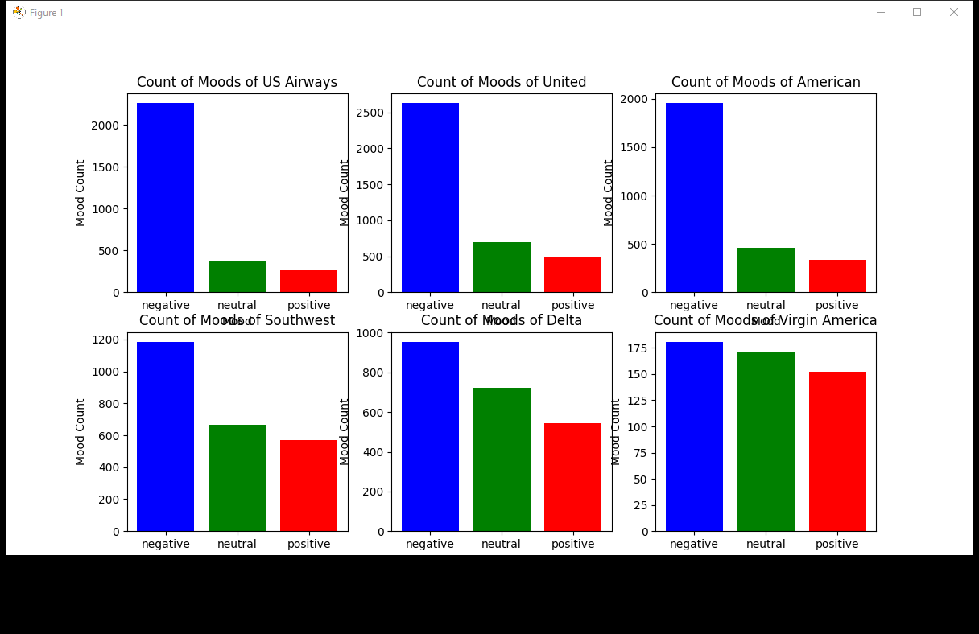
OUTPUT

Slide 5
Wordcloud plots for negative tweets to visualise most frequent words for each.
from wordcloud import WordCloud,STOPWORDS
new_df=df[df['airline_sentiment']=='negative']
words = ' '.join(new_df['text'])
cleaned_word = " ".join([word for word in words.split()
if 'http' not in word
and not word.startswith('@')
and word != 'RT'
])
wordcloud = WordCloud(stopwords=STOPWORDS,
background_color='white',
width=3000,
height=2500
).generate(cleaned_word)
plt.figure(1,figsize=(15, 15))
plt.imshow(wordcloud)
plt.axis('off')
plt.show()

Slide 6
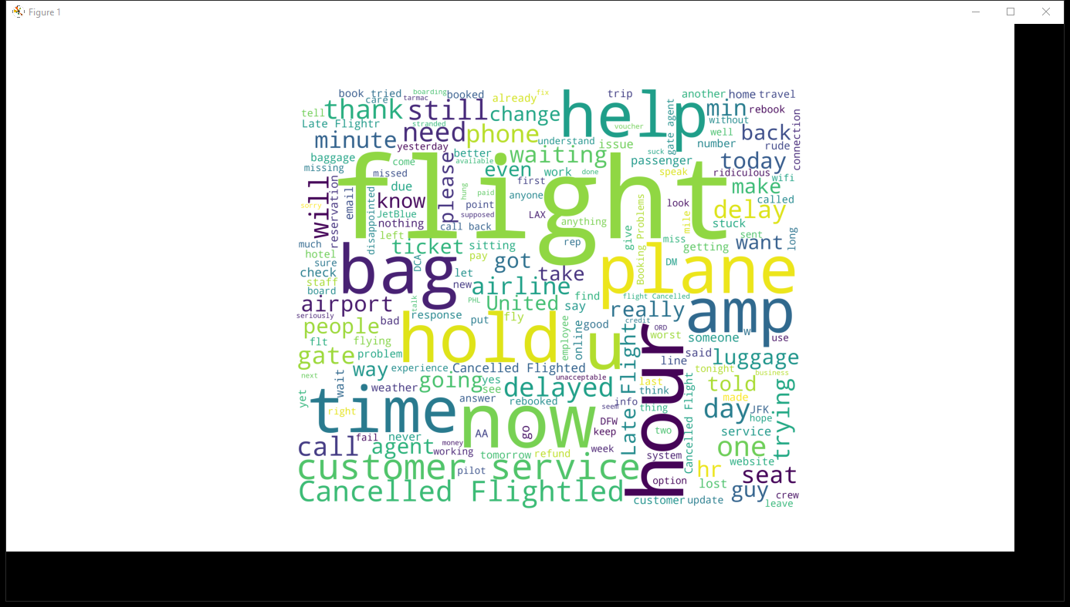
OUTPUT

Slide 7
Wordcloud plots for positive tweets to visualise most frequent words for each
new_df=df[df['airline_sentiment']=='positive']
words = ' '.join(new_df['text'])
cleaned_word = " ".join([word for word in words.split()
if 'http' not in word
and not word.startswith('@')
and word != 'RT'
])
wordcloud = WordCloud(stopwords=STOPWORDS,
background_color='white',
width=3000,
height=2500
).generate(cleaned_word)
plt.figure(1,figsize=(15,15))
plt.imshow(wordcloud)
plt.axis('off')
plt.show()

Slide 8
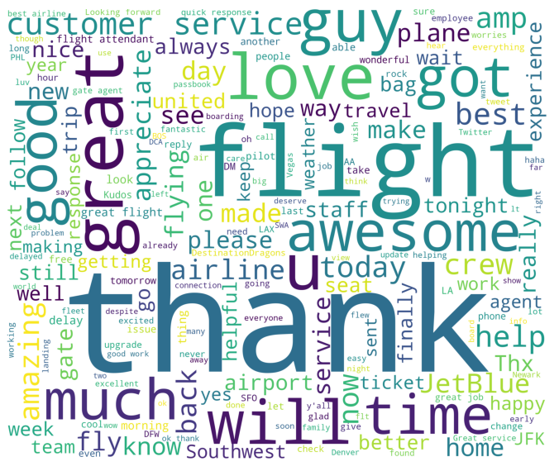
OUTPUT

Slide 9
Visualising negative tweet-sentiment relationship with dates
airlines= ['US Airways','United','American','Southwest','Delta','Virgin America']
df['negativereason'].nunique()
NR_Count=dict(df['negativereason'].value_counts(sort=False))
def NR_Count(Airline):
if Airline=='All':
a=df
else:
a=df[df['airline']==Airline]
count=dict(a['negativereason'].value_counts())
Unique_reason=list(df['negativereason'].unique())
Unique_reason=[x for x in Unique_reason if str(x) != 'nan']
Reason_frame=pd.DataFrame({'Reasons':Unique_reason})
Reason_frame['count']=Reason_frame['Reasons'].apply(lambda x: count[x])
return Reason_frame
def plot_reason(Airline):
a=NR_Count(Airline)
count=a['count']
Index = range(1,(len(a)+1))

Slide 10
plt.bar(Index,count, color=['blue','yellow','red','orange','black','brown','gray','cyan','purple','green'])
plt.xticks(Index,a['Reasons'],rotation=90)
plt.ylabel('Count')
plt.xlabel('Reason')
plt.title('Count of Reasons for '+Airline)
plot_reason('All')
plt.figure(2,figsize=(15,15))
for i in airlines:
indices= airlines.index(i)
plt.subplot(2,3,indices+1)
plt.subplots_adjust(hspace=0.9)
plot_reason(i)
plt.show()

Slide 11
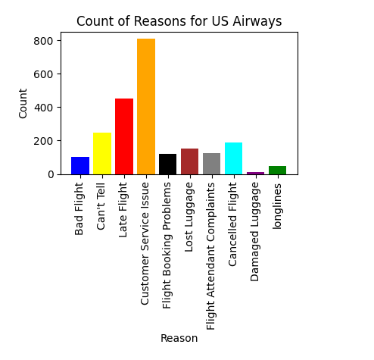
OUTPUT

Slide 12
A relationship between negative sentiments and date
day_df = day_df.loc(axis=0)[:,:,'negative']
#groupby and plot data
ax2 = day_df.groupby(['tweet_created','airline']).sum().unstack().plot(kind = 'bar', color=['blue', 'green', 'red','yellow','orange','purple'], figsize = (15,8), rot = 70)
labels = ['American','Delta','Southwest','US Airways','United','Virgin America']
ax2.legend(labels = labels)
ax2.set_xlabel('Date')
ax2.set_ylabel('Negative Tweets')
plt.show()

Slide 13
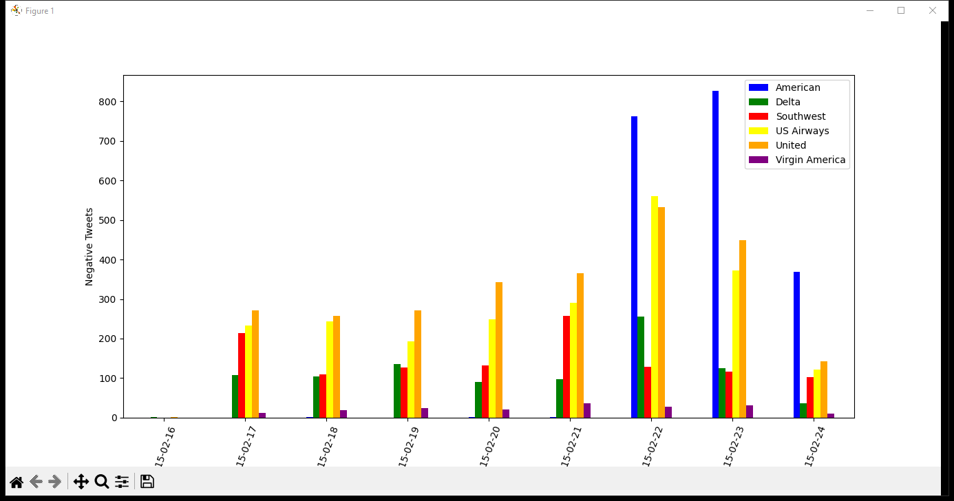
OUTPUT

Slide 14
CONCLUSION
1.Very positive
2.Positive
3.Neutral
4.Negative
5. Very negative
This is usually referred to as graded or fine-grained sentiment analysis, and could be used to interpret 5-star ratings in a review
The AI of sentiment analysis in marketing is very useful to learn the future AI
THANK YOU

