Slide 1
Voting Application Using Block Chain

Slide 2
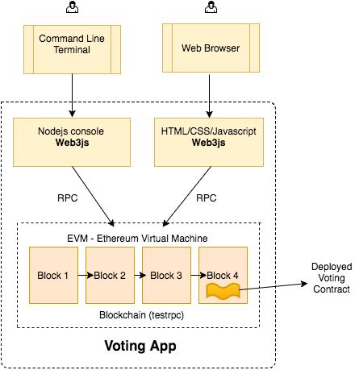
Application Overview

Slide 3
Project Plan
Phase : 1
Develop Complete Application in Locally and Complete the Application
1
2
3
4
5
6
7
Phase : 2
Deploy Application in to Live Etherium Block chain for live run
8
9
10

Slide 4
Current Status ( 3 - 4 Week )
Brain Storming Ideas and research about Block chain
Learn about platforms that we can use for create this app
Get consult from Mr. Bruce
Learn about block chain Data Structure
Decided platforms and Technologies that we using
Create Git Hub Project to Keep team Up to date.
Start Developing Application Locally .

