Slide 1
Software Development Life Cycle ( SDLC )

Slide 2
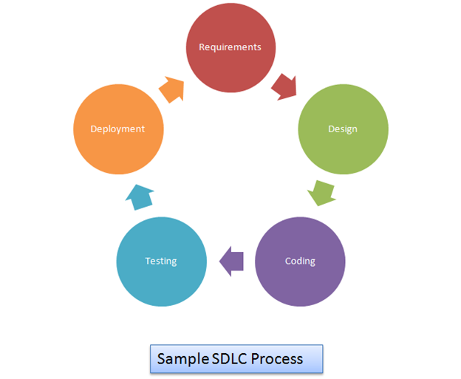
What is SDLC ..?
Software Development life cycle is the Framework that Process define by an Organization to Develop an Application from it inception to decommission …!
Use Security as part of Testing

Slide 3

Why Secure SDLC over SDCL ..?
SDCL Approach
Patching Software after deploy
S-SDLC Approach
Every phase of SDCL Integrate with security

Slide 4
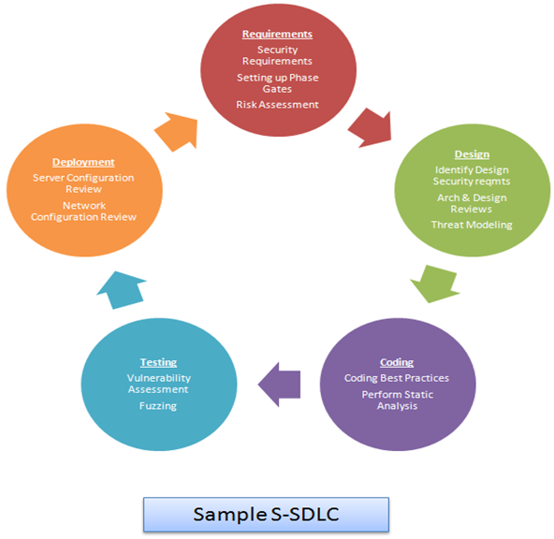
Overview of S-SDLC
Requirements Gathering
Security Requirements
Setting up Phase Gates
Risk Assessment
Design
Identify Design Requirements from security perspective
Architecture & Design Reviews
Threat Modeling
Coding
Coding Best Practices
Perform Static Analysis
Testing
Vulnerability Assessment
Fuzzing
Deployment
Server Configuration Review
Network Configuration Review

