Slide 1

V.AI – Victor

Slide 2







Slide 3



Slide 4
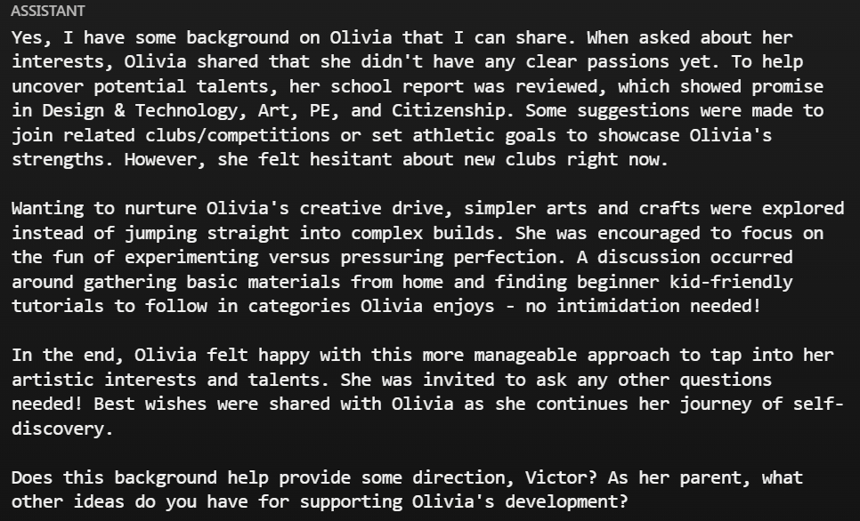


Slide 5
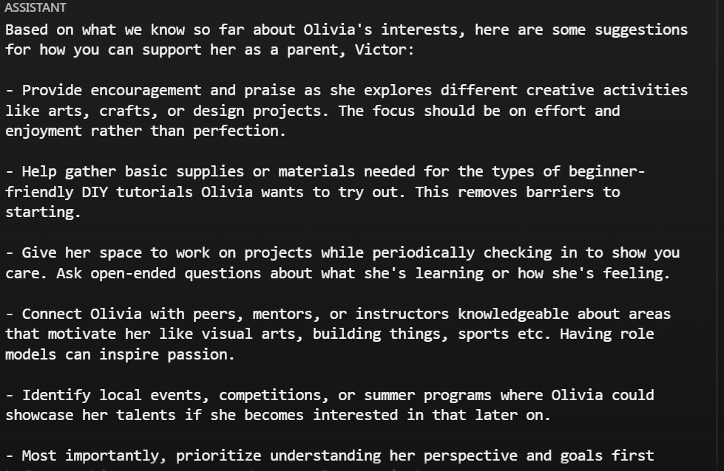



Slide 6




