Slide 1
NGO MANAGEMENT SYSTEM
TEAM 5

Slide 2

PROBLEM STATEMENT
Liver disease and limb loss impact a large number of people globally, with significant consequences on their quality of life.
Access to care and support for these conditions is challenging, and the shortage of organ donors and high cost of prosthetics exacerbate the difficulties faced by affected individuals.
A comprehensive system is needed to provide access to resources and support, and facilitate donor-recipient connections.

Slide 3

Solution offered
The AED Final Project, an NGO management system, can address the challenges faced by individuals with liver disease and limb loss by providing access to resources and support.
The system can also facilitate connections between donors and recipients, addressing the shortage of organ donors for liver transplants and the high cost of prosthetics and rehabilitation services.
Through its comprehensive approach, the NGO management system can improve the quality of life for individuals with these conditions and help them manage their health effectively.

Slide 4
Players and Their contribution
NGO MANAGEMENT System
The project work was a collective hardwork of the team, we have combinedly worked on the UI and Backend. The breakdown of contributions :
Backend
Mails – Arun, Address – Harish. connection – Neha, DB4O – Harish, Employee - Arun Delivery – Harish, Enterprise – Harish, Legal – Arun, Hospital – Neha, Organ – Neha
NGO – Neha, Admin –Arun, Advocate – Arun, Coordination – Harish, Inventory – Harish, Lab –Arun, Limbs – Arun, Role – Harish, Individual roles are handled by respectives User – Neha, User accounts – Harish, Workqueue – Arun.
UI
Main -Arun UI, Admin – Harish, Advocate – Neha, Delivery – Arun, Advocate – Harish, Coordinator – Arun, Donor – Neha, Lab – Harish, Limb – Harish, Receiver – Arun, System Admin – Neha.

Slide 5

USE-CASES
Resource Hub: The Ngo Management System can serve as a centralized resource hub for individuals with liver disease and limb loss, providing them with access to information, support groups, rehabilitation services.
Donor-Recipient Matching: The system can facilitate connections between liver donors and recipients, helping to address the shortage of organs available for transplant. Similarly, the system can connect individuals who are in need of prosthetics with donors or financial assistance programs that can help them afford the cost of these devices.
Tracking and Monitoring: The Ngo Management System can be used to track and monitor the health of individuals with liver disease and limb loss, providing them with personalized recommendations for managing their conditions and alerting them to potential health risks. This feature can help individuals to stay on top of their health and make informed decisions about their care.
Communication and Coordination: The system can facilitate communication and coordination between healthcare providers, social workers, and other support services involved in the care of individuals with liver disease and limb loss. This feature can help to ensure that individuals receive coordinated, high-quality care that addresses all of their needs.

Slide 6

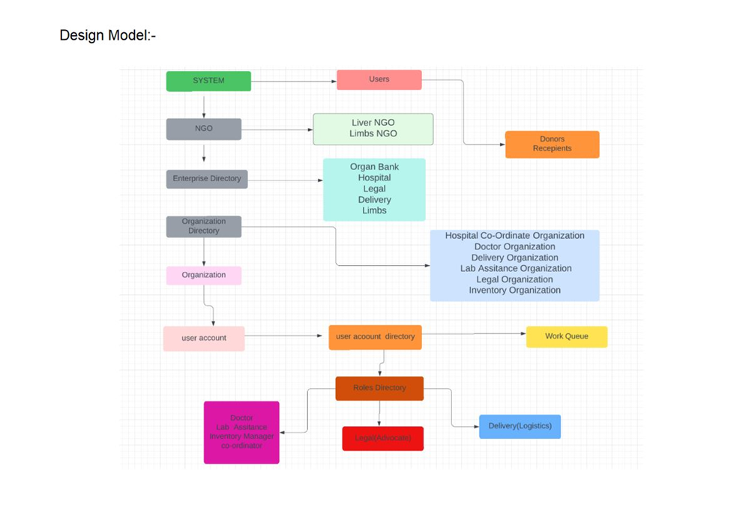
Design of the project

Slide 7

Enterprises roles
Liver Enterprise: The Liver enterprise can be responsible for managing the transplantation process, including donor evaluation, organ procurement, and transplantation surgery. They can also provide medical expertise in the diagnosis, treatment, and management of liver disease and work with the Legal enterprise to ensure that the project is in compliance with all relevant laws and regulations.
Legal Enterprise: The Legal enterprise can provide legal expertise in the areas of healthcare regulations, patient confidentiality, liability, and medical malpractice. They can ensure that the project is in compliance with all relevant laws and regulations, and provide legal advice and support as needed.
Hospital Enterprise: The Hospital enterprise can provide medical care to patients with liver disease and limb loss. They can collaborate with the Liver and Limbs enterprises to provide transplantation surgery and prosthetic or orthotic services. They can also work with the Legal enterprise to ensure that patient confidentiality and privacy are protected.
Delivery Enterprise: The Delivery enterprise can be responsible for the transportation and delivery of medical supplies, drugs, organs, and prosthetics or orthotics. They can ensure that these items are transported safely and efficiently, adhering to all relevant regulatory requirements.

Slide 8
Enterprises roles
5.Limbs Enterprise: The Limbs enterprise can provide prosthetic and orthotic services to people with limb loss. They can collaborate with the Hospital enterprise to ensure that patients receive the necessary care and treatment.
6.Coordination Enterprise: The Coordination enterprise can manage the overall coordination of the project, including communication and networking between users, recruitment of donors and recipients, and fundraising activities. They can also coordinate with other enterprises to ensure that the project's objectives are being met.
7.Inventory Enterprise: The Inventory enterprise can be responsible for managing the procurement, storage, and distribution of medical supplies, drugs, organs, prosthetics, and orthotics required for the treatment and care of people with liver disease and limb loss. They can ensure that these items are available to patients when needed.
8.Lab Enterprise: The Lab enterprise can provide laboratory services to evaluate organ function and monitor the progress of patients with liver disease. They can collaborate with the Liver enterprise to ensure that donors and recipients are evaluated thoroughly and that the transplantation surgery is successful.

Slide 9

Thank You
Neha Reddy damannagari, Arun Balasubramanian, harish rao takkallapally

