Slide 1
Federated Deep Learning for the Diagnosis of Cerebellar Ataxia: Privacy Preservation and Auto-Crafted Feature Extractor
Guide Presented by
Mr. Sudesh Rao Nishmitha
Assistant Professor Gd II 4NM20AI030
Department of AI&ML

Slide 2
Table of contents
Introduction
Literature Survey
Material
Method
Experiments and Evaluation
Conclusion
References

Slide 3
Introduction
Cerebellar Ataxia (CA) is the un-coordinated movement resulting from impaired function of the cerebellum.
The conventional machine learning (ML) approaches involve a broad range of motion sensors to capture ataxic movements.
DL is a representative learning in which the model itself extracts the features needed for pattern recognition from the raw input data called auto-crafted feature extraction.
Federated learning (FL) has emerged as a promising solution that protects the privacy of patient data while achieving DL by distributed AI to combine local (individual-level) and global (group-level) mode.

Slide 4
Literature Survey
The conventional machine learning (ML) approaches involve a broad range of motion sensors to capture ataxic movements.
Traditional ML is limited by feature selection, impacting accuracy.
Proposed method is diverse sensor-based approaches enhance ataxia diagnosis. DL combined with FL improves accuracy and data privacy.
Experimental results indicate that the recurrence plot yields the highest validation accuracy (86.69%) with MobileNetV2 model in diagnosing CA.

Slide 5
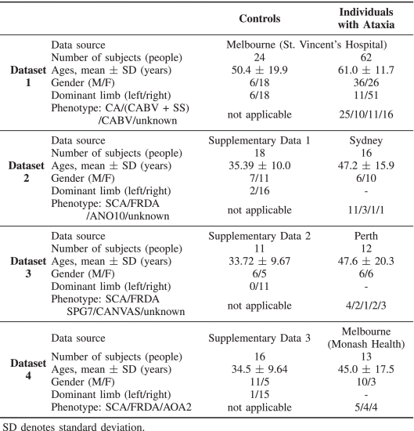
Materials
Datasets in this study were provided by four clinics, located in three Australian states
Two time synchronized IMU sensors were attached in the midline to the back at the level of the fourth thoracic vertebra and the chest at the manubriosternal joint
The IMU sensor recorded data for 30 seconds with the eyes open and 30 seconds with the eyes closed. The subject repeated the protocol with their feet together and apart.

Slide 6
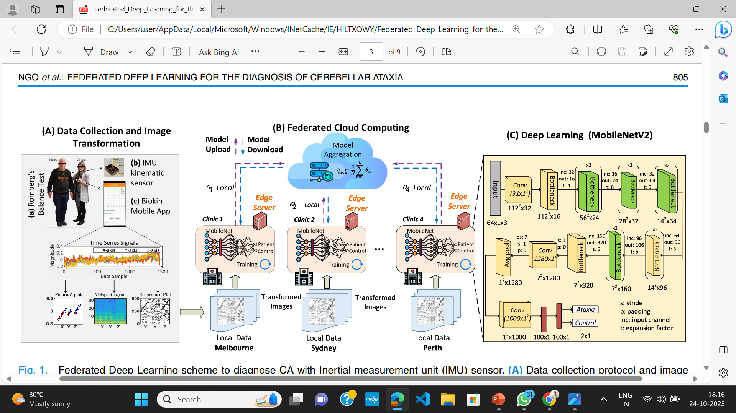
Federated Deep Learning scheme to diagnose CA with Inertial measurement unit (IMU) sensor.

Slide 7
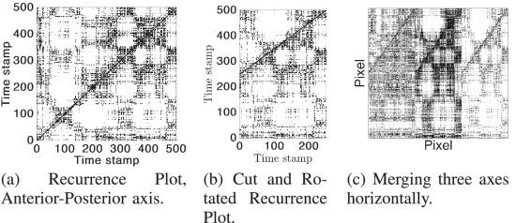
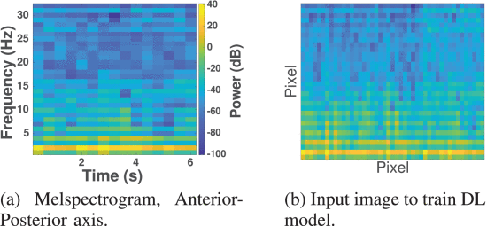
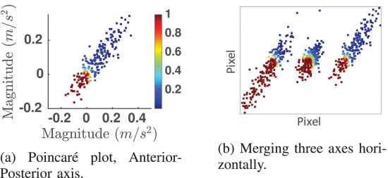
Methods
Signal Pre-Processing
Interpolating and sliding a fixed-sized window with two second overlapping was used to pre-process the raw data.
Image Transformation Techniques

Slide 8
Methods
Deep Learning Models
MobileNetV2
ResNet101V2
DenseNet
VGG16
Transfer Learning
Transfer learning is employed to reuse pre-existing knowledge when data is limited, with a pre-trained model as a fixed feature extractor.
The last fully connected layer is replaced with trainable layers to distinguish ataxia from healthy controls in a diagnosis-specific setup.

Slide 9
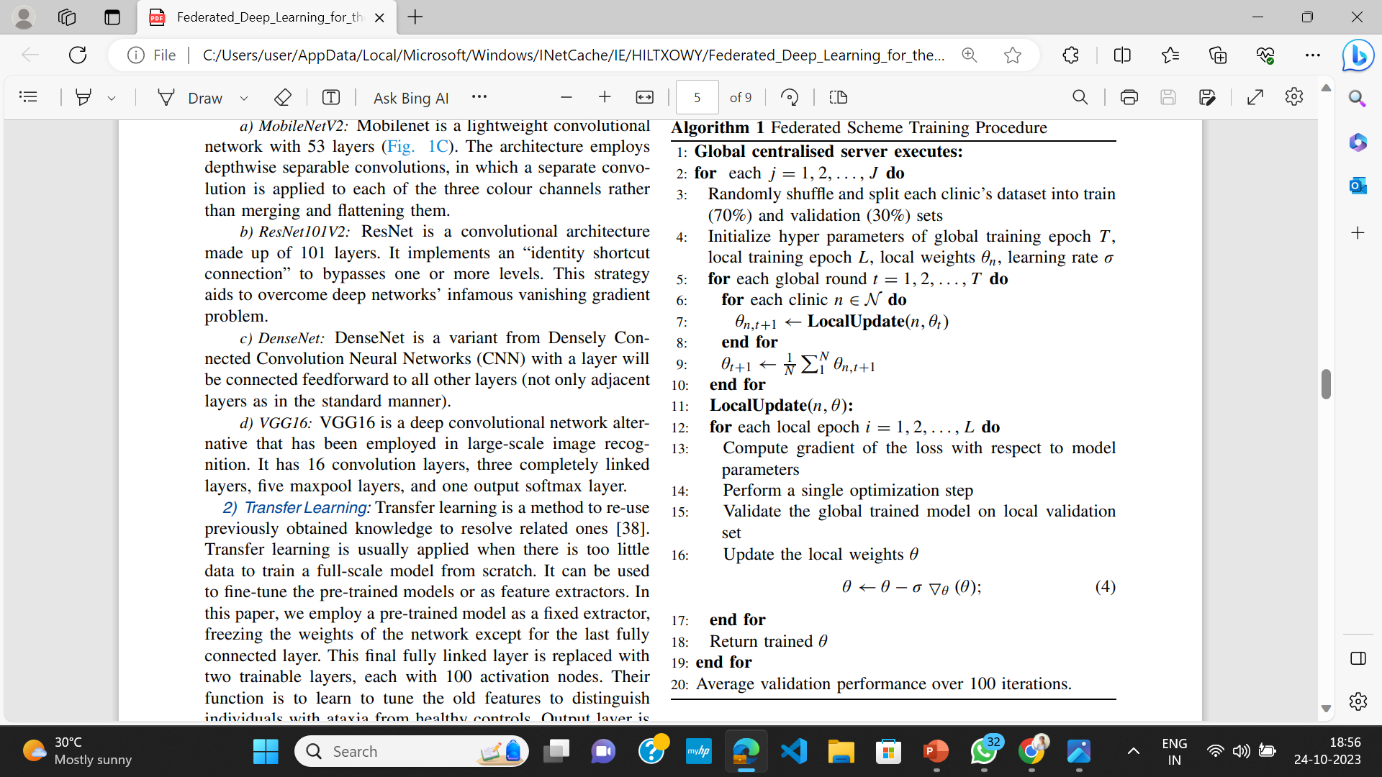
Algorithm

Slide 10
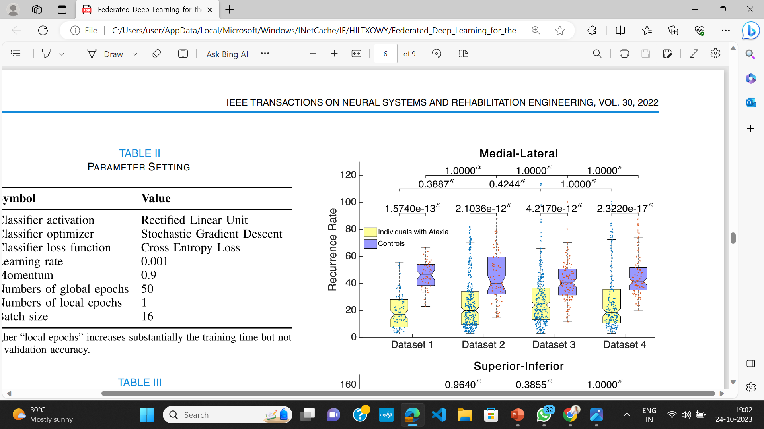
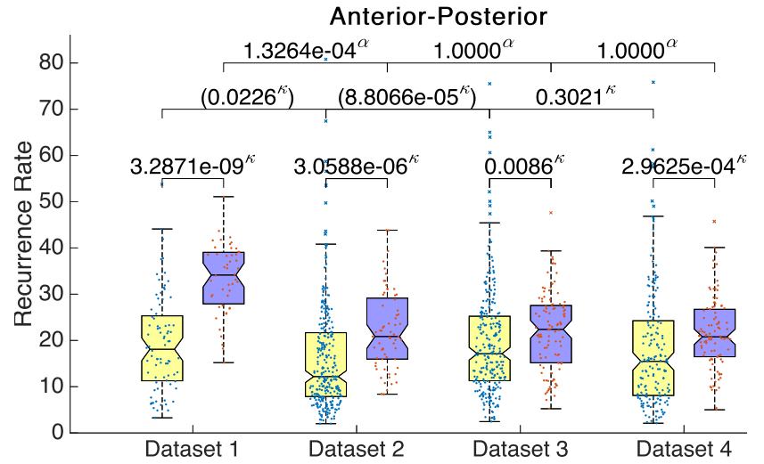
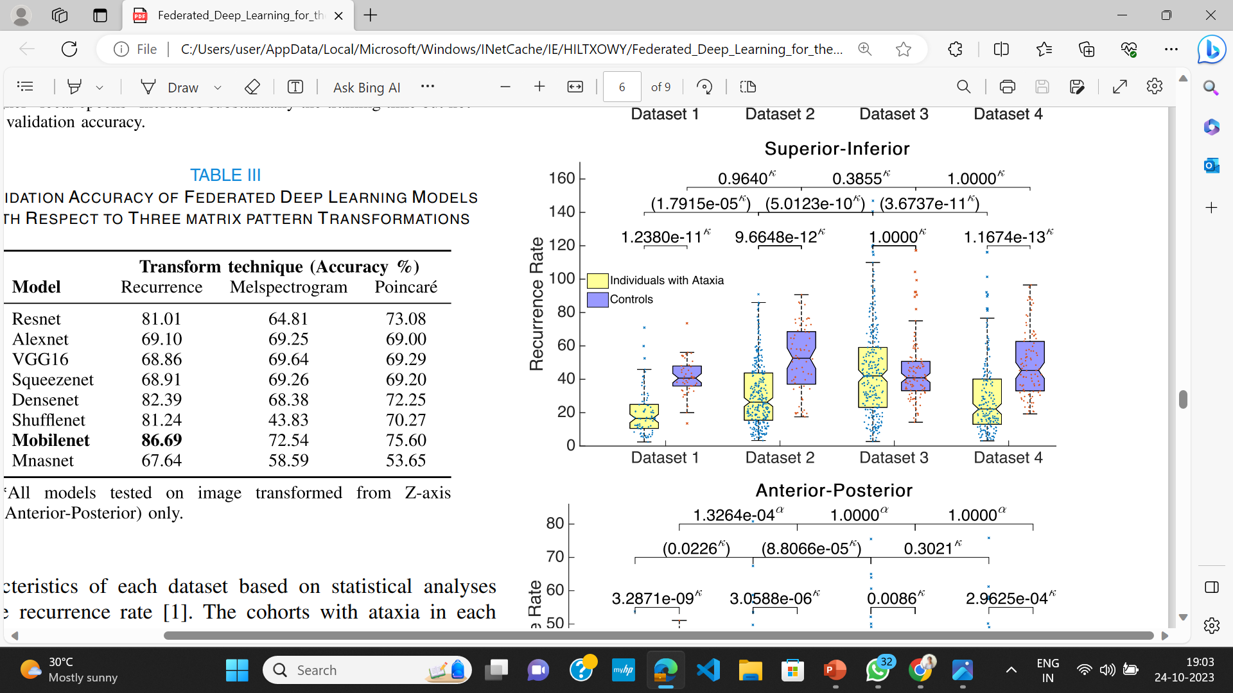
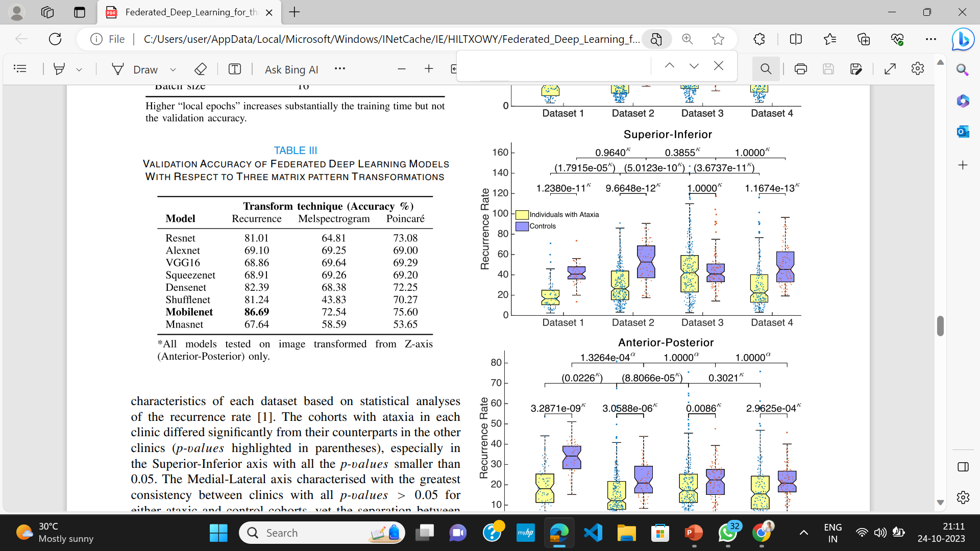
Experiments and Evaluations
Diagnostic Results

Slide 11
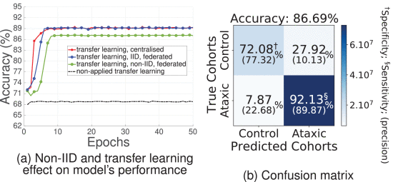
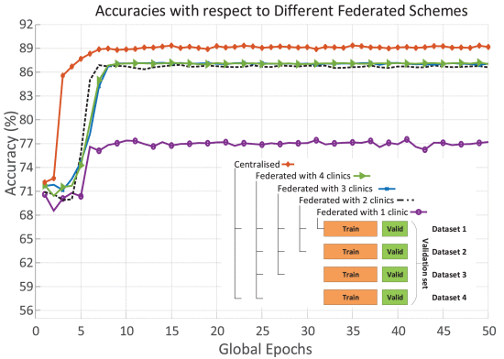
Experiments and Evaluations
Effect of Transfer Learning and IID Dataset on Performance of FL Model

Slide 12
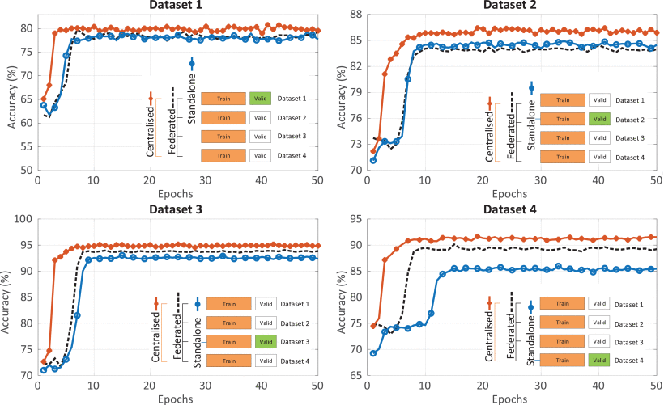
Experiments and Evaluations
Performance Evaluations on Federated Deep Learning

Slide 13
Conclusion
This study proposed a novel scheme to utilize image transformation-based approach on DL framework integrated with FL for the CA diagnosis
The results of the analysis indicated the possibility to classify 86.69% accurate using a lightweight convolutional architecture (MobileNetV2) with the recurrence plot transformer
It saved analysis and deployment time by eliminating the laborious work of feature extraction.
The FL enables privacy protection for the participant clinics with a deployable and practical scheme for implementation

Slide 14
References
Thang Ngo, "Federated Deep Learning for the Diagnosis of Cerebellar Ataxia: Privacy Preservation and Auto-Crafted Feature Extractor," in IEEE Access, vol. 30, pp. 803-811, 2022, Doi: 10.1109/TNSRE.2022.3161272.
Qiong Wu, "Personalized Federated Learning for Intelligent IoT Applications: A Cloud -Edge Based Framework ," in IEEE Access, vol. 1, pp. 35-44, 2020, Doi: 10.1109/OJCS.2020.2993259
T. Ngo et al., “Balance deficits due to cerebellar ataxia: A machine learning and cloud-based approach,” IEEE Trans. Biomed. Eng., vol. 68, no. 5, pp. 1507–1517, 2021,Doi: 10.1109/TBME.2020.3030077

Slide 15
THANK YOU

