Slide 1
Predicting Sediment Particle Size Distributions with Machine Learning
Random Forest vs Support Vector Regression
UE24CS352A · Machine Learning Mini-Project
Problem Number: 62
Arnav Chaudhary : PES1UG24CS081
Arundhathi K : PES1UG24CS082
Notes:
Introduce the project: we predict two properties of suspended sediment particles (median size d50 and size variance) from eight measurements, comparing Random Forest and SVR. Mention we followed Egan's paper and used synthetic data.

Slide 2
Settling models need particle size
Why it matters
8 measured inputs
salinity, temperature, wave and tidal velocity, refractive index, chlorophyll-a, two optical ratios
Settling velocity drives sediment transport, carbon burial, contaminant spread and coastal erosion.
The difficulty
Settling depends on particle size, which changes within seconds as particles clump and break apart (flocculation). Existing models are tuned to single sites.
Random Forest / SVR
regression models
Our question
Can a regression model predict median diameter d50 and size variance σ² from routine water measurements?
d50 and σ²
median size (µm) and variance (µm²)
Notes:
Explain flocculation simply: particles stick together and break up in seconds, so size is hard to predict with fixed formulas. The paper asks whether machine learning can learn the relationship from data. We frame it as regression with two targets.

Slide 3
A synthetic stand-in for the field data
5000
8
Hydrodynamic
wave-induced velocity, mean tidal velocity
samples
input features
Water chemistry
salinity, temperature
2
80 / 20
Optical / biological
targets: d50, σ²
train / test split
particle refractive index, chlorophyll-a, two optical peak ratios
Synthetic by design. Targets are illustrative functions of the inputs plus Gaussian noise (σ = 12 µm for d50, 8 µm² for σ²), not validated sediment physics. The noise sets a ceiling on achievable R²: 0.930 for d50, 0.958 for σ²
Notes:
The original field data was not available, so we generated data with the same variables. Be upfront: the targets are formulas plus noise. Because we know the noise, we can compute the best R² any model could get - the noise ceiling.

Slide 4
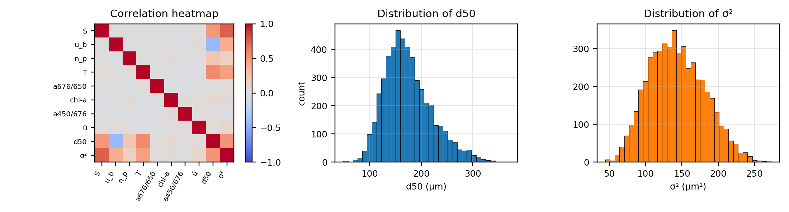
Salinity and temperature drive both targets
Positive drivers
Wave velocity
Weak features
Salinity and temperature correlate positively with both d50 and σ².
Correlates −0.43 with d50 but +0.39 with σ²: the wave × salinity interaction wins for d50.
Tidal velocity, chlorophyll-a and the two optical ratios are near zero correlation.
Notes:
Both targets are roughly bell-shaped. Point out the heatmap: salinity and temperature are the red cells against d50 and variance. Wave velocity is negative for d50. The remaining four inputs are almost white.

Slide 5
Five steps, test set touched only once
1
2
3
4
5
Split
Select features
Tune RF
Tune SVR
Evaluate
20 % test set held out; everything else for tuning.
Random Forest importance, keep the top 4.
Number of trees from the out-of-bag score.
C, ε, γ by 3-fold cross-validation.
R², MAE, RMSE on test; 5-fold CV as a check.
No leakage: scaling happens inside the pipeline, so validation folds never influence it. Models: one Random Forest per target, and RBF-kernel SVR with standardised inputs and targets.
Notes:
Walk through the five steps. Stress that the test set is used once at the end, and that feature scaling is inside the pipeline so cross-validation is honest.

Slide 6
Four features carry almost all the signal
Top 4 kept
Salinity, temperature, wave velocity and refractive index.
Methods agree
Impurity and permutation importance give the same ranking.
Cheap to drop the rest
Removing the other four lowers test R² by only 0.004
to 0.005.
Read with care
Importance mirrors the coefficients we chose; it checks the method, not the physics.
Notes:
Salinity dominates variance (0.56); for d50 salinity, temperature and wave velocity are comparable. The bottom four are near zero. Be honest that this matches the generator, so it validates the method rather than discovering physics.

Slide 7
Tuning: 100 trees, small SVR grid
Model | Target | Chosen setting
Random Forest | d50, σ² | 100 trees
SVR (RBF) | d50 | C = 10, ε = 0.1, γ = 0.1
SVR (RBF) | σ² | C = 1, ε = 0.1, γ = 0.1
Random Forest. OOB R² is flat from about 20 trees (5 trees scores below zero); we took the smallest count within 0.002 of the best, which is 100.
SVR. 18 combinations of C, ε, γ by 3-fold CV (CV R² 0.920 for d50, 0.945 for σ²). The σ² optimum sits at the lowest C in the grid; scores barely change for larger C.
Notes:
The OOB score is a free validation estimate: each tree is scored on samples it did not train on. For SVR we kept the grid small. If asked: C=1 is the lowest value tried for variance, but the score hardly moves with larger C.

Slide 8
SVR edges out RF, both near the ceiling
Target | Model | MAE | RMSE | CV R²
d50 (µm) | RF | 11.24 | 13.95 | 0.905
d50 (µm) | SVR | 10.49 | 12.97 | 0.920
σ² (µm²) | RF | 7.98 | 9.86 | 0.934
σ² (µm²) | SVR | 7.11 | 8.86 | 0.946
Held-out test set, 1000 samples. 5-fold CV on all data agrees with the test scores (spread ≤ 0.005). Using all 8 features instead of 4 gives RF test R² of 0.914 and 0.939.
Notes:
Headline numbers: SVR 0.921 and 0.948 versus RF 0.909 and 0.936. SVR is within about 0.01 of the noise ceiling (0.930 and 0.958); RF is within about 0.02. The y-axis starts at 0.80 so differences are visible; say that out loud.

Slide 9
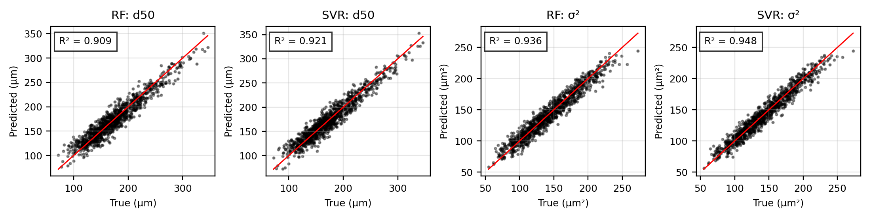
Predictions track the true values
Close to the 1:1 line
Where RF struggles
Typical error is about 10 µm on d50 (6 % of its mean) and 7 µm² on σ² (5 %).
Random Forest flattens at the extremes because trees cannot extrapolate beyond the training range.
Notes:
Red line is a perfect prediction. SVR points cluster tighter, especially at the high end. The RF flattening at extremes is a known property of tree ensembles.

Slide 10
What the results tell us
Near the ceiling
SVR suits smooth targets
SVR is within about 0.01 R² of the best possible score and RF within about 0.02, so both learned most of the structure; the rest is injected noise.
An RBF kernel fits smooth surfaces more naturally than piecewise-constant trees, hence the small, consistent edge.
Four sensors are enough
Not comparable to the paper
Dropping four uninformative features costs almost nothing, which is the practical point for field campaigns.
Egan reports 0.81 and 0.75 (RF) on real data. Ours are higher because our noise is low and the relationship is known.
Notes:
Keep the last card in mind for Q&A: someone will ask why our R-squared is higher than the paper. Answer: synthetic data with small noise, so it is not a like-for-like comparison.

Slide 11
Limitations and next steps
Limitations
Next steps
The data is synthetic, so scores show the pipeline works, not that it predicts real flocculation.
Inputs are independent and uniform; field data is correlated and time-dependent.
Importance rankings reflect the coefficients we chose.
Generalisation to other sites was not tested.
Run the same pipeline on real field data.
Add correlated inputs and heavier noise.
Widen the SVR grid (lower C for σ²).
Test cross-site generalisation, as the paper proposes.
Notes:
Being upfront about limitations is a strength in the review. The most important is the first: the data is synthetic.

Slide 12
Demo and Q&A
github.com/ArundhathiK29/ml-sediment-mini-project
pip install -r requirements.txt
jupyter notebook ml_mini_project.ipynb → Restart & Run All
Notes:
Run the notebook live (or show the saved outputs). Sections to show: data generation, feature importance, tuning, final test table, prediction plots.

