Slide 1
DAMG 6210 Database Design
Nik Bear Brown
@NikBearBrown
Entity Relationship Model (ERM)

Slide 2
Topics
Entity Relationship Model (ERM)
Entity Sets
Relationship Sets
Design Issues
Mapping Constraints
Keys
E-R Diagram
Extended E-R Features
Design of an E-R Database Schema
Reduction of an E-R Schema to Tables

Slide 3
Database Design Process
Requirement collection and analysis
DB requirements and functional requirements
Conceptual DB design using a high-level model
Easier to understand and communicate with others
Logical DB design (data model mapping)
Conceptual schema is transformed from a high-level data model into implementation data model
Physical DB design
Internal data structures and file organizations for DB are specified
Notes:
2

Slide 4
Conceptual Design
Conceptual design: (ER Model is used at this stage.)
What are the entities and relationships in the enterprise?
What information about these entities and relationships should we store in the database?
What are the integrity constraints or business rules that hold?
A database `schema’ in the ER Model can be represented pictorially (ER diagrams).
An ER diagram can be mapped into a relational schema.
Notes:
2

Slide 5
Entity-Relationship Model (ERM)
Entity Sets
Relationship Sets
Design Issues
Mapping Constraints
Keys
E-R Diagram
Extended E-R Features
Design of an E-R Database Schema
Reduction of an E-R Schema to Tables

Slide 6
ERM Definitions
An entity is an object in an abstract world.
An attribute of an entity can have a value from a value set (domain)
Each entity belongs to some one entity type s.t. entities in one entity type have the same attributes (so each entity type is a set of similar entities).

Slide 7
ERM Definitions
A key attribute of an entity type is one whose value uniquely identifies an entity of that type.
A combination of attributes may form a composite key.
If there is no applicable value for an attribute that attribute is set to a null value.

Slide 8
Entity Sets
A database can be modeled as:
a collection of entities,
relationship among entities.
An entity is an object that exists and is distinguishable from other objects.
Example: person, tweet, company, event, film (a thing, a noun)
Entities have attributes
Example: people have names and addresses
An entity set is a set of entities of the same type that share the same properties.
Example: set of all persons, companies, tweets

Slide 9
ER Model Basics
Entity: Real-world object distinguishable from other objects. An entity is described (in DB) using a set of attributes.
Entity Set: A collection of similar entities. E.g., all employees.
All entities in an entity set have the same set of attributes. (Until we consider ISA hierarchies, anyway!)
Each entity set has a key.
Each attribute has a domain.
Notes:
3
The slides for this text are organized into several modules. Each lecture contains about enough material for a 1.25 hour class period. (The time estimate is very approximate--it will vary with the instructor, and lectures also differ in length; so use this as a rough guideline.) This covers Lectures 1 and 2 (of 6) in Module (5).
Module (1): Introduction (DBMS, Relational Model)
Module (2): Storage and File Organizations (Disks, Buffering, Indexes)
Module (3): Database Concepts (Relational Queries, DDL/ICs, Views and Security)
Module (4): Relational Implementation (Query Evaluation, Optimization)
Module (5): Database Design (ER Model, Normalization, Physical Design, Tuning)
Module (6): Transaction Processing (Concurrency Control, Recovery)
Module (7): Advanced Topics

Slide 10
ER Model Example - Twitter
We want to model a Twiiter user and a tweet?
Entities?
Entity Sets?
entity attributes. (Until we consider ISA hierarchies, anyway!)
Each entity set has a key.
Each attribute has a domain.
Notes:
3
The slides for this text are organized into several modules. Each lecture contains about enough material for a 1.25 hour class period. (The time estimate is very approximate--it will vary with the instructor, and lectures also differ in length; so use this as a rough guideline.) This covers Lectures 1 and 2 (of 6) in Module (5).
Module (1): Introduction (DBMS, Relational Model)
Module (2): Storage and File Organizations (Disks, Buffering, Indexes)
Module (3): Database Concepts (Relational Queries, DDL/ICs, Views and Security)
Module (4): Relational Implementation (Query Evaluation, Optimization)
Module (5): Database Design (ER Model, Normalization, Physical Design, Tuning)
Module (6): Transaction Processing (Concurrency Control, Recovery)
Module (7): Advanced Topics

Slide 11
Twitter API
https://dev.twitter.com/
https://dev.twitter.com/rest/public
https://dev.twitter.com/rest/public/search
Notes:
3
The slides for this text are organized into several modules. Each lecture contains about enough material for a 1.25 hour class period. (The time estimate is very approximate--it will vary with the instructor, and lectures also differ in length; so use this as a rough guideline.) This covers Lectures 1 and 2 (of 6) in Module (5).
Module (1): Introduction (DBMS, Relational Model)
Module (2): Storage and File Organizations (Disks, Buffering, Indexes)
Module (3): Database Concepts (Relational Queries, DDL/ICs, Views and Security)
Module (4): Relational Implementation (Query Evaluation, Optimization)
Module (5): Database Design (ER Model, Normalization, Physical Design, Tuning)
Module (6): Transaction Processing (Concurrency Control, Recovery)
Module (7): Advanced Topics

Slide 12
Twitter API JSON
https://dev.twitter.com/rest/reference/get/statuses/user_timeline
https://api.twitter.com/1.1/statuses/user_timeline.json
Notes:
3
The slides for this text are organized into several modules. Each lecture contains about enough material for a 1.25 hour class period. (The time estimate is very approximate--it will vary with the instructor, and lectures also differ in length; so use this as a rough guideline.) This covers Lectures 1 and 2 (of 6) in Module (5).
Module (1): Introduction (DBMS, Relational Model)
Module (2): Storage and File Organizations (Disks, Buffering, Indexes)
Module (3): Database Concepts (Relational Queries, DDL/ICs, Views and Security)
Module (4): Relational Implementation (Query Evaluation, Optimization)
Module (5): Database Design (ER Model, Normalization, Physical Design, Tuning)
Module (6): Transaction Processing (Concurrency Control, Recovery)
Module (7): Advanced Topics

Slide 13



Social Network Applications

Slide 14
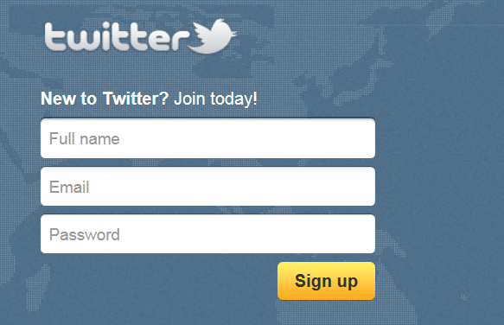
Accounts are free
Notes:
If you don’t already have one, sign up for a Twitter account.
Pick your user name carefully, because you will be stuck with it.

Slide 15
Using Twitter
Skills: familiarity with the Twitter user interface and major features, using the hashtag (#) and at-sign (@), searching and tweeting images and videos
Concepts: evolution of Twitter applications and access modes, citizen journalism, trending topics and finding people as well as information
Notes:
We present Twitter’s major features by looking at the home, discover and connect views as well as the user’s profile view.
We will see that Twitter has evolved over the years and is now commonly used to discover interesting people and information. Citizen journalists use it to report on current events.

Slide 16
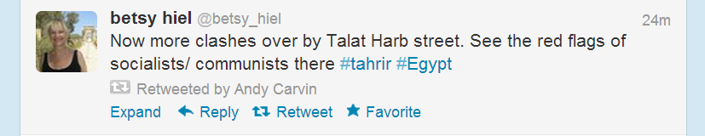
Mark, re-tweet, reply or expand
Notes:
Rolling your cursor over a tweet allows you to mark it as a favorite, re-tweet it, reply to or expand it.
If you re-tweet it, it will be posted in your tweet stream and your followers will see it.
In this example, Andy Carvin has re-tweeted Betsy Hiel’s post.
Replying let’s you tweet a reply to the person who had posted it.
If they enable notifications, they will also receive your reply by email.
Opening it shows information about the Tweet.
Twitter counts messages, re-tweets and favorite in order to single out important or trending tweets.
Note that this tweet is 24 minutes old – it is describing a protest in real time.
Let’s look at another helpful video before checking out more Twitter features.

Slide 17

Watch this video
http://commoncraft.com/twitter-search
Notes:
Pause and watch this video.
It will show you how you can search for tweets.

Slide 18
Two special characters
@username: specify a particular Twitter user
Hashtag (#): tag posts on a given topic
@username: at beginning of tweet is private DM
140 character limit
Notes:
Two special characters, @ and #, were used in the search video.
We mentioned earlier that, if you reply to a tweet, you send a message to the person who posted it.
Personal identifiers begin with an at sign (@) followed by the name of the Twitter user.
Hashtags are terms that are preceded by the number or hash sign (#).
If everyone agrees to include a certain hashtag in their tweets on a given topic, it will be easy to retrieve them.
Let’s look at a hashtag search example.

Slide 19
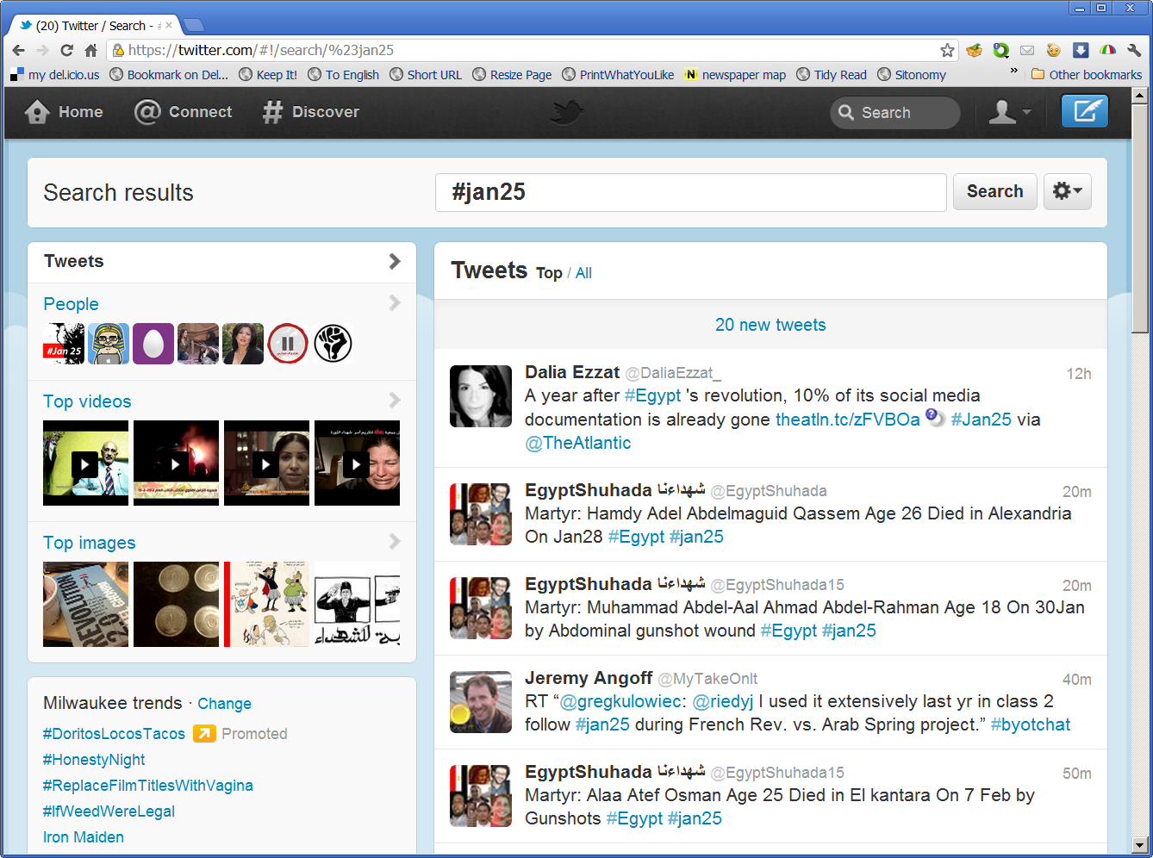
Search for #Jan25
Notes:
The hashtag #Jan25 was used to organize the first day of protests in Egypt’s 2011 political protests.
People agreed to use it in tweets relevant to the demonstrations and revolution.
As you see above, I searched for #Jan25 during the spring of 2011.
The latest tweets at that time are shown on the right.
On the left you see people – prominent journalists and activists – who have used the #Jan25 hashtag in tweets.
They are chosen automatically by a program that considers the number of people who like, re-tweet and reply to their posts.
Below those, you see links to similarly popular images and videos.

Slide 20

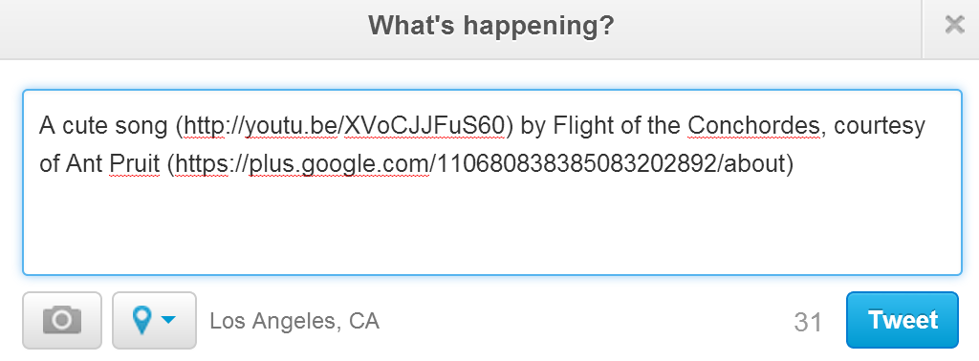

Tweets with videos
I have typed 146 characters, but Twitter says I have 31 more. Why is it letting me type more than 140 characters?
Notes:
A link to a video is inserted in this post.
As you see, the links are shortened by Twitter, saving character space.

Slide 21
Resources
Twitter support:
https://support.twitter.com/
A video introduction to Twitter:
http://screencast.com/t/Sf1wAW8ta
A “Prezi” of the above video:
http://bit.ly/fQ3pbK
Book about the use of Twitter in business by tech journalist Julio Ojeda-Zapata:
http://yourtech.typepad.com/twitinbiz/
Interview of Juilio Ojeda Zapata on his use of Twitter as a journalist (audio and transcript).
http://www.onthemedia.org/transcripts/2008/08/22/06
Introduction to Twitter in business:
http://business.twitter.com/
Twitter search in plain English (3m 19s video):
http://commoncraft.com/twitter-search
Talk by Clay Shirky, which includes examples of Twitter in citizen journalism:
http://cis275topics.blogspot.com/2010/09/how-social-media-can-make-history.html
Interview of Twitter co-founders on their backgrounds, Twitter evolution and plans for the future:
http://cis275topics.blogspot.com/2010/09/evolution-and-impact-of-twitter.html

Slide 22

Tie goals to metrics to measure success
How Will You Measure Success?
Twitter
Traffic
Leads
Sales
Coupon Redemption
Contest Entries
Mentions
Retweets
@Replies
Qualified Follows
Posting/Engagement Consistency
Website
Notes:
Traveling Transcripts – Awareness/Branding – Mentions, RTs, @Replies, Qualified Follows - Traffic

Slide 23
Tools used to track metrics
How Will You Measure Success?
Twitter
Traffic
Leads
Sales
Coupon Redemption
Contest Entries
Mentions
Retweets
@Replies
Qualified Follows
Posting/Engagement Consistency
Website
Hootsuite
Buffer
TrueSocialMetrics
Twitter Lists
Google Analytics
eCommerce
In-store

Slide 24
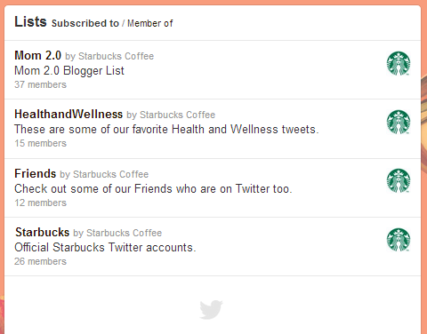
Segment your audience with Twitter lists
Who Do You Want to Build a Relationship With?
Current Customers
Sales Leads
Bloggers
Employees
Competition
Thought Leaders
Geography
Industries
Notes:
Relocation Companies, Schools Brides-to-Be, Caterers/Halls
Qualified Follows

Slide 25
Find great content to share
How Will You Build the Relationship?
Twitter Lists
Hashtags
Keywords
Follow Blogs
Newsletters
Pinterest
Google+
Delicious
AllTop

Slide 26
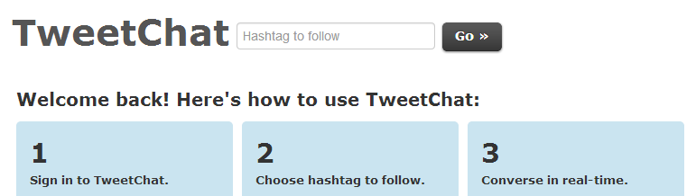
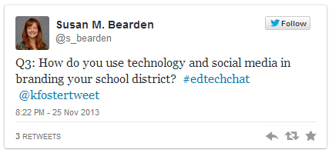

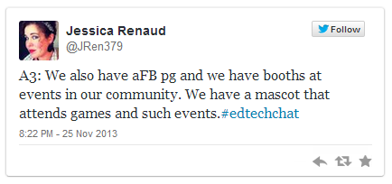
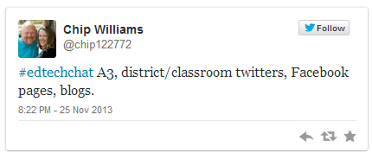
Join Twitter Chats
How Will You Build the Relationship?

Slide 27

#Hashtags... use sparingly
How Will You Build the Relationship?
#if #you #hashtag #every #word
#you #will #annoy & #lose #followers

Slide 28
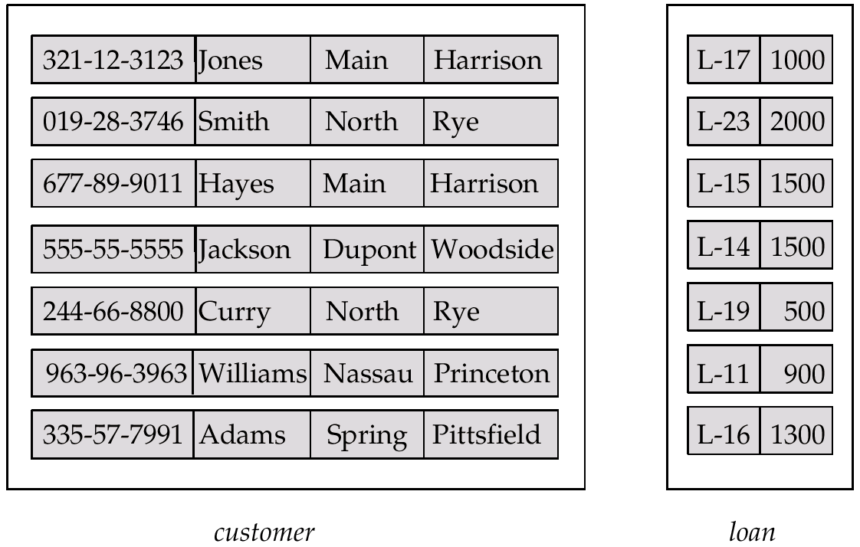
Entity Sets customer and loan
customer-id customer- customer- customer- loan- amount name street city number

Slide 29
Attributes
An entity is represented by a set of attributes, that is descriptive properties possessed by all members of an entity set.
Domain – the set of permitted values for each attribute
Attribute types:
Simple and composite attributes.
Single-valued and multi-valued attributes
E.g. multivalued attribute: phone-numbers
Derived attributes
Can be computed from other attributes
E.g. age, given date of birth
Example:
customer = (customer-id, customer-name, customer-street, customer-city) loan = (loan-number, amount)

Slide 30
ER Model Basics (Contd.)
name
ssn
lot
since
Employees
name
dname
super-visor
subor-dinate
ssn
lot
did
budget
Works_In
Reports_To
Employees
Departments
Relationship: Association among two or more entities. e.g., Jack works in Pharmacy department.
Relationship Set: Collection of similar relationships.
An n-ary relationship set R relates n entity sets E1 ... En; each relationship in R involves entities e1 in E1, ..., en in En
Same entity set could participate in different relationship sets, or in different “roles” in same set.
Notes:
4

Slide 31
Relationship Sets
A relationship is an association among several entities
Example: Hayes depositor A-102 customer entity relationship set account entity
A relationship set is a mathematical relation among n ≥ 2 entities, each taken from entity sets
{(e₁, e₂, … e_{n}) | e₁ ∈ E₁, e₂ ∈ E₂, …, e_{n} ∈ E_{n}} where (e₁, e₂, …, e_{n}) is a relationship
Example:
(Hayes, A-102) ∈ depositor

Slide 32
Degree of a Relationship Set
Refers to number of entity sets that participate in a relationship set.
Relationship sets that involve two entity sets are binary (or degree two). Generally, most relationship sets in a database system are binary.
Relationship sets may involve more than two entity sets.
Relationships between more than two entity sets are rare. Most relationships are binary. (More on this later.)
E.g. Suppose employees of a bank may have jobs (responsibilities) at multiple branches, with different jobs at different branches. Then there is a ternary relationship set between entity sets employee, job and branch

Slide 33
Mapping Cardinalities
Express the number of entities to which another entity can be associated via a relationship set.
Most useful in describing binary relationship sets.
For a binary relationship set the mapping cardinality must be one of the following types:
One to one
One to many
Many to one
Many to many

Slide 34
Key Constraints
since
name
dname
ssn
lot
did
budget
Consider Works_In: An employee can work in many departments; a dept can have many employees.
In contrast, each dept has at most one manager, according to the key constraint on Manages.
Employees
Manages
Departments
1-to-1
1-to Many
Many-to-1
Many-to-Many
Notes:
6

Slide 35
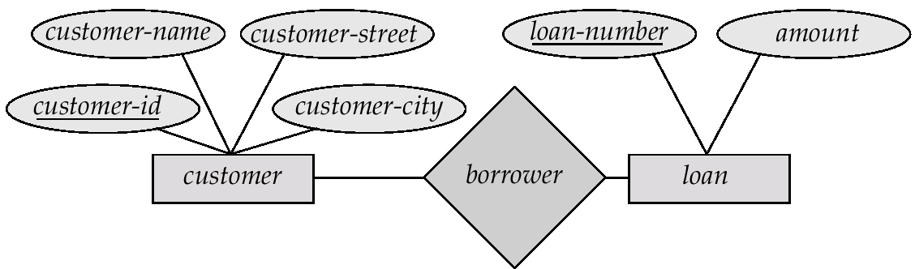
E-R Diagrams
Rectangles represent entity sets.
Diamonds represent relationship sets.
Lines link attributes to entity sets and entity sets to relationship sets.
Ellipses represent attributes
Double ellipses represent multivalued attributes.
Dashed ellipses denote derived attributes.
Underline indicates primary key attributes (will study later)

Slide 37
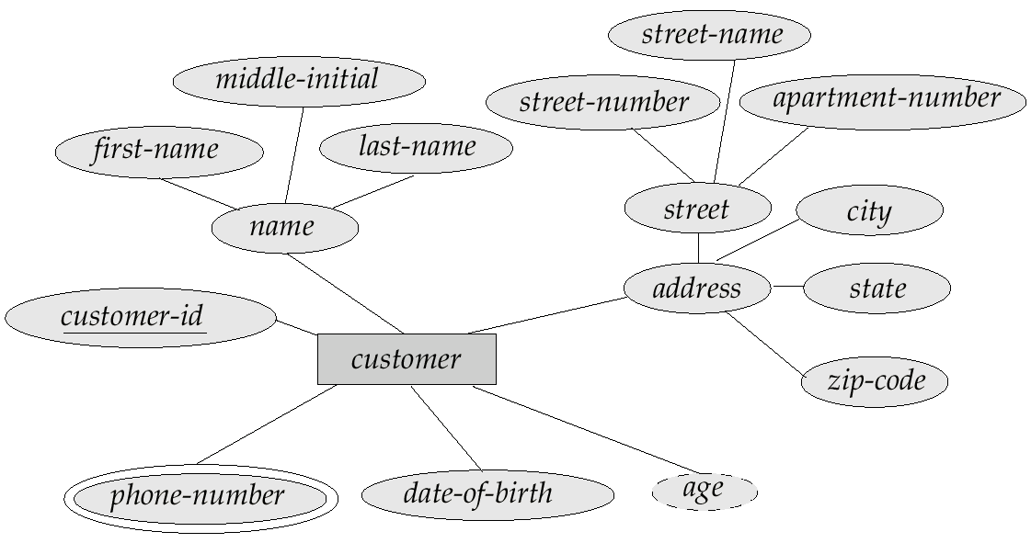
E-R Diagram With Composite, Multivalued, and Derived Attributes

Slide 38
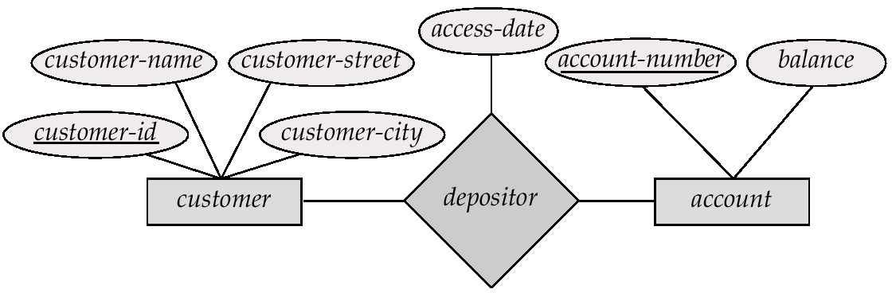
Relationship Sets with Attributes

Slide 39
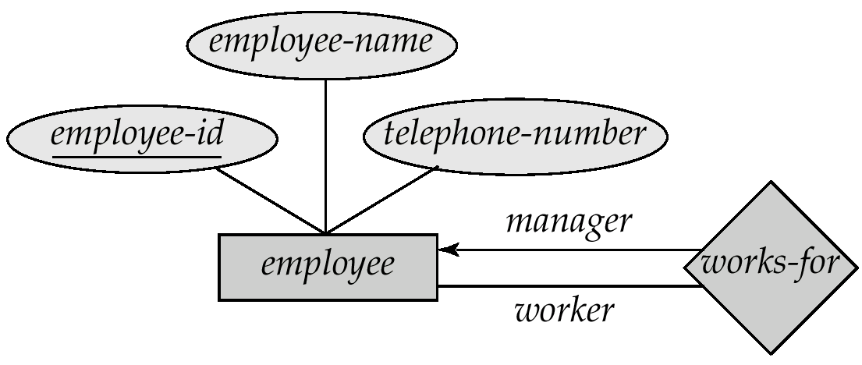
Roles
Entity sets of a relationship need not be distinct
The labels “manager” and “worker” are called roles; they specify how employee entities interact via the works-for relationship set.
Roles are indicated in E-R diagrams by labeling the lines that connect diamonds to rectangles.
Role labels are optional, and are used to clarify semantics of the relationship

Slide 40
Structural Constraints
Structural constraints of a relationship type:
Cardinality ratio: Limits the number of relationship instances an entity can participate in, eg. 1:1, 1:N, M:N
Participation constraint: If each entity of an entity type is required to participate in some instance of a relationship type, then that participation is total; otherwise, it is partial.

Slide 41
Structural Constraint Min, Max
A more complete specification of the structural constraint on a relationship type can be given by the integer pair (min, max), which means an entity must participate in at least min and at most max relationship instances.

Slide 42
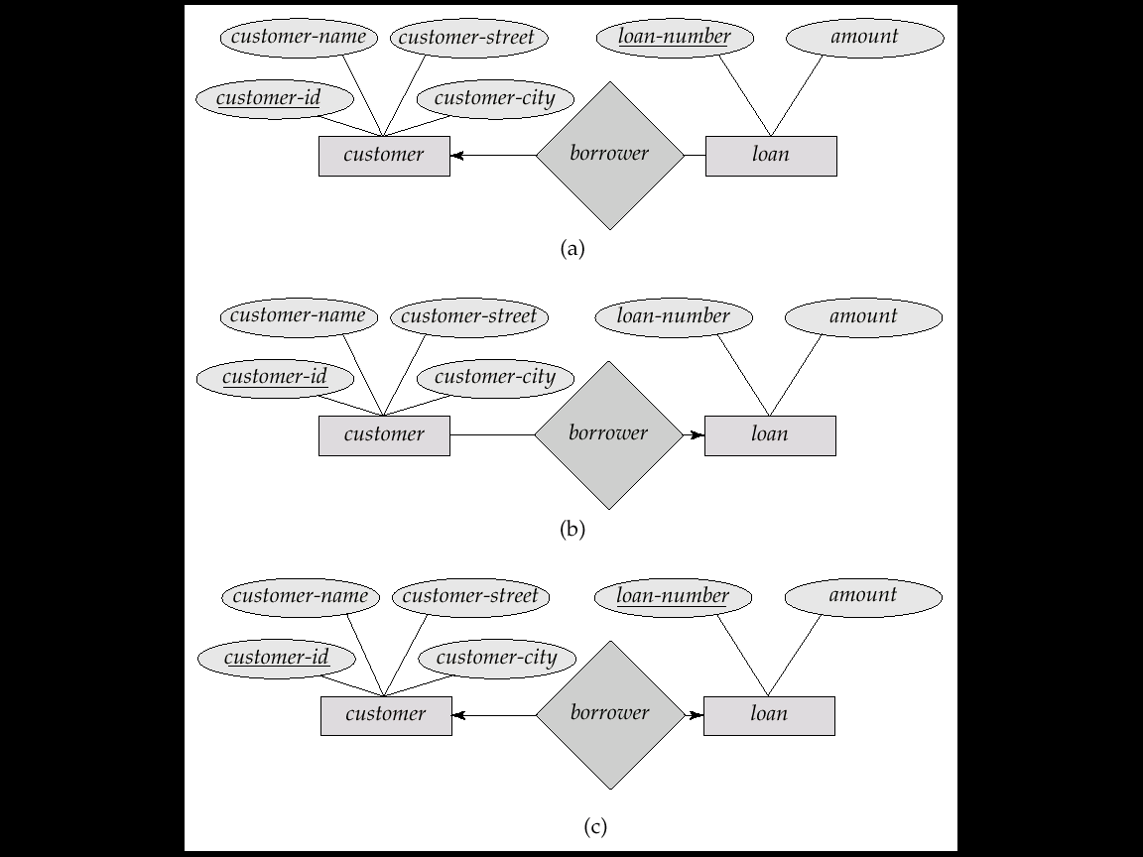
Cardinality Constraints
We express cardinality constraints by drawing either a directed line (→), signifying “one,” or an undirected line (—), signifying “many,” between the relationship set and the entity set.
E.g.: One-to-one relationship:
A customer is associated with at most one loan via the relationship borrower
A loan is associated with at most one customer via borrower

Slide 43
One-To-Many Relationship
In the one-to-many relationship a loan is associated with at most one customer via borrower, a customer is associated with several (including 0) loans via borrower

Slide 44
Many-To-One Relationships
In a many-to-one relationship a loan is associated with several (including 0) customers via borrower, a customer is associated with at most one loan via borrower

Slide 45
Many-To-Many Relationship
A customer is associated with several (possibly 0) loans via borrower
A loan is associated with several (possibly 0) customers via borrower

Slide 46
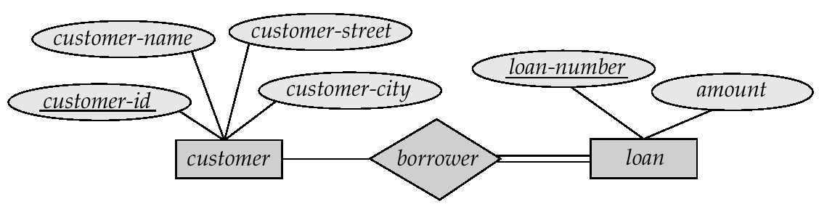
Participation of an Entity Set in a Relationship Set
Total participation (indicated by double line): every entity in the entity set participates in at least one relationship in the relationship set
E.g. participation of loan in borrower is total
every loan must have a customer associated to it via borrower
Partial participation: some entities may not participate in any relationship in the relationship set
E.g. participation of customer in borrower is partial

Slide 47
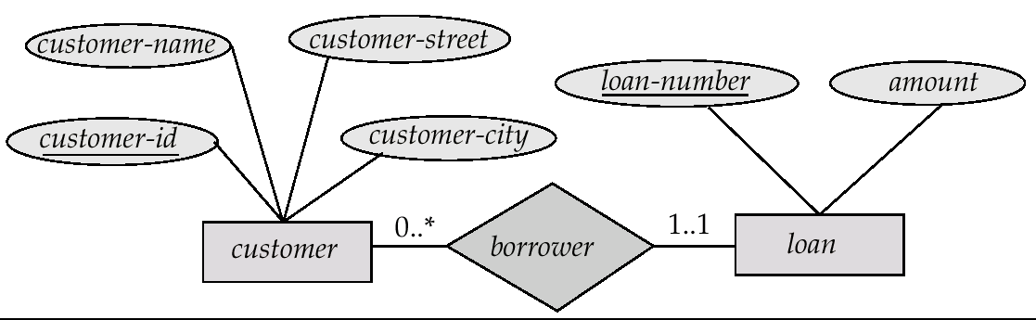
Alternative Notation for Cardinality Limits
Cardinality limits can also express participation constraints

Slide 48
Keys
A super key of an entity set is a set of one or more attributes whose values uniquely determine each entity.
A candidate key of an entity set is a minimal super key
Customer-id is candidate key of customer
account-number is candidate key of account
Although several candidate keys may exist, one of the candidate keys is selected to be the primary key.

Slide 49
Keys for Relationship Sets
The combination of primary keys of the participating entity sets forms a super key of a relationship set.
(customer-id, account-number) is the super key of depositor
NOTE: this means a pair of entity sets can have at most one relationship in a particular relationship set.
E.g. if we wish to track all access-dates to each account by each customer, we cannot assume a relationship for each access. We can use a multivalued attribute though
Must consider the mapping cardinality of the relationship set when deciding the what are the candidate keys
Need to consider semantics of relationship set in selecting the primary key in case of more than one candidate key

Slide 50
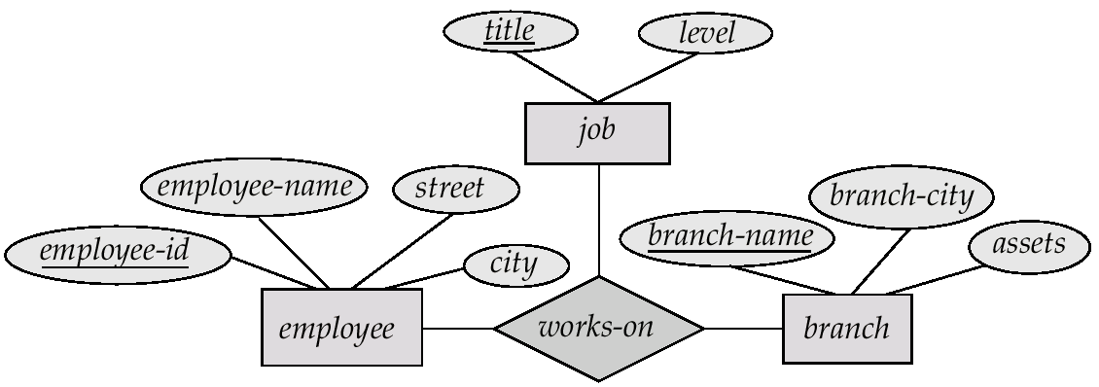
E-R Diagram with a Ternary Relationship

Slide 51
Cardinality Constraints on Ternary Relationship
We allow at most one arrow out of a ternary (or greater degree) relationship to indicate a cardinality constraint
E.g. an arrow from works-on to job indicates each employee works on at most one job at any branch.
If there is more than one arrow, there are two ways of defining the meaning.
E.g a ternary relationship R between A, B and C with arrows to B and C could mean
1. each A entity is associated with a unique entity from B and C or
2. each pair of entities from (A, B) is associated with a unique C entity, and each pair (A, C) is associated with a unique B
Each alternative has been used in different formalisms
To avoid confusion we outlaw more than one arrow

Slide 52
Binary Vs. Non-Binary Relationships
Some relationships that appear to be non-binary may be better represented using binary relationships
E.g. A ternary relationship parents, relating a child to his/her father and mother, is best replaced by two binary relationships, father and mother
Using two binary relationships allows partial information (e.g. only mother being know)
But there are some relationships that are naturally non-binary
E.g. works-on

Slide 53
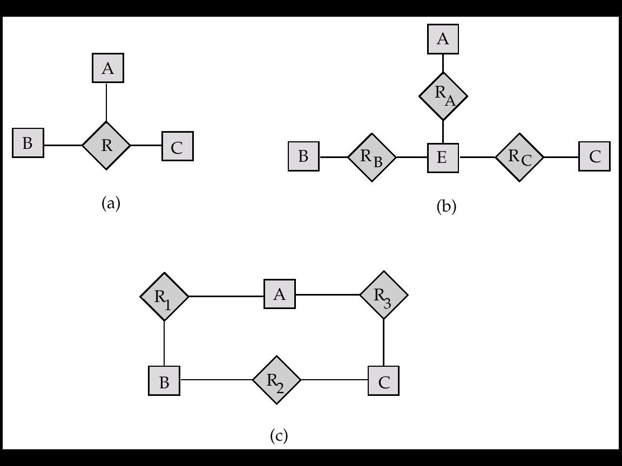
Converting Non-Binary Relationships to Binary Form
In general, any non-binary relationship can be represented using binary relationships by creating an artificial entity set.
Replace R between entity sets A, B and C by an entity set E, and three relationship sets:
1. R_{A}, relating E and A 2.R_{B}, relating E and B
3. R_{C}, relating E and C
Create a special identifying attribute for E
Add any attributes of R to E
For each relationship (a_{i} , b_{i} , c_{i}) in R, create
1. a new entity e_{i} in the entity set E 2. add (e_{i} , a_{i} ) to R_{A}
3. add (e_{i} , b_{i} ) to R_{B} 4. add (e_{i} , c_{i} ) to R_{C}

Slide 54
Converting Non-Binary Relationships (Cont.)
Also need to translate constraints
Translating all constraints may not be possible
There may be instances in the translated schema that cannot correspond to any instance of R
Exercise: add constraints to the relationships R_{A}, R_{B} and R_{C} to ensure that a newly created entity corresponds to exactly one entity in each of entity sets A, B and C
We can avoid creating an identifying attribute by making E a weak entity set (described shortly) identified by the three relationship sets

Slide 55
Design Issues
Use of entity sets vs. attributes Choice mainly depends on the structure of the enterprise being modeled, and on the semantics associated with the attribute in question.
Use of entity sets vs. relationship sets Possible guideline is to designate a relationship set to describe an action that occurs between entities
Binary versus n-ary relationship sets Although it is possible to replace any nonbinary (n-ary, for n > 2) relationship set by a number of distinct binary relationship sets, a n-ary relationship set shows more clearly that several entities participate in a single relationship.
Placement of relationship attributes

Slide 56
How about doing an ER design interactively on the board? Suggest an application to be modeled.

Slide 57
Weak Entities
A weak entity can be identified uniquely only by considering the primary key of another (owner) entity.
Owner entity set and weak entity set must participate in a one-to-many relationship set (one owner, many weak entities).
Weak entity set must have total participation in this identifying relationship set.
name
ssn
lot
cost
pname
age
Employees
Policy
Dependents
Notes:
10

Slide 58
Weak Entity Sets
An entity set that does not have a primary key is referred to as a weak entity set.
The existence of a weak entity set depends on the existence of a identifying entity set
it must relate to the identifying entity set via a total, one-to-many relationship set from the identifying to the weak entity set
Identifying relationship depicted using a double diamond
The discriminator (or partial key) of a weak entity set is the set of attributes that distinguishes among all the entities of a weak entity set.
The primary key of a weak entity set is formed by the primary key of the strong entity set on which the weak entity set is existence dependent, plus the weak entity set’s discriminator.

Slide 59
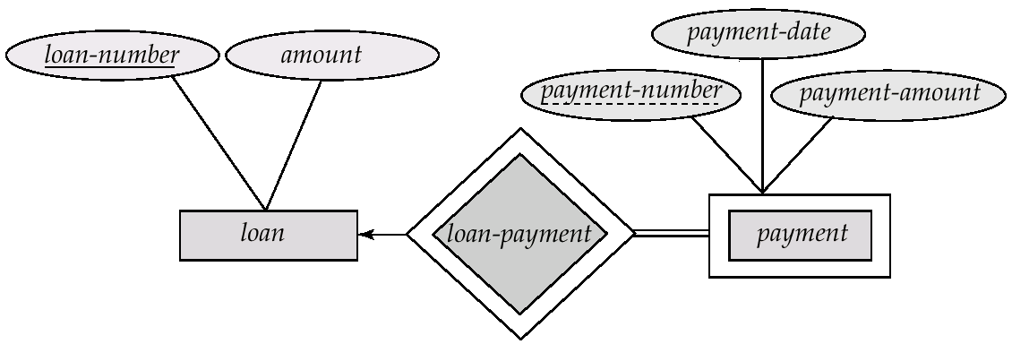
Weak Entity Sets (Cont.)
We depict a weak entity set by double rectangles.
We underline the discriminator of a weak entity set with a dashed line.
payment-number – discriminator of the payment entity set
Primary key for payment – (loan-number, payment-number)

Slide 60
Weak Entity Sets (Cont.)
Note: the primary key of the strong entity set is not explicitly stored with the weak entity set, since it is implicit in the identifying relationship.
If loan-number were explicitly stored, payment could be made a strong entity, but then the relationship between payment and loan would be duplicated by an implicit relationship defined by the attribute loan-number common to payment and loan

Slide 61
More Weak Entity Set Examples
In a university, a course is a strong entity and a course-offering can be modeled as a weak entity
The discriminator of course-offering would be semester (including year) and section-number (if there is more than one section)
If we model course-offering as a strong entity we would model course-number as an attribute.
Then the relationship with course would be implicit in the course-number attribute

Slide 62
Specialization
Top-down design process; we designate subgroupings within an entity set that are distinctive from other entities in the set.
These subgroupings become lower-level entity sets that have attributes or participate in relationships that do not apply to the higher-level entity set.
Depicted by a triangle component labeled ISA (E.g. customer “is a” person).
Attribute inheritance – a lower-level entity set inherits all the attributes and relationship participation of the higher-level entity set to which it is linked.

Slide 63
Entity vs. Attribute
Should address be an attribute of Employees or an entity (connected to Employees by a relationship)?
Depends upon the use we want to make of address information, and the semantics of the data:
If we have several addresses per employee, address must be an entity (since attributes cannot be set-valued).
If the structure (city, street, etc.) is important, e.g., we want to retrieve employees in a given city, address must be modeled as an entity (since attribute values are atomic).

Slide 64
Entity vs. Attribute (Contd.)
from
to
Works_In4 does not allow an employee to work in a department for two or more periods.
Similar to the problem of wanting to record several addresses for an employee: We want to record several values of the descriptive attributes for each instance of this relationship. Accomplished by introducing new entity set, Duration.
name
dname
ssn
lot
did
budget
Employees
Works_In4
Departments
name
dname
ssn
lot
did
budget
Employees
Works_In4
Departments
from
Duration
to
Notes:
5

Slide 65
Entity vs. Relationship
First ER diagram OK if a manager gets a separate discretionary budget for each dept.
What if a manager gets a discretionary budget that covers all managed depts?
Redundancy: dbudget stored for each dept managed by manager.
Misleading: Suggests dbudget associated with department-mgr combination.
since
dbudget
name
dname
ssn
lot
did
budget
Employees
Manages2
Departments
name
ssn
lot
since
dname
Employees
did
budget
Manages2
Departments
ISA
This fixes the
problem!
Managers
dbudget
Notes:
6

Slide 66
Binary vs. Ternary Relationships
name
ssn
lot
pname
age
If each policy is owned by just 1 employee, and each dependent is tied to the covering policy, first diagram is inaccurate.
What are the additional constraints in the 2nd diagram?
Employees
Covers
Dependents
Bad design
Policies
policyid
cost
name
pname
age
ssn
lot
Dependents
Employees
Purchaser
Beneficiary
Better design
Policies
policyid
cost
Notes:
7

Slide 67
Binary vs. Ternary Relationships (Contd.)
Previous example illustrated a case when two binary relationships were better than one ternary relationship.
An example in the other direction: a ternary relation Contracts relates entity sets Parts, Departments and Suppliers, and has descriptive attribute qty. No combination of binary relationships is an adequate substitute:
S “can-supply” P, D “needs” P, and D “deals-with” S does not imply that D has agreed to buy P from S.
How do we record qty?
Notes:
9

Slide 68
Summary of Conceptual Design
Conceptual design follows requirements analysis,
Yields a high-level description of data to be stored
ER model popular for conceptual design
Constructs are expressive, close to the way people think about their applications.
Basic constructs: entities, relationships, and attributes (of entities and relationships).
Some additional constructs: weak entities, ISA hierarchies, and aggregation.
Note: There are many variations on ER model.
Notes:
11

Slide 69
Summary of ER (Contd.)
Several kinds of integrity constraints can be expressed in the ER model: key constraints, participation constraints, and overlap/covering constraints for ISA hierarchies. Some foreign key constraints are also implicit in the definition of a relationship set.
Some constraints (notably, functional dependencies) cannot be expressed in the ER model.
Constraints play an important role in determining the best database design for an enterprise.
Notes:
12

Slide 70
Summary of ER (Contd.)
ER design is subjective. There are often many ways to model a given scenario! Analyzing alternatives can be tricky, especially for a large enterprise. Common choices include:
Entity vs. attribute, entity vs. relationship, binary or n-ary relationship, whether or not to use ISA hierarchies, and whether or not to use aggregation.
Ensuring good database design: resulting relational schema should be analyzed and refined further. FD information and normalization techniques are especially useful.
Notes:
13

Slide 71
Exercise
name
ssn
addr
acct#
balance
What can you say about policy of the bank from the ER diagram?
What can you say about the policy of the company?
Customer
CustAcct
Account
name
ssn
lot
Employees
Manages
Dept
deptid
budget
Notes:
7

Slide 72
Design Exercise
Design a DB using ER, and sketch the resulting diagram. State any important assumptions you made in reaching the design. Show explicitly whether relationships are 1-1, 1-M, or N-M.
UVA registrar’s office: It maintains data about each class, including the instructor, students, enrollment, time and place of the class meetings. For each student-class pair, a grade is recorded.
Hospital: It maintains all patients visited, including age and address. It also keeps track of the information about billing, visits, data, reason for visit, and treatment.
Notes:
12

Slide 73
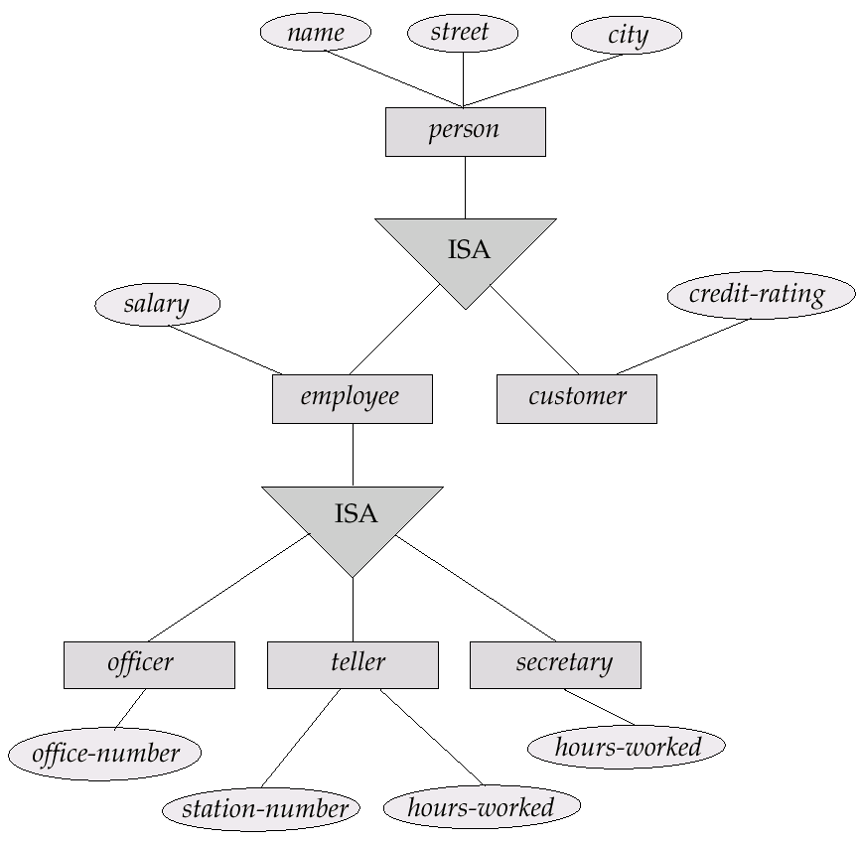
Specialization Example

Slide 74
Generalization
A bottom-up design process – combine a number of entity sets that share the same features into a higher-level entity set.
Specialization and generalization are simple inversions of each other; they are represented in an E-R diagram in the same way.
The terms specialization and generalization are used interchangeably.

Slide 75
Specialization and Generalization (Contd.)
Can have multiple specializations of an entity set based on different features.
E.g. permanent-employee vs. temporary-employee, in addition to officer vs. secretary vs. teller
Each particular employee would be
a member of one of permanent-employee or temporary-employee,
and also a member of one of officer, secretary, or teller
The ISA relationship also referred to as superclass - subclass relationship

Slide 76
Design Constraints on a Specialization/Generalization
Constraint on which entities can be members of a given lower-level entity set.
condition-defined
E.g. all customers over 65 years are members of senior-citizen entity set; senior-citizen ISA person.
user-defined
Constraint on whether or not entities may belong to more than one lower-level entity set within a single generalization.
Disjoint
an entity can belong to only one lower-level entity set
Noted in E-R diagram by writing disjoint next to the ISA triangle
Overlapping
an entity can belong to more than one lower-level entity set

Slide 77
Design Constraints on a Specialization/Generalization (Contd.)
Completeness constraint -- specifies whether or not an entity in the higher-level entity set must belong to at least one of the lower-level entity sets within a generalization.
total : an entity must belong to one of the lower-level entity sets
partial: an entity need not belong to one of the lower-level entity sets

Slide 78
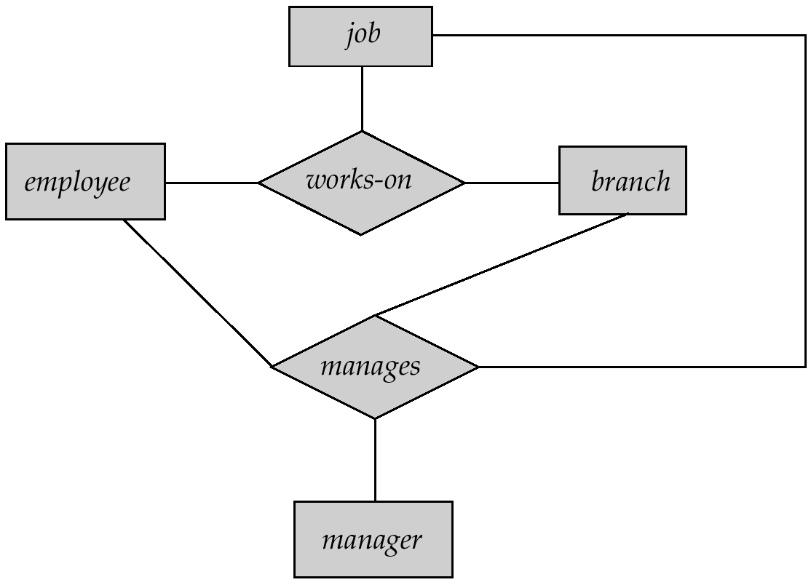
Aggregation
Consider the ternary relationship works-on, which we saw earlier
Suppose we want to record managers for tasks performed by an employee at a branch

Slide 79
Aggregation (Cont.)
Relationship sets works-on and manages represent overlapping information
Every manages relationship corresponds to a works-on relationship
However, some works-on relationships may not correspond to any manages relationships
So we can’t discard the works-on relationship
Eliminate this redundancy via aggregation
Treat relationship as an abstract entity
Allows relationships between relationships
Abstraction of relationship into new entity
Without introducing redundancy, the following diagram represents:
An employee works on a particular job at a particular branch
An employee, branch, job combination may have an associated manager

Slide 80
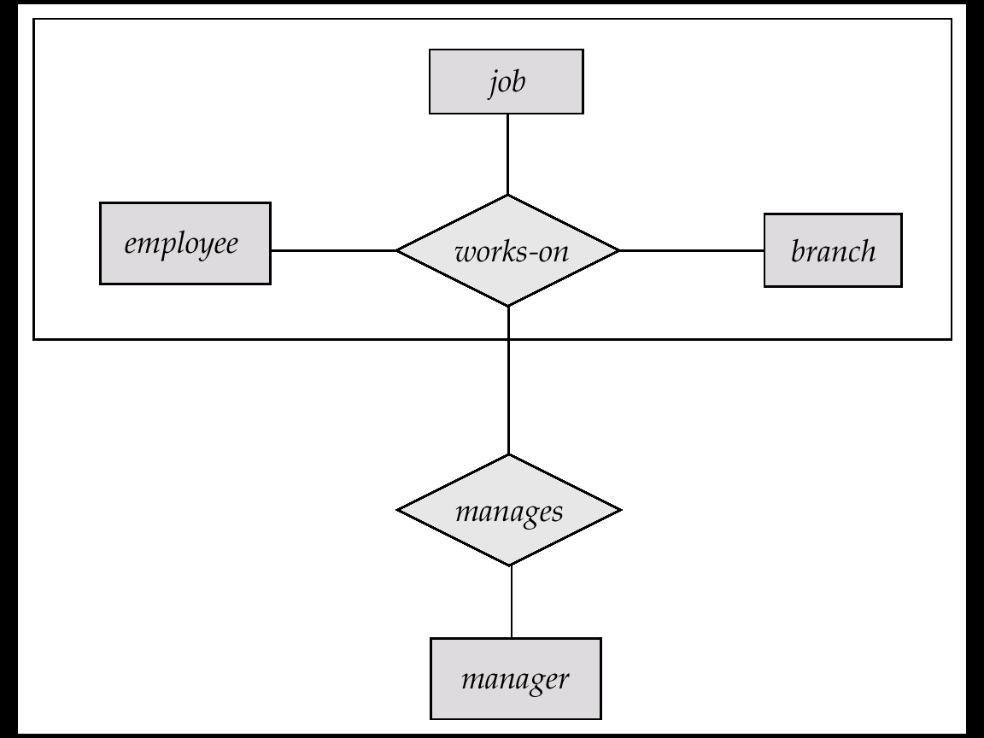
E-R Diagram With Aggregation

Slide 81
E-R Design Decisions
The use of an attribute or entity set to represent an object.
Whether a real-world concept is best expressed by an entity set or a relationship set.
The use of a ternary relationship versus a pair of binary relationships.
The use of a strong or weak entity set.
The use of specialization/generalization – contributes to modularity in the design.
The use of aggregation – can treat the aggregate entity set as a single unit without concern for the details of its internal structure.

Slide 82
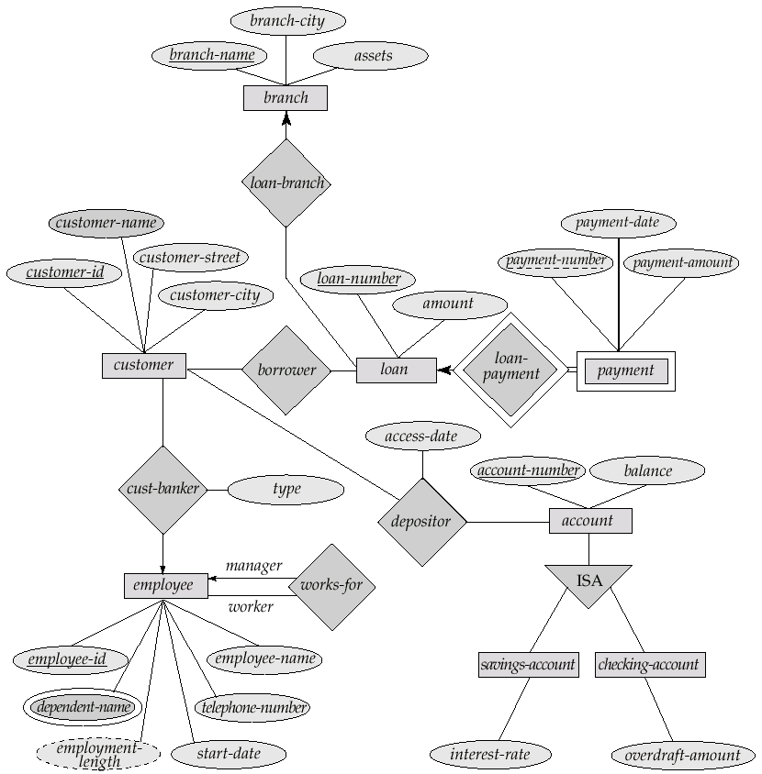
E-R Diagram for a Banking Enterprise

Slide 83
How about doing another ER design interactively on the board?

Slide 84
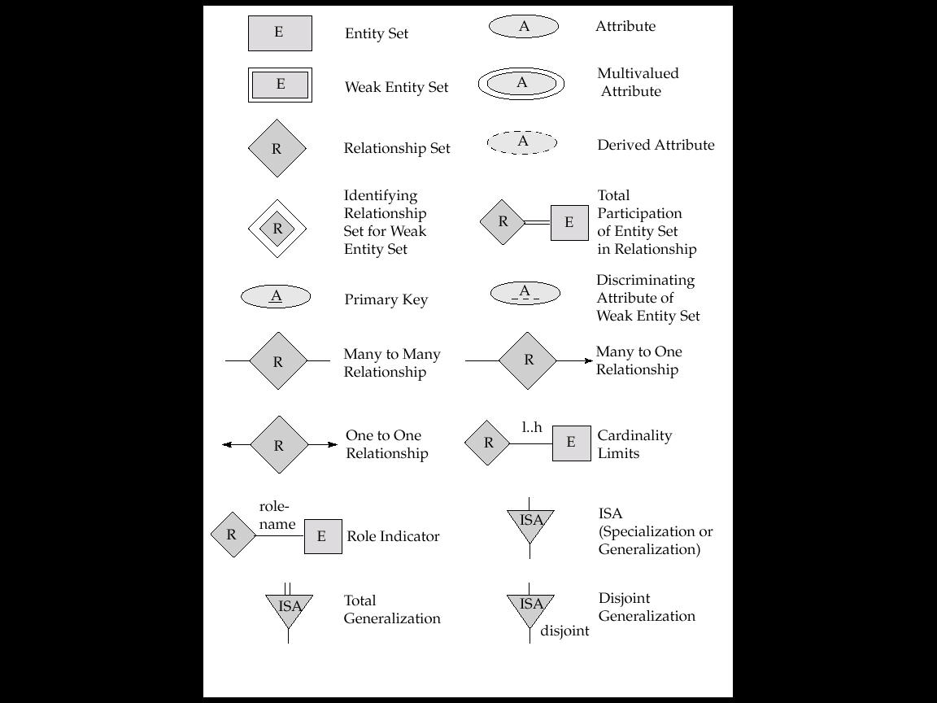
Summary of Symbols Used in E-R Notation

Slide 85
Summary of Symbols (Cont.)

Slide 86
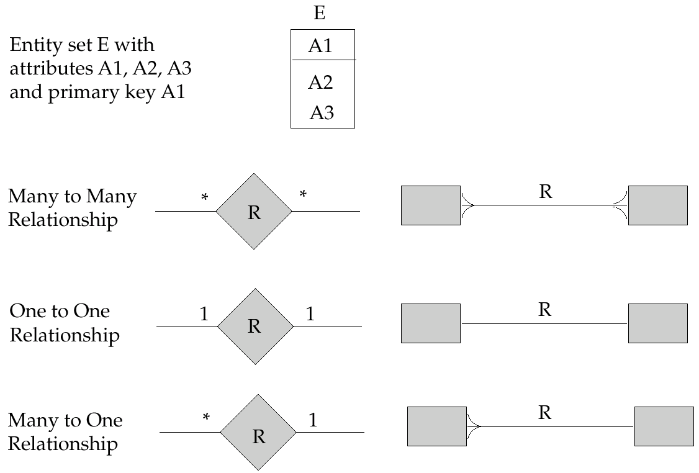
Alternative E-R Notations

Slide 87
UML
UML: Unified Modeling Language
UML has many components to graphically model different aspects of an entire software system
UML Class Diagrams correspond to E-R Diagram, but several differences.

Slide 88
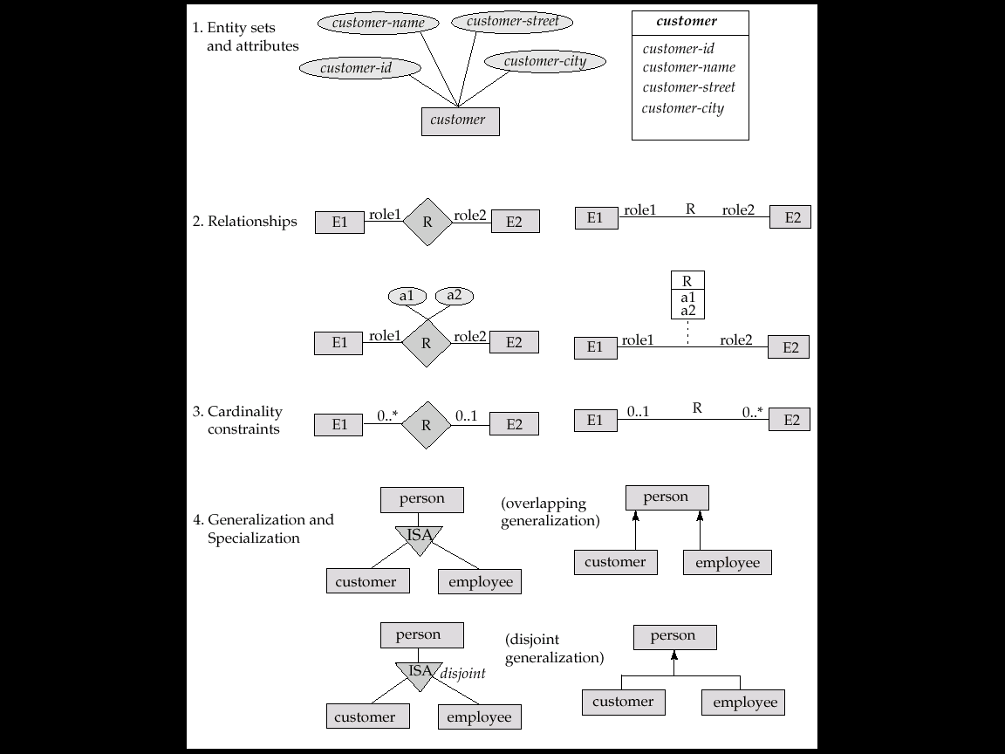
Summary of UML Class Diagram Notation

Slide 89
UML Class Diagrams (Contd.)
Entity sets are shown as boxes, and attributes are shown within the box, rather than as separate ellipses in E-R diagrams.
Binary relationship sets are represented in UML by just drawing a line connecting the entity sets. The relationship set name is written adjacent to the line.
The role played by an entity set in a relationship set may also be specified by writing the role name on the line, adjacent to the entity set.
The relationship set name may alternatively be written in a box, along with attributes of the relationship set, and the box is connected, using a dotted line, to the line depicting the relationship set.
Non-binary relationships drawn using diamonds, just as in ER diagrams

Slide 90
UML Class Diagram Notation (Cont.)
overlapping
disjoint
*Note reversal of position in cardinality constraint depiction
*Generalization can use merged or separate arrows independent
of disjoint/overlapping

Slide 91
UML Class Diagrams (Contd.)
Cardinality constraints are specified in the form l..h, where l denotes the minimum and h the maximum number of relationships an entity can participate in.
Beware: the positioning of the constraints is exactly the reverse of the positioning of constraints in E-R diagrams.
The constraint 0..* on the E2 side and 0..1 on the E1 side means that each E2 entity can participate in at most one relationship, whereas each E1 entity can participate in many relationships; in other words, the relationship is many to one from E2 to E1.
Single values, such as 1 or * may be written on edges; The single value 1 on an edge is treated as equivalent to 1..1, while * is equivalent to 0..*.

Slide 92
Reduction of an E-R Schema to Tables
Primary keys allow entity sets and relationship sets to be expressed uniformly as tables which represent the contents of the database.
A database which conforms to an E-R diagram can be represented by a collection of tables.
For each entity set and relationship set there is a unique table which is assigned the name of the corresponding entity set or relationship set.
Each table has a number of columns (generally corresponding to attributes), which have unique names.
Converting an E-R diagram to a table format is the basis for deriving a relational database design from an E-R diagram.

Slide 93
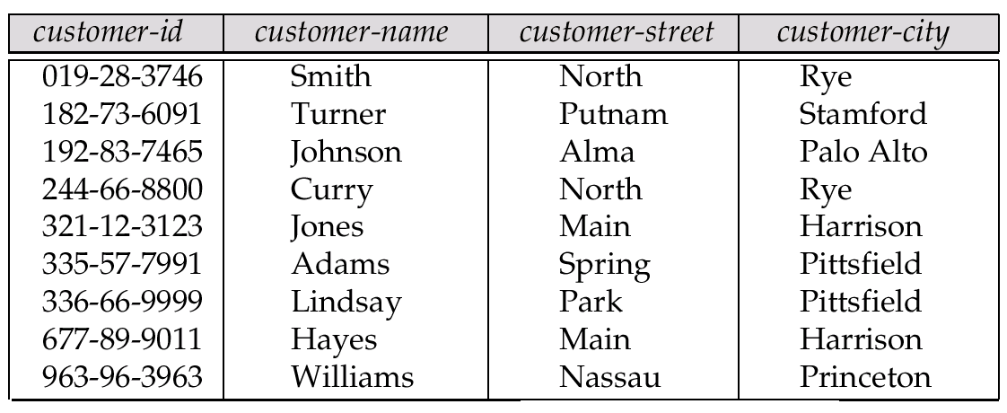
Representing Entity Sets as Tables
A strong entity set reduces to a table with the same attributes.

Slide 94
Composite and Multivalued Attributes
Composite attributes are flattened out by creating a separate attribute for each component attribute
E.g. given entity set customer with composite attribute name with component attributes first-name and last-name the table corresponding to the entity set has two attributes name.first-name and name.last-name
A multivalued attribute M of an entity E is represented by a separate table EM
Table EM has attributes corresponding to the primary key of E and an attribute corresponding to multivalued attribute M
E.g. Multivalued attribute dependent-names of employee is represented by a table employee-dependent-names( employee-id, dname)
Each value of the multivalued attribute maps to a separate row of the table EM
E.g., an employee entity with primary key John and dependents Johnson and Johndotir maps to two rows: (John, Johnson) and (John, Johndotir)

Slide 95
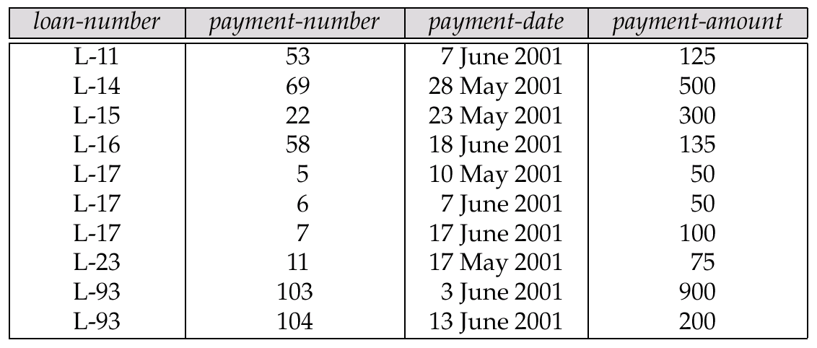
Representing Weak Entity Sets
A weak entity set becomes a table that includes a column for the primary key of the identifying strong entity set

Slide 96
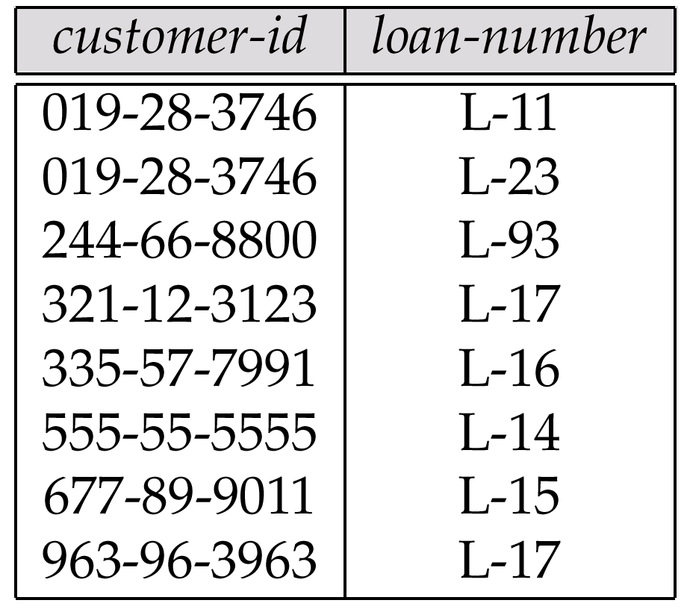
Representing Relationship Sets as Tables
A many-to-many relationship set is represented as a table with columns for the primary keys of the two participating entity sets, and any descriptive attributes of the relationship set.
E.g.: table for relationship set borrower

Slide 97
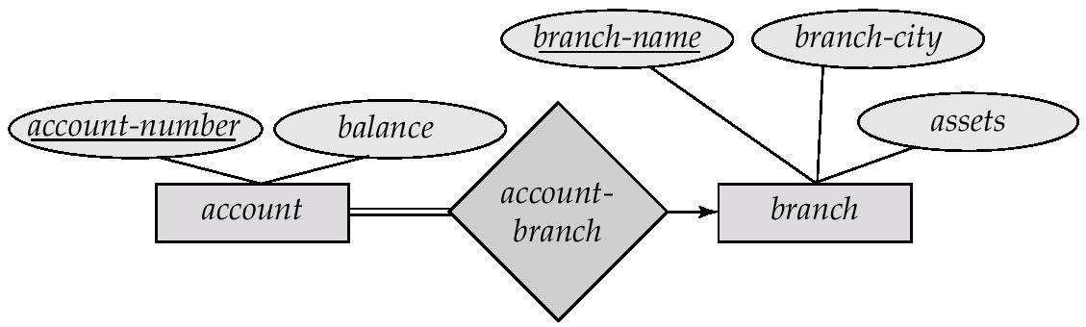
Redundancy of Tables
Many-to-one and one-to-many relationship sets that are total on the many-side can be represented by adding an extra attribute to the many side, containing the primary key of the one side
E.g.: Instead of creating a table for relationship account-branch, add an attribute branch to the entity set account

Slide 98
Redundancy of Tables (Cont.)
For one-to-one relationship sets, either side can be chosen to act as the “many” side
That is, extra attribute can be added to either of the tables corresponding to the two entity sets
If participation is partial on the many side, replacing a table by an extra attribute in the relation corresponding to the “many” side could result in null values
The table corresponding to a relationship set linking a weak entity set to its identifying strong entity set is redundant.
E.g. The payment table already contains the information that would appear in the loan-payment table (i.e., the columns loan-number and payment-number).

Slide 99
Representing Specialization as Tables
Method 1:
Form a table for the higher level entity
Form a table for each lower level entity set, include primary key of higher level entity set and local attributes table table attributes person name, street, city customer name, credit-rating employee name, salary
Drawback: getting information about, e.g., employee requires accessing two tables

Slide 100
Representing Specialization as Tables (Cont.)
Method 2:
Form a table for each entity set with all local and inherited attributes table table attributes person name, street, city customer name, street, city, credit-rating employee name, street, city, salary
If specialization is total, table for generalized entity (person) not required to store information
Can be defined as a “view” relation containing union of specialization tables
But explicit table may still be needed for foreign key constraints
Drawback: street and city may be stored redundantly for persons who are both customers and employees

Slide 101
Relations Corresponding to Aggregation
To represent aggregation, create a table containing
primary key of the aggregated relationship,
the primary key of the associated entity set
Any descriptive attributes

Slide 102
Relations Corresponding to Aggregation (Cont.)
E.g. to represent aggregation manages between relationship works-on and entity set manager, create a table manages(employee-id, branch-name, title, manager-name)
Table works-on is redundant provided we are willing to store null values for attribute manager-name in table manages

Slide 103
End of Chapter 2

Slide 104
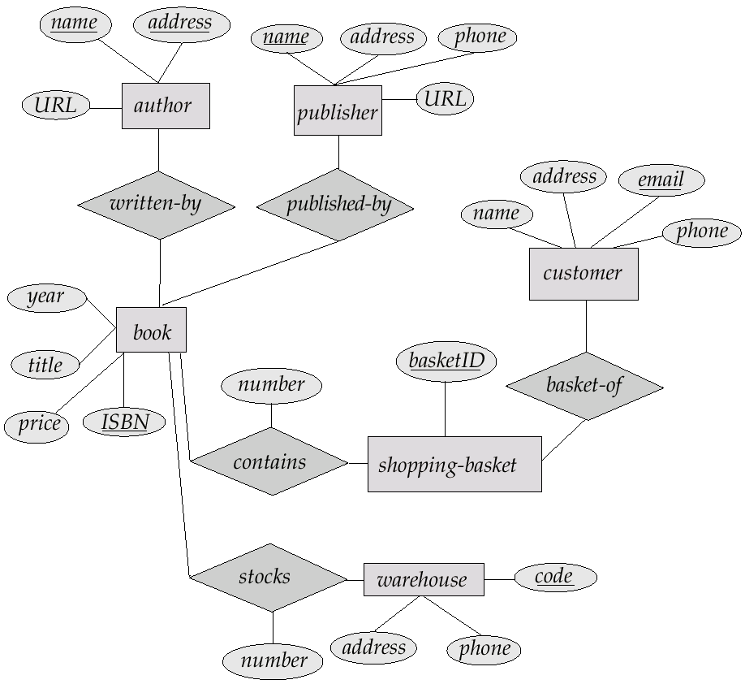
E-R Diagram for Exercise 2.10

Slide 105
E-R Diagram for Exercise 2.15

Slide 106
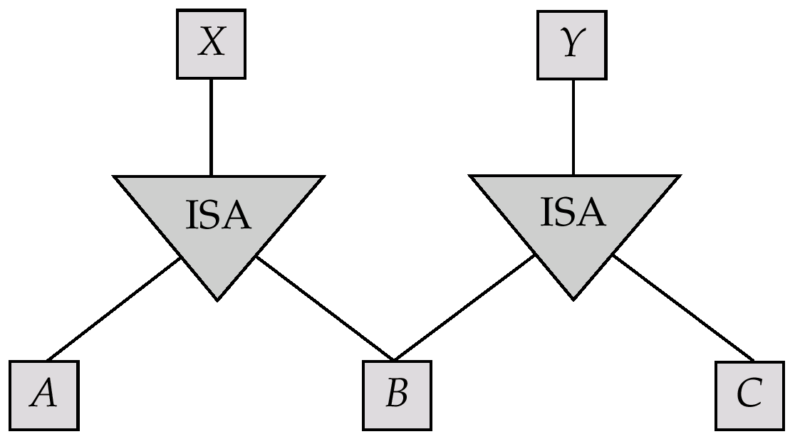
E-R Diagram for Exercise 2.22

Slide 107
E-R Diagram for Exercise 2.15

Slide 108
Existence Dependencies
If the existence of entity x depends on the existence of entity y, then x is said to be existence dependent on y.
y is a dominant entity (in example below, loan)
x is a subordinate entity (in example below, payment)
loan-payment
loan
payment
If a loan entity is deleted, then all its associated payment entities must be deleted also.

