Slide 1
DAMG 6210 Database Design
Nik Bear Brown
@NikBearBrown
Relational Algebra
Relational Calculus

Slide 2
Topics
Relational Algebra
Relational Calculus

Slide 3
Relational algebra and relational calculus
Relational algebra and relational calculus are formal languages associated with the relational model.
Informally, relational algebra is a (high-level) procedural language and relational calculus a non-procedural language.
However, formally both are equivalent to one another.
A language that produces a relation that can be derived using relational calculus is relationally complete.

Slide 4
SQL Overview
SQL is the language of relational databases.
It is used for every aspect of database development and management.
Anyone who works with relational databases is expected to have a knowledge of SQL.

Slide 5
Objectives of SQL
Ideally, database language should allow user to:
create the database and relation structures;
perform insertion, modification, deletion of data from relations;
perform simple and complex queries.
Must perform these tasks with minimal user effort and command structure/syntax must be easy to learn.
It must be portable.

Slide 6
Non-procedural SQL
It is non-procedural - you specify what information you require, rather than how to get it;

Slide 7
Objectives of SQL
Consists of standard English words:
1) CREATE TABLE Staff(staffNo VARCHAR(5),
lName VARCHAR(15),
salary DECIMAL(7,2));
2) INSERT INTO Staff VALUES (‘SG16’, ‘Brown’, 8300);
3) SELECT staffNo, lName, salary
FROM Staff
WHERE salary > 10000;

Slide 8
History of SQL
In 1974, D. Chamberlin (IBM San Jose Laboratory) defined language called ‘Structured English Query Language’ (SEQUEL).
A revised version, SEQUEL/2, was defined in 1976 but name was subsequently changed to SQL for legal reasons.

Slide 9
History of SQL
Still pronounced ‘see-quel’, though official pronunciation is ‘S-Q-L’. (or squirrel or ‘s-quel’, )
IBM subsequently produced a prototype DBMS called System R, based on SEQUEL/2.
Roots of SQL, however, are in SQUARE (Specifying Queries as Relational Expressions), which predates System R project.

Slide 10
History of SQL
In late 70s, ORACLE appeared and was probably first commercial RDBMS based on SQL.
In 1987, ANSI and ISO published an initial standard for SQL.
In 1989, ISO published an addendum that defined an ‘Integrity Enhancement Feature’.
In 1992, first major revision to ISO standard occurred, referred to as SQL2 or SQL/92.
In 1999, SQL:1999 was released with support for object-oriented data management.
In late 2003, SQL:2003 was released.
In summer 2008, SQL:2008 was released.
In late 2011, SQL:2011 was released.

Slide 11
SQL History
SQL is the programming language used for accessing and manipulating data and objects in relational databases.
The first versions of SQL were developed by IBM in the 1970s.
SQL first became an ANSI standard in 1986 and an ISO standard in 1987.
There was a major revision to the standard in 1992.
Additional modifications were made in 1999, 2003, and 2006.

Slide 12
Importance of SQL
SQL has become part of application architectures such as IBM’s Systems Application Architecture.
It is strategic choice of many large and influential organizations (e.g. X/OPEN).
SQL is Federal Information Processing Standard (FIPS) to which conformance is required for all sales of databases to American Government.

Slide 13
Nature of SQL
SQL is a declarative language.
Procedural languages like C# or Java describe how to accomplish a task step by step.
In a declarative language, you say what you want to do, not how.

Slide 14
SQL Functionality
SQL is not case sensitive.
In some environments SQL statements must be ended with a semicolon.
SQL is usually divided into two broad areas of functionality:
DDL (Data Definition Language)
DML (Data Manipulation Language)

Slide 15
DDL
Data definition language is the set of SQL keywords and commands used to create, alter, and remove database objects.
An example is the CREATE TABLE command:
CREATE TABLE TestTable
(
TestID INT IDENTITY (1,1),
TestDescription NVARCHAR(255)
)

Slide 16
DML
Data manipulation language is the set of key words and commands used to retrieve and modify data.
SELECT, UPDATE, INSERT, and DELETE are the primary actions of DML.

Slide 17
Importance of SQL
SQL is used in other standards and even influences development of other standards as a definitional tool. Examples include:
ISO’s Information Resource Directory System (IRDS) Standard
Remote Data Access (RDA) Standard.

Slide 18
Writing SQL Commands
SQL statement consists of reserved words and user-defined words.
Reserved words are a fixed part of SQL and must be spelt exactly as required and cannot be split across lines.
User-defined words are made up by user and represent names of various database objects such as relations, columns, views.

Slide 19
Writing SQL Commands
Most components of an SQL statement are case insensitive, except for literal character data.
More readable with indentation and lineation:
Each clause should begin on a new line.
Start of a clause should line up with start of other clauses.
If clause has several parts, should each appear on a separate line and be indented under start of clause.

Slide 20
Writing SQL Commands
Use extended form of BNF notation:
- Upper-case letters represent reserved words.
- Lower-case letters represent user-defined words.
- | indicates a choice among alternatives.
- Curly braces indicate a required element.
- Square brackets indicate an optional element.
- … indicates optional repetition (0 or more).

Slide 21
Literals
Literals are constants used in SQL statements.
All non-numeric literals must be enclosed in single quotes (e.g. ‘London’).
All numeric literals must not be enclosed in quotes (e.g. 650.00).

Slide 22
Select Statement
The SELECT statement is used to retrieve data from the database.
The basic syntax is:
SELECT <columnName>, <columnName>
FROM <TableName>
SELECT StudentFirstName, StudentLastName, StudentPhone
FROM Student

Slide 23
SELECT Statement
SELECT [DISTINCT | ALL]
{* | [columnExpression [AS newName]] [,...] }
FROM TableName [alias] [, ...]
[WHERE condition]
[GROUP BY columnList] [HAVING condition]
[ORDER BY columnList]

Slide 24
SELECT Statement
FROM Specifies table(s) to be used.
WHERE Filters rows.
GROUP BY Forms groups of rows with same
column value.
HAVING Filters groups subject to some
condition.
SELECT Specifies which columns are to
appear in output.
ORDER BY Specifies the order of the output.

Slide 25
SELECT Statement
Order of the clauses cannot be changed.
Only SELECT and FROM are mandatory.

Slide 26
Select All Columns, All Rows
List full details of all staff.
SELECT staffNo, fName, lName, address,
position, sex, DOB, salary, branchNo
FROM Staff;
Can use * as an abbreviation for ‘all columns’:
SELECT *
FROM Staff;

Slide 27
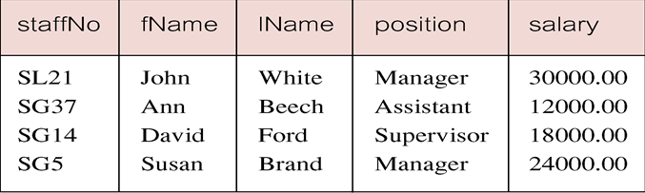
Select Comparison Search Condition
List all staff with a salary greater than 10,000.
SELECT staffNo, fName, lName, position, salary
FROM Staff
WHERE salary > 10000;

Slide 28
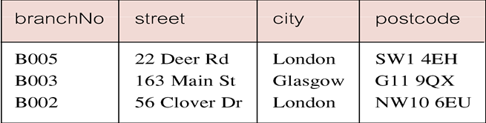
Select Compound Comparison Search Condition
List addresses of all branch offices in London or Glasgow.
SELECT *
FROM Branch
WHERE city = ‘London’ OR city = ‘Glasgow’;

Slide 29
Select Range Search Condition
List all staff with a salary between 20,000 and 30,000.
SELECT staffNo, fName, lName, position, salary
FROM Staff
WHERE salary BETWEEN 20000 AND 30000;
BETWEEN test includes the endpoints of range.

Slide 30
Select Range Search Condition
Also a negated version NOT BETWEEN.
BETWEEN does not add much to SQL’s expressive power. Could also write:
SELECT staffNo, fName, lName, position, salary
FROM Staff
WHERE salary>=20000 AND salary <= 30000;
Useful, though, for a range of values.

Slide 31
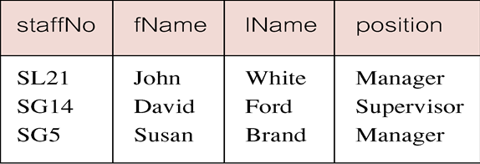
Select Set Membership
List all managers and supervisors.
SELECT staffNo, fName, lName, position
FROM Staff
WHERE position IN (‘Manager’, ‘Supervisor’);

Slide 32
The * WildCard
Instead of listing each of the columns, you can use an * to include all columns.
SELECT * FROM
Listing the columns does give you the ability to choose both which columns and which order to present them.
With the * you return all the columns in the order they have in the underlying table.

Slide 33
Distinct Key Word
Sometimes a query will return multiple duplicate values.
For instance the statement
SELECT Key FROM Session
Could return numerous instances of each customer.
The DISTINCT keyword will make it so it only returns one instance of each Key.

Slide 34
Distinct Key Word
SELECT DISTINCT Key
FROM Session
The DISTINCT keyword always operates on the whole role, not on individual columns.
It only returns distinct rows.

Slide 35
Calculations
You can do calculations in SELECT statements.
SELECT ItemNumber, ItemPrice, Quantity, ItemPrice * Quantity
FROM CustomerOrder

Slide 36
Order of Operations
The order of operation is the same as in algebra.
Whatever is in parentheses is executed first. If parentheses are nested, the innermost is executed first, then the next most inner, etc.
Then all division and multiplication left to right
And finally all addition and subtraction left to right

Slide 37
Sorting
You can sort the results of a query by using the keywords ORDER BY.
SELECT *
FROM Session ORDER BY SessionDate
ORDER BY does an ascending A-Z, 1-10, etc. sort by default.
You can change the direction by using the DESC keyword after the field to be sorted.

Slide 38
Aliasing
Sometimes it is useful to alias a column name to make a more readable result set.
SELECT StudentLastName AS [Last Name], StudentFirstName AS [First Name]
FROM Student
The AS keyword is optional.
Double quotes “ “ can be used instead of square brackets.

Slide 39
Where Clause
The WHERE clause allows you to limit the rows you return in a query.
You use the WHERE clause to specify the criteria by which the rows will be filtered.
SELECT LastName, FirstName, Phone, City
FROM Customer
WHERE City = ‘Boston’

Slide 40
Other Criteria
As well as equal you can use other operators for the criteria:
>
<
>=
=<
Character and date values in the criteria are quoted with single quotes.
Numerical values are not quoted.

Slide 41
Like
The LIKE keyword used in a WHERE operator with a wildcard (% or _) allows you to search for patterns in character-based fields.
The following returns all items whose name starts with “T.”
SELECT ItemName, ItemPrice
FROM Inventory
WHERE ItemName LIKE ‘T%’

Slide 42
Between
The BETWEEN keyword can be used in criteria to return values between to other values.
BETWEEN is inclusive of its ends.
SELECT Key, SessionDate, StudentKey
FROM Session
WHERE SessionDate BETWEEN ’11/1/2014’ AND ‘11/30/2014’

Slide 43
AND OR NOT
You can use keywords AND, OR, and NOT to combine criteria in a query.
AND is exclusive. Or is Inclusive.
WHERE City = ‘Boston’ OR City=‘Los Angeles’ returns all records that have either Boston or Los Angeles for their city.
WHERE City=‘Boston’ AND City=‘Los Angeles’ returns nothing because the record cannot have both at the same time.
NOT excludes.
WHERE NOT City = ‘Los Angeles’ returns every city except Los Angeles.

Slide 44
NULL
Nulls are special cases. They are not a value and so cannot be compared to a value using = or < or >.
To locate nulls you can use the IS keyword in a criteria:
WHERE StudentKey IS NULL
WHERE StudentKey IS NOT NULL

Slide 45
Select Set Membership
There is a negated version (NOT IN).
IN does not add much to SQL’s expressive power. Could have expressed this as:
SELECT staffNo, fName, lName, position
FROM Staff
WHERE position=‘Manager’ OR
position=‘Supervisor’;
IN is more efficient when set contains many values.

Slide 46
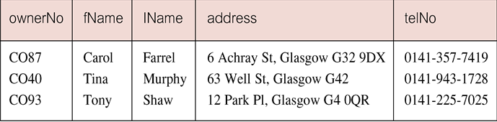
Select Pattern Matching
Find all owners with the string ‘Glasgow’ in their address.
SELECT ownerNo, fName, lName, address, telNo
FROM PrivateOwner
WHERE address LIKE ‘%Glasgow%’;

Slide 47
Select Pattern Matching
SQL has two special pattern matching symbols:
%: sequence of zero or more characters;
_ (underscore): any single character.
LIKE ‘%Glasgow%’ means a sequence of characters of any length containing ‘Glasgow’.

Slide 48
Select NULL Search Condition
List details of all viewings on property PG4 where a comment has not been supplied.
There are 2 viewings for property PG4, one with and one without a comment.
Have to test for null explicitly using special keyword IS NULL:
SELECT clientNo, viewDate
FROM Viewing
WHERE propertyNo = ‘PG4’ AND
comment IS NULL;

Slide 49
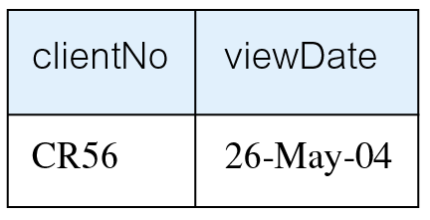
Select NULL Search Condition
Negated version (IS NOT NULL) can test for non-null values.

Slide 50
Select Single Column Ordering
List salaries for all staff, arranged in descending order of salary.
SELECT staffNo, fName, lName, salary
FROM Staff
ORDER BY salary DESC;

Slide 51
Select Multiple Column Ordering
Produce abbreviated list of properties in order of property type.
SELECT propertyNo, type, rooms, rent
FROM PropertyForRent
ORDER BY type;

Slide 52
Select Multiple Column Ordering
To arrange in order of rent, specify minor order:
SELECT propertyNo, type, rooms, rent
FROM PropertyForRent
ORDER BY type, rent DESC;

Slide 53
SELECT Statement - Aggregates
ISO standard defines five aggregate functions:
COUNT returns number of values in specified column.
SUM returns sum of values in specified column.
AVG returns average of values in specified column.
MIN returns smallest value in specified column.
MAX returns largest value in specified column.

Slide 54
SELECT Statement - Aggregates
Each operates on a single column of a table and returns a single value.
COUNT, MIN, and MAX apply to numeric and non-numeric fields, but SUM and AVG may be used on numeric fields only.
Apart from COUNT(*), each function eliminates nulls first and operates only on remaining non-null values.

Slide 55
SELECT Statement - Aggregates
COUNT(*) counts all rows of a table, regardless of whether nulls or duplicate values occur.
Can use DISTINCT before column name to eliminate duplicates.
DISTINCT has no effect with MIN/MAX, but may have with SUM/AVG.

Slide 56
SELECT Statement - Aggregates
Aggregate functions can be used only in SELECT list and in HAVING clause.
If SELECT list includes an aggregate function and there is no GROUP BY clause, SELECT list cannot reference a column out with an aggregate function. For example, the following is illegal:
SELECT staffNo, COUNT(salary)
FROM Staff;

Slide 57
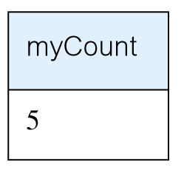
Select - Use of COUNT(*)
How many properties cost more than £350 per month to rent?
SELECT COUNT(*) AS myCount
FROM PropertyForRent
WHERE rent > 350;

Slide 58
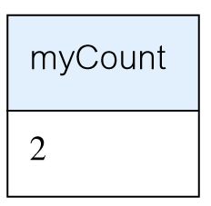
Select - Use of COUNT(DISTINCT)
How many different properties viewed in May ‘13?
SELECT COUNT(DISTINCT propertyNo) AS myCount
FROM Viewing
WHERE viewDate BETWEEN ‘1-May-13’
AND ‘31-May-13’;

Slide 59
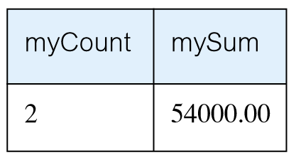
Select - Use of COUNT and SUM
Find number of Managers and sum of their salaries.
SELECT COUNT(staffNo) AS myCount,
SUM(salary) AS mySum
FROM Staff
WHERE position = ‘Manager’;

Slide 60
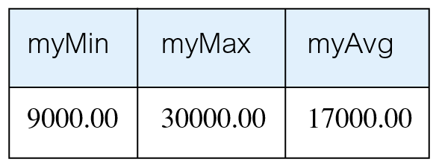
Select - Use of MIN, MAX, AVG
Find minimum, maximum, and average staff salary.
SELECT MIN(salary) AS myMin,
MAX(salary) AS myMax,
AVG(salary) AS myAvg
FROM Staff;

Slide 61
SELECT Statement - Grouping
Use GROUP BY clause to get sub-totals.
SELECT and GROUP BY closely integrated: each item in SELECT list must be single-valued per group, and SELECT clause may only contain:
column names
aggregate functions
constants
expression involving combinations of the above.

Slide 62
SELECT Statement - Grouping
All column names in SELECT list must appear in GROUP BY clause unless name is used only in an aggregate function.
If WHERE is used with GROUP BY, WHERE is applied first, then groups are formed from remaining rows satisfying predicate.
ISO considers two nulls to be equal for purposes of GROUP BY.

Slide 63
Select - Use of GROUP BY
Find number of staff in each branch and their total salaries.
SELECT branchNo,
COUNT(staffNo) AS myCount,
SUM(salary) AS mySum
FROM Staff
GROUP BY branchNo
ORDER BY branchNo;

Slide 64
Restricted Groupings – HAVING clause
HAVING clause is designed for use with GROUP BY to restrict groups that appear in final result table.
Similar to WHERE, but WHERE filters individual rows whereas HAVING filters groups.
Column names in HAVING clause must also appear in the GROUP BY list or be contained within an aggregate function.

Slide 65
Select - Use of HAVING
For each branch with more than 1 member of staff, find number of staff in each branch and sum of their salaries.
SELECT branchNo,
COUNT(staffNo) AS myCount,
SUM(salary) AS mySum
FROM Staff
GROUP BY branchNo
HAVING COUNT(staffNo) > 1
ORDER BY branchNo;

Slide 66
Subqueries
Some SQL statements can have a SELECT embedded within them.
A subselect can be used in WHERE and HAVING clauses of an outer SELECT, where it is called a subquery or nested query.
Subselects may also appear in INSERT, UPDATE, and DELETE statements.

Slide 67
Select - Subquery with Equality
List staff who work in branch at ‘163 Main St’.
SELECT staffNo, fName, lName, position
FROM Staff
WHERE branchNo =
(SELECT branchNo
FROM Branch
WHERE street = ‘163 Main St’);

Slide 68
Select - Subquery with Equality
Inner SELECT finds branch number for branch at ‘163 Main St’ (‘B003’).
Outer SELECT then retrieves details of all staff who work at this branch.
Outer SELECT then becomes:
SELECT staffNo, fName, lName, position
FROM Staff
WHERE branchNo = ‘B003’;

Slide 69
Select - Subquery with Aggregate
List all staff whose salary is greater than the average salary, and show by how much.
SELECT staffNo, fName, lName, position,
salary – (SELECT AVG(salary) FROM Staff) As SalDiff
FROM Staff
WHERE salary >
(SELECT AVG(salary)
FROM Staff);

Slide 70
Select - Subquery with Aggregate
Cannot write ‘WHERE salary > AVG(salary)’
Instead, use subquery to find average salary (17000), and then use outer SELECT to find those staff with salary greater than this:
SELECT staffNo, fName, lName, position,
salary – 17000 As salDiff
FROM Staff
WHERE salary > 17000;

Slide 71
Subquery Rules
ORDER BY clause may not be used in a subquery (although it may be used in outermost SELECT).
Subquery SELECT list must consist of a single column name or expression, except for subqueries that use EXISTS.
By default, column names refer to table name in FROM clause of subquery. Can refer to a table in FROM using an alias.

Slide 72
Subquery Rules
When subquery is an operand in a comparison, subquery must appear on right-hand side.
A subquery may not be used as an operand in an expression.

Slide 73
Select - Nested subquery: use of IN
List properties handled by staff at ‘163 Main St’.
SELECT propertyNo, street, city, postcode, type, rooms, rent
FROM PropertyForRent
WHERE staffNo IN
(SELECT staffNo
FROM Staff
WHERE branchNo =
(SELECT branchNo
FROM Branch
WHERE street = ‘163 Main St’));

Slide 74
ANY and ALL
ANY and ALL may be used with subqueries that produce a single column of numbers.
With ALL, condition will only be true if it is satisfied by all values produced by subquery.
With ANY, condition will be true if it is satisfied by any values produced by subquery.
If subquery is empty, ALL returns true, ANY returns false.
SOME may be used in place of ANY.

Slide 75
Select - Use of ANY/SOME
Find staff whose salary is larger than salary of at least one member of staff at branch B003.
SELECT staffNo, fName, lName, position, salary
FROM Staff
WHERE salary > SOME
(SELECT salary
FROM Staff
WHERE branchNo = ‘B003’);

Slide 76
Use of ALL
Find staff whose salary is larger than salary of every member of staff at branch B003.
SELECT staffNo, fName, lName, position, salary
FROM Staff
WHERE salary > ALL
(SELECT salary
FROM Staff
WHERE branchNo = ‘B003’);

Slide 77
Functions
Functions always have the same basic syntax:
<function name>(function arguments)
There are hundreds of built-in functions.
We will be concerned with two broad types of functions:
Scalar functions
Aggregate functions

Slide 78
Scalar Functions
Scalar functions operate on a single row at a time.
Here is a list of scalar functions used in this chapter.
Function Name | Description
GETDATE() | Returns current date and time
MONTH | Returns the month as an integer (1 to 12) from a Date value
YEAR | Returns the Year as a four-digit integer from a date value

Slide 79
Aggregate Functions
Aggregate functions operate on multiple rows at a time.
Here is a table of common aggregate functions:
Aggregate Function | Description
COUNT | Counts the number of values : COUNT(*) counts all the rows. COUNT(columnName) counts all the values in the column but ignores nulls
SUM | Sums or totals numeric values: SUM (InStock)
AVG | Returns the mean average of a set of numeric values: AVG(Price). By default nulls are ignored.
MAX | Returns the highest value in a set of numeric or datetime values: MAX(price)
MIN | Returns the smallest value in a set of numeric or datetime values: MIN(Price)

Slide 80
Using Distinct in Aggregate Functions
You can use the DISTINCT keyword with aggregate functions.
Doing so means the function will ignore duplicate values in its calculation.
SELECT COUNT(DISTINCT StudentKey) AS [Unduplicated]
FROM Session

Slide 81
Group By
When a SELECT clause includes an aggregate function and columns that are not a part of that function, you must use the GROUP BY keywords to group by each of the non-included columns.
This is necessary because you are mixing functions that operate on multiple rows with columns that refer to values in individual rows only.

Slide 82
Group By Example
SELECT Key, COUNT(SessionTimeKey) AS [Total Sessions]
FROM Session
GROUP BY Key

Slide 83
Having
The HAVING keyword is used when there is an aggregate function in the criteria of a query.
SELECT Key, COUNT(SessionTimeKey) AS [Total Sessions]
FROM Session
GROUP BY Key
HAVING COUNT(SessionTimeKey)<4

Slide 84
EXISTS and NOT EXISTS
EXISTS and NOT EXISTS are for use only with subqueries.
Produce a simple true/false result.
True if and only if there exists at least one row in result table returned by subquery.
False if subquery returns an empty result table.
NOT EXISTS is the opposite of EXISTS.

Slide 85
EXISTS and NOT EXISTS
As (NOT) EXISTS check only for existence or non-existence of rows in subquery result table, subquery can contain any number of columns.
Common for subqueries following (NOT) EXISTS to be of form:
(SELECT * ...)

Slide 86
Query using EXISTS
Find all staff who work in a London branch.
SELECT staffNo, fName, lName, position
FROM Staff s
WHERE EXISTS
(SELECT *
FROM Branch b
WHERE s.branchNo = b.branchNo AND
city = ‘London’);

Slide 87
Query using EXISTS
Note, search condition s.branchNo = b.branchNo is necessary to consider correct branch record for each member of staff.
If omitted, would get all staff records listed out because subquery:
SELECT * FROM Branch WHERE city=‘London’
would always be true and query would be:
SELECT staffNo, fName, lName, position FROM Staff
WHERE true;

Slide 88
Query using EXISTS
Could also write this query using join construct:
SELECT staffNo, fName, lName, position
FROM Staff s, Branch b
WHERE s.branchNo = b.branchNo AND
city = ‘London’;

Slide 89
Joins
In database design and normalization, the data are broken into several discrete tables.
Joins are the mechanism for recombining the data into one result set.
We will look at three kinds of joins:
Inner joins
Equi joins
Outer joins

Slide 90
Multi-Table Queries
Can use subqueries provided result columns come from same table.
If result columns come from more than one table must use a join.
To perform join, include more than one table in FROM clause.
Use comma as separator and typically include WHERE clause to specify join column(s).

Slide 91
Multi-Table Queries
Also possible to use an alias for a table named in FROM clause.
Alias is separated from table name with a space.
Alias can be used to qualify column names when there is ambiguity.

Slide 92
Simple Join
List names of all clients who have viewed a property along with any comment supplied.
SELECT c.clientNo, fName, lName,
propertyNo, comment
FROM Client c, Viewing v
WHERE c.clientNo = v.clientNo;

Slide 93
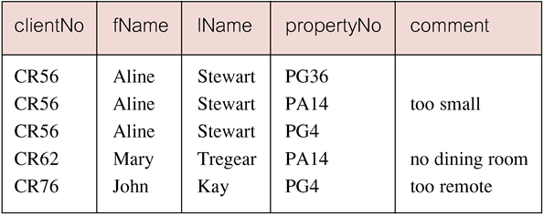
Simple Join
Only those rows from both tables that have identical values in the clientNo columns (c.clientNo = v.clientNo) are included in result.
Equivalent to equi-join in relational algebra.

Slide 94
Basic INNER JOIN Syntax
SELECT <column1, column2>
FROM <table1>
INNER JOIN <table2>
ON <table1>.<column>=<table2>.<column>

Slide 95
Inner Joins
Inner joins return related records from each of the tables joined.
SELECT LastName,
FirstName,
SessionDateKey,
SessionTimeKey,
StudentKey
SessionStatus
FROM
INNER JOIN Session
ON .Key = Session.Key

Slide 96
Alternative JOIN Constructs
SQL provides alternative ways to specify joins:
FROM Client c JOIN Viewing v ON c.clientNo = v.clientNo
FROM Client JOIN Viewing USING clientNo
FROM Client NATURAL JOIN Viewing
In each case, FROM replaces original FROM and WHERE. However, first produces table with two identical clientNo columns.

Slide 97
Equi Joins
Equi joins present an alternative way to perform inner joins. Some older RDMSs only support this alternative form. The example below also uses an alias for the table name.
SELECT t.Key,
LastName,
FirstName,
SessionDateKey,
SessionTimeKey,
StudentKey
FROM t,
Session s
WHERE t.Key = s.Key
AND LastName = ‘Brown’

Slide 98
Three Table Join
For each branch, list staff who manage properties, including city in which branch is located and properties they manage.
SELECT b.branchNo, b.city, s.staffNo, fName, lName,
propertyNo
FROM Branch b, Staff s, PropertyForRent p
WHERE b.branchNo = s.branchNo AND
s.staffNo = p.staffNo
ORDER BY b.branchNo, s.staffNo, propertyNo;

Slide 99
Sorting a join
For each branch, list numbers and names of staff who manage properties, and properties they manage.
SELECT s.branchNo, s.staffNo, fName, lName,
propertyNo
FROM Staff s, PropertyForRent p
WHERE s.staffNo = p.staffNo
ORDER BY s.branchNo, s.staffNo, propertyNo;

Slide 100
Multiple Grouping Columns
Find number of properties handled by each staff member.
SELECT s.branchNo, s.staffNo, COUNT(*) AS myCount
FROM Staff s, PropertyForRent p
WHERE s.staffNo = p.staffNo
GROUP BY s.branchNo, s.staffNo
ORDER BY s.branchNo, s.staffNo;

Slide 101
Computing a Join
Procedure for generating results of a join are:
1. Form Cartesian product of the tables named in FROM clause.
2. If there is a WHERE clause, apply the search condition to each row of the product table, retaining those rows that satisfy the condition.
3. For each remaining row, determine value of each item in SELECT list to produce a single row in result table.

Slide 102
Computing a Join
4. If DISTINCT has been specified, eliminate any duplicate rows from the result table.
5. If there is an ORDER BY clause, sort result table as required.
SQL provides special format of SELECT for Cartesian product:
SELECT [DISTINCT | ALL] {* | columnList}
FROM Table1 CROSS JOIN Table2

Slide 103
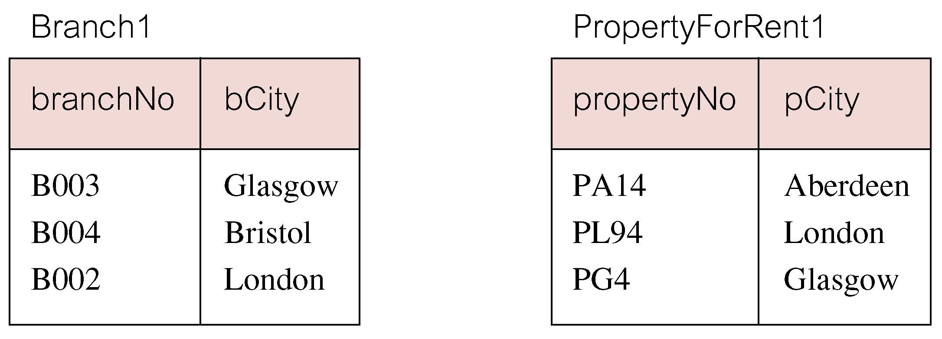
Outer Joins
If one row of a joined table is unmatched, row is omitted from result table.
Outer join operations retain rows that do not satisfy the join condition.
Consider following tables:

Slide 104
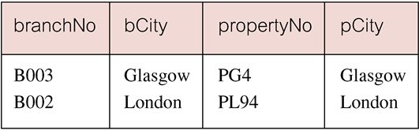
Outer Joins
The (inner) join of these two tables:
SELECT b.*, p.*
FROM Branch1 b, PropertyForRent1 p
WHERE b.bCity = p.pCity;

Slide 105
Outer Joins
Result table has two rows where cities are same.
There are no rows corresponding to branches in Bristol and Aberdeen.
To include unmatched rows in result table, use an Outer join.

Slide 106
Left Outer Join
List branches and properties that are in same city along with any unmatched properties.
SELECT b.*, p.*
FROM Branch1 b LEFT JOIN
PropertyForRent1 p ON b.bCity = p.pCity;

Slide 107
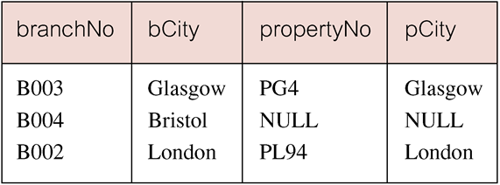
Left Outer Join
Includes those rows of first (left) table unmatched with rows from second (right) table.
Columns from second table are filled with NULLs.

Slide 108
Right Outer Join
List branches and properties in same city and any unmatched properties.
SELECT b.*, p.*
FROM Branch1 b RIGHT JOIN
PropertyForRent1 p ON b.bCity = p.pCity;

Slide 109
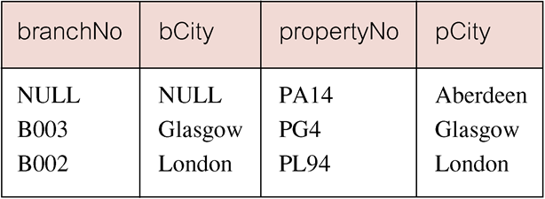
Right Outer Join
Right Outer join includes those rows of second (right) table that are unmatched with rows from first (left) table.
Columns from first table are filled with NULLs.

Slide 110
Full Outer Join
List branches and properties in same city and any unmatched branches or properties. (on both sides)
SELECT b.*, p.*
FROM Branch1 b FULL JOIN
PropertyForRent1 p ON b.bCity = p.pCity;

Slide 111
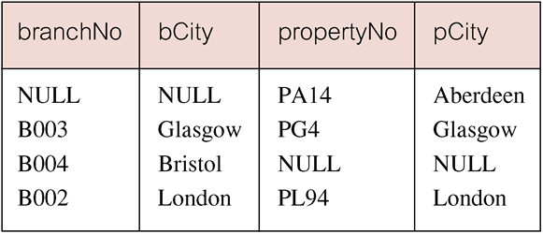
Full Outer Join
Includes rows that are unmatched in both tables.
Unmatched columns are filled with NULLs.

Slide 112
OUTER JOIN Syntax
Outer joins return records that are not matched. The following query returns s that have no sessions scheduled.
SELECT <column1>, <column2>
FROM <table1>
LEFT OUTER JOIN <table2> ON <table1>.<column>=<table2>.<column>

Slide 113
Outer Join Example
SELECT t.Key,
LastName,
SessionDateKey
FROM t
LEFT OUTER JOIN Session s
ON t.Key = s.Key
WHERE SessionDateKey IS Null

Slide 114
Inserts
To insert a record into a table, you use the following syntax:
INSERT INTO <tablename>(<ColumnName>, <columnName>, ...)
VALUES(<value1>, <value2>, ...)

Slide 115
Updates
Updates allow you to change existing records. The syntax is:
UPDATE <TableName>
SET <ColumnName> = <New Value>,
<ColumnName>=<new value>
WHERE <ColumnName> = <criteria>

Slide 116
Deletes
Deletes allow you to remove a record from a table:
DELETE FROM <TableName>
WHERE <columnName> = <criteria>

Slide 117
Deletes and Updates
Deletes and updates are dangerous. If you do not specify a criteria, the update or delete will be applied to all the rows in a table.
Also, referential integrity may prevent a deletion. You cannot delete a parent that has children in another table.

Slide 118
SubQuery Example
SELECT DISTINCT COUNT(*) AS Total,
(SELECT COUNT(*)
FROM Session
WHERE SessionStatus='NS') AS NoShow,
(SELECT COUNT(*)
FROM Session
WHERE SessionStatus='c') AS Completed
FROM Session
This example shows subqueries used in the SELECT clause to return Aggregate values.

Slide 119
Locating Duplicates
SELECT Lastname, firstname, email, phone, COUNT(*) AS [duplicates]
FROM contact
GROUP BY Lastname, firstName, email, Phone
HAVING COUNT(*) >1
This SQL finds duplicate values in in a table.

Slide 120
Documentation: Testing Plans
When testing the database, you should document all your SQL queries and their results.
On the next slide is a sample of a test table, showing the test and results.

Slide 121
Union, Intersect, and Difference
Can use normal set operations of Union, Intersection, and Difference to combine results of two or more queries into a single result table.
Union of two tables, A and B, is table containing all rows in either A or B or both.
Intersection is table containing all rows common to both A and B.
Difference is table containing all rows in A but not in B.
Two tables must be union compatible.

Slide 122
Union, Intersect, and Difference
Format of set operator clause in each case is:
op [ALL] [CORRESPONDING [BY {column1 [, ...]}]]
If CORRESPONDING BY specified, set operation performed on the named column(s).
If CORRESPONDING specified but not BY clause, operation performed on common columns.
If ALL specified, result can include duplicate rows.

Slide 123
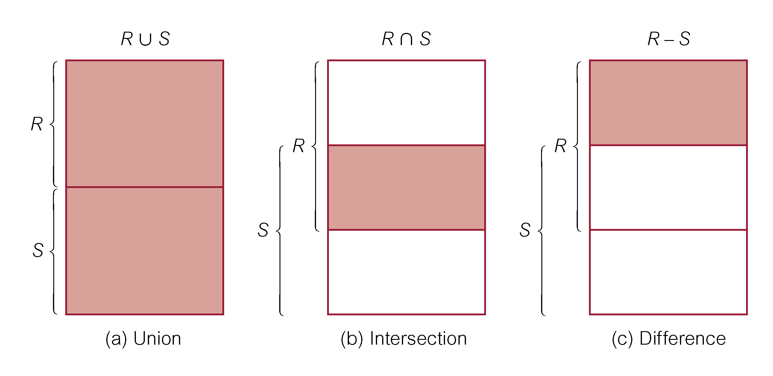
Union, Intersect, and Difference

Slide 124
Use of UNION
List all cities where there is either a branch office or a property.
(SELECT city
FROM Branch
WHERE city IS NOT NULL) UNION
(SELECT city
FROM PropertyForRent
WHERE city IS NOT NULL);

Slide 125
Use of UNION
Or
(SELECT * FROM Branch WHERE city IS NOT NULL) UNION CORRESPONDING BY city (SELECT * FROM PropertyForRent WHERE city IS NOT NULL);

Slide 126
Union Example
INSERT INTO Contact(LastName, FirstName, Email, Phone)
SELECT StudentLastName AS LastName,
StudentFirstName AS FirstName,
StudentEmail AS Email,
StudentPhone AS Phone
FROM Student
WHERE StudentEmail IS NOT NULL
UNION
SELECT LastName,
FirstName,
Email,
Phone
FROM
WHERE Email IS NOT NULL
This UNION query joins the tables Student and into a single result and writes them to the table Contact.

Slide 127
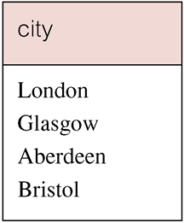
Use of UNION
Produces result tables from both queries and merges both tables together.

Slide 128
Use of INTERSECT
List all cities where there is both a branch office and a property.
(SELECT city FROM Branch)
INTERSECT
(SELECT city FROM PropertyForRent);

Slide 129
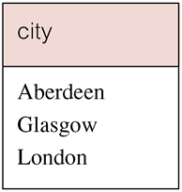
Use of INTERSECT
Or
(SELECT * FROM Branch)
INTERSECT CORRESPONDING BY city
(SELECT * FROM PropertyForRent);

Slide 130
Use of INTERSECT
Could rewrite this query without INTERSECT operator:
SELECT b.city
FROM Branch b PropertyForRent p
WHERE b.city = p.city;
Or:
SELECT DISTINCT city FROM Branch b
WHERE EXISTS
(SELECT * FROM PropertyForRent p
WHERE p.city = b.city);

Slide 131
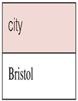
Use of EXCEPT
List of all cities where there is a branch office but no properties.
(SELECT city FROM Branch)
EXCEPT
(SELECT city FROM PropertyForRent);
Or
(SELECT * FROM Branch)
EXCEPT CORRESPONDING BY city
(SELECT * FROM PropertyForRent);

Slide 132
Use of EXCEPT
Could rewrite this query without EXCEPT:
SELECT DISTINCT city FROM Branch
WHERE city NOT IN
(SELECT city FROM PropertyForRent);
Or
SELECT DISTINCT city FROM Branch b
WHERE NOT EXISTS
(SELECT * FROM PropertyForRent p
WHERE p.city = b.city);

Slide 133
INSERT
INSERT INTO TableName [ (columnList) ]
VALUES (dataValueList)
columnList is optional; if omitted, SQL assumes a list of all columns in their original CREATE TABLE order.
Any columns omitted must have been declared as NULL when table was created, unless DEFAULT was specified when creating column.

Slide 134
INSERT
dataValueList must match columnList as follows:
number of items in each list must be same;
must be direct correspondence in position of items in two lists;
data type of each item in dataValueList must be compatible with data type of corresponding column.

Slide 135
INSERT … VALUES
Insert a new row into Staff table supplying data for all columns.
INSERT INTO Staff
VALUES (‘SG16’, ‘Alan’, ‘Brown’, ‘Assistant’, ‘M’, Date‘1957-05-25’, 8300, ‘B003’);

Slide 136
INSERT using Defaults
Insert a new row into Staff table supplying data for all mandatory columns.
INSERT INTO Staff (staffNo, fName, lName,
position, salary, branchNo)
VALUES (‘SG44’, ‘Anne’, ‘Jones’,
‘Assistant’, 8100, ‘B003’);
Or
INSERT INTO Staff
VALUES (‘SG44’, ‘Anne’, ‘Jones’, ‘Assistant’, NULL,
NULL, 8100, ‘B003’);

Slide 137
INSERT … SELECT
Second form of INSERT allows multiple rows to be copied from one or more tables to another:
INSERT INTO TableName [ (columnList) ]
SELECT ...

Slide 138
INSERT … SELECT
Assume there is a table StaffPropCount that contains names of staff and number of properties they manage:
StaffPropCount(staffNo, fName, lName, propCnt)
Populate StaffPropCount using Staff and PropertyForRent tables.

Slide 139
INSERT … SELECT
INSERT INTO StaffPropCount
(SELECT s.staffNo, fName, lName, COUNT(*)
FROM Staff s, PropertyForRent p
WHERE s.staffNo = p.staffNo
GROUP BY s.staffNo, fName, lName)
UNION
(SELECT staffNo, fName, lName, 0
FROM Staff
WHERE staffNo NOT IN
(SELECT DISTINCT staffNo
FROM PropertyForRent));

Slide 140
UPDATE
UPDATE TableName
SET columnName1 = dataValue1
[, columnName2 = dataValue2...]
[WHERE searchCondition]
TableName can be name of a base table or an updatable view.
SET clause specifies names of one or more columns that are to be updated.

Slide 141
UPDATE
WHERE clause is optional:
if omitted, named columns are updated for all rows in table;
if specified, only those rows that satisfy searchCondition are updated.
New dataValue(s) must be compatible with data type for corresponding column.

Slide 142
UPDATE All Rows
Give all staff a 3% pay increase.
UPDATE Staff
SET salary = salary*1.03;
Give all Managers a 5% pay increase.
UPDATE Staff
SET salary = salary*1.05
WHERE position = ‘Manager’;

Slide 143
UPDATE Multiple Columns
Promote David Ford (staffNo=‘SG14’) to Manager and change his salary to £18,000.
UPDATE Staff
SET position = ‘Manager’, salary = 18000
WHERE staffNo = ‘SG14’;

Slide 144
DELETE
DELETE FROM TableName
[WHERE searchCondition]
TableName can be name of a base table or an updatable view.
searchCondition is optional; if omitted, all rows are deleted from table. This does not delete table. If search_condition is specified, only those rows that satisfy condition are deleted.

Slide 145
DELETE Specific Rows
Delete all viewings that relate to property PG4.
DELETE FROM Viewing
WHERE propertyNo = ‘PG4’;
Delete all records from the Viewing table.
DELETE FROM Viewing;

Slide 146
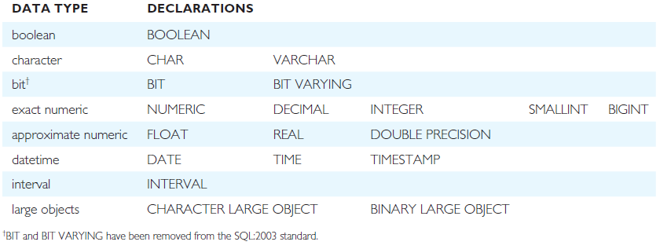
ISO SQL Data Types

Slide 147
Data Definition
SQL DDL allows database objects such as schemas, domains, tables, views, and indexes to be created and destroyed.
Main SQL DDL statements are:
CREATE SCHEMA DROP SCHEMA
CREATE/ALTER DOMAIN DROP DOMAIN
CREATE/ALTER TABLE DROP TABLE
CREATE VIEW DROP VIEW
Many DBMSs also provide:
CREATE INDEX DROP INDEX

Slide 148
Data Definition
Relations and other database objects exist in an environment.
Each environment contains one or more catalogs, and each catalog consists of set of schemas.
Schema is named collection of related database objects.
Objects in a schema can be tables, views, domains, assertions, collations, translations, and character sets. All have same owner.

Slide 149
CREATE SCHEMA
CREATE SCHEMA [Name |
AUTHORIZATION CreatorId ]
DROP SCHEMA Name [RESTRICT | CASCADE ]
With RESTRICT (default), schema must be empty or operation fails.
With CASCADE, operation cascades to drop all objects associated with schema in order defined above. If any of these operations fail, DROP SCHEMA fails.

Slide 150
CREATE TABLE
CREATE TABLE TableName
{(colName dataType [NOT NULL] [UNIQUE]
[DEFAULT defaultOption]
[CHECK searchCondition] [,...]}
[PRIMARY KEY (listOfColumns),]
{[UNIQUE (listOfColumns),] […,]}
{[FOREIGN KEY (listOfFKColumns)
REFERENCES ParentTableName [(listOfCKColumns)],
[ON UPDATE referentialAction]
[ON DELETE referentialAction ]] [,…]}
{[CHECK (searchCondition)] [,…] })

Slide 151
CREATE TABLE
Creates a table with one or more columns of the specified dataType.
With NOT NULL, system rejects any attempt to insert a null in the column.
Can specify a DEFAULT value for the column.
Primary keys should always be specified as NOT NULL.
FOREIGN KEY clause specifies FK along with the referential action.

Slide 152
CREATE TABLE
CREATE TABLE PropertyForRent (
propertyNo PNumber NOT NULL, ….
rooms PRooms NOT NULL DEFAULT 4,
rent PRent NOT NULL, DEFAULT 600,
ownerNo OwnerNumber NOT NULL,
staffNo StaffNumber
Constraint StaffNotHandlingTooMuch ….
branchNo BranchNumber NOT NULL,
PRIMARY KEY (propertyNo),
FOREIGN KEY (staffNo) REFERENCES Staff
ON DELETE SET NULL ON UPDATE CASCADE ….);

Slide 153
ALTER TABLE
Add a new column to a table.
Drop a column from a table.
Add a new table constraint.
Drop a table constraint.
Set a default for a column.
Drop a default for a column.

Slide 154
ALTER TABLE
Change Staff table by removing default of ‘Assistant’ for position column and setting default for sex column to female (‘F’).
ALTER TABLE Staff
ALTER position DROP DEFAULT;
ALTER TABLE Staff
ALTER sex SET DEFAULT ‘F’;

Slide 155
ALTER TABLE
Remove constraint from PropertyForRent that staff are not allowed to handle more than 100 properties at a time. Add new column to Client table.
ALTER TABLE PropertyForRent
DROP CONSTRAINT StaffNotHandlingTooMuch;
ALTER TABLE Client
ADD prefNoRooms PRooms;

Slide 156
DROP TABLE
DROP TABLE TableName [RESTRICT | CASCADE]
e.g. DROP TABLE PropertyForRent;
Removes named table and all rows within it.
With RESTRICT, if any other objects depend for their existence on continued existence of this table, SQL does not allow request.
With CASCADE, SQL drops all dependent objects (and objects dependent on these objects).

Slide 157
Views
View
Dynamic result of one or more relational operations operating on base relations to produce another relation.
Virtual relation that does not necessarily actually exist in the database but is produced upon request, at time of request.

Slide 158
Views
Contents of a view are defined as a query on one or more base relations.
With view resolution, any operations on view are automatically translated into operations on relations from which it is derived.
With view materialization, the view is stored as a temporary table, which is maintained as the underlying base tables are updated.

Slide 159
SQL - CREATE VIEW
CREATE VIEW ViewName [ (newColumnName [,...]) ]
AS subselect
[WITH [CASCADED | LOCAL] CHECK OPTION]
Can assign a name to each column in view.
If list of column names is specified, it must have same number of items as number of columns produced by subselect.
If omitted, each column takes name of corresponding column in subselect.

Slide 160
SQL - CREATE VIEW
List must be specified if there is any ambiguity in a column name.
The subselect is known as the defining query.
WITH CHECK OPTION ensures that if a row fails to satisfy WHERE clause of defining query, it is not added to underlying base table.
Need SELECT privilege on all tables referenced in subselect and USAGE privilege on any domains used in referenced columns.

Slide 161
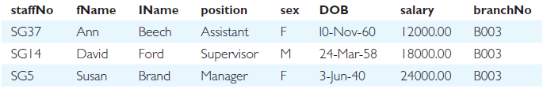
Create Horizontal View
Create view so that manager at branch B003 can only see details for staff who work in his or her office.
CREATE VIEW Manager3Staff
AS SELECT *
FROM Staff
WHERE branchNo = ‘B003’;

Slide 162
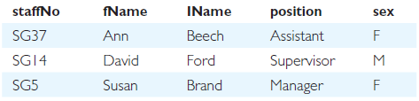
Create Vertical View
Create view of staff details at branch B003 excluding salaries.
CREATE VIEW Staff3
AS SELECT staffNo, fName, lName, position, sex
FROM Staff
WHERE branchNo = ‘B003’;

Slide 163
Grouped and Joined Views
Create view of staff who manage properties for rent, including branch number they work at, staff number, and number of properties they manage.
CREATE VIEW StaffPropCnt (branchNo, staffNo, cnt)
AS SELECT s.branchNo, s.staffNo, COUNT(*)
FROM Staff s, PropertyForRent p
WHERE s.staffNo = p.staffNo
GROUP BY s.branchNo, s.staffNo;

Slide 164
SQL - DROP VIEW
DROP VIEW ViewName [RESTRICT | CASCADE]
Causes definition of view to be deleted from database.
For example:
DROP VIEW Manager3Staff;

Slide 165
SQL - DROP VIEW
With CASCADE, all related dependent objects are deleted; i.e. any views defined on view being dropped.
With RESTRICT (default), if any other objects depend for their existence on continued existence of view being dropped, command is rejected.

Slide 166
View Resolution
Count number of properties managed by each member at branch B003.
SELECT staffNo, cnt
FROM StaffPropCnt
WHERE branchNo = ‘B003’
ORDER BY staffNo;

Slide 167
View Resolution
(a) View column names in SELECT list are translated into their corresponding column names in the defining query:
SELECT s.staffNo As staffNo, COUNT(*) As cnt
(b) View names in FROM are replaced with corresponding FROM lists of defining query:
FROM Staff s, PropertyForRent p

Slide 168
View Resolution
(c) WHERE from user query is combined with WHERE of defining query using AND:
WHERE s.staffNo = p.staffNo AND branchNo = ‘B003’
(d) GROUP BY and HAVING clauses copied from defining query:
GROUP BY s.branchNo, s.staffNo
(e) ORDER BY copied from query with view column name translated into defining query column name
ORDER BY s.staffNo

Slide 169
View Resolution
(f) Final merged query is now executed to produce the result:
SELECT s.staffNo AS staffNo, COUNT(*) AS cnt
FROM Staff s, PropertyForRent p
WHERE s.staffNo = p.staffNo AND
branchNo = ‘B003’
GROUP BY s.branchNo, s.staffNo
ORDER BY s.staffNo;

Slide 170
Restrictions on Views
SQL imposes several restrictions on creation and use of views.
(a) If column in view is based on an aggregate function:
Column may appear only in SELECT and ORDER BY clauses of queries that access view.
Column may not be used in WHERE nor be an argument to an aggregate function in any query based on view.

Slide 171
Restrictions on Views
For example, following query would fail:
SELECT COUNT(cnt)
FROM StaffPropCnt;
Similarly, following query would also fail:
SELECT *
FROM StaffPropCnt
WHERE cnt > 2;

Slide 172
Restrictions on Views
(b) Grouped view may never be joined with a base table or a view.
For example, StaffPropCnt view is a grouped view, so any attempt to join this view with another table or view fails.

Slide 173
View Updatability
All updates to base table reflected in all views that encompass base table.
Similarly, may expect that if view is updated then base table(s) will reflect change.

Slide 174
View Updatability
However, consider again view StaffPropCnt.
If we tried to insert record showing that at branch B003, SG5 manages 2 properties:
INSERT INTO StaffPropCnt
VALUES (‘B003’, ‘SG5’, 2);
Have to insert 2 records into PropertyForRent showing which properties SG5 manages. However, do not know which properties they are; i.e. do not know primary keys!

Slide 175
View Updatability
If change definition of view and replace count with actual property numbers:
CREATE VIEW StaffPropList (branchNo,
staffNo, propertyNo)
AS SELECT s.branchNo, s.staffNo, p.propertyNo
FROM Staff s, PropertyForRent p
WHERE s.staffNo = p.staffNo;

Slide 176
View Updatability
Now try to insert the record:
INSERT INTO StaffPropList
VALUES (‘B003’, ‘SG5’, ‘PG19’);
Still problem, because in PropertyForRent all columns except postcode/staffNo are not allowed nulls.
However, have no way of giving remaining non-null columns values.

Slide 177
View Updatability
ISO specifies that a view is updatable if and only if:
- DISTINCT is not specified.
- Every element in SELECT list of defining query is a column name and no column appears more than once.
- FROM clause specifies only one table, excluding any views based on a join, union, intersection or difference.
- No nested SELECT referencing outer table.
- No GROUP BY or HAVING clause.
- Also, every row added through view must not violate integrity constraints of base table.

Slide 178
Updatable View
For view to be updatable, DBMS must be able to trace any row or column back to its row or column in the source table.

Slide 179
WITH CHECK OPTION
Rows exist in a view because they satisfy WHERE condition of defining query.
If a row changes and no longer satisfies condition, it disappears from the view.
New rows appear within view when insert/update on view cause them to satisfy WHERE condition.
Rows that enter or leave a view are called migrating rows.
WITH CHECK OPTION prohibits a row migrating out of the view.

Slide 180
WITH CHECK OPTION
LOCAL/CASCADED apply to view hierarchies.
With LOCAL, any row insert/update on view and any view directly or indirectly defined on this view must not cause row to disappear from view unless row also disappears from derived view/table.
With CASCADED (default), any row insert/ update on this view and on any view directly or indirectly defined on this view must not cause row to disappear from the view.

Slide 181
WITH CHECK OPTION
CREATE VIEW Manager3Staff
AS SELECT *
FROM Staff
WHERE branchNo = ‘B003’
WITH CHECK OPTION;
Cannot update branch number of row B003 to B002 as this would cause row to migrate from view.
Also cannot insert a row into view with a branch number that does not equal B003.

Slide 182
WITH CHECK OPTION
Now consider the following:
CREATE VIEW LowSalary
AS SELECT * FROM Staff WHERE salary > 9000;
CREATE VIEW HighSalary
AS SELECT * FROM LowSalary
WHERE salary > 10000
WITH LOCAL CHECK OPTION;
CREATE VIEW Manager3Staff
AS SELECT * FROM HighSalary
WHERE branchNo = ‘B003’;

Slide 183
WITH CHECK OPTION
UPDATE Manager3Staff
SET salary = 9500
WHERE staffNo = ‘SG37’;
This update would fail: although update would cause row to disappear from HighSalary, row would not disappear from LowSalary.
However, if update tried to set salary to 8000, update would succeed as row would no longer be part of LowSalary.

Slide 184
WITH CHECK OPTION
If HighSalary had specified WITH CASCADED CHECK OPTION, setting salary to 9500 or 8000 would be rejected because row would disappear from HighSalary.
To prevent anomalies like this, each view should be created using WITH CASCADED CHECK OPTION.

Slide 185
Advantages of Views
Data independence
Currency
Improved security
Reduced complexity
Convenience
Customization
Data integrity

Slide 186
Disadvantages of Views
Update restriction
Structure restriction
Performance

Slide 187
View Materialization
View resolution mechanism may be slow, particularly if view is accessed frequently.
View materialization stores view as temporary table when view is first queried.
Thereafter, queries based on materialized view can be faster than recomputing view each time.
Difficulty is maintaining the currency of view while base tables(s) are being updated.

Slide 188
View Maintenance
View maintenance aims to apply only those changes necessary to keep view current.
Consider following view:
CREATE VIEW StaffPropRent(staffNo)
AS SELECT DISTINCT staffNo
FROM PropertyForRent
WHERE branchNo = ‘B003’ AND
rent > 400;

Slide 189
View Materialization
If insert row into PropertyForRent with rent ≤400 then view would be unchanged.
If insert row for property PG24 at branch B003 with staffNo = SG19 and rent = 550, then row would appear in materialized view.
If insert row for property PG54 at branch B003 with staffNo = SG37 and rent = 450, then no new row would need to be added to materialized view.
If delete property PG24, row should be deleted from materialized view.
If delete property PG54, then row for PG37 should not be deleted (because of existing property PG21).

Slide 190
Transactions
SQL defines transaction model based on COMMIT and ROLLBACK.
Transaction is logical unit of work with one or more SQL statements guaranteed to be atomic with respect to recovery.
An SQL transaction automatically begins with a transaction-initiating SQL statement (e.g., SELECT, INSERT).
Changes made by transaction are not visible to other concurrently executing transactions until transaction completes.

Slide 191
Transactions
Transaction can complete in one of four ways:
- COMMIT ends transaction successfully, making changes permanent.
- ROLLBACK aborts transaction, backing out any changes made by transaction.
- For programmatic SQL, successful program termination ends final transaction successfully, even if COMMIT has not been executed.
- For programmatic SQL, abnormal program end aborts transaction.

Slide 192
Transactions
New transaction starts with next transaction-initiating statement.
SQL transactions cannot be nested.
SET TRANSACTION configures transaction:
SET TRANSACTION
[READ ONLY | READ WRITE] |
[ISOLATION LEVEL READ UNCOMMITTED |
READ COMMITTED|REPEATABLE READ |SERIALIZABLE ]

Slide 193
Immediate and Deferred Integrity Constraints
Do not always want constraints to be checked immediately, but instead at transaction commit.
Constraint may be defined as INITIALLY IMMEDIATE or INITIALLY DEFERRED, indicating mode the constraint assumes at start of each transaction.
In former case, also possible to specify whether mode can be changed subsequently using qualifier [NOT] DEFERRABLE.
Default mode is INITIALLY IMMEDIATE.

Slide 194
Immediate and Deferred Integrity Constraints
SET CONSTRAINTS statement used to set mode for specified constraints for current transaction:
SET CONSTRAINTS
{ALL | constraintName [, . . . ]}
{DEFERRED ¦ IMMEDIATE}

Slide 195
Access Control - Authorization and Ownership
Authorization identifier is normal SQL identifier used to establish identity of a user. Usually has an associated password.
Used to determine which objects user may reference and what operations may be performed on those objects.
Each object created in SQL has an owner, as defined in AUTHORIZATION clause of schema to which object belongs.
Owner is only person who may know about it.

Slide 196
Privileges
Actions user permitted to carry out on given base table or view:
SELECT Retrieve data from a table.
INSERT Insert new rows into a table.
UPDATE Modify rows of data in a table.
DELETE Delete rows of data from a table.
REFERENCES Reference columns of named table in integrity constraints.
USAGE Use domains, collations, character sets, and translations.

Slide 197
Privileges
Can restrict INSERT/UPDATE/REFERENCES to named columns.
Owner of table must grant other users the necessary privileges using GRANT statement.
To create view, user must have SELECT privilege on all tables that make up view and REFERENCES privilege on the named columns.

Slide 198
GRANT
GRANT {PrivilegeList | ALL PRIVILEGES}
ON ObjectName
TO {AuthorizationIdList | PUBLIC}
[WITH GRANT OPTION]
PrivilegeList consists of one or more of above privileges separated by commas.
ALL PRIVILEGES grants all privileges to a user.

Slide 199
GRANT
PUBLIC allows access to be granted to all present and future authorized users.
ObjectName can be a base table, view, domain, character set, collation or translation.
WITH GRANT OPTION allows privileges to be passed on.

Slide 200
Example GRANT
Give Manager full privileges to Staff table.
GRANT ALL PRIVILEGES
ON Staff
TO Manager WITH GRANT OPTION;
Give users Personnel and Director SELECT and UPDATE on column salary of Staff.
GRANT SELECT, UPDATE (salary)
ON Staff
TO Personnel, Director;

Slide 201
GRANT Specific Privileges to PUBLIC
Give all users SELECT on Branch table.
GRANT SELECT
ON Branch
TO PUBLIC;

Slide 202
REVOKE
REVOKE takes away privileges granted with GRANT.
REVOKE [GRANT OPTION FOR]
{PrivilegeList | ALL PRIVILEGES}
ON ObjectName
FROM {AuthorizationIdList | PUBLIC}
[RESTRICT | CASCADE]
ALL PRIVILEGES refers to all privileges granted to a user by user revoking privileges.

Slide 203
REVOKE
GRANT OPTION FOR allows privileges passed on via WITH GRANT OPTION of GRANT to be revoked separately from the privileges themselves.
REVOKE fails if it results in an abandoned object, such as a view, unless the CASCADE keyword has been specified.
Privileges granted to this user by other users are not affected.

Slide 204
REVOKE Specific Privileges
Revoke privilege SELECT on Branch table from all users.
REVOKE SELECT
ON Branch
FROM PUBLIC;
Revoke all privileges given to Director on Staff table.
REVOKE ALL PRIVILEGES
ON Staff
FROM Director;

Slide 205
Creating a Trigger
Triggers are programs that are triggered by an event, typically INSERT, UPDATE, or DELETE.
They can be used to enforce business rules that referential integrity and constraints alone cannot enforce.
The basic syntax for creating a trigger is:
CREATE TRIGGER <trigger_name> ON <table_name>
[FOR, AFTER, INSTEAD OF] [INSERT, UPDATE, DELETE]
AS
{SQL Code}

Slide 206
Advanced SQL
SQL is a powerful language and there is much more that can be done with it.
Subqueries allow a user to embed whole independent SELECT statements in the SELECT clause or as a criterion in the WHERE clause.
Unions allow a user to blend the results of a two-result set into a single tabular output.
You can use SQL to find and remove duplicates.
Indexes help a database administrator speed up query results and optimize the database.

Slide 207
Integrity Enhancement Feature
Consider five types of integrity constraints:
required data
domain constraints
entity integrity
referential integrity
general constraints.

Slide 208
Integrity Enhancement Feature
Required Data
position VARCHAR(10) NOT NULL
Domain Constraints
(a) CHECK
sex CHAR NOT NULL
CHECK (sex IN (‘M’, ‘F’))

Slide 209
Integrity Enhancement Feature
(b) CREATE DOMAIN
CREATE DOMAIN DomainName [AS] dataType
[DEFAULT defaultOption]
[CHECK (searchCondition)]
For example:
CREATE DOMAIN SexType AS CHAR
CHECK (VALUE IN (‘M’, ‘F’));
sex SexType NOT NULL

Slide 210
Integrity Enhancement Feature
searchCondition can involve a table lookup:
CREATE DOMAIN BranchNo AS CHAR(4)
CHECK (VALUE IN (SELECT branchNo
FROM Branch));
Domains can be removed using DROP DOMAIN:
DROP DOMAIN DomainName
[RESTRICT | CASCADE]

Slide 211
IEF - Entity Integrity
Primary key of a table must contain a unique, non-null value for each row.
ISO standard supports FOREIGN KEY clause in CREATE and ALTER TABLE statements:
PRIMARY KEY(staffNo)
PRIMARY KEY(clientNo, propertyNo)
Can only have one PRIMARY KEY clause per table. Can still ensure uniqueness for alternate keys using UNIQUE:
UNIQUE(telNo)

Slide 212
IEF - Referential Integrity
FK is column or set of columns that links each row in child table containing foreign FK to row of parent table containing matching PK.
Referential integrity means that, if FK contains a value, that value must refer to existing row in parent table.
ISO standard supports definition of FKs with FOREIGN KEY clause in CREATE and ALTER TABLE:
FOREIGN KEY(branchNo) REFERENCES Branch

Slide 213
IEF - Referential Integrity
Any INSERT/UPDATE attempting to create FK value in child table without matching CK value in parent is rejected.
Action taken attempting to update/delete a CK value in parent table with matching rows in child is dependent on referential action specified using ON UPDATE and ON DELETE subclauses:
CASCADE - SET NULL
SET DEFAULT - NO ACTION

Slide 214
IEF - Referential Integrity
CASCADE: Delete row from parent and delete matching rows in child, and so on in cascading manner.
SET NULL: Delete row from parent and set FK column(s) in child to NULL. Only valid if FK columns are NOT NULL.
SET DEFAULT: Delete row from parent and set each component of FK in child to specified default. Only valid if DEFAULT specified for FK columns.
NO ACTION: Reject delete from parent. Default.

Slide 215
IEF - Referential Integrity
FOREIGN KEY (staffNo) REFERENCES Staff ON DELETE SET NULL
FOREIGN KEY (ownerNo) REFERENCES Owner ON UPDATE CASCADE

Slide 216
IEF - General Constraints
Could use CHECK/UNIQUE in CREATE and ALTER TABLE.
Similar to the CHECK clause, also have:
CREATE ASSERTION AssertionName
CHECK (searchCondition)

Slide 217
IEF - General Constraints
CREATE ASSERTION StaffNotHandlingTooMuch
CHECK (NOT EXISTS (SELECT staffNo
FROM PropertyForRent
GROUP BY staffNo
HAVING COUNT(*) > 100))

