Slide 1
DAMG 6210 Database Design
Nik Bear Brown
@NikBearBrown
Relational Algebra
Relational Calculus

Slide 2
Topics
Relational Algebra
Relational Calculus

Slide 3
Relational algebra and relational calculus
Relational algebra and relational calculus are formal languages associated with the relational model.
Informally, relational algebra is a (high-level) procedural language and relational calculus a non-procedural language.
However, formally both are equivalent to one another.
A language that produces a relation that can be derived using relational calculus is relationally complete.

Slide 4
Relational algebra and relational calculus
Two mathematical Query Languages form the basis for “real” languages (e.g. SQL), and for implementation:
Relational Algebra: More operational, very useful for representing execution plans.
Relational Calculus: Lets users describe what they want, rather than how to compute it. (Non-operational, declarative.)

Slide 5
Relational Algebra
Relational algebra operations work on one or more relations to define another relation without changing the original relations.
Both operands and results are relations, so output from one operation can become input to another operation.
Allows expressions to be nested, just as in arithmetic. This property is called closure.

Slide 6
Relational Algebra
Five basic operations in relational algebra: Selection, Projection, Cartesian product, Union, and Set Difference.
These perform most of the data retrieval operations needed.
Also have Join, Intersection, and Division operations, which can be expressed in terms of 5 basic operations

Slide 7




Relational Algebra
Basic operations:
Selection ( ) Selects a subset of rows from relation.
Projection ( ) Deletes unwanted columns from relation.
Cross-product ( ) Allows us to combine two relations.
Set-difference ( ) Tuples in reln. 1, but not in reln. 2.
Union ( ∪ ) Tuples in reln. 1 and in reln. 2.
Additional operations:
Intersection, join, division, renaming: Not essential, but (very!) useful.
Since each operation returns a relation, operations can be composed! (Algebra is “closed”.)

Slide 8
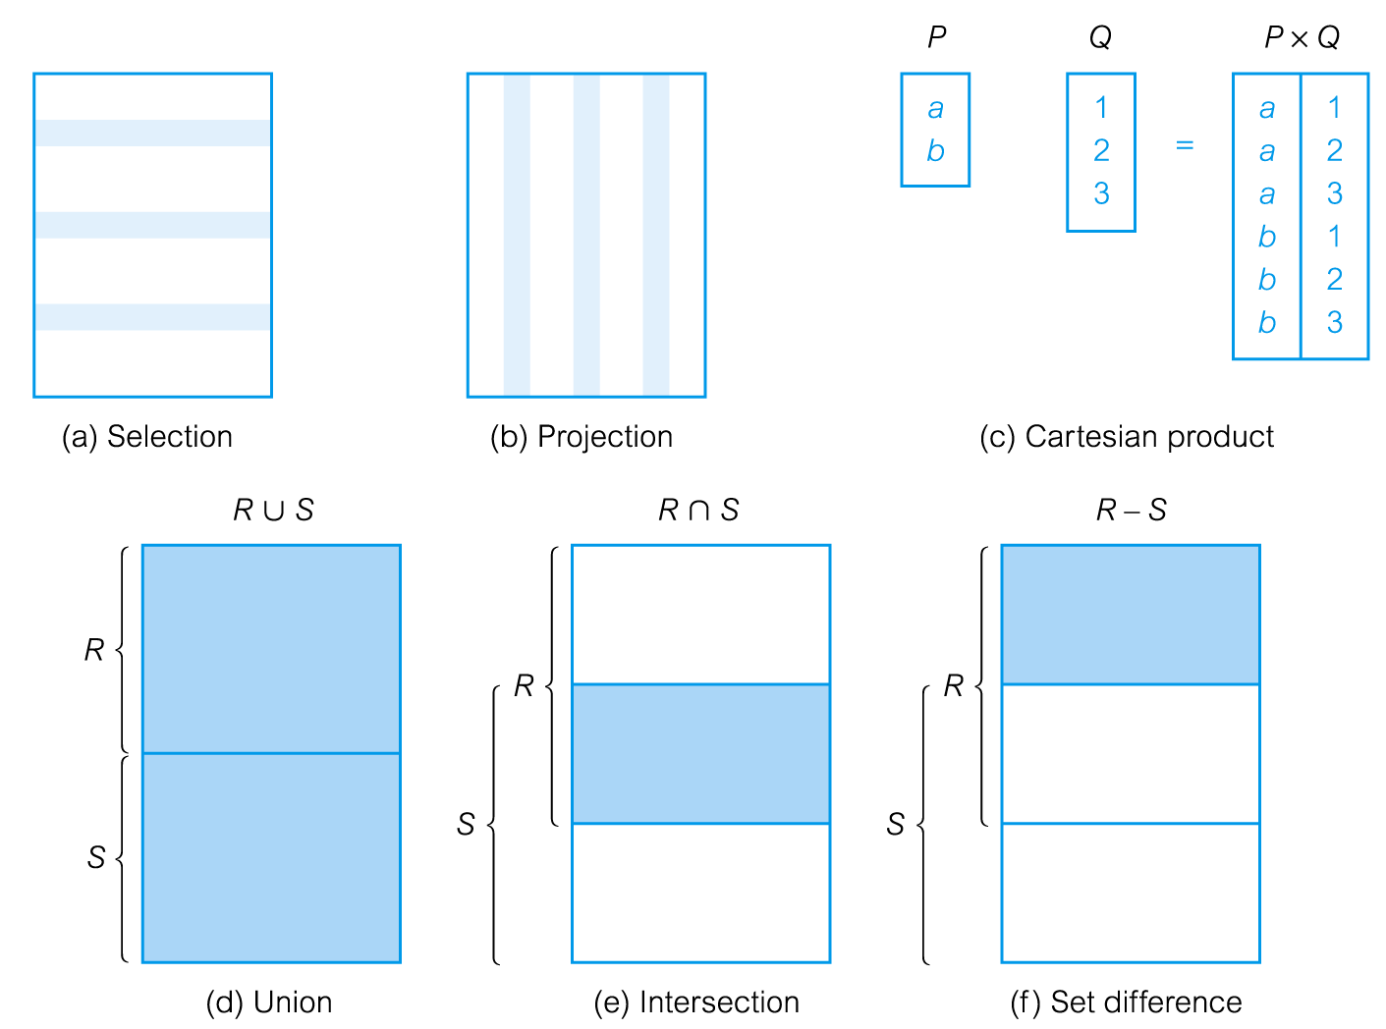
Relational Algebra Operations

Slide 9
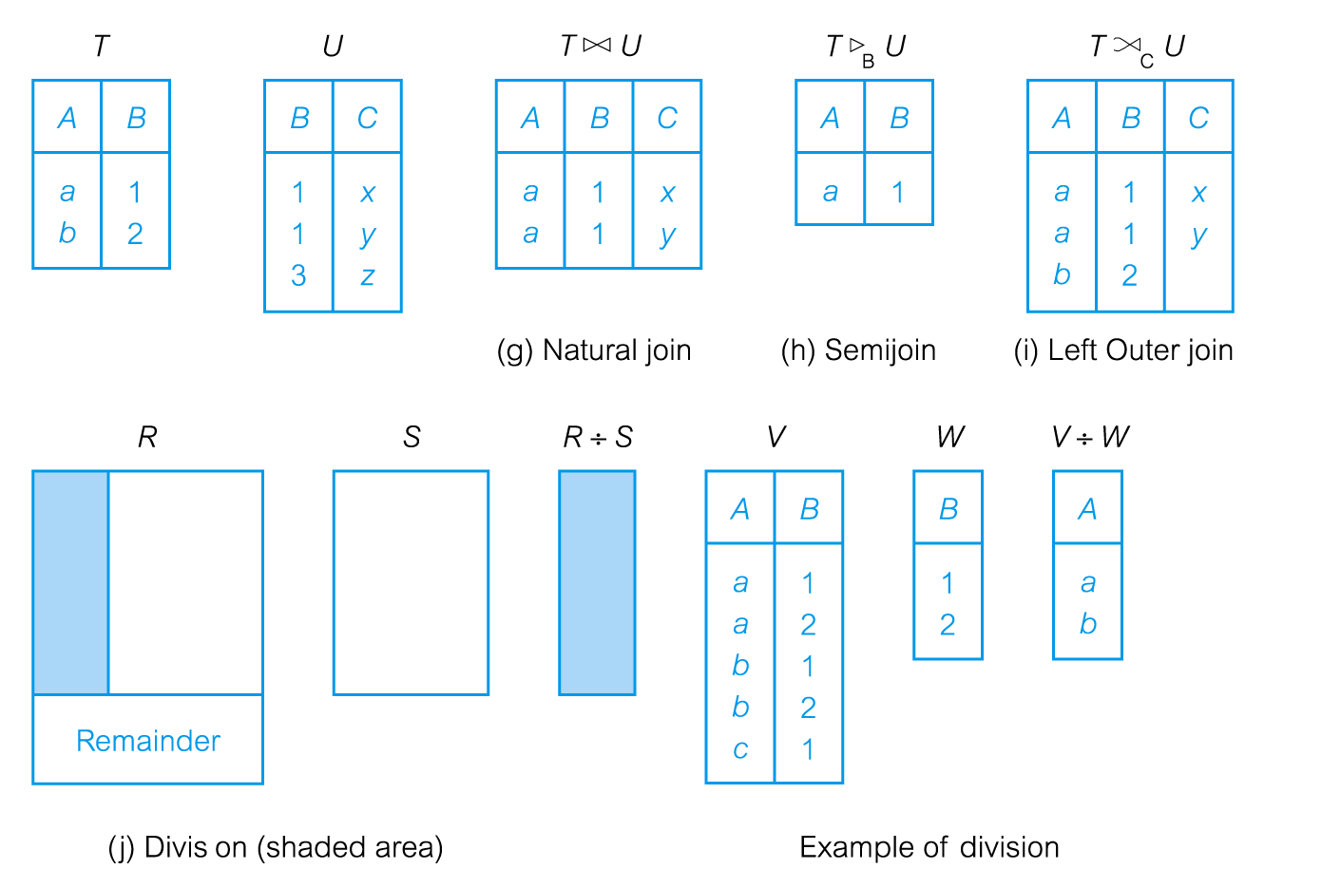
Relational Algebra Operations

Slide 10
Selection (or Restriction)
σ_{predicate} (R)
Works on a single relation R and defines a relation that contains only those tuples (rows) of R that satisfy the specified condition (predicate).

Slide 11
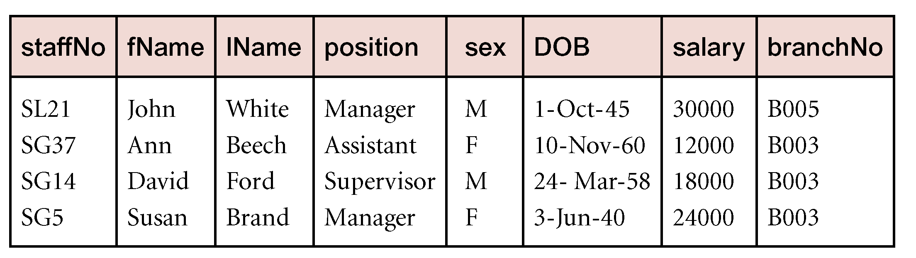
Example - Selection (or Restriction)
List all staff with a salary greater than £10,000.
σ_{salary > 10000} (Staff)

Slide 12
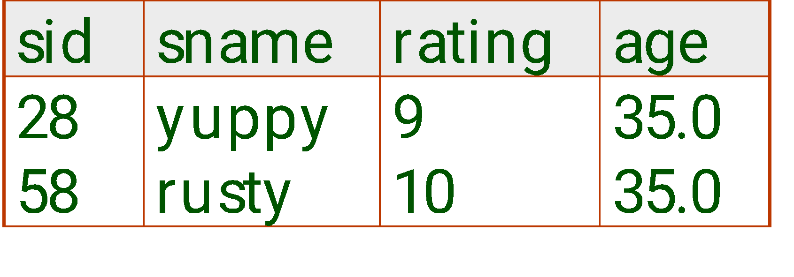
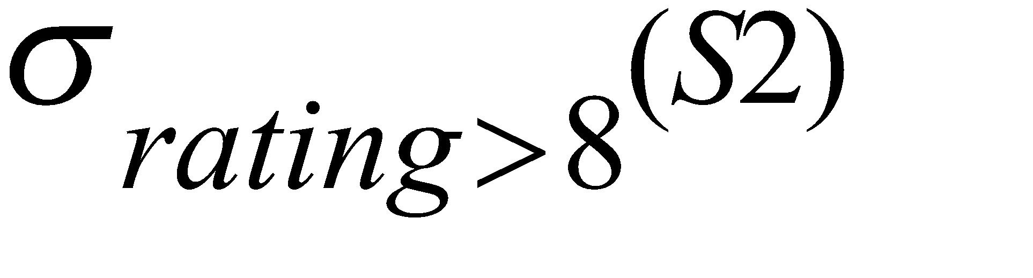
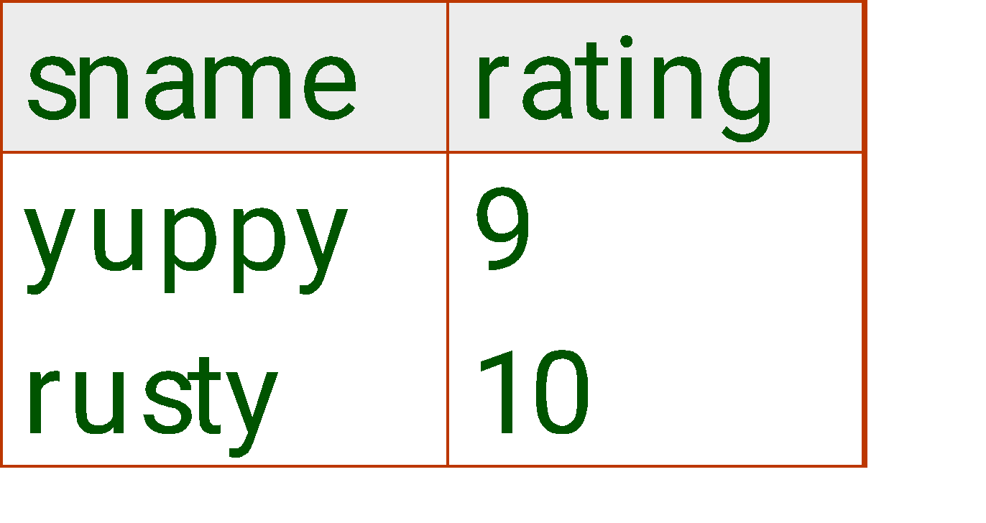
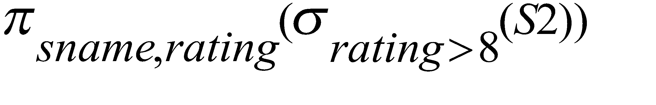
Selection
Selects rows that satisfy selection condition.
No duplicates in result! (Why?)
Schema of result identical to schema of (only) input relation.
Result relation can be the input for another relational algebra operation! (Operator composition.)

Slide 13
Selection
Notation: σ _{p}(r)
p is called the selection predicate , r can be the name of a table, or another query
Predicate:
Simple
attr1 = attr2
Attr = constant value
(also, <, > , etc)
Complex
predicate1 AND predicate2
predicate1 OR predicate2
NOT (predicate)

Slide 14
Projection
Π_{col1, . . . , coln}(R)
Works on a single relation R and defines a relation that contains a vertical subset of R, extracting the values of specified attributes and eliminating duplicates.

Slide 15
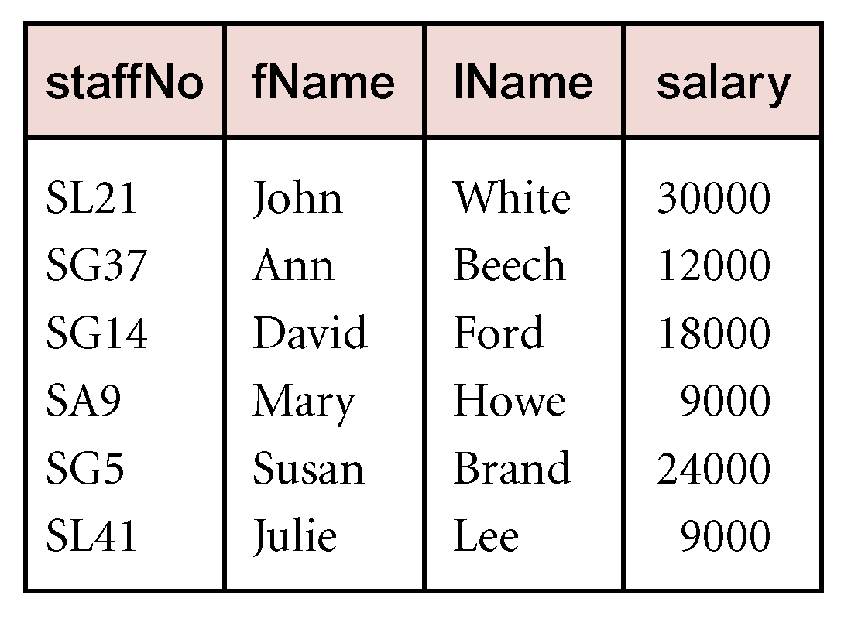
Example - Projection
Produce a list of salaries for all staff, showing only staffNo, fName, lName, and salary details.
Π_{staffNo, fName, lName, salary}(Staff)

Slide 16
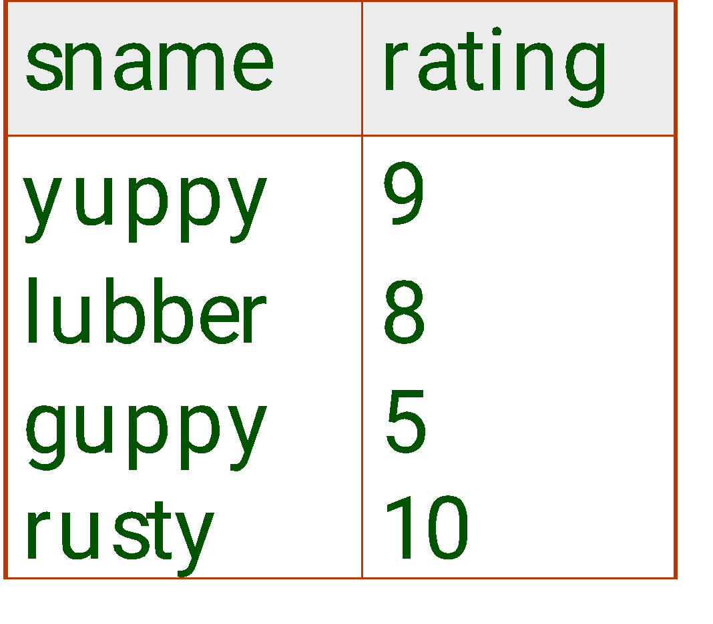
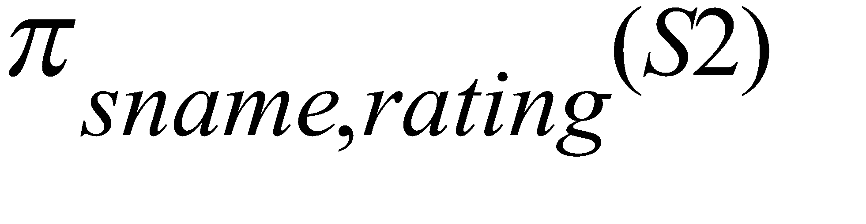
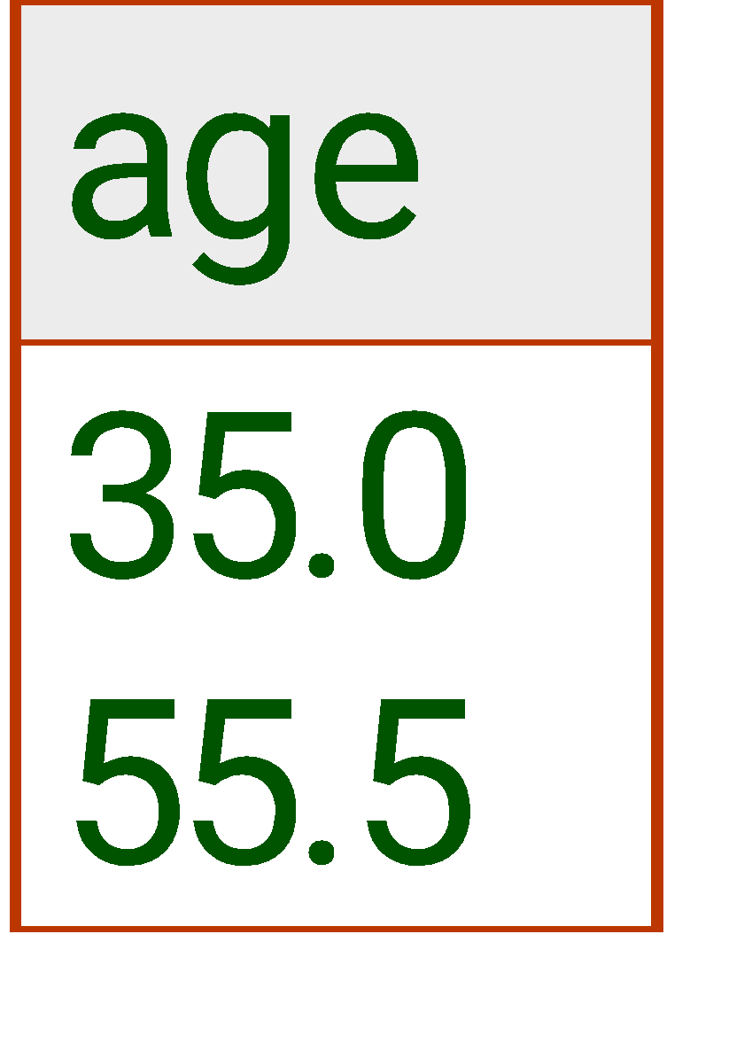
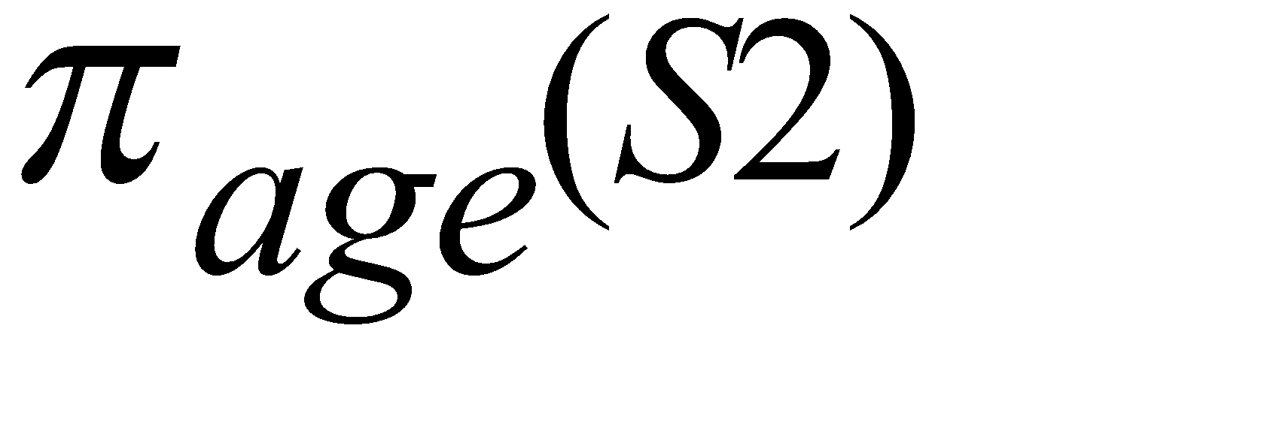
Projection
Deletes attributes that are not in projection list.
Schema of result contains exactly the fields in the projection list, with the same names that they had in the (only) input relation.
Projection operator has to eliminate duplicates! (Why??)
Note: real systems typically don’t do duplicate elimination unless the user explicitly asks for it. (Why not?)

Slide 17
Union
R ∪ S
Union of two relations R and S defines a relation that contains all the tuples of R, or S, or both R and S, duplicate tuples being eliminated.
R and S must be union-compatible.
If R and S have I and J tuples, respectively, union is obtained by concatenating them into one relation with a maximum of (I + J) tuples.

Slide 18
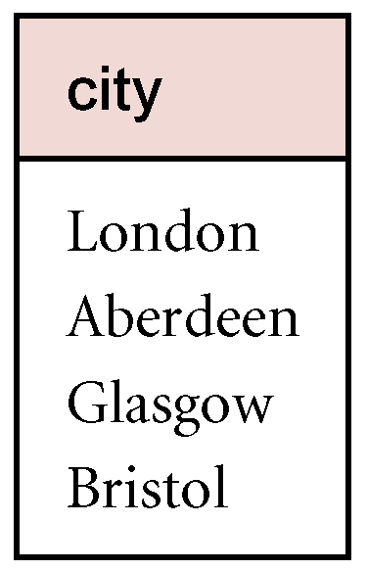
Example - Union
List all cities where there is either a branch office or a property for rent.
Π_{city}(Branch) ∪ Π_{city}(PropertyForRent)

Slide 19
Set Difference
R – S
Defines a relation consisting of the tuples that are in relation R, but not in S.
R and S must be union-compatible.

Slide 20
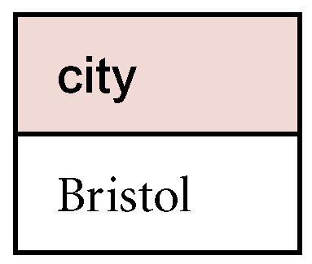
Example - Set Difference
List all cities where there is a branch office but no properties for rent.
Π_{city}(Branch) – Π_{city}(PropertyForRent)

Slide 21
Intersection
R ∩ S
Defines a relation consisting of the set of all tuples that are in both R and S.
R and S must be union-compatible.
Expressed using basic operations:
R ∩ S = R – (R – S)

Slide 22
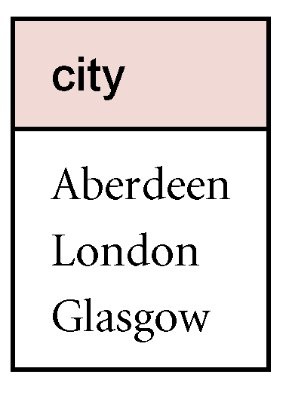
Example - Intersection
List all cities where there is both a branch office and at least one property for rent.
Π_{city}(Branch) ∩ Π_{city}(PropertyForRent)

Slide 23
Cartesian product
R X S
Defines a relation that is the concatenation of every tuple of relation R with every tuple of relation S.

Slide 24
Cartesian-Product
S1 × R1: Each row of S1 paired with each row of R1.
Like the c.p for mathematical relations: every tuple of S1 “appended” to every tuple of R1
Q: How many rows in the result?
Result schema has one field per field of S1 and R1, with field names `inherited’ if possible.
May have a naming conflict: Both S1 and R1 have a field with the same name.
In this case, can use the renaming operator…

Slide 25
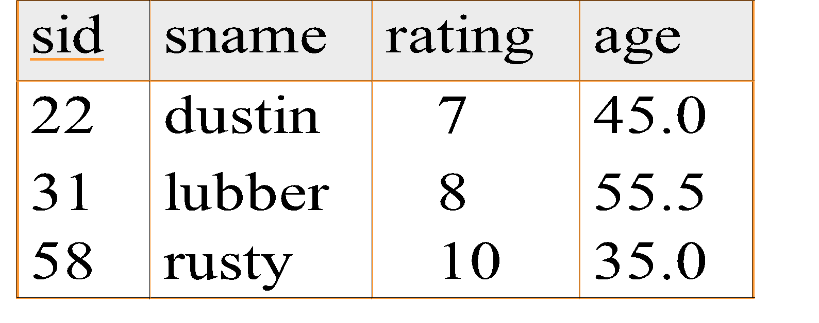
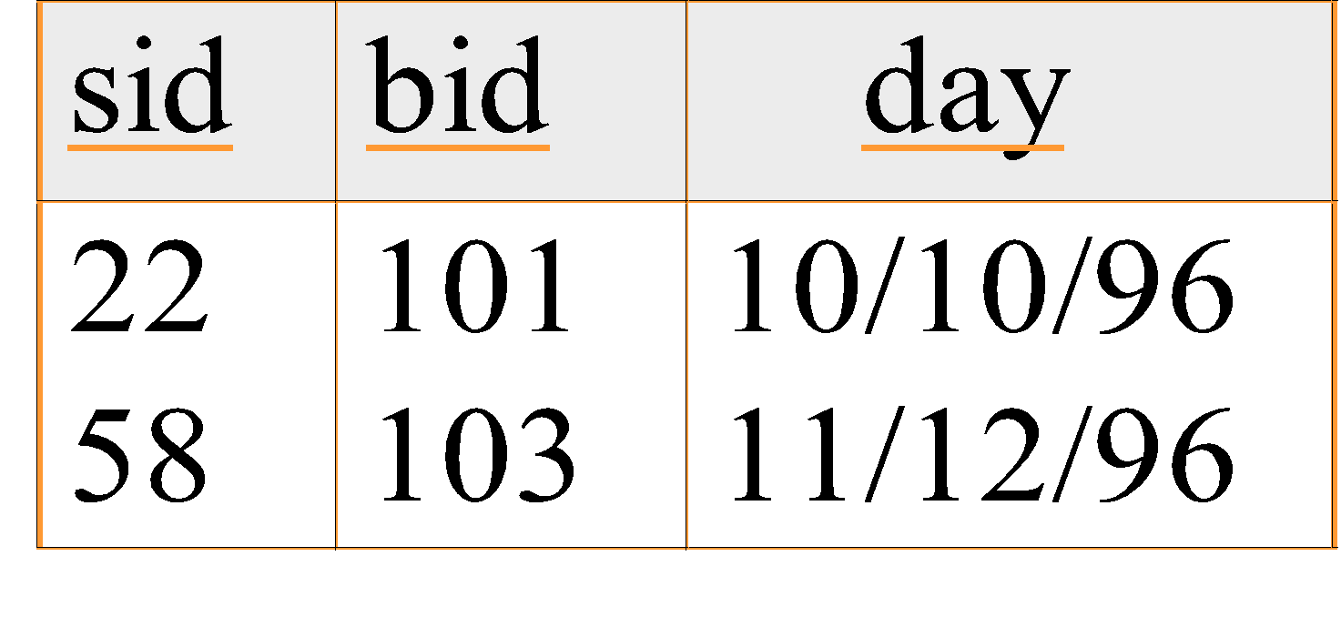
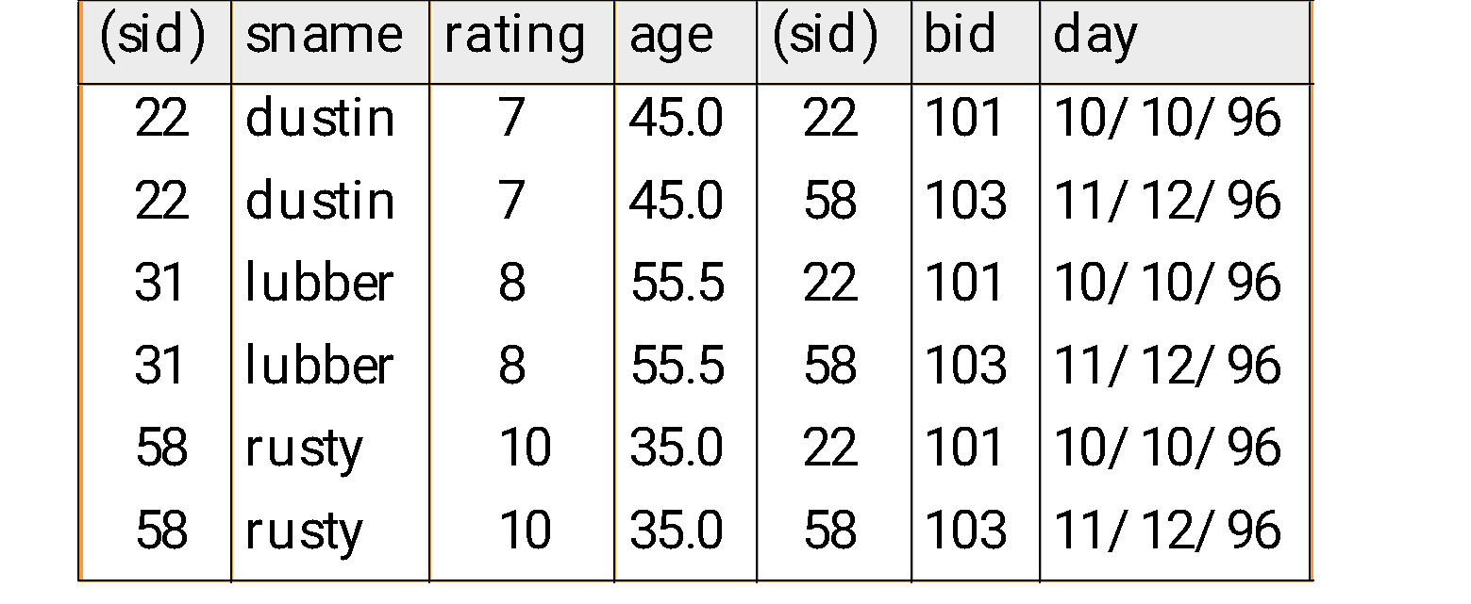
Cartesian Product Example
R1
S1
S1 X R1 =

Slide 26
Cartesian Products
For sets A, B, the Cartesian product, or cross product, of A and B is denoted by A × B and equals {(a, b) | a ∈ A, b ∈ B}
Elements of A × B are ordered pairs. For (a, b), (c, d) ∈ A × B , (a, b) = (c, d) if and only if a = c and b = d

Slide 27
Cartesian Products
Properties:
If A, B are finite, it follows from the rule of product that |A × B| = |A||B|
Although we generally will not have A × B = B × A, we will have |A×B|=|B×A|

Slide 28
Cartesian Products Example A
Let A = {2, 3, 4}, B = {4, 5}. Then
a) A × B = {(2, 4), (2, 5), (3, 4), (3, 5), (4, 4), (4, 5)}
b) B × A = {(4, 2), (4, 3), (4, 4), (5, 2), (5, 3), (5, 4)}
c) B² = B × B = {(4, 4), (4, 5), (5, 4), (5, 5)}
d) B³ = B × B × B = {(a, b, c) | a, b, c ∈ B}; for instance, (4, 5, 5) ∈ B³

Slide 29
Cartesian Products Example B
An experiment E is conducted as follows:
A single dice is rolled and its outcome noted,
and then a coin is flipped and its outcome noted.
Determine a sample space S for E
S1={1, 2, 3, 4, 5, 6} be a sample space dice.
S2= {H, T} be a sample space coin.
Then S = S1 × S2 is a sample space for E.

Slide 30
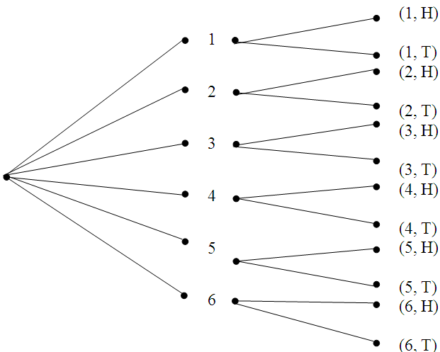
Cartesian Products Example B

Slide 31
Relations
Let A = {0,1,2}, B = {1,2,3}. A x B = {(0,1), (0,2), (0,3), (1,1), (1,2), (1,3), (2,1), (2,2), (2,3)}
Let say an element x in A is related to an element y in B iff x is less than y. x R y: x is related to y
0 R 1, 0 R 2, 0 R 3, 1 R 2, 1 R 3, 2 R 3
The set of all ordered pair in A x B where elements are related {(0,1), (0,2), (0,3), (1,2), (1,3), (2,3)}

Slide 32
Relations
For sets A, B, a (binary) relation R from A to B is a subset of A × B. Any subset of A × A is called a (binary) relation on A
Given an ordered pair (a, b) in A x B, x is related to y by R (x R y) iff (x, y) is in R
In general, for finite sets A, B with |A| = m and |B|= n, there are 2^{mn} relations from A to B, including the empty relation as well as the relation A × B itself

Slide 33
Relations Example
Let A = {2, 3, 4}, B = {4, 5}. Then
A × B = {(2, 4), (2, 5), (3, 4), (3, 5), (4, 4), (4, 5)}.
The following are some of the relations from A to B.
∅
{(2, 4)}
{(2, 4), (2, 5)}
{(2, 4), (3, 4), (4, 4)}
{(2, 4), (3, 4), (4, 5)}
A × B
Since |A × B| = 6, there are 2⁶ possible relations from A to Β (for there are 2⁶ possible subsets of A × B )

Slide 34
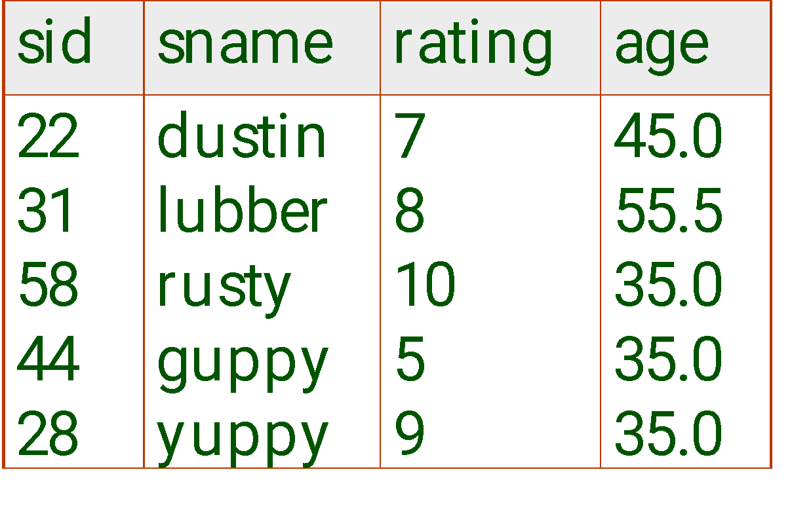

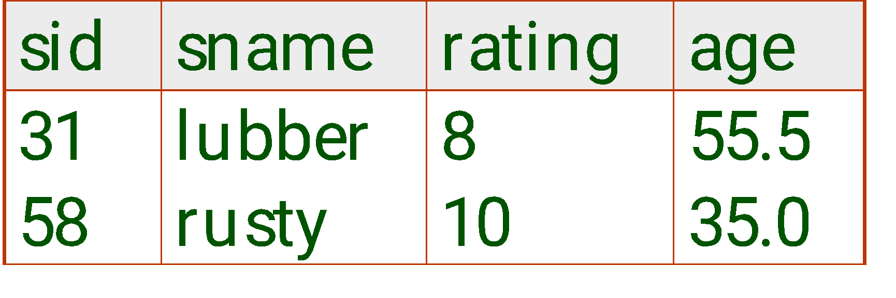
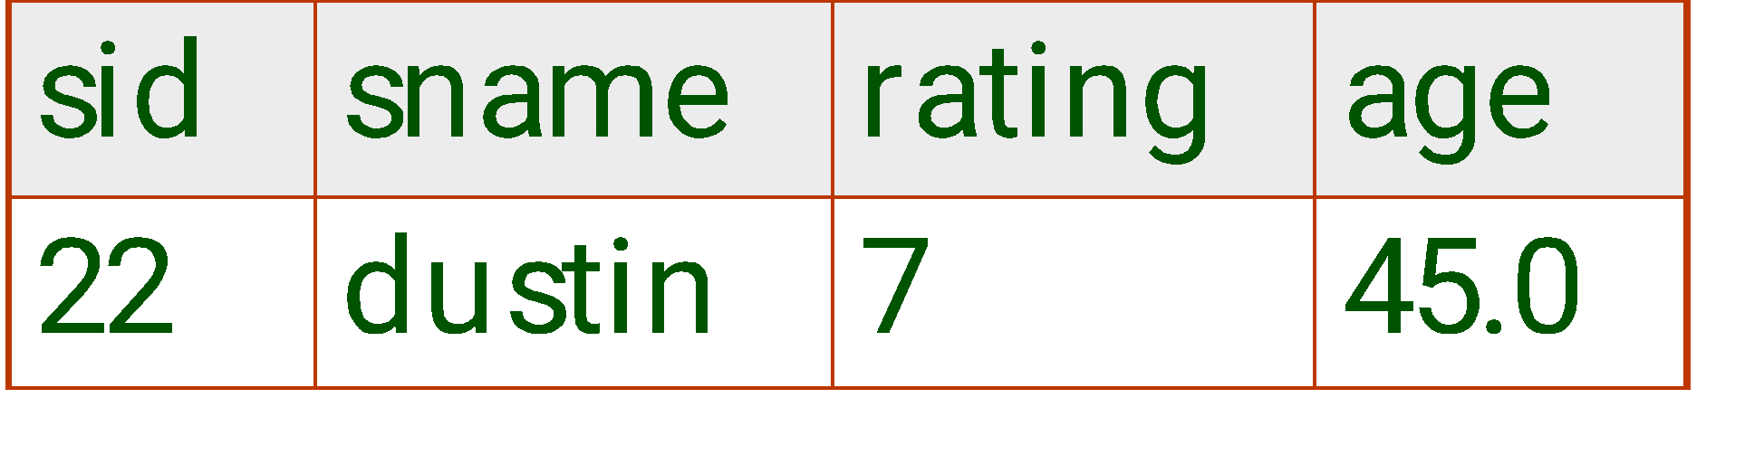


Union, Intersection, Set-Difference
All of these operations take two input relations, which must be union-compatible:
Same number of fields.
`Corresponding’ fields have the same type.
What is the schema of result?

Slide 35
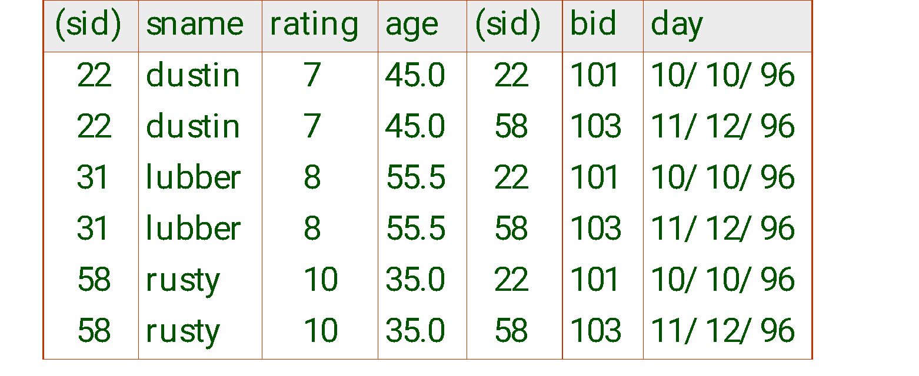
Cross-Product
Each row of S1 is paired with each row of R1.
Result schema has one field per field of S1 and R1, with field names `inherited’ if possible.
Conflict: Both S1 and R1 have a field called sid.

Slide 36
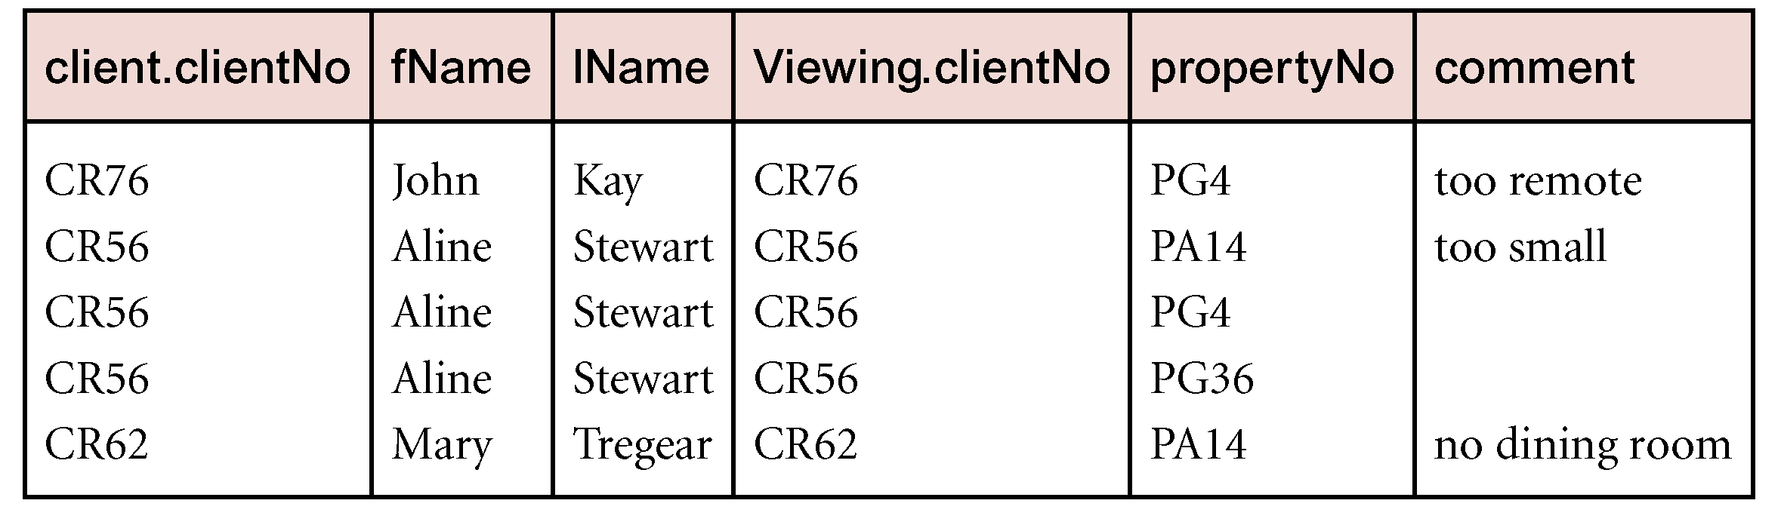
Example - Cartesian product and Selection
Use selection operation to extract those tuples where Client.clientNo = Viewing.clientNo.
sClient.clientNo = Viewing.clientNo((Õ_{clientNo, fName, lName}(Client)) Χ (Õ_{clientNo, propertyNo, comment}(Viewing)))
Cartesian product and Selection can be reduced to a single operation called a Join.

Slide 37
Join Operations
Join is a derivative of Cartesian product.
Equivalent to performing a Selection, using join predicate as selection formula, over Cartesian product of the two operand relations.
One of the most difficult operations to implement efficiently in an RDBMS and one reason why RDBMSs have intrinsic performance problems.

Slide 38
Join Operations
Various forms of join operation
Theta join
Equijoin (a particular type of Theta join)
Natural join
Outer join
Semijoin

Slide 39
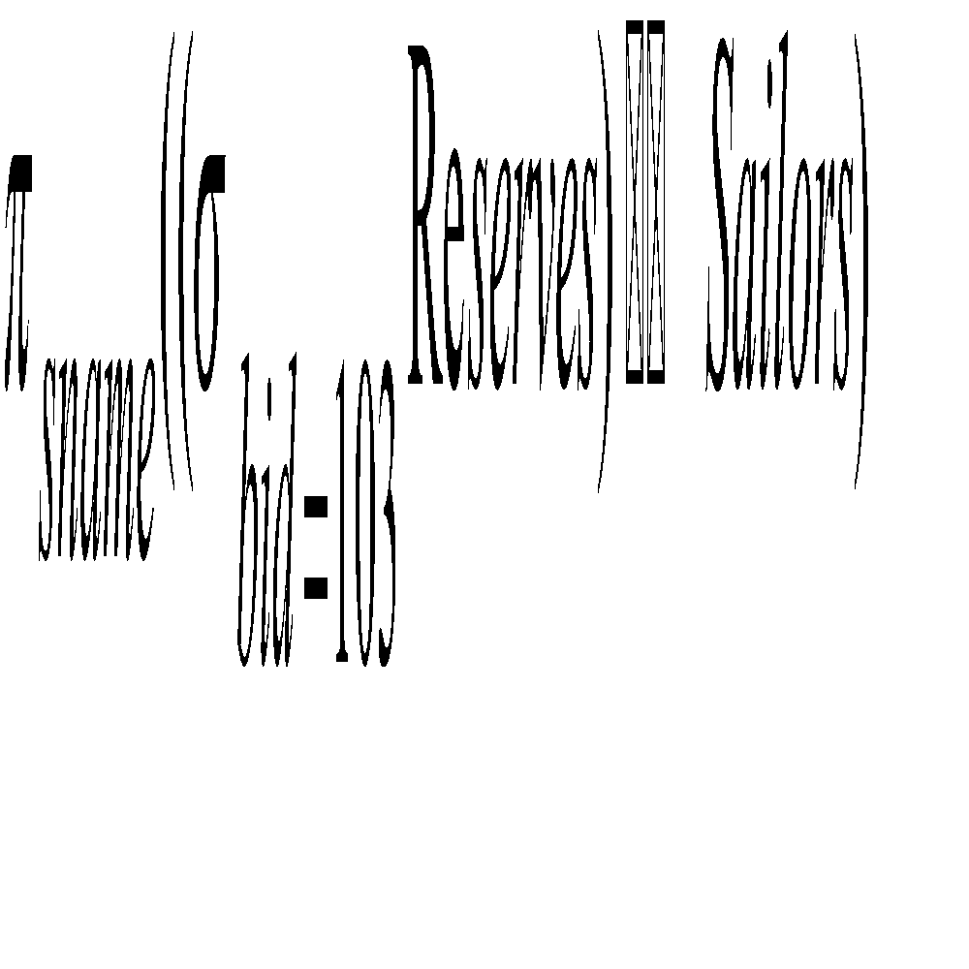
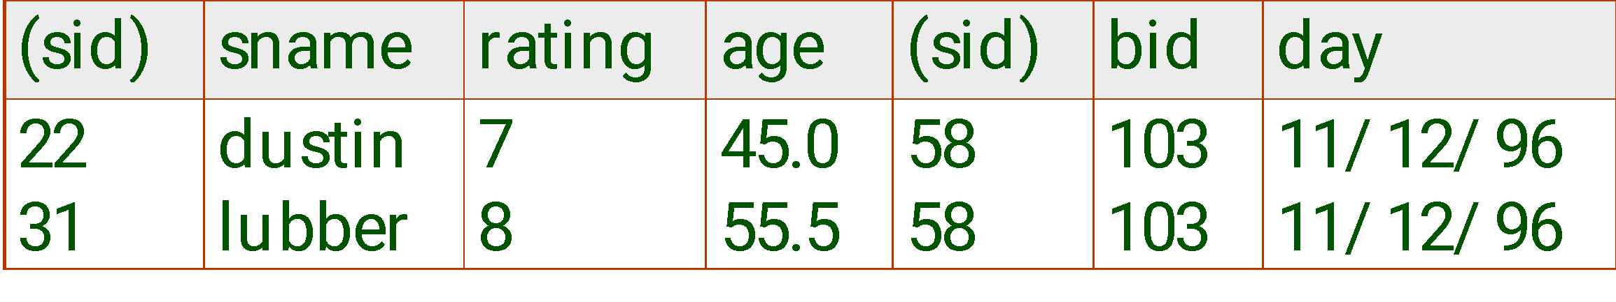
Joins
Condition Join: R _{C} S = σ_{C} (R × S)
S1 _{S1.sid < R1.sid} R1
Result schema same as that of cross-product.
Fewer tuples than cross-product, might be able to compute more efficiently
Sometimes called a theta-join.

Slide 40
Theta join (θ-join)
R _{F}S
Defines a relation that contains tuples satisfying the predicate F from the Cartesian product of R and S.
The predicate F is of the form R.a_{i} θ S.b_{i} where θ may be one of the comparison operators (<, ≤, >, ≥, =, ≠).

Slide 41
Theta join (θ-join)
Can rewrite Theta join using basic Selection and Cartesian product operations.
R _{F}S = σ_{F}(R Χ S)
Degree of a Theta join is sum of degrees of the operand relations R and S. If predicate F contains only equality (=), the term Equijoin is used.

Slide 42
Example - Equijoin
List the names and comments of all clients who have viewed a property for rent.
(Π_{clientNo, fName, lName}(Client)) Client.clientNo = Viewing.clientNo (Π_{clientNo, propertyNo, comment}(Viewing))

Slide 43
Natural join
R S
An Equijoin of the two relations R and S over all common attributes x. One occurrence of each common attribute is eliminated from the result.

Slide 44
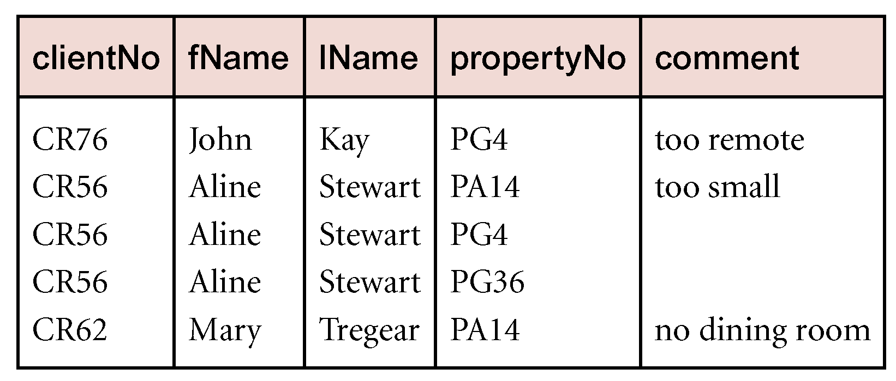
Example - Natural join
List the names and comments of all clients who have viewed a property for rent.
(Π_{clientNo, fName, lName}(Client))
(Π_{clientNo, propertyNo, comment}(Viewing))

Slide 45
Outer join
To display rows in the result that do not have matching values in the join column, use Outer join.
R S
(Left) outer join is join in which tuples from R that do not have matching values in common columns of S are also included in result relation.

Slide 46
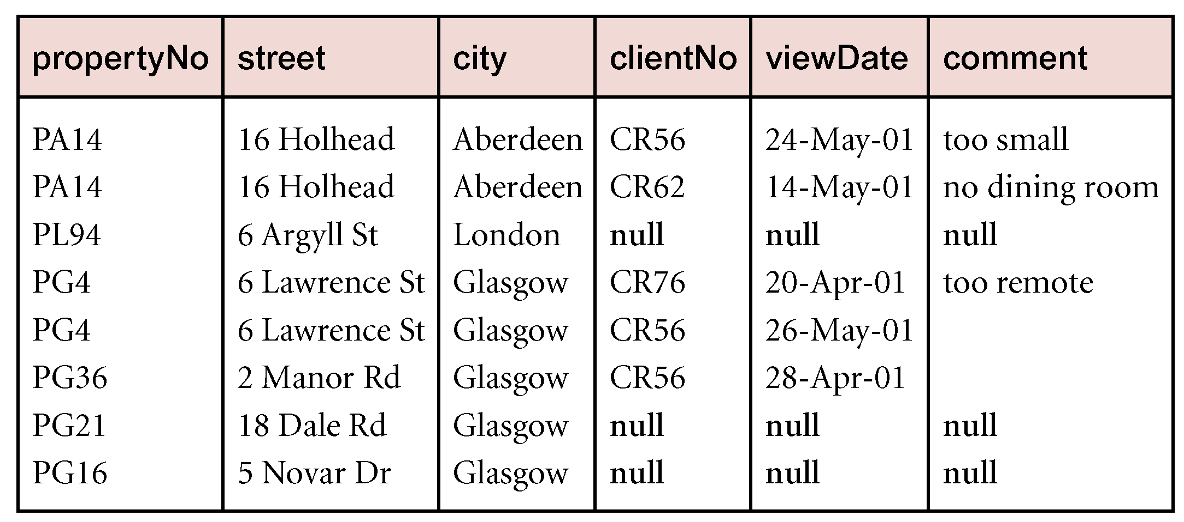
Example - Left Outer join
Produce a status report on property viewings.
Π_{propertyNo, street, city}(PropertyForRent)
Viewing

Slide 47
Semijoin
R _{F} S
Defines a relation that contains the tuples of R that participate in the join of R with S.
Can rewrite Semijoin using Projection and Join:
R _{F} S = Π_{A}(R _{F} S)

Slide 48
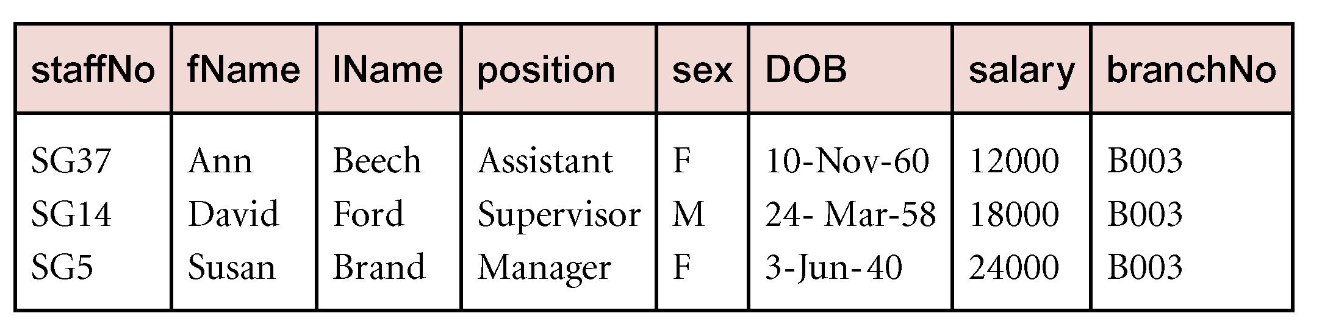
Example - Semijoin
List complete details of all staff who work at the branch in Glasgow.
Staff _{Staff.branchNo=Branch.branchNo}(σ_{city=‘Glasgow’}(Branch))

Slide 49
Division
R ÷ S
Defines a relation over the attributes C that consists of set of tuples from R that match combination of every tuple in S.
Expressed using basic operations:
T₁ ← Π_{C}(R)
T₂ ← Π_{C}((S X T₁) – R)
T ← T₁ – T₂

Slide 50
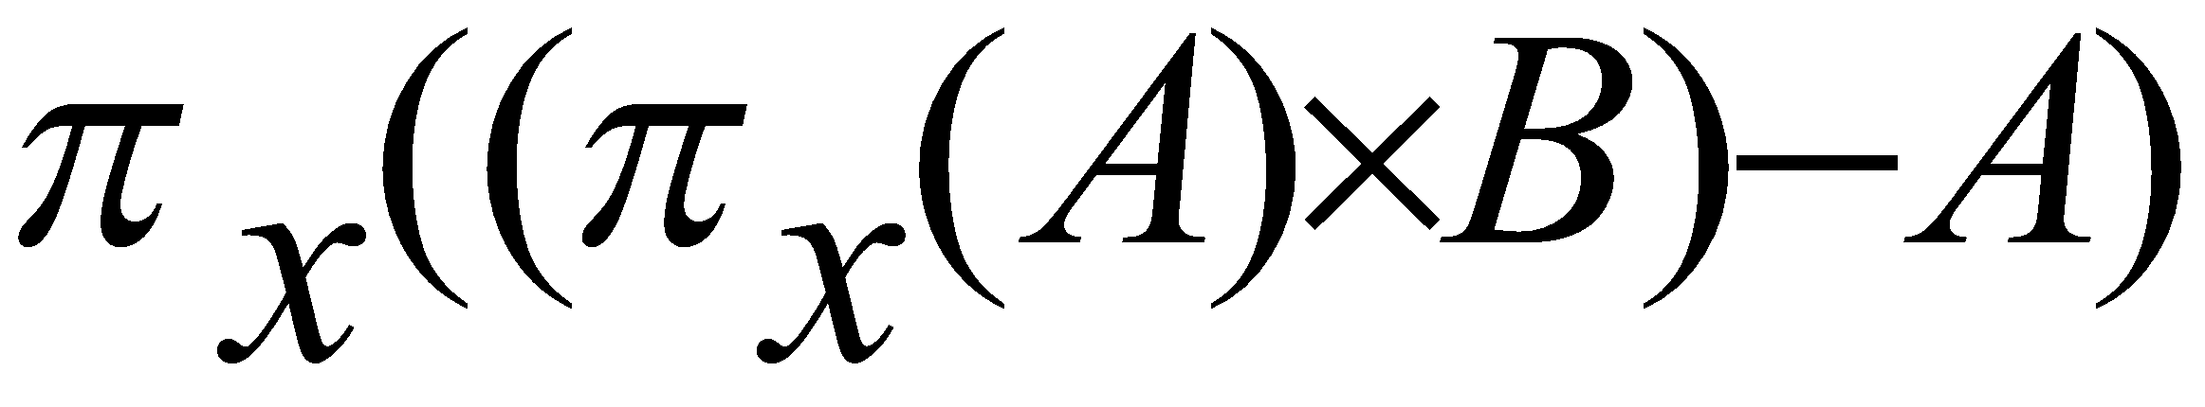
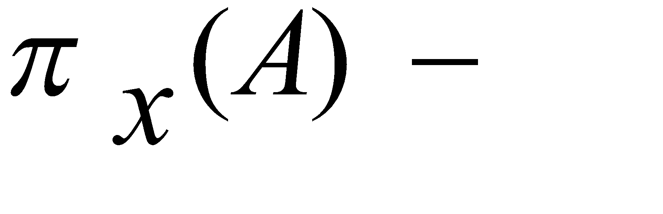
Expressing A/B Using Basic Operators
Division is not essential op; just a useful shorthand.
(Also true of joins, but joins are so common that systems implement joins specially.)
Idea: For A/B, compute all x values that are not `disqualified’ by some y value in B.
x value is disqualified if by attaching y value from B, we obtain an xy tuple that is not in A.
Disqualified x values:
A/B:
Disqualified x values

Slide 51
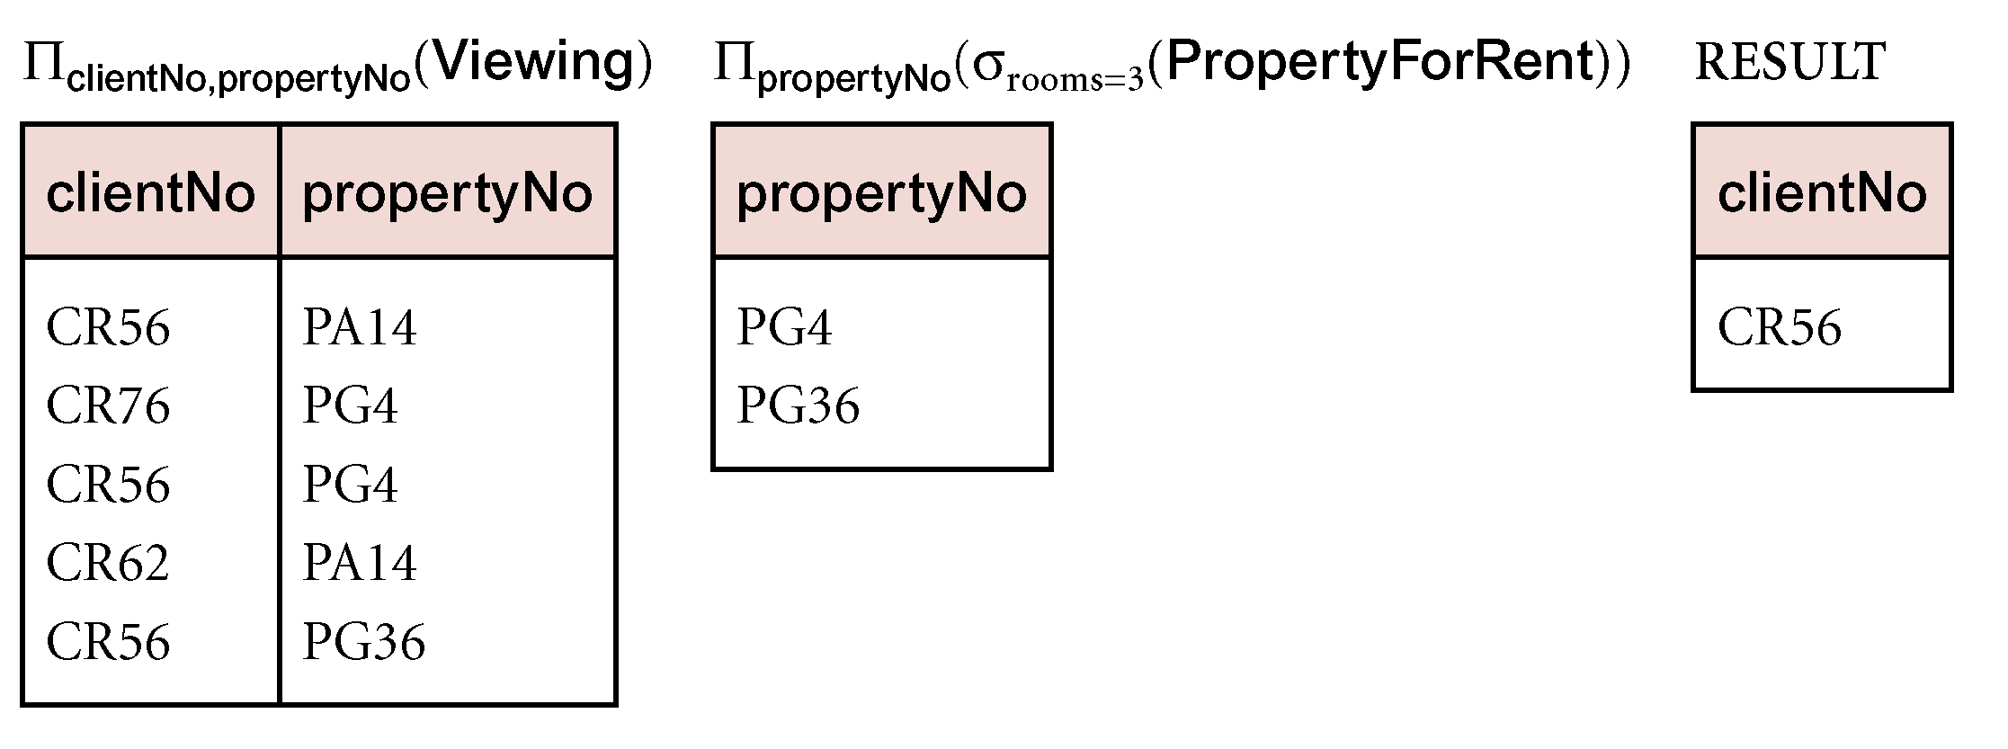
Example - Division
Identify all clients who have viewed all properties with three rooms.
(Π_{clientNo, propertyNo}(Viewing)) ÷
(Π_{propertyNo}(σ_{rooms = 3} (PropertyForRent)))

Slide 52
Aggregate Operations
ℑ_{AL}(R)
Applies aggregate function list, AL, to R to define a relation over the aggregate list.
AL contains one or more (<aggregate_function>, <attribute>) pairs .
Main aggregate functions are: COUNT, SUM, AVG, MIN, and MAX.

Slide 53
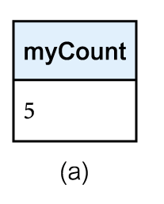
Example – Aggregate Operations
How many properties cost more than £350 per month to rent?
ρ_{R}(myCount) ℑ_{COUNT} _{propertyNo} (σ_{rent > 350} (PropertyForRent))

Slide 54
Grouping Operation
_{GA}ℑ_{AL}(R)
Groups tuples of R by grouping attributes, GA, and then applies aggregate function list, AL, to define a new relation.
AL contains one or more (<aggregate_function>, <attribute>) pairs.
Resulting relation contains the grouping attributes, GA, along with results of each of the aggregate functions.

Slide 55
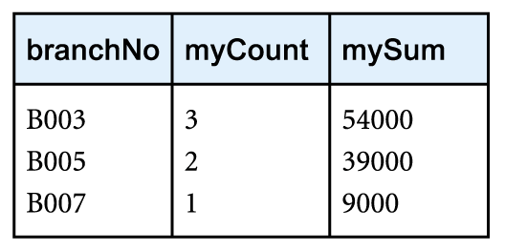
Example – Grouping Operation
Find the number of staff working in each branch and the sum of their salaries.
ρ_{R}(branchNo, myCount, mySum)
_{branchNo} ℑ _{COUNT staffNo,} _{SUM salary} (Staff)

