Slide 1
DAMG 6210 Database Design
Nik Bear Brown
@NikBearBrown

Slide 2
Topics
SQL

Slide 3
Writing SQL Commands
Most components of an SQL statement are case insensitive, except for literal character data.
More readable with indentation and lineation:
Each clause should begin on a new line.
Start of a clause should line up with start of other clauses.
If clause has several parts, should each appear on a separate line and be indented under start of clause.

Slide 4
Writing SQL Commands
Use extended form of BNF notation:
- Upper-case letters represent reserved words.
- Lower-case letters represent user-defined words.
- | indicates a choice among alternatives.
- Curly braces indicate a required element.
- Square brackets indicate an optional element.
- … indicates optional repetition (0 or more).

Slide 5
Literals
Literals are constants used in SQL statements.
All non-numeric literals must be enclosed in single quotes (e.g. ‘London’).
All numeric literals must not be enclosed in quotes (e.g. 650.00).

Slide 6
Select Statement
The SELECT statement is used to retrieve data from the database.
The basic syntax is:
SELECT <columnName>, <columnName>
FROM <TableName>
SELECT StudentFirstName, StudentLastName, StudentPhone
FROM Student

Slide 7
SELECT Statement
SELECT [DISTINCT | ALL]
{* | [columnExpression [AS newName]] [,...] }
FROM TableName [alias] [, ...]
[WHERE condition]
[GROUP BY columnList] [HAVING condition]
[ORDER BY columnList]

Slide 8
SELECT Statement
FROM Specifies table(s) to be used.
WHERE Filters rows.
GROUP BY Forms groups of rows with same
column value.
HAVING Filters groups subject to some
condition.
SELECT Specifies which columns are to
appear in output.
ORDER BY Specifies the order of the output.

Slide 9
SELECT Statement
Order of the clauses cannot be changed.
Only SELECT and FROM are mandatory.

Slide 10
Select All Columns, All Rows
List full details of all staff.
SELECT staffNo, fName, lName, address,
position, sex, DOB, salary, branchNo
FROM Staff;
Can use * as an abbreviation for ‘all columns’:
SELECT *
FROM Staff;

Slide 11
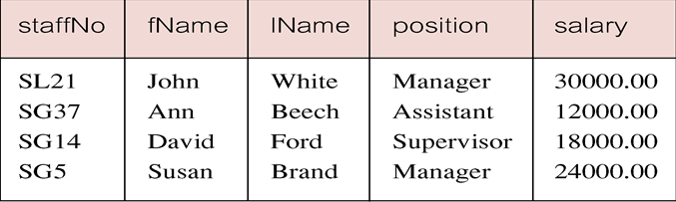
Select Comparison Search Condition
List all staff with a salary greater than 10,000.
SELECT staffNo, fName, lName, position, salary
FROM Staff
WHERE salary > 10000;

Slide 12
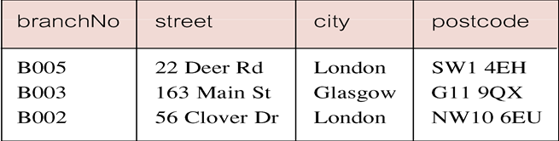
Select Compound Comparison Search Condition
List addresses of all branch offices in London or Glasgow.
SELECT *
FROM Branch
WHERE city = ‘London’ OR city = ‘Glasgow’;

Slide 13
Select Range Search Condition
List all staff with a salary between 20,000 and 30,000.
SELECT staffNo, fName, lName, position, salary
FROM Staff
WHERE salary BETWEEN 20000 AND 30000;
BETWEEN test includes the endpoints of range.

Slide 14
Select Range Search Condition
Also a negated version NOT BETWEEN.
BETWEEN does not add much to SQL’s expressive power. Could also write:
SELECT staffNo, fName, lName, position, salary
FROM Staff
WHERE salary>=20000 AND salary <= 30000;
Useful, though, for a range of values.

Slide 15
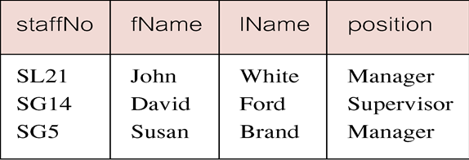
Select Set Membership
List all managers and supervisors.
SELECT staffNo, fName, lName, position
FROM Staff
WHERE position IN (‘Manager’, ‘Supervisor’);

Slide 16
The * WildCard
Instead of listing each of the columns, you can use an * to include all columns.
SELECT * FROM
Listing the columns does give you the ability to choose both which columns and which order to present them.
With the * you return all the columns in the order they have in the underlying table.

Slide 17
Distinct Key Word
Sometimes a query will return multiple duplicate values.
For instance the statement
SELECT Key FROM Session
Could return numerous instances of each customer.
The DISTINCT keyword will make it so it only returns one instance of each Key.

Slide 18
Distinct Key Word
SELECT DISTINCT Key
FROM Session
The DISTINCT keyword always operates on the whole role, not on individual columns.
It only returns distinct rows.

Slide 19
Calculations
You can do calculations in SELECT statements.
SELECT ItemNumber, ItemPrice, Quantity, ItemPrice * Quantity
FROM CustomerOrder

Slide 20
Order of Operations
The order of operation is the same as in algebra.
Whatever is in parentheses is executed first. If parentheses are nested, the innermost is executed first, then the next most inner, etc.
Then all division and multiplication left to right
And finally all addition and subtraction left to right

Slide 21
Sorting
You can sort the results of a query by using the keywords ORDER BY.
SELECT *
FROM Session ORDER BY SessionDate
ORDER BY does an ascending A-Z, 1-10, etc. sort by default.
You can change the direction by using the DESC keyword after the field to be sorted.

Slide 22
Aliasing
Sometimes it is useful to alias a column name to make a more readable result set.
SELECT StudentLastName AS [Last Name], StudentFirstName AS [First Name]
FROM Student
The AS keyword is optional.
Double quotes “ “ can be used instead of square brackets.

Slide 23
Where Clause
The WHERE clause allows you to limit the rows you return in a query.
You use the WHERE clause to specify the criteria by which the rows will be filtered.
SELECT LastName, FirstName, Phone, City
FROM Customer
WHERE City = ‘Boston’

Slide 24
Other Criteria
As well as equal you can use other operators for the criteria:
>
<
>=
=<
Character and date values in the criteria are quoted with single quotes.
Numerical values are not quoted.

Slide 25
Like
The LIKE keyword used in a WHERE operator with a wildcard (% or _) allows you to search for patterns in character-based fields.
The following returns all items whose name starts with “T.”
SELECT ItemName, ItemPrice
FROM Inventory
WHERE ItemName LIKE ‘T%’

Slide 26
Between
The BETWEEN keyword can be used in criteria to return values between to other values.
BETWEEN is inclusive of its ends.
SELECT Key, SessionDate, StudentKey
FROM Session
WHERE SessionDate BETWEEN ’11/1/2014’ AND ‘11/30/2014’

Slide 27
AND OR NOT
You can use keywords AND, OR, and NOT to combine criteria in a query.
AND is exclusive. Or is Inclusive.
WHERE City = ‘Boston’ OR City=‘Los Angeles’ returns all records that have either Boston or Los Angeles for their city.
WHERE City=‘Boston’ AND City=‘Los Angeles’ returns nothing because the record cannot have both at the same time.
NOT excludes.
WHERE NOT City = ‘Los Angeles’ returns every city except Los Angeles.

Slide 28
NULL
Nulls are special cases. They are not a value and so cannot be compared to a value using = or < or >.
To locate nulls you can use the IS keyword in a criteria:
WHERE StudentKey IS NULL
WHERE StudentKey IS NOT NULL

Slide 29
Select Set Membership
There is a negated version (NOT IN).
IN does not add much to SQL’s expressive power. Could have expressed this as:
SELECT staffNo, fName, lName, position
FROM Staff
WHERE position=‘Manager’ OR
position=‘Supervisor’;
IN is more efficient when set contains many values.

Slide 30
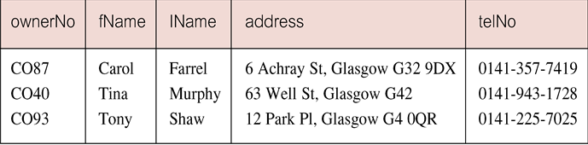
Select Pattern Matching
Find all owners with the string ‘Glasgow’ in their address.
SELECT ownerNo, fName, lName, address, telNo
FROM PrivateOwner
WHERE address LIKE ‘%Glasgow%’;

Slide 31
Select Pattern Matching
SQL has two special pattern matching symbols:
%: sequence of zero or more characters;
_ (underscore): any single character.
LIKE ‘%Glasgow%’ means a sequence of characters of any length containing ‘Glasgow’.

Slide 32
Select NULL Search Condition
List details of all viewings on property PG4 where a comment has not been supplied.
There are 2 viewings for property PG4, one with and one without a comment.
Have to test for null explicitly using special keyword IS NULL:
SELECT clientNo, viewDate
FROM Viewing
WHERE propertyNo = ‘PG4’ AND
comment IS NULL;

Slide 33
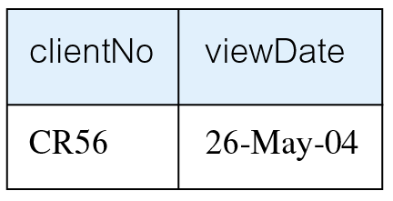
Select NULL Search Condition
Negated version (IS NOT NULL) can test for non-null values.

Slide 34
Select Single Column Ordering
List salaries for all staff, arranged in descending order of salary.
SELECT staffNo, fName, lName, salary
FROM Staff
ORDER BY salary DESC;

Slide 35
Select Multiple Column Ordering
Produce abbreviated list of properties in order of property type.
SELECT propertyNo, type, rooms, rent
FROM PropertyForRent
ORDER BY type;

Slide 36
Select Multiple Column Ordering
To arrange in order of rent, specify minor order:
SELECT propertyNo, type, rooms, rent
FROM PropertyForRent
ORDER BY type, rent DESC;

Slide 37
SELECT Statement - Aggregates
ISO standard defines five aggregate functions:
COUNT returns number of values in specified column.
SUM returns sum of values in specified column.
AVG returns average of values in specified column.
MIN returns smallest value in specified column.
MAX returns largest value in specified column.

Slide 38
SELECT Statement - Aggregates
Each operates on a single column of a table and returns a single value.
COUNT, MIN, and MAX apply to numeric and non-numeric fields, but SUM and AVG may be used on numeric fields only.
Apart from COUNT(*), each function eliminates nulls first and operates only on remaining non-null values.

Slide 39
SELECT Statement - Aggregates
COUNT(*) counts all rows of a table, regardless of whether nulls or duplicate values occur.
Can use DISTINCT before column name to eliminate duplicates.
DISTINCT has no effect with MIN/MAX, but may have with SUM/AVG.

Slide 40
SELECT Statement - Aggregates
Aggregate functions can be used only in SELECT list and in HAVING clause.
If SELECT list includes an aggregate function and there is no GROUP BY clause, SELECT list cannot reference a column out with an aggregate function. For example, the following is illegal:
SELECT staffNo, COUNT(salary)
FROM Staff;

Slide 41
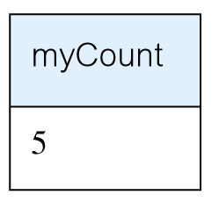
Select - Use of COUNT(*)
How many properties cost more than £350 per month to rent?
SELECT COUNT(*) AS myCount
FROM PropertyForRent
WHERE rent > 350;

Slide 42
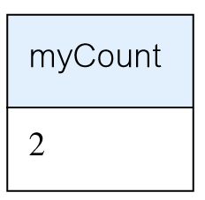
Select - Use of COUNT(DISTINCT)
How many different properties viewed in May ‘13?
SELECT COUNT(DISTINCT propertyNo) AS myCount
FROM Viewing
WHERE viewDate BETWEEN ‘1-May-13’
AND ‘31-May-13’;

Slide 43
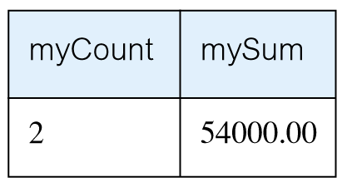
Select - Use of COUNT and SUM
Find number of Managers and sum of their salaries.
SELECT COUNT(staffNo) AS myCount,
SUM(salary) AS mySum
FROM Staff
WHERE position = ‘Manager’;

Slide 44
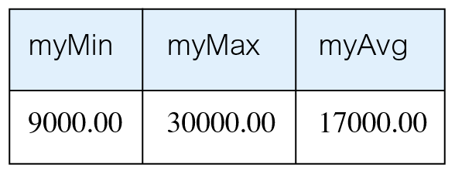
Select - Use of MIN, MAX, AVG
Find minimum, maximum, and average staff salary.
SELECT MIN(salary) AS myMin,
MAX(salary) AS myMax,
AVG(salary) AS myAvg
FROM Staff;

Slide 45
SELECT Statement - Grouping
Use GROUP BY clause to get sub-totals.
SELECT and GROUP BY closely integrated: each item in SELECT list must be single-valued per group, and SELECT clause may only contain:
column names
aggregate functions
constants
expression involving combinations of the above.

Slide 46
SELECT Statement - Grouping
All column names in SELECT list must appear in GROUP BY clause unless name is used only in an aggregate function.
If WHERE is used with GROUP BY, WHERE is applied first, then groups are formed from remaining rows satisfying predicate.
ISO considers two nulls to be equal for purposes of GROUP BY.

Slide 47
Select - Use of GROUP BY
Find number of staff in each branch and their total salaries.
SELECT branchNo,
COUNT(staffNo) AS myCount,
SUM(salary) AS mySum
FROM Staff
GROUP BY branchNo
ORDER BY branchNo;

Slide 48
Restricted Groupings – HAVING clause
HAVING clause is designed for use with GROUP BY to restrict groups that appear in final result table.
Similar to WHERE, but WHERE filters individual rows whereas HAVING filters groups.
Column names in HAVING clause must also appear in the GROUP BY list or be contained within an aggregate function.

Slide 49
Select - Use of HAVING
For each branch with more than 1 member of staff, find number of staff in each branch and sum of their salaries.
SELECT branchNo,
COUNT(staffNo) AS myCount,
SUM(salary) AS mySum
FROM Staff
GROUP BY branchNo
HAVING COUNT(staffNo) > 1
ORDER BY branchNo;

Slide 50
Subqueries
Some SQL statements can have a SELECT embedded within them.
A subselect can be used in WHERE and HAVING clauses of an outer SELECT, where it is called a subquery or nested query.
Subselects may also appear in INSERT, UPDATE, and DELETE statements.

Slide 51
Select - Subquery with Equality
List staff who work in branch at ‘163 Main St’.
SELECT staffNo, fName, lName, position
FROM Staff
WHERE branchNo =
(SELECT branchNo
FROM Branch
WHERE street = ‘163 Main St’);

Slide 52
Select - Subquery with Equality
Inner SELECT finds branch number for branch at ‘163 Main St’ (‘B003’).
Outer SELECT then retrieves details of all staff who work at this branch.
Outer SELECT then becomes:
SELECT staffNo, fName, lName, position
FROM Staff
WHERE branchNo = ‘B003’;

Slide 53
Select - Subquery with Aggregate
List all staff whose salary is greater than the average salary, and show by how much.
SELECT staffNo, fName, lName, position,
salary – (SELECT AVG(salary) FROM Staff) As SalDiff
FROM Staff
WHERE salary >
(SELECT AVG(salary)
FROM Staff);

Slide 54
Select - Subquery with Aggregate
Cannot write ‘WHERE salary > AVG(salary)’
Instead, use subquery to find average salary (17000), and then use outer SELECT to find those staff with salary greater than this:
SELECT staffNo, fName, lName, position,
salary – 17000 As salDiff
FROM Staff
WHERE salary > 17000;

Slide 55
Subquery Rules
ORDER BY clause may not be used in a subquery (although it may be used in outermost SELECT).
Subquery SELECT list must consist of a single column name or expression, except for subqueries that use EXISTS.
By default, column names refer to table name in FROM clause of subquery. Can refer to a table in FROM using an alias.

Slide 56
Subquery Rules
When subquery is an operand in a comparison, subquery must appear on right-hand side.
A subquery may not be used as an operand in an expression.

Slide 57
Select - Nested subquery: use of IN
List properties handled by staff at ‘163 Main St’.
SELECT propertyNo, street, city, postcode, type, rooms, rent
FROM PropertyForRent
WHERE staffNo IN
(SELECT staffNo
FROM Staff
WHERE branchNo =
(SELECT branchNo
FROM Branch
WHERE street = ‘163 Main St’));

Slide 58
ANY and ALL
ANY and ALL may be used with subqueries that produce a single column of numbers.
With ALL, condition will only be true if it is satisfied by all values produced by subquery.
With ANY, condition will be true if it is satisfied by any values produced by subquery.
If subquery is empty, ALL returns true, ANY returns false.
SOME may be used in place of ANY.

Slide 59
Select - Use of ANY/SOME
Find staff whose salary is larger than salary of at least one member of staff at branch B003.
SELECT staffNo, fName, lName, position, salary
FROM Staff
WHERE salary > SOME
(SELECT salary
FROM Staff
WHERE branchNo = ‘B003’);

Slide 60
Use of ALL
Find staff whose salary is larger than salary of every member of staff at branch B003.
SELECT staffNo, fName, lName, position, salary
FROM Staff
WHERE salary > ALL
(SELECT salary
FROM Staff
WHERE branchNo = ‘B003’);

Slide 61
Functions
Functions always have the same basic syntax:
<function name>(function arguments)
There are hundreds of built-in functions.
We will be concerned with two broad types of functions:
Scalar functions
Aggregate functions

Slide 62
Scalar Functions
Scalar functions operate on a single row at a time.
Here is a list of scalar functions used in this chapter.
Function Name | Description
GETDATE() | Returns current date and time
MONTH | Returns the month as an integer (1 to 12) from a Date value
YEAR | Returns the Year as a four-digit integer from a date value

Slide 63
Aggregate Functions
Aggregate functions operate on multiple rows at a time.
Here is a table of common aggregate functions:
Aggregate Function | Description
COUNT | Counts the number of values : COUNT(*) counts all the rows. COUNT(columnName) counts all the values in the column but ignores nulls
SUM | Sums or totals numeric values: SUM (InStock)
AVG | Returns the mean average of a set of numeric values: AVG(Price). By default nulls are ignored.
MAX | Returns the highest value in a set of numeric or datetime values: MAX(price)
MIN | Returns the smallest value in a set of numeric or datetime values: MIN(Price)

Slide 64
Using Distinct in Aggregate Functions
You can use the DISTINCT keyword with aggregate functions.
Doing so means the function will ignore duplicate values in its calculation.
SELECT COUNT(DISTINCT StudentKey) AS [Unduplicated]
FROM Session

Slide 65
Group By
When a SELECT clause includes an aggregate function and columns that are not a part of that function, you must use the GROUP BY keywords to group by each of the non-included columns.
This is necessary because you are mixing functions that operate on multiple rows with columns that refer to values in individual rows only.

Slide 66
Group By Example
SELECT Key, COUNT(SessionTimeKey) AS [Total Sessions]
FROM Session
GROUP BY Key

Slide 67
Having
The HAVING keyword is used when there is an aggregate function in the criteria of a query.
SELECT Key, COUNT(SessionTimeKey) AS [Total Sessions]
FROM Session
GROUP BY Key
HAVING COUNT(SessionTimeKey)<4

Slide 68
EXISTS and NOT EXISTS
EXISTS and NOT EXISTS are for use only with subqueries.
Produce a simple true/false result.
True if and only if there exists at least one row in result table returned by subquery.
False if subquery returns an empty result table.
NOT EXISTS is the opposite of EXISTS.

Slide 69
EXISTS and NOT EXISTS
As (NOT) EXISTS check only for existence or non-existence of rows in subquery result table, subquery can contain any number of columns.
Common for subqueries following (NOT) EXISTS to be of form:
(SELECT * ...)

Slide 70
Query using EXISTS
Find all staff who work in a London branch.
SELECT staffNo, fName, lName, position
FROM Staff s
WHERE EXISTS
(SELECT *
FROM Branch b
WHERE s.branchNo = b.branchNo AND
city = ‘London’);

Slide 71
Query using EXISTS
Note, search condition s.branchNo = b.branchNo is necessary to consider correct branch record for each member of staff.
If omitted, would get all staff records listed out because subquery:
SELECT * FROM Branch WHERE city=‘London’
would always be true and query would be:
SELECT staffNo, fName, lName, position FROM Staff
WHERE true;

Slide 72
Query using EXISTS
Could also write this query using join construct:
SELECT staffNo, fName, lName, position
FROM Staff s, Branch b
WHERE s.branchNo = b.branchNo AND
city = ‘London’;

Slide 73
Joins
In database design and normalization, the data are broken into several discrete tables.
Joins are the mechanism for recombining the data into one result set.
We will look at three kinds of joins:
Inner joins
Equi joins
Outer joins

Slide 74
Multi-Table Queries
Can use subqueries provided result columns come from same table.
If result columns come from more than one table must use a join.
To perform join, include more than one table in FROM clause.
Use comma as separator and typically include WHERE clause to specify join column(s).

Slide 75
Multi-Table Queries
Also possible to use an alias for a table named in FROM clause.
Alias is separated from table name with a space.
Alias can be used to qualify column names when there is ambiguity.

Slide 76
Simple Join
List names of all clients who have viewed a property along with any comment supplied.
SELECT c.clientNo, fName, lName,
propertyNo, comment
FROM Client c, Viewing v
WHERE c.clientNo = v.clientNo;

Slide 77
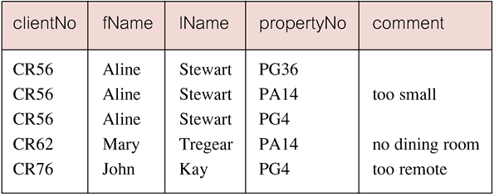
Simple Join
Only those rows from both tables that have identical values in the clientNo columns (c.clientNo = v.clientNo) are included in result.
Equivalent to equi-join in relational algebra.

Slide 78
Basic INNER JOIN Syntax
SELECT <column1, column2>
FROM <table1>
INNER JOIN <table2>
ON <table1>.<column>=<table2>.<column>

Slide 79
Inner Joins
Inner joins return related records from each of the tables joined.
SELECT LastName,
FirstName,
SessionDateKey,
SessionTimeKey,
StudentKey
SessionStatus
FROM
INNER JOIN Session
ON .Key = Session.Key

Slide 80
Alternative JOIN Constructs
SQL provides alternative ways to specify joins:
FROM Client c JOIN Viewing v ON c.clientNo = v.clientNo
FROM Client JOIN Viewing USING clientNo
FROM Client NATURAL JOIN Viewing
In each case, FROM replaces original FROM and WHERE. However, first produces table with two identical clientNo columns.

Slide 81
Equi Joins
Equi joins present an alternative way to perform inner joins. Some older RDMSs only support this alternative form. The example below also uses an alias for the table name.
SELECT t.Key,
LastName,
FirstName,
SessionDateKey,
SessionTimeKey,
StudentKey
FROM t,
Session s
WHERE t.Key = s.Key
AND LastName = ‘Brown’

Slide 82
Three Table Join
For each branch, list staff who manage properties, including city in which branch is located and properties they manage.
SELECT b.branchNo, b.city, s.staffNo, fName, lName,
propertyNo
FROM Branch b, Staff s, PropertyForRent p
WHERE b.branchNo = s.branchNo AND
s.staffNo = p.staffNo
ORDER BY b.branchNo, s.staffNo, propertyNo;

Slide 83
Sorting a join
For each branch, list numbers and names of staff who manage properties, and properties they manage.
SELECT s.branchNo, s.staffNo, fName, lName,
propertyNo
FROM Staff s, PropertyForRent p
WHERE s.staffNo = p.staffNo
ORDER BY s.branchNo, s.staffNo, propertyNo;

Slide 84
Multiple Grouping Columns
Find number of properties handled by each staff member.
SELECT s.branchNo, s.staffNo, COUNT(*) AS myCount
FROM Staff s, PropertyForRent p
WHERE s.staffNo = p.staffNo
GROUP BY s.branchNo, s.staffNo
ORDER BY s.branchNo, s.staffNo;

Slide 85
Computing a Join
Procedure for generating results of a join are:
1. Form Cartesian product of the tables named in FROM clause.
2. If there is a WHERE clause, apply the search condition to each row of the product table, retaining those rows that satisfy the condition.
3. For each remaining row, determine value of each item in SELECT list to produce a single row in result table.

Slide 86
Computing a Join
4. If DISTINCT has been specified, eliminate any duplicate rows from the result table.
5. If there is an ORDER BY clause, sort result table as required.
SQL provides special format of SELECT for Cartesian product:
SELECT [DISTINCT | ALL] {* | columnList}
FROM Table1 CROSS JOIN Table2

Slide 87
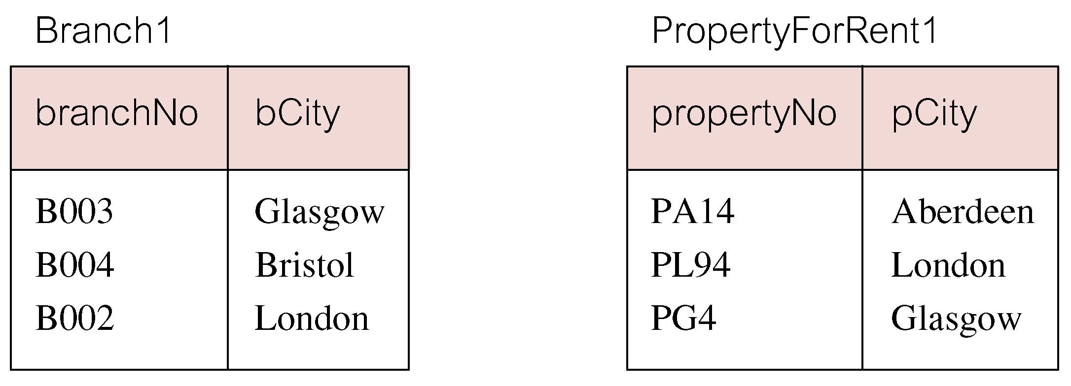
Outer Joins
If one row of a joined table is unmatched, row is omitted from result table.
Outer join operations retain rows that do not satisfy the join condition.
Consider following tables:

Slide 88
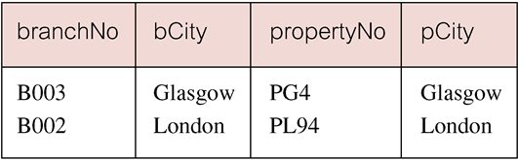
Outer Joins
The (inner) join of these two tables:
SELECT b.*, p.*
FROM Branch1 b, PropertyForRent1 p
WHERE b.bCity = p.pCity;

Slide 89
Outer Joins
Result table has two rows where cities are same.
There are no rows corresponding to branches in Bristol and Aberdeen.
To include unmatched rows in result table, use an Outer join.

Slide 90
Left Outer Join
List branches and properties that are in same city along with any unmatched properties.
SELECT b.*, p.*
FROM Branch1 b LEFT JOIN
PropertyForRent1 p ON b.bCity = p.pCity;

Slide 91
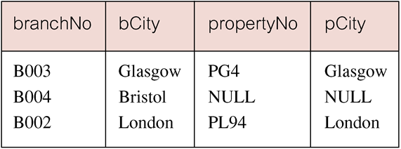
Left Outer Join
Includes those rows of first (left) table unmatched with rows from second (right) table.
Columns from second table are filled with NULLs.

Slide 92
Right Outer Join
List branches and properties in same city and any unmatched properties.
SELECT b.*, p.*
FROM Branch1 b RIGHT JOIN
PropertyForRent1 p ON b.bCity = p.pCity;

Slide 93
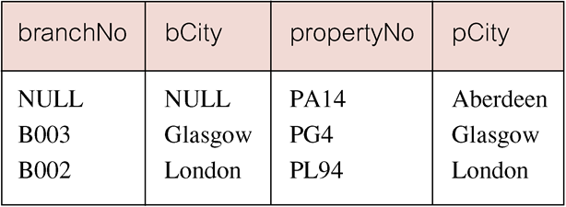
Right Outer Join
Right Outer join includes those rows of second (right) table that are unmatched with rows from first (left) table.
Columns from first table are filled with NULLs.

Slide 94
Full Outer Join
List branches and properties in same city and any unmatched branches or properties. (on both sides)
SELECT b.*, p.*
FROM Branch1 b FULL JOIN
PropertyForRent1 p ON b.bCity = p.pCity;

Slide 95
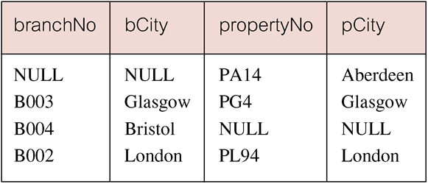
Full Outer Join
Includes rows that are unmatched in both tables.
Unmatched columns are filled with NULLs.

Slide 96
OUTER JOIN Syntax
Outer joins return records that are not matched. The following query returns s that have no sessions scheduled.
SELECT <column1>, <column2>
FROM <table1>
LEFT OUTER JOIN <table2> ON <table1>.<column>=<table2>.<column>

Slide 97
Outer Join Example
SELECT t.Key,
LastName,
SessionDateKey
FROM t
LEFT OUTER JOIN Session s
ON t.Key = s.Key
WHERE SessionDateKey IS Null

Slide 98
Inserts
To insert a record into a table, you use the following syntax:
INSERT INTO <tablename>(<ColumnName>, <columnName>, ...)
VALUES(<value1>, <value2>, ...)

Slide 99
Updates
Updates allow you to change existing records. The syntax is:
UPDATE <TableName>
SET <ColumnName> = <New Value>,
<ColumnName>=<new value>
WHERE <ColumnName> = <criteria>

Slide 100
Deletes
Deletes allow you to remove a record from a table:
DELETE FROM <TableName>
WHERE <columnName> = <criteria>

Slide 101
Deletes and Updates
Deletes and updates are dangerous. If you do not specify a criteria, the update or delete will be applied to all the rows in a table.
Also, referential integrity may prevent a deletion. You cannot delete a parent that has children in another table.

Slide 102
SubQuery Example
SELECT DISTINCT COUNT(*) AS Total,
(SELECT COUNT(*)
FROM Session
WHERE SessionStatus='NS') AS NoShow,
(SELECT COUNT(*)
FROM Session
WHERE SessionStatus='c') AS Completed
FROM Session
This example shows subqueries used in the SELECT clause to return Aggregate values.

Slide 103
Locating Duplicates
SELECT Lastname, firstname, email, phone, COUNT(*) AS [duplicates]
FROM contact
GROUP BY Lastname, firstName, email, Phone
HAVING COUNT(*) >1
This SQL finds duplicate values in in a table.

Slide 104
Documentation: Testing Plans
When testing the database, you should document all your SQL queries and their results.
On the next slide is a sample of a test table, showing the test and results.

Slide 105
Union, Intersect, and Difference
Can use normal set operations of Union, Intersection, and Difference to combine results of two or more queries into a single result table.
Union of two tables, A and B, is table containing all rows in either A or B or both.
Intersection is table containing all rows common to both A and B.
Difference is table containing all rows in A but not in B.
Two tables must be union compatible.

Slide 106
Union, Intersect, and Difference
Format of set operator clause in each case is:
op [ALL] [CORRESPONDING [BY {column1 [, ...]}]]
If CORRESPONDING BY specified, set operation performed on the named column(s).
If CORRESPONDING specified but not BY clause, operation performed on common columns.
If ALL specified, result can include duplicate rows.

Slide 107
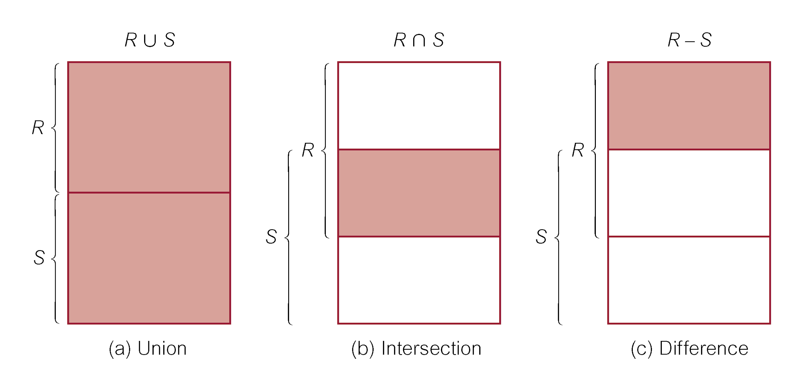
Union, Intersect, and Difference

Slide 108
Use of UNION
List all cities where there is either a branch office or a property.
(SELECT city
FROM Branch
WHERE city IS NOT NULL) UNION
(SELECT city
FROM PropertyForRent
WHERE city IS NOT NULL);

Slide 109
Use of UNION
Or
(SELECT * FROM Branch WHERE city IS NOT NULL) UNION CORRESPONDING BY city (SELECT * FROM PropertyForRent WHERE city IS NOT NULL);

Slide 110
Union Example
INSERT INTO Contact(LastName, FirstName, Email, Phone)
SELECT StudentLastName AS LastName,
StudentFirstName AS FirstName,
StudentEmail AS Email,
StudentPhone AS Phone
FROM Student
WHERE StudentEmail IS NOT NULL
UNION
SELECT LastName,
FirstName,
Email,
Phone
FROM
WHERE Email IS NOT NULL
This UNION query joins the tables Student and into a single result and writes them to the table Contact.

Slide 111
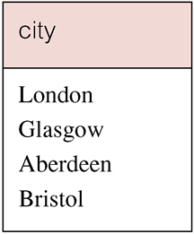
Use of UNION
Produces result tables from both queries and merges both tables together.

Slide 112
Use of INTERSECT
List all cities where there is both a branch office and a property.
(SELECT city FROM Branch)
INTERSECT
(SELECT city FROM PropertyForRent);

Slide 113
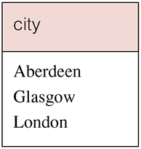
Use of INTERSECT
Or
(SELECT * FROM Branch)
INTERSECT CORRESPONDING BY city
(SELECT * FROM PropertyForRent);

Slide 114
Use of INTERSECT
Could rewrite this query without INTERSECT operator:
SELECT b.city
FROM Branch b PropertyForRent p
WHERE b.city = p.city;
Or:
SELECT DISTINCT city FROM Branch b
WHERE EXISTS
(SELECT * FROM PropertyForRent p
WHERE p.city = b.city);

Slide 115
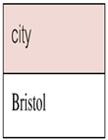
Use of EXCEPT
List of all cities where there is a branch office but no properties.
(SELECT city FROM Branch)
EXCEPT
(SELECT city FROM PropertyForRent);
Or
(SELECT * FROM Branch)
EXCEPT CORRESPONDING BY city
(SELECT * FROM PropertyForRent);

Slide 116
Use of EXCEPT
Could rewrite this query without EXCEPT:
SELECT DISTINCT city FROM Branch
WHERE city NOT IN
(SELECT city FROM PropertyForRent);
Or
SELECT DISTINCT city FROM Branch b
WHERE NOT EXISTS
(SELECT * FROM PropertyForRent p
WHERE p.city = b.city);

Slide 117
INSERT
INSERT INTO TableName [ (columnList) ]
VALUES (dataValueList)
columnList is optional; if omitted, SQL assumes a list of all columns in their original CREATE TABLE order.
Any columns omitted must have been declared as NULL when table was created, unless DEFAULT was specified when creating column.

Slide 118
INSERT
dataValueList must match columnList as follows:
number of items in each list must be same;
must be direct correspondence in position of items in two lists;
data type of each item in dataValueList must be compatible with data type of corresponding column.

Slide 119
INSERT … VALUES
Insert a new row into Staff table supplying data for all columns.
INSERT INTO Staff
VALUES (‘SG16’, ‘Alan’, ‘Brown’, ‘Assistant’, ‘M’, Date‘1957-05-25’, 8300, ‘B003’);

Slide 120
INSERT using Defaults
Insert a new row into Staff table supplying data for all mandatory columns.
INSERT INTO Staff (staffNo, fName, lName,
position, salary, branchNo)
VALUES (‘SG44’, ‘Anne’, ‘Jones’,
‘Assistant’, 8100, ‘B003’);
Or
INSERT INTO Staff
VALUES (‘SG44’, ‘Anne’, ‘Jones’, ‘Assistant’, NULL,
NULL, 8100, ‘B003’);

Slide 121
INSERT … SELECT
Second form of INSERT allows multiple rows to be copied from one or more tables to another:
INSERT INTO TableName [ (columnList) ]
SELECT ...

Slide 122
INSERT … SELECT
Assume there is a table StaffPropCount that contains names of staff and number of properties they manage:
StaffPropCount(staffNo, fName, lName, propCnt)
Populate StaffPropCount using Staff and PropertyForRent tables.

Slide 123
INSERT … SELECT
INSERT INTO StaffPropCount
(SELECT s.staffNo, fName, lName, COUNT(*)
FROM Staff s, PropertyForRent p
WHERE s.staffNo = p.staffNo
GROUP BY s.staffNo, fName, lName)
UNION
(SELECT staffNo, fName, lName, 0
FROM Staff
WHERE staffNo NOT IN
(SELECT DISTINCT staffNo
FROM PropertyForRent));

Slide 124
UPDATE
UPDATE TableName
SET columnName1 = dataValue1
[, columnName2 = dataValue2...]
[WHERE searchCondition]
TableName can be name of a base table or an updatable view.
SET clause specifies names of one or more columns that are to be updated.

Slide 125
UPDATE
WHERE clause is optional:
if omitted, named columns are updated for all rows in table;
if specified, only those rows that satisfy searchCondition are updated.
New dataValue(s) must be compatible with data type for corresponding column.

Slide 126
UPDATE All Rows
Give all staff a 3% pay increase.
UPDATE Staff
SET salary = salary*1.03;
Give all Managers a 5% pay increase.
UPDATE Staff
SET salary = salary*1.05
WHERE position = ‘Manager’;

Slide 127
UPDATE Multiple Columns
Promote David Ford (staffNo=‘SG14’) to Manager and change his salary to £18,000.
UPDATE Staff
SET position = ‘Manager’, salary = 18000
WHERE staffNo = ‘SG14’;

Slide 128
DELETE
DELETE FROM TableName
[WHERE searchCondition]
TableName can be name of a base table or an updatable view.
searchCondition is optional; if omitted, all rows are deleted from table. This does not delete table. If search_condition is specified, only those rows that satisfy condition are deleted.

Slide 129
DELETE Specific Rows
Delete all viewings that relate to property PG4.
DELETE FROM Viewing
WHERE propertyNo = ‘PG4’;
Delete all records from the Viewing table.
DELETE FROM Viewing;

Slide 130
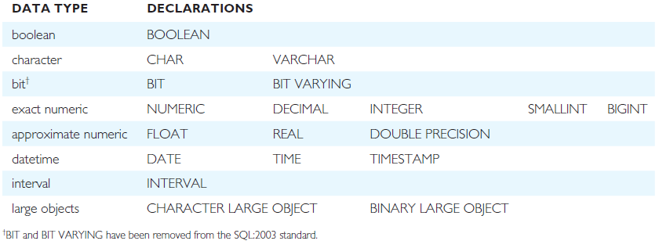
ISO SQL Data Types

Slide 131
Data Definition
SQL DDL allows database objects such as schemas, domains, tables, views, and indexes to be created and destroyed.
Main SQL DDL statements are:
CREATE SCHEMA DROP SCHEMA
CREATE/ALTER DOMAIN DROP DOMAIN
CREATE/ALTER TABLE DROP TABLE
CREATE VIEW DROP VIEW
Many DBMSs also provide:
CREATE INDEX DROP INDEX

Slide 132
Data Definition
Relations and other database objects exist in an environment.
Each environment contains one or more catalogs, and each catalog consists of set of schemas.
Schema is named collection of related database objects.
Objects in a schema can be tables, views, domains, assertions, collations, translations, and character sets. All have same owner.

Slide 133
CREATE SCHEMA
CREATE SCHEMA [Name |
AUTHORIZATION CreatorId ]
DROP SCHEMA Name [RESTRICT | CASCADE ]
With RESTRICT (default), schema must be empty or operation fails.
With CASCADE, operation cascades to drop all objects associated with schema in order defined above. If any of these operations fail, DROP SCHEMA fails.

Slide 134
CREATE TABLE
CREATE TABLE TableName
{(colName dataType [NOT NULL] [UNIQUE]
[DEFAULT defaultOption]
[CHECK searchCondition] [,...]}
[PRIMARY KEY (listOfColumns),]
{[UNIQUE (listOfColumns),] […,]}
{[FOREIGN KEY (listOfFKColumns)
REFERENCES ParentTableName [(listOfCKColumns)],
[ON UPDATE referentialAction]
[ON DELETE referentialAction ]] [,…]}
{[CHECK (searchCondition)] [,…] })

Slide 135
CREATE TABLE
Creates a table with one or more columns of the specified dataType.
With NOT NULL, system rejects any attempt to insert a null in the column.
Can specify a DEFAULT value for the column.
Primary keys should always be specified as NOT NULL.
FOREIGN KEY clause specifies FK along with the referential action.

Slide 136
CREATE TABLE
CREATE TABLE PropertyForRent (
propertyNo PNumber NOT NULL, ….
rooms PRooms NOT NULL DEFAULT 4,
rent PRent NOT NULL, DEFAULT 600,
ownerNo OwnerNumber NOT NULL,
staffNo StaffNumber
Constraint StaffNotHandlingTooMuch ….
branchNo BranchNumber NOT NULL,
PRIMARY KEY (propertyNo),
FOREIGN KEY (staffNo) REFERENCES Staff
ON DELETE SET NULL ON UPDATE CASCADE ….);

Slide 137
ALTER TABLE
Add a new column to a table.
Drop a column from a table.
Add a new table constraint.
Drop a table constraint.
Set a default for a column.
Drop a default for a column.

Slide 138
ALTER TABLE
Change Staff table by removing default of ‘Assistant’ for position column and setting default for sex column to female (‘F’).
ALTER TABLE Staff
ALTER position DROP DEFAULT;
ALTER TABLE Staff
ALTER sex SET DEFAULT ‘F’;

Slide 139
ALTER TABLE
Remove constraint from PropertyForRent that staff are not allowed to handle more than 100 properties at a time. Add new column to Client table.
ALTER TABLE PropertyForRent
DROP CONSTRAINT StaffNotHandlingTooMuch;
ALTER TABLE Client
ADD prefNoRooms PRooms;

Slide 140
DROP TABLE
DROP TABLE TableName [RESTRICT | CASCADE]
e.g. DROP TABLE PropertyForRent;
Removes named table and all rows within it.
With RESTRICT, if any other objects depend for their existence on continued existence of this table, SQL does not allow request.
With CASCADE, SQL drops all dependent objects (and objects dependent on these objects).

Slide 141
Views
View
Dynamic result of one or more relational operations operating on base relations to produce another relation.
Virtual relation that does not necessarily actually exist in the database but is produced upon request, at time of request.

Slide 142
Views
Contents of a view are defined as a query on one or more base relations.
With view resolution, any operations on view are automatically translated into operations on relations from which it is derived.
With view materialization, the view is stored as a temporary table, which is maintained as the underlying base tables are updated.

Slide 143
SQL - CREATE VIEW
CREATE VIEW ViewName [ (newColumnName [,...]) ]
AS subselect
[WITH [CASCADED | LOCAL] CHECK OPTION]
Can assign a name to each column in view.
If list of column names is specified, it must have same number of items as number of columns produced by subselect.
If omitted, each column takes name of corresponding column in subselect.

Slide 144
SQL - CREATE VIEW
List must be specified if there is any ambiguity in a column name.
The subselect is known as the defining query.
WITH CHECK OPTION ensures that if a row fails to satisfy WHERE clause of defining query, it is not added to underlying base table.
Need SELECT privilege on all tables referenced in subselect and USAGE privilege on any domains used in referenced columns.

