Slide 1

Good Luck
DEPARTMENT OF COMPUTER SCIENCE & ENGINEERING
<Font Size 14>
SUSHILA DEVI BANSAL COLLEGE OF TECHNOLOGY
INDORE- 453331

Slide 2

Good Luck
Career Guidance for Students

Slide 3
Presented By
Arundhati Panwar - 0829CS211038
Sonali Salve – 0829CS191165
Gouri Thakur – 0829CS211062
Dimple kumari – 0829CS211040

Slide 4
Project Guide By
Prof. Manisha kadam

Slide 5
Steps Of Presentation
Introduction to Career Guidance
Why do we need Career guidance?
Career Roadmap Planning
GOODLUCK :- A Career guidance website
Main Features
College and University Guidance
Courses & Video Resources
Use case diagram
Sequence diagram
Activity diagram
Website Upgrade
Conclusion

Slide 6
WEBSITE UPGRADE
News Letter Subscription
Vocation Section
Self Assessment
Job Search through Cources
AI Tools

Slide 7
CONCLUSION
In conclusion , Our career guidance website has successfully provided accessible resources, engaged users,
and adapted to evolving needs. Despite challenges like technical constraints and user outreach,
we've persevered. Moving forward, we aim to expand partnerships, integrate emerging tech,
and optimize for mobile. We're committed to empowering individuals on their career journeys,
and we're grateful for the support of all stakeholders and users.

Slide 8

INTRODUCTION TO CAREER GUIDANCE
.
Career guidance is a process that helps individuals make informed career decisions. It involves self-assessment, exploring career options, goal-setting, skill development, job search support, and assistance with career transitions. Career counselors and advisors provide guidance at various career stages.

Slide 9

WHY DO WE NEED CAREER GUIDANCE ?
We need career guidance for several reasons:
Informed decisions: Career guidance helps individuals make informed choices about their career path based on their strengths, interests, and goals.
Skill development: It assists in identifying and developing the necessary skills and qualifications for career success.
Job market awareness: It keeps individuals informed about the ever-changing job market and employment opportunities.
Career satisfaction: Proper guidance can lead to more satisfying and fulfilling careers by aligning personal values and interests with professional choices.
Efficiency: It can save time and effort by providing a structured approach to achieving career goals.

Slide 10

CAREER ROADMAP PLANNING
Career roadmap planning is a structured approach to achieving your career goals. It includes setting clear goals, identifying necessary skills, and creating a step-by-step plan to get there. It helps you navigate your career path with purpose and direction.

Slide 11

GOOD LUCK :- A CAREER GUIDANCE WEBSITE
**"Good Luck: A Career Guidance Website"**
- Helps students choose courses and colleges after high school.
- Features course recommendations, college databases, and career profiles.
- Offers interactive quizzes, scholarship information, and expert advice.
- Provides test prep resources, a blog, and user forums.
- Mobile-friendly, with user accounts and social media integration.

Slide 12
MAIN FEATURES
Course recommendations
College & university database
Video Content
Mobile-friendly Design
Guidance blog

Slide 13
COLLEGE & UNIVERSITY GUIDANCE
The college and university guidance section of our website provides a comprehensive resource for students exploring higher education options. It includes detailed profiles of institutions with information on admission requirements, costs, financial aid, majors, and programs, as well as user-generated reviews and ratings. Users can access advice on applications, campus life, and career services, and find tools for comparing and calculating costs. We offer virtual campus tours, interviews with current students, and links to official websites for up-to-date details. Our site also highlights rankings, accreditation status, and alumni success stories, making it a one-stop destination for students seeking information on colleges and universities for their career aspirations.

Slide 14
COURSES & VIDEO RESOURCES
Our website offers a diverse range of courses and video resources to empower students in their educational and career journey. The courses cover various subjects and fields, providing valuable insights, tutorials, and skill-building opportunities. Our video resources feature interviews with professionals, educational webinars, and informative content on career choices and academic paths. Whether students are exploring new interests, enhancing their skills, or seeking in-depth career guidance, our extensive course catalog and video library are here to support and inspire their aspirations.

Slide 15
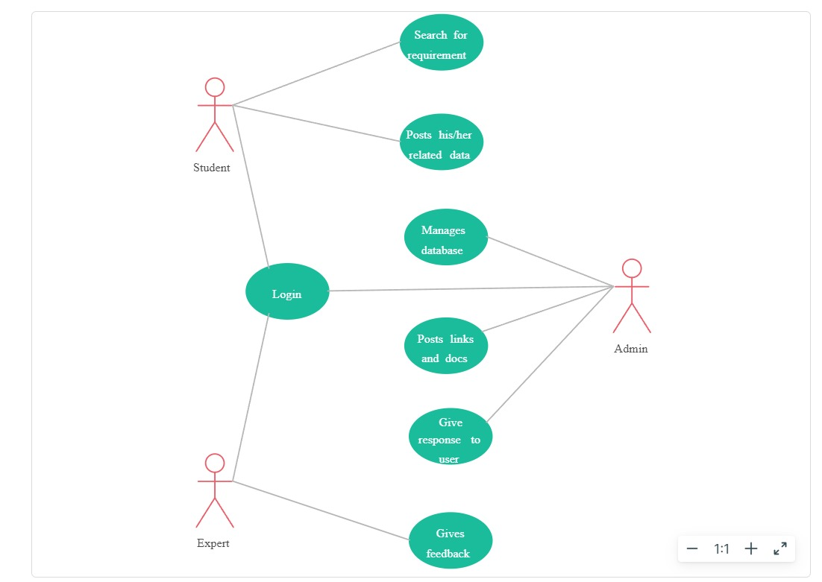
Use Case Diagram

Slide 16
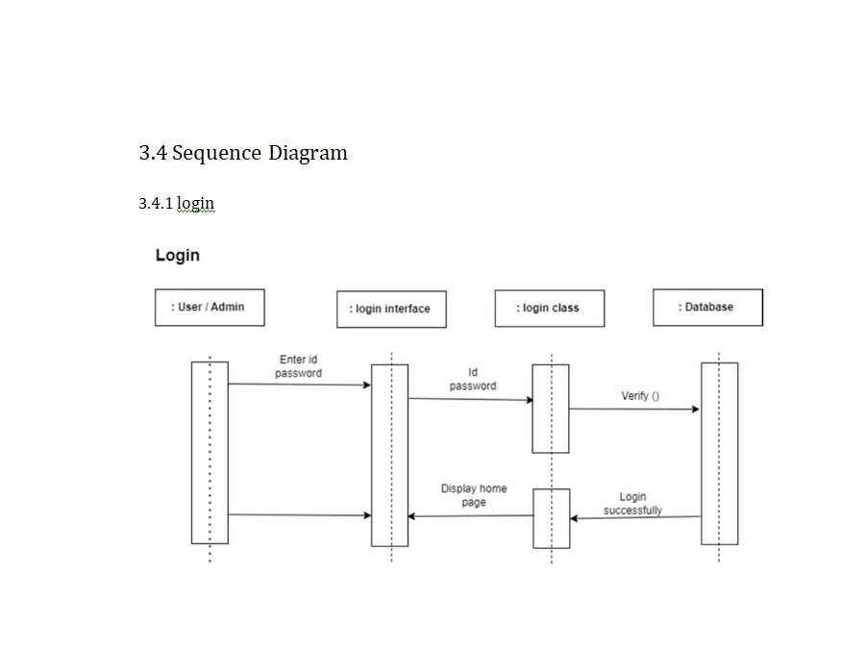

Slide 17
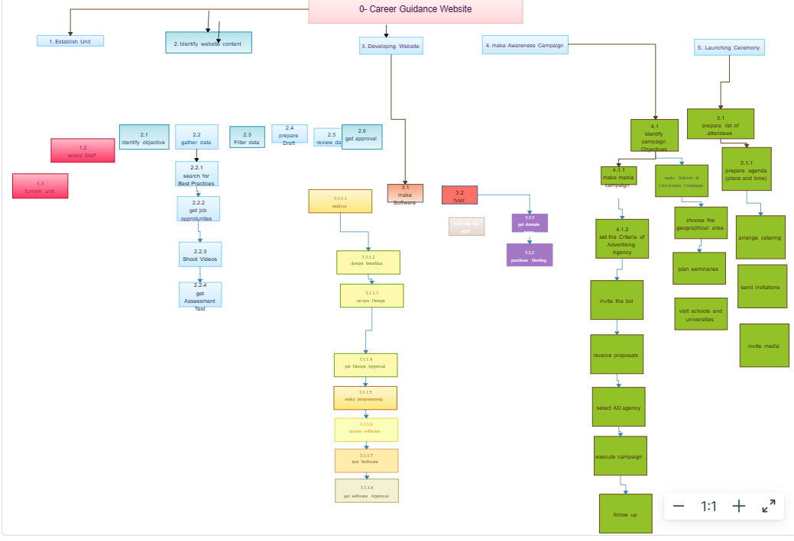
Activity Diagram

Slide 18
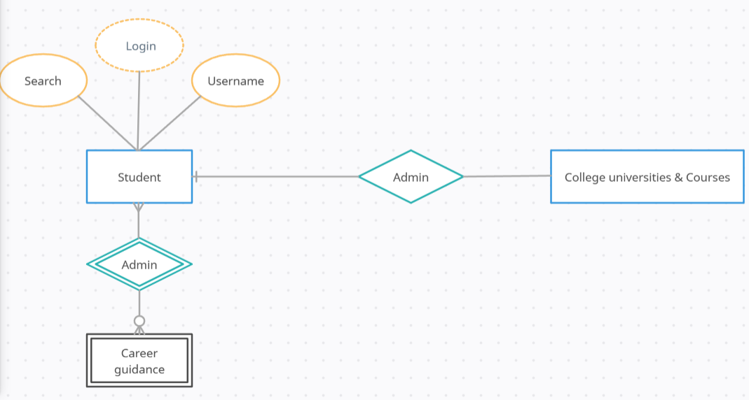
ER Diagram

Slide 19
Jul-Dec 2023
Good Luck – Career Guidance
A project report submitted to
Rajiv Gandhi Proudyogiki Vishwavidhyalaya, Bhopal
in partial fulfillment for the award of
the degree of
Bachelor of Technology
in
Computer Science & Engineering
PROJECT GUIDE SUBMITTED BY
Prof. Manisha Kadam Arundhati Panwar – 0829CS211038
Sonali Salve-0829CS191165
Gouri Thakur – 0829CS211062
Dimple Kumari- 0829CS211040

