Slide 1
ARUN D.
(821721104007)
B.E COMPUTER SCIENCE AND ENGINEERING 3RD YEAR
Sir Issac Newton College of engineering and technology

Slide 2


CAR SALES PRICE PREDICTION USING ARTIFICIAL NEURAL NETWORKS(ANN)

Slide 3
AGENDA
The agenda of car sales price prediction using Artificial neural network(ANN) Provide a structured approach to guide the car sales price prediction project from data preprocessing to model deployment and beyond Adjustments can be made based on specific project requirements and constraints. Distribution of categories
Data Exploration and Preprocessing
Data Information and Data Cleaning
Data Visualization
Feature Engineering and Scaling
Building Artificial Neural Network
Training the ANN Model
Random prediction
This process techniques are used to make enhanced sales price prediction algorithm. Deep learning models are often employed to build effective sales price prediction system.

Slide 4
PROBLEM STATEMENT
We've implemented a sophisticated deep learning approach utilizing an Artificial Neural Network (ANN) architecture developed with TensorFlow/Keras. This ANN has been meticulously trained on our comprehensive dataset to predict car sales prices accurately by leveraging a multitude of influential features.
Through rigorous optimization and fine-tuning, our model harnesses the power of deep learning to deliver precise regression-based predictions, offering valuable insights into the complex dynamics of the automotive market. With this advanced methodology, we aim to significantly enhance the accuracy and reliability of our sales price forecasts, empowering stakeholders to make informed decisions and drive business growth effectively.

Slide 5
PROJECT OVERVIEW
In today's competitive automotive market, accurately predicting car sales prices is crucial for both buyers and sellers. This project aims to leverage the power of Artificial Neural Networks (ANNs) to predict car sales prices with high precision and reliability. By utilizing advanced machine learning techniques, we seek to empower stakeholders in the automotive industry with actionable insights to make informed decisions and optimize business strategies.
The project will follow a systematic approach, starting with data collection and preprocessing, followed by model development, training, and evaluation. We will employ artificial neural networks, a powerful class of machine learning algorithms inspired by the human brain, to learn complex patterns and relationships within the car sales dataset. Through iterative experimentation and optimization, we will fine-tune the model to achieve optimal performance and generalization ability.

Slide 6
Who are the end users?
In the context of car sales price prediction using Artificial Neural Networks (ANNs), the end users can be diverse and may include:
Automobile Dealerships
Car Buyers
Financial Institutions
Insurance Companies
Automobile Manufacturers
Market Analysts and Researchers
Government Agencies
Automotive Service Providers
Investors and Speculators
These end users represent a wide range of stakeholders in the automotive ecosystem, each benefiting from the insights provided by car sales price predictions powered by ANN technology.

Slide 7
Your solution and its value proposition
Car sales price prediction leverages state-of-the-art Artificial Neural Networks (ANNs) to accurately forecast the prices of vehicles in the automotive market. The value proposition of our solution lies in its ability to provide reliable and precise predictions, enabling various stakeholders in the automotive industry to make informed decisions and optimize their operations.
We design and fine-tune the architecture of the ANN model specifically for car sales price prediction. This customization ensures that the model is optimized for the task at hand, resulting in improved accuracy and efficiency.
We prioritize continuous model monitoring and updates to adapt to changing market dynamics and evolving consumer preferences. This ensures that the predictive model remains relevant and effective over time.

Slide 8
Precision and Accuracy:
Our solution delivers highly accurate predictions of car sales prices, providing stakeholders with confidence in their decision-making processes. This precision enables them to optimize pricing strategies, negotiate better deals, and minimize financial risks.
Efficiency and Automation:
By automating the price prediction process, our solution streamlines operations for automotive dealerships, financial institutions, and other stakeholders. This efficiency translates into time and cost savings, allowing organizations to focus on core business activities.
Insightful Analysis:
In addition to predicting prices, our solution provides valuable insights into market trends, consumer behavior, and other factors influencing car sales. This analysis enables stakeholders to gain a deeper understanding of the automotive market and make strategic decisions accordingly.
In summary, our solution for car sales price prediction using Artificial Neural Networks offers precision, efficiency, insightful analysis, and a competitive advantage to stakeholders in the automotive industry. By harnessing the power of advanced machine learning techniques, we empower organizations to make informed decisions and achieve their business objectives with confidence.

Slide 9
The wow in your solution
The car sales industry by leveraging cutting-edge technology to predict prices with unprecedented accuracy and efficiency. Our solution utilizes state-of-the-art Artificial Neural Networks (ANNs), a form of artificial intelligence inspired by the human brain, to analyze vast amounts of data and identify complex patterns. This allows us to make highly accurate predictions that outperform traditional methods.
Our predictive model continuously learns and adapts to changing market dynamics, ensuring that it stays relevant and effective over time. By incorporating real-time data and feedback, the model evolves to reflect the latest trends and consumer preferences. With our solution, users gain instantaneous insights into market trends, competitor pricing strategies, and customer behavior. This enables them to make data-driven decisions in real-time, giving them a competitive edge in a fast-paced industry.

Slide 10
By providing accurate price predictions based on objective data analysis, our solution promotes transparency and fairness in the car sales process. This builds trust with customers and enhances the reputation of businesses using our solution.
Our solution empowers users to make strategic decisions that drive business growth. Whether it's optimizing inventory, adjusting pricing strategies, or identifying new market opportunities, our solution provides the insights needed to succeed.
In summary, our solution is not just a tool for predicting car sales prices; it's a game-changer that revolutionizes the way the industry operates. With its advanced technology, real-time insights, seamless integration, and strategic capabilities, our solution sets a new standard for excellence in the automotive market.

Slide 11
Modelling
Design a suitable architecture for the Artificial Neural Network (ANN) to predict car sales prices. This includes determining the number of layers, neurons per layer, activation functions, and any regularization techniques to be employed.
Create wireframes for the ANN architecture, depicting the layout and connections between layers. The wireframes should visually represent the structure of the neural network, including input, hidden, and output layers.
This modelling plan outlines the steps involved in designing, training, evaluating, and optimizing the Artificial Neural Network (ANN) for car sales price prediction. By incorporating wireframes, stakeholders gain visual representations of the model architecture, training process, and interpretation of results, enhancing understanding and facilitating decision-making.

Slide 12
Dropping unnecessary columns
Annual salary vs. Purchase amount
Credit card debt vs. purchase amount
Load car_purchase .csv
Data Visualization
Scatter plots
net worth vs. purchase amount
Preprocessing
Data Loading
Handling missing values
MinMaxScaler and train_test_split functions
Data Scaling and Splitting
mean squared error
adam
epochs, batch size, and validation split
Model Training
Activation function
Build ANN Model
Mean absolute error
R2 score to assess prediction accuracy
Training History Visualization
Prediction
Training loss
validation loss

Slide 13
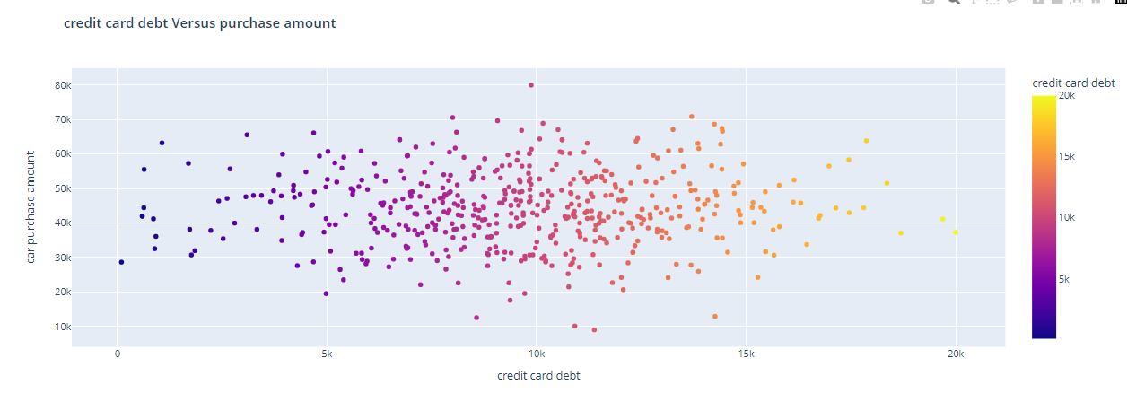
DATA VIRTUALIZATION

Slide 14
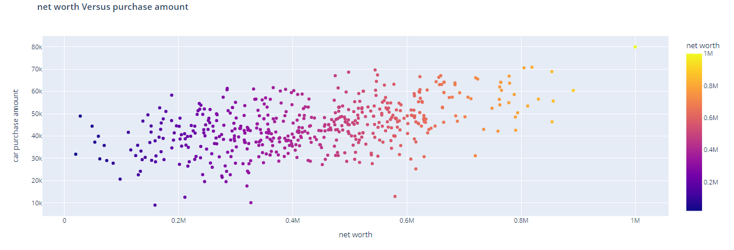

Slide 15
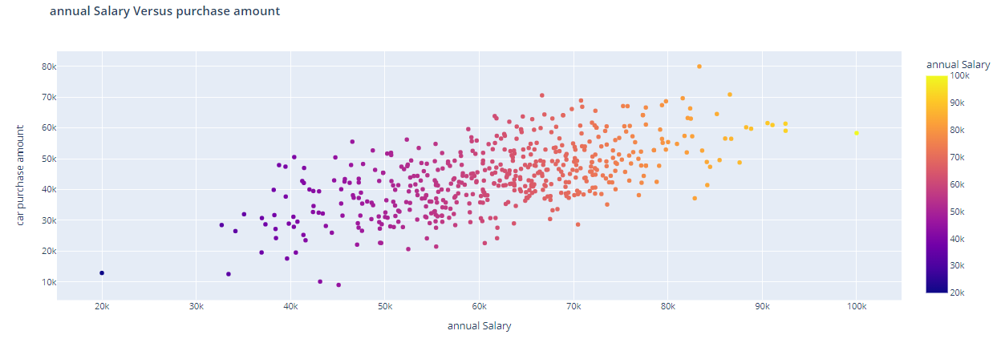

Slide 16
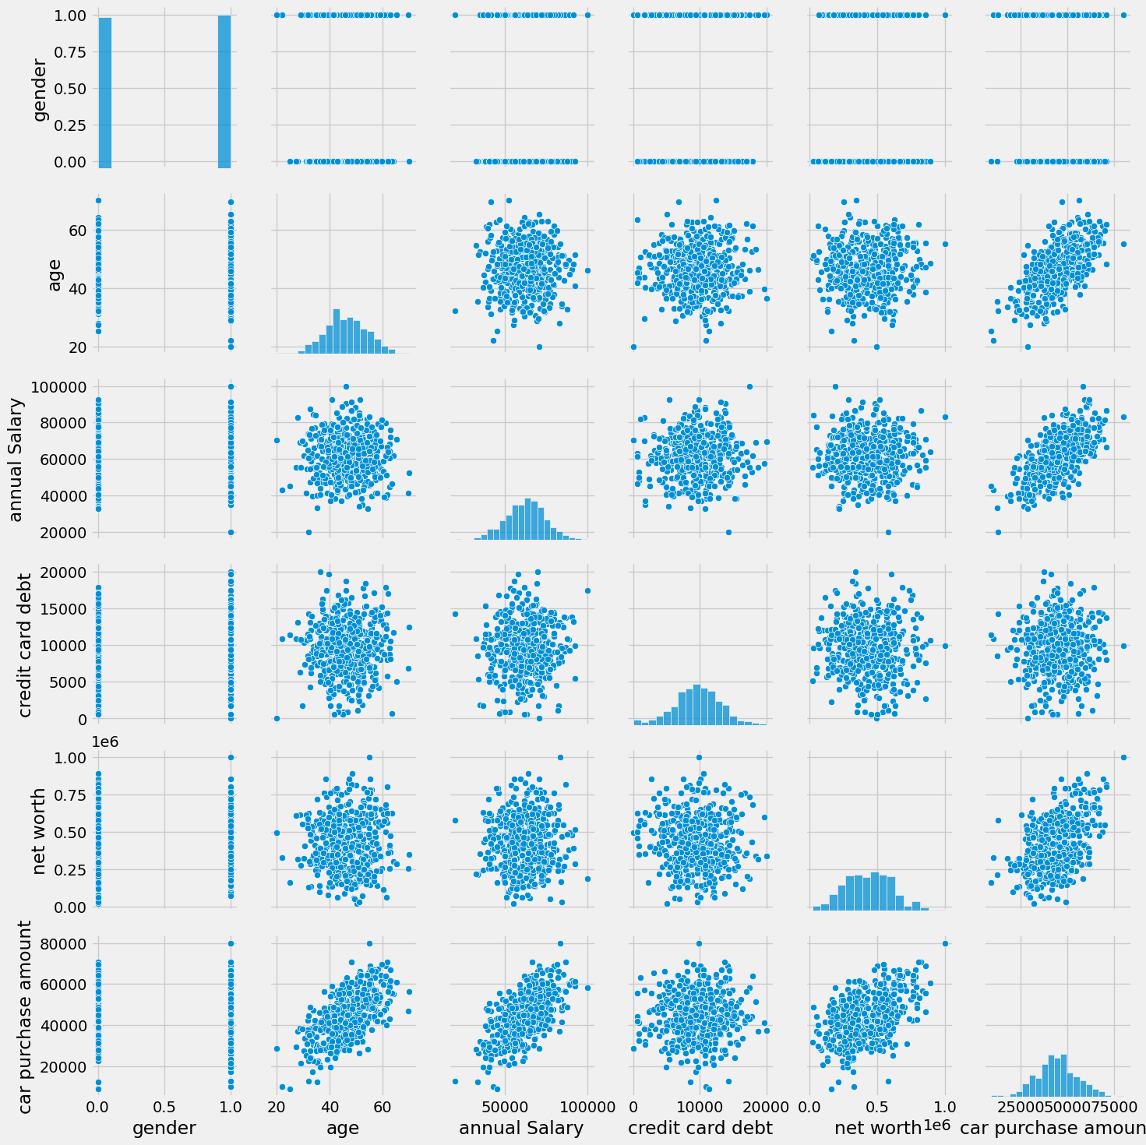

Slide 17
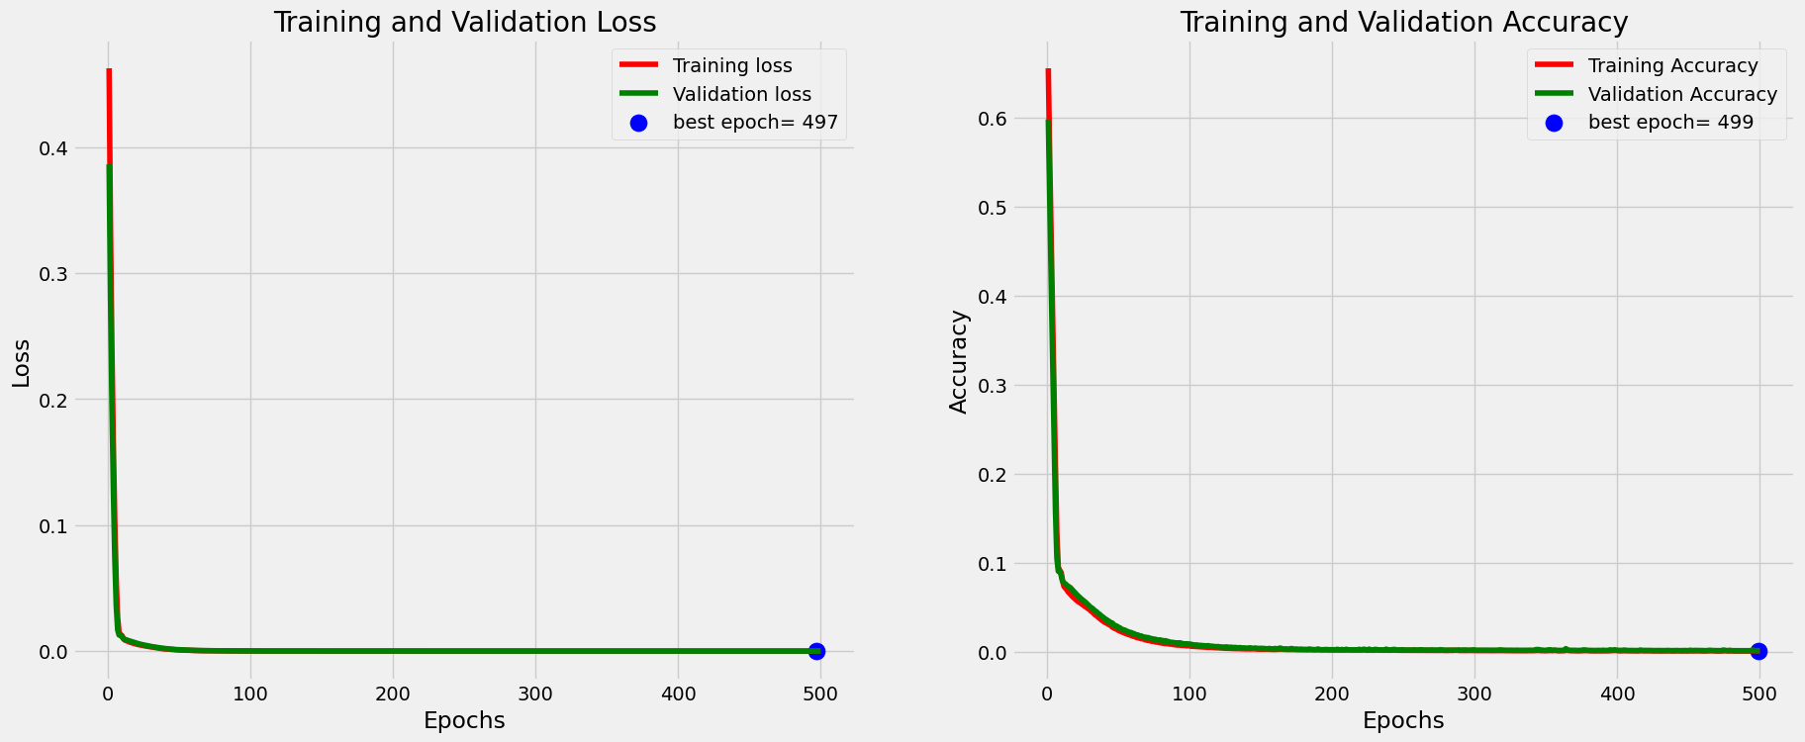
RESULTS
Training & validation loss and accuracy :

Slide 18
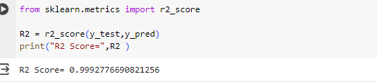
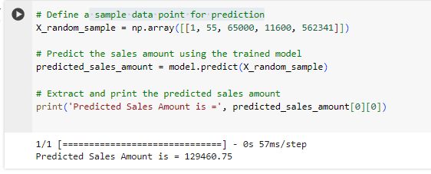
Prediction R2 score:
sample data point for prediction:

Slide 19
Thank you!!

