Slide 1
Enhance, Don't Distort: Brightness-Preserving Reversible Contrast Enhancement
A reproduction of Kim, Lussi, Qu, Huang & Kim (IEEE TCSVT, 2019)

Slide 2
Motivation
• Maximal contrast enhancement over-brightens or over-darkens images.
• Medical/consumer use needs enhancement that keeps the original brightness.
• And it must stay reversible with a hidden payload.

Slide 3
Problem Statement
• Enhance contrast to an appropriate (not maximal) level.
• Preserve mean brightness (low AMBE).
• Embed data and recover the exact original.

Slide 4
Existing Work
• Wu-Huang 2015 CE-RDH maximises contrast -> brightness drift.
• Histogram equalisation: irreversible, brightness shift.
• This paper: adaptive, brightness-preserving bin selection.

Slide 5
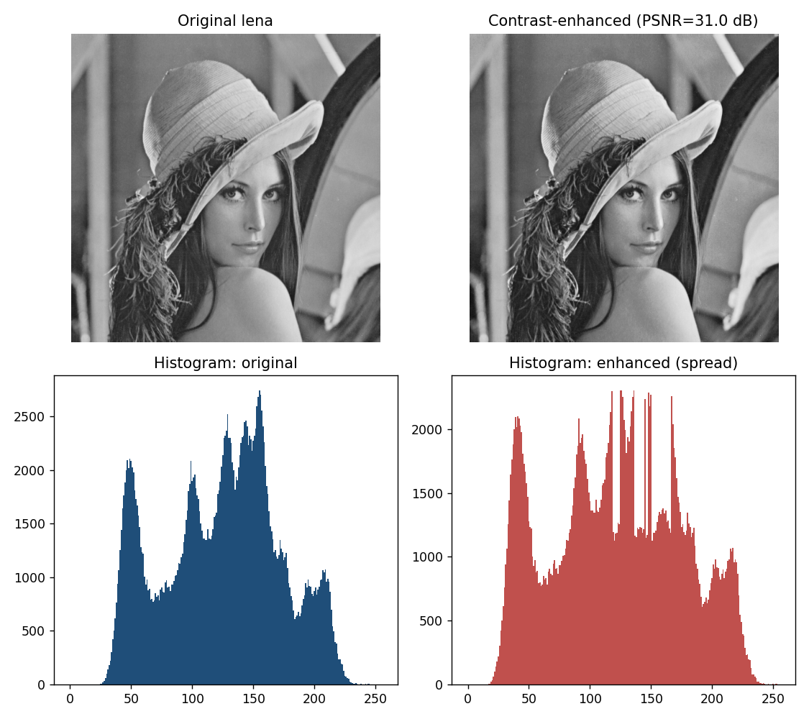
Proposed Method
• Split histogram peaks, but choose which side to expand adaptively.
• Balance left/right expansion so mean brightness is preserved.
• Stop at an appropriate contrast, not the maximum.

Slide 6
Workflow
• Pre-shift boundaries.
• Iterate: pick peaks, expand the brightness-balancing side, embed.
• Automatic stop on brightness/contrast criterion.
• Reverse -> exact original.

Slide 7
Mathematical Model
• Peaks a<b; expand outward embedding bits.
• AMBE = |mean(orig) - mean(marked)| kept small by side balancing.
• Contrast sigma rises; PSNR falls with iterations.

Slide 8
Experimental Setup
• USC-SIPI grayscale, iterations 2..10.
• Metrics: payload, PSNR, RMS contrast, entropy, AMBE.
• Reversibility verified each run.

Slide 9
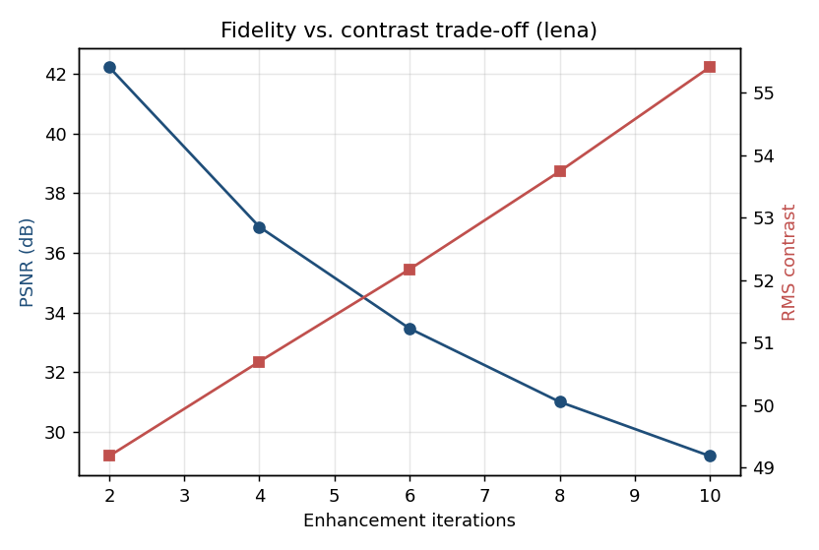
Results
• Contrast rises while AMBE stays modest.
• Payload scales with enhancement.
• All runs bit-exact reversible.

Slide 10
Advantages
• Brightness-preserving (natural look).
• Appropriate, not extreme, enhancement.
• Fully reversible.

Slide 11
Limitations
• Global brightness metric only.
• Full-range images enhance less.
• Strong enhancement lowers PSNR.

Slide 12
Future Scope
• Local brightness preservation.
• Perceptual stopping rules.
• Colour / medical extensions.

Slide 13
Conclusion
• Reproduced brightness-preserving CE-RDH.
• Confirmed contrast gain with controlled AMBE and reversibility.

Slide 14
References
• Kim et al. Auto Brightness-Preserving CE. IEEE TCSVT 29(8), 2019.
• Wu, Dugelay, Shi. CE-RDH. IEEE SPL 22(1), 2015.
• Ni et al. RDH. IEEE TCSVT 16(3), 2006.

