Slide 1
Layer by Layer: Multistage Bidirectional Reversible Data Hiding
A reproduction of Kumar, Walia & Gupta (EAAI, 2025)

Slide 2
Motivation
• One-pass hiding caps capacity.
• Repeat embedding in stages to accumulate payload.
• Bidirectional expansion uses both sides of the peak.

Slide 3
Problem Statement
• Embed a large payload with minimal distortion.
• Guarantee exact recovery of image and data.
• Beat the capacity-PSNR trade-off of plain histogram shifting.

Slide 4
Existing Work
• Ni 2006 histogram shifting: low capacity.
• Thodi-Rodriguez PEE; Sachnev sorting+prediction.
• This paper: a refined prediction/embedding strategy.

Slide 5
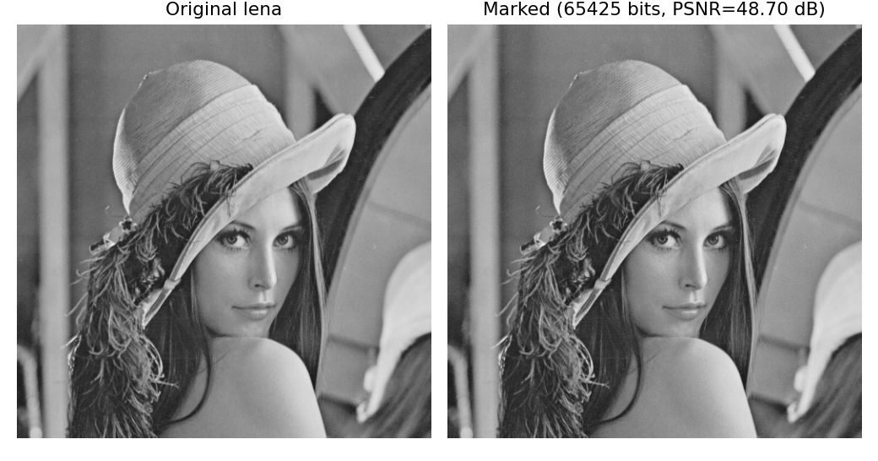
Proposed Method
• Predict; expand PE bins both ways.
• Embed one bit per innermost-bin pixel.
• Repeat over multiple stages.
• Fully reversible.

Slide 6
Workflow
• Predict each pixel from neighbours.
• Form the prediction-error histogram.
• Expand innermost bins to embed; shift the rest.
• Reverse to recover image + data.

Slide 7
Mathematical Model
• e = pixel - prediction.
• Embed at e in {0,-1}: e' = e +/- b; shift |e|>=1 outward.
• Capacity = count of innermost-bin errors; PSNR falls as levels grow.

Slide 8
Experimental Setup
• 8 USC-SIPI 512x512 grayscale images, embedding levels 1..3.
• Metrics: payload (bpp), PSNR, SSIM, exact reversibility.

Slide 9
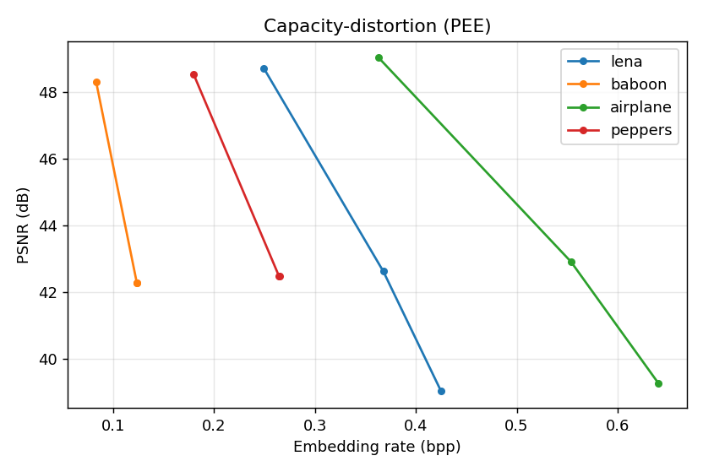
Results
• Capacity grows with stages.
• PSNR falls gracefully.
• All runs bit-exact reversible.

Slide 10
Advantages
• High, tunable capacity.
• Reversible.
• Simple stages.

Slide 11
Limitations
• Predictor/schedule approximated.
• Image-dependent capacity.
• PSNR cost per stage.

Slide 12
Future Scope
• Adaptive predictors.
• Stage-count selection.
• Larger corpora.

Slide 13
Conclusion
• Reproduced a high-capacity prediction-error RDH core.
• Confirmed literature-consistent capacity-PSNR and exact recovery.

Slide 14
References
• Kumar et al. Bidirectional Multistage RDH. EAAI 156, 2025.
• Sachnev et al. Sorting+Prediction. IEEE TCSVT 19(7), 2009.
• Ni et al. RDH. IEEE TCSVT 16(3), 2006.

