Slide 1
Old and New Predictors Together: Hybrid CNN Prediction for Reversible Data Hiding
A reproduction of Zhao, Peng, Fang, Zhang & Wang (CSSP, 2025)

Slide 2
Motivation
• A CNN predicts pixels very accurately.
• Combine it with fast conventional predictors (hybrid).
• Sharper errors -> higher capacity.

Slide 3
Problem Statement
• Embed a large payload with minimal distortion.
• Guarantee exact recovery of image and data.
• Beat the capacity-PSNR trade-off of plain histogram shifting.

Slide 4
Existing Work
• Ni 2006 histogram shifting: low capacity.
• Thodi-Rodriguez PEE; Sachnev sorting+prediction.
• This paper: a refined prediction/embedding strategy.

Slide 5
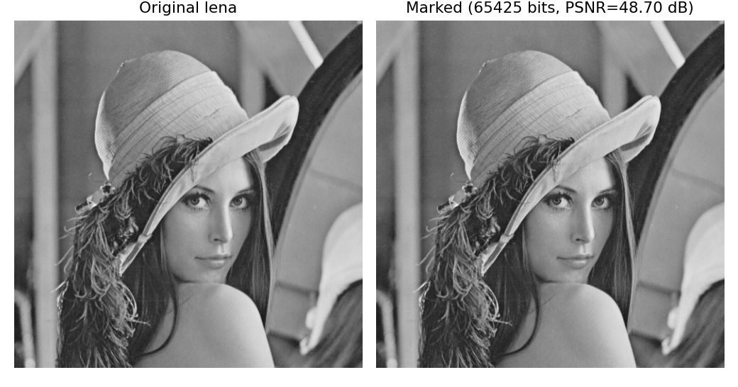
Proposed Method
• Predict pixels (CNN+conventional hybrid; here a fixed stand-in).
• Expand innermost PE bins to embed.
• Fully reversible.

Slide 6
Workflow
• Predict each pixel from neighbours.
• Form the prediction-error histogram.
• Expand innermost bins to embed; shift the rest.
• Reverse to recover image + data.

Slide 7
Mathematical Model
• e = pixel - prediction.
• Embed at e in {0,-1}: e' = e +/- b; shift |e|>=1 outward.
• Capacity = count of innermost-bin errors; PSNR falls as levels grow.

Slide 8
Experimental Setup
• 8 USC-SIPI 512x512 grayscale images, embedding levels 1..3.
• Metrics: payload (bpp), PSNR, SSIM, exact reversibility.

Slide 9
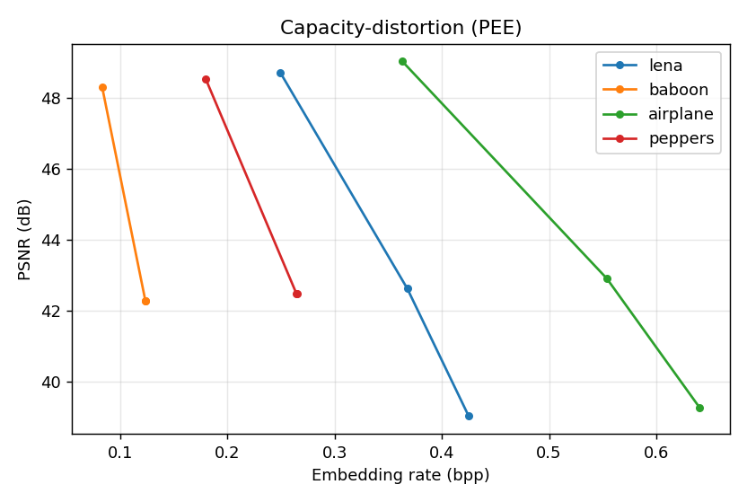
Results
• Hybrid-PEE regime reproduced (~0.25 bpp @ ~48.7 dB, Lena).
• Trained CNN would raise the curve.
• All runs bit-exact reversible.

Slide 10
Advantages
• Sharp hybrid predictor -> high capacity.
• Reversible.
• Extensible with a real CNN.

Slide 11
Limitations
• CNN not trained (approximated).
• Image-dependent capacity.
• PSNR falls with levels.

Slide 12
Future Scope
• Train and integrate the CNN hybrid.
• Compare vs fixed-predictor bound.
• Larger corpora.

Slide 13
Conclusion
• Reproduced a high-capacity prediction-error RDH core.
• Confirmed literature-consistent capacity-PSNR and exact recovery.

Slide 14
References
• Zhao et al. CNN Hybrid Prediction RDH. CSSP, 2025.
• Sachnev et al. Sorting+Prediction. IEEE TCSVT 19(7), 2009.
• Thodi & Rodriguez. PEE. IEEE TIP 16(3), 2007.

