Slide 1
Seeing Every Tissue: Reversible Contrast Enhancement for MR Brain Images
A reproduction of Wu, Zheng, Huang & Hu (IEEE SPL, 2021)

Slide 2
Motivation
• MR brain images have poor tissue contrast.
• Irreversible enhancement is unacceptable for diagnosis.
• We want reversible multi-tissue contrast enhancement + payload.

Slide 3
Problem Statement
• Enhance diagnostic contrast of a region of interest (ROI).
• Embed clinical/annotation data during enhancement.
• Recover the exact original image (no diagnostic loss).

Slide 4
Existing Work
• Ni 2006 histogram shifting: high fidelity, low capacity.
• Wu-Huang 2015 CE-RDH: whole-image contrast enhancement.
• This paper: medical/ROI-focused reversible enhancement.

Slide 5
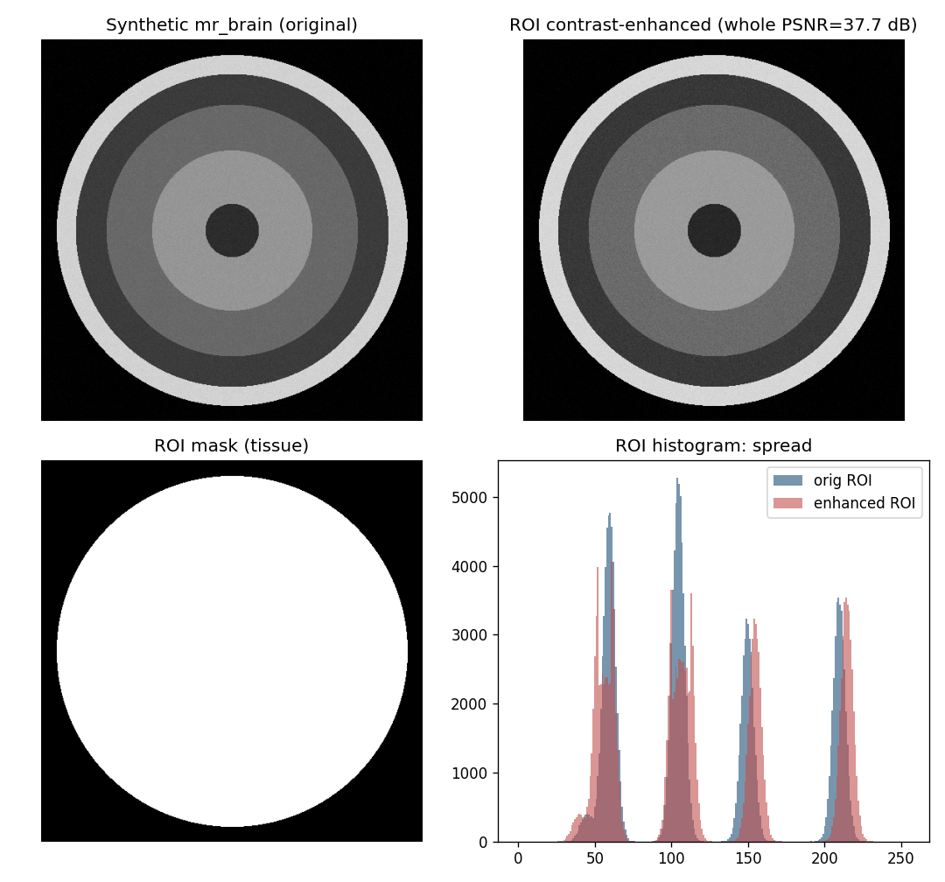
Proposed Method
• Segment tissue ROI.
• Expand ROI histogram to separate tissue clusters.
• Embed one bit per expanded peak pixel.
• Background untouched -> exact recovery.

Slide 6
Workflow
• Segment ROI (tissue).
• Enhance ROI histogram + embed payload.
• Leave background untouched.
• Reverse -> exact original.

Slide 7
Mathematical Model
• ROI pixels expanded outward around peaks; 1 bit / peak pixel.
• ROI RMS contrast sigma rises; whole-image PSNR bounded.
• AMBE tracks ROI brightness stability.

Slide 8
Experimental Setup
• Synthetic MR/CT phantoms (no real patient data available).
• Tissue ROI via thresholding; iterations swept.
• Metrics: ROI payload, whole PSNR, ROI contrast/entropy, reversibility.

Slide 9
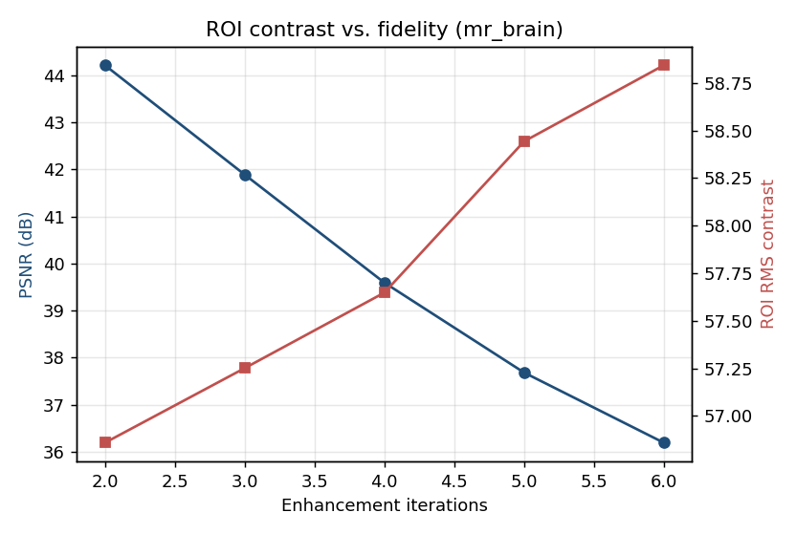
Results
• ROI contrast (RMS, entropy) rises with iterations.
• Whole-image PSNR stays high.
• All runs bit-exact reversible.

Slide 10
Advantages
• Diagnostic contrast where it matters.
• Fully reversible.
• Background preserved.

Slide 11
Limitations
• Synthetic phantoms only.
• Threshold ROI.
• Strong CE lowers PSNR.

Slide 12
Future Scope
• Real MR datasets.
• Learned segmentation.
• 3D volumetric CE.

Slide 13
Conclusion
• Reproduced ROI-restricted reversible contrast enhancement.
• Confirmed ROI contrast gain with exact recovery on phantoms.

Slide 14
References
• Wu et al. Multi-Tissue MR CE. IEEE SPL 28, 2021.
• Wu, Dugelay, Shi. CE-RDH. IEEE SPL 22(1), 2015.
• Ni et al. RDH. IEEE TCSVT 16(3), 2006.

