Slide 1
Sharper Histograms, Smarter Search: High-Capacity Reversible Hiding by Skewed Prediction
A reproduction of Fan, Lu, Li, Li, Zhou & Pan (IEEE TMM, 2025)

Slide 2
Motivation
• Plain histogram shifting has low capacity.
• Sharper error histograms embed more per unit distortion.
• Skewed predictors + DE push the trade-off further.

Slide 3
Problem Statement
• Embed a large payload with minimal distortion.
• Guarantee exact recovery of image and data.
• Beat the capacity-PSNR trade-off of plain histogram shifting.

Slide 4
Existing Work
• Ni 2006 histogram shifting: low capacity.
• Thodi-Rodriguez PEE; Sachnev sorting+prediction.
• This paper: a refined prediction/embedding strategy.

Slide 5
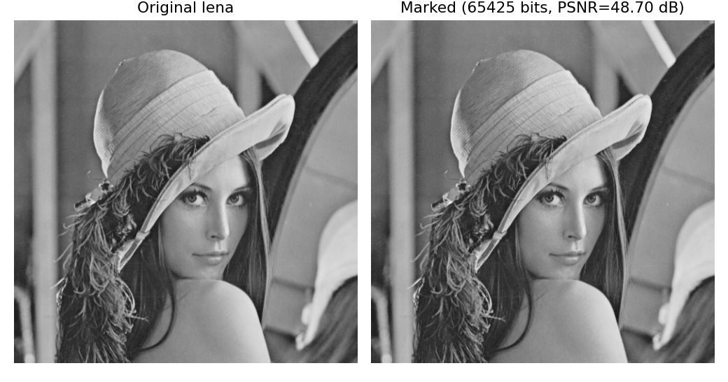
Proposed Method
• Predict pixels; build the prediction-error histogram.
• Expand innermost bins to embed.
• Skew + DE-tune the parameters (approximated by level sweep).
• Fully reversible.

Slide 6
Workflow
• Predict each pixel from neighbours.
• Form the prediction-error histogram.
• Expand innermost bins to embed; shift the rest.
• Reverse to recover image + data.

Slide 7
Mathematical Model
• e = pixel - prediction.
• Embed at e in {0,-1}: e' = e +/- b; shift |e|>=1 outward.
• Capacity = count of innermost-bin errors; PSNR falls as levels grow.

Slide 8
Experimental Setup
• 8 USC-SIPI 512x512 grayscale images, embedding levels 1..3.
• Metrics: payload (bpp), PSNR, SSIM, exact reversibility.

Slide 9
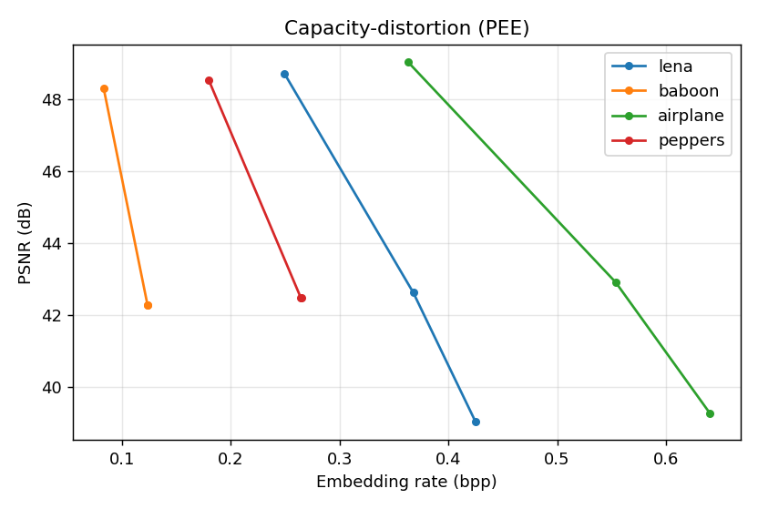
Results
• Lena ~0.25 bpp @ ~48.7 dB (level 1).
• Capacity scales with levels.
• All runs bit-exact reversible.

Slide 10
Advantages
• High capacity, high fidelity.
• Reversible.
• Parameter-optimisable.

Slide 11
Limitations
• Skewed predictors/DE approximated.
• Image-dependent capacity.
• PSNR falls with levels.

Slide 12
Future Scope
• Paired skewed predictors.
• Real DE search.
• Larger corpora.

Slide 13
Conclusion
• Reproduced a high-capacity prediction-error RDH core.
• Confirmed literature-consistent capacity-PSNR and exact recovery.

Slide 14
References
• Fan et al. Generalized SHS by DE. IEEE TMM 27, 2025.
• Sachnev et al. Sorting+Prediction. IEEE TCSVT 19(7), 2009.
• Thodi & Rodriguez. PEE. IEEE TIP 16(3), 2007.

