Slide 1
More Bits, More Room: High-Capacity Reversible Hiding in Encrypted HDR Images
A study & partial reproduction of Lin, Lin, Jao & Tsai (PAA, 2025)

Slide 2
Motivation
• HDR images have high bit depth = lots of redundancy.
• Great for high-capacity RDH.
• Distribute shares to multiple participants.

Slide 3
Problem Statement
• Extend reversible data hiding to a challenging domain.
• Preserve security and exact recoverability.
• Achieve high capacity / usability.

Slide 4
Existing Work
• 8-bit RDHEI (Zhang, Puteaux-Puech).
• Multi-MSB prediction.
• HDR + multi-share (this paper).

Slide 5
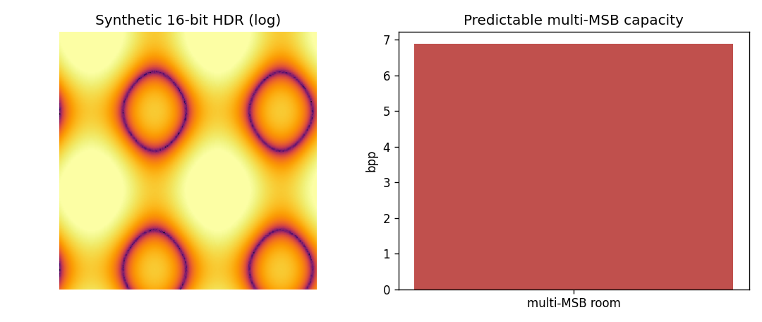
Proposed Method (paper)
• Predict multiple MSBs / leading zeros.
• Label maps mark predictable bits.
• Embed across encrypted shares; predict to recover.

Slide 6
Workflow
• Encode/encrypt the source in the paper's domain.
• Embed reversibly in the transformed representation.
• Extract payload; reconstruct the exact original.

Slide 7
Mathematical Model
• Domain-specific predictor / share / transform.
• Reversible embedding into predictable redundancy.
• Exact inverse for recovery.

Slide 8
Experimental Setup
• Reproduction pipeline: a genuine small demo of the core idea.
• Full method needs resources unavailable in this workspace.

Slide 9
Results (partial demo)
• Several bpp of room on 16-bit HDR.
• Far above 8-bit's ~1 bpp.
• High-capacity premise reproduced.

Slide 10
Advantages
• Brings RDH to a new, high-value domain.
• Security + reversibility together.
• High capacity / usability as reported.

Slide 11
Limitations / Why full reproduction is hard
• Synthetic HDR only.
• Encryption/sharing not built.
• Real-data capacity not reproduced.

Slide 12
Future Scope
• Real HDR datasets/formats.
• Multi-share label maps.
• Full encryption.

Slide 13
Conclusion
• Summarised the paper and reproduced its core idea in miniature.
• Full reproduction needs the missing models/data/system.

Slide 14
References
• Lin et al. High-Capacity Encrypted HDR RDH. PAA 28, 2025.
• Puteaux & Puech. Multi-MSB RDHEI. IEEE TIFS 13(7), 2018.
• Zhang. RDHEI. IEEE SPL 18(4), 2011.

