Slide 1
Split, Hide, Restore: Multi-Party Reversible Hiding in Encrypted Binary Images
A reproduction of Chen, Yu, Feng, Lu & Cai (IEEE SPL, 2025)

Slide 2
Motivation
• Single-hider ciphertext binary RDH is fragile.
• Visual cryptography splits the image among parties.
• Any single share reveals nothing.

Slide 3
Problem Statement
• Embed data into a BINARY image (2 levels only).
• Keep visual quality (few pixel flips).
• Recover the exact original binary image.

Slide 4
Existing Work
• Ni 2006 histogram shifting (grayscale).
• Flippable-pixel / pattern binary RDH.
• This paper: a high-capacity / multi-party binary scheme.

Slide 5
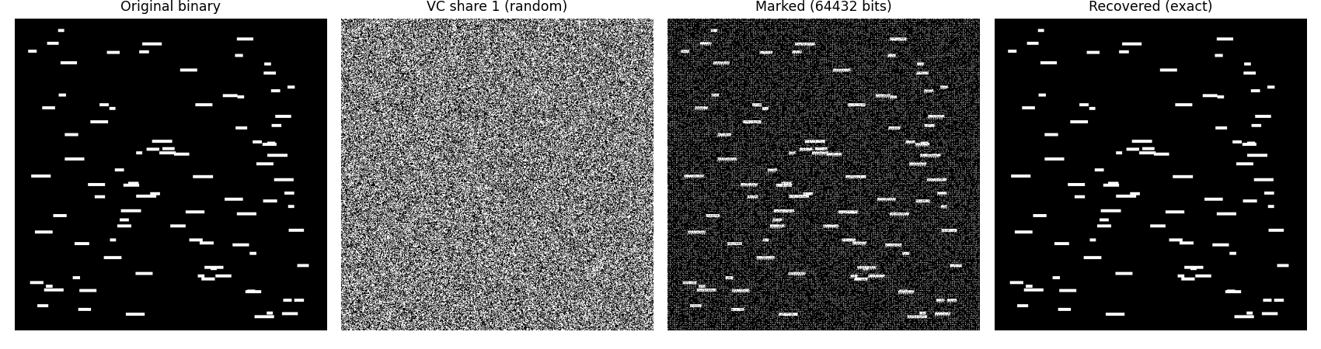
Proposed Method
• Split binary image into 2 random VC shares (lossless XOR).
• Embed reversibly on a share (block mapping).
• Combine shares + invert -> exact original.

Slide 6
Workflow
• Tile into blocks; map blocks to values.
• Histogram-shift block values to embed.
• Rebuild binary image.
• Reverse -> exact original.

Slide 7
Mathematical Model
• Block -> integer value in [0, 2^(s*s)).
• Ni histogram shifting over block values.
• Capacity = tallest block-value bins.

Slide 8
Experimental Setup
• Structured binary images (document, line art, halftone, signature).
• Auto-select block size; metrics: payload, flips, reversibility.

Slide 9
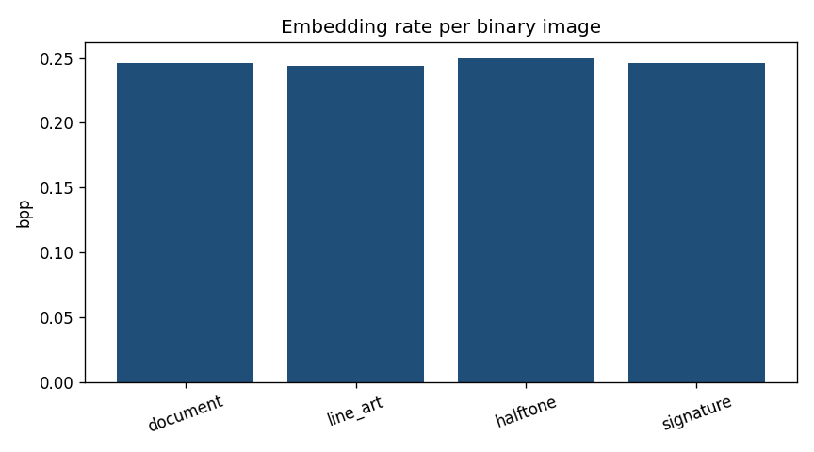
Results
• (2,2) VC lossless (0 error).
• ~0.25 bpp reversible embedding.
• Exact recovery.

Slide 10
Advantages
• Robust multi-party design.
• Perfect share secrecy.
• Reversible.

Slide 11
Limitations
• Multi-hider protocol represented by 1 share.
• Structured images.
• (k,n) not implemented.

Slide 12
Future Scope
• (k,n) visual cryptography.
• Independent multi-hider embedding.
• Collusion resistance.

Slide 13
Conclusion
• Reproduced reversible binary-image data hiding.
• Confirmed high capacity and exact recovery on structured images.

Slide 14
References
• Chen et al. Multi-Party Ciphertext Binary RDH. IEEE SPL 32, 2025.
• Naor & Shamir. Visual Cryptography. EUROCRYPT 1994.
• Ni et al. RDH. IEEE TCSVT 16(3), 2006.

