Slide 1
Brightening the Picture, Losing Nothing: Reversible Contrast Enhancement by Histogram Expansion
A reproduction of Lyu, Yue & Yin (JVCIR, 2023)

Slide 2
Motivation
• Low-contrast images (medical, surveillance) are hard to read.
• Classic contrast enhancement is irreversible and destroys the original.
• We want enhancement AND a hidden payload AND exact recovery.

Slide 3
Problem Statement
• Enhance global contrast reversibly.
• Embed a large payload during enhancement.
• Keep brightness stable and recover the exact original.

Slide 4
Existing Work
• Ni 2006 histogram shifting: fidelity, tiny capacity.
• Wu-Huang 2015 CE-RDH: enhances contrast by splitting the two peaks.
• This paper: automatic histogram expansion with brightness control.

Slide 5
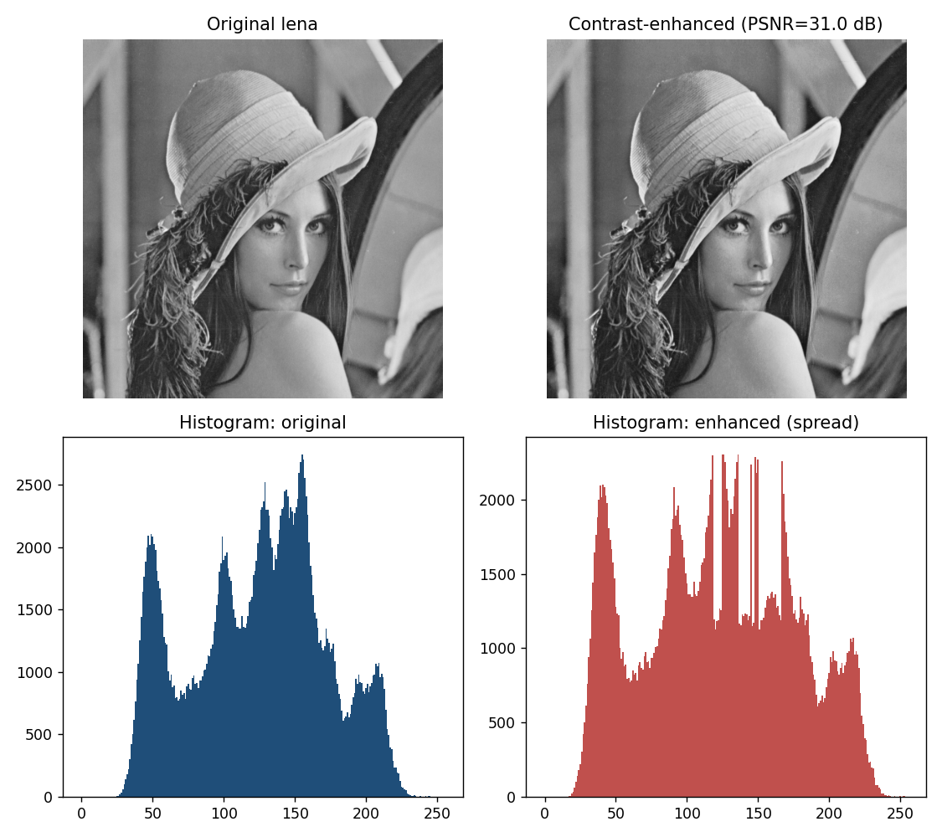
Proposed Method
• Iteratively expand the two tallest histogram bins outward.
• Each expansion embeds one bit per peak pixel and widens the tonal range.
• Average brightness guides how far to expand (automatic stopping).

Slide 6
Workflow
• Pre-shift boundary pixels (location map).
• Repeat: pick two peaks -> expand -> embed bits.
• Stop when brightness/quality criterion is met.
• Receiver reverses every iteration -> exact original.

Slide 7
Mathematical Model
• Peaks a<b (two tallest bins).
• Shift: v<a -> v-1 ; v>b -> v+1 (spread).
• Embed: a-pixel bit1->a-1 ; b-pixel bit1->b+1.
• Contrast rises with iterations; PSNR falls monotonically.

Slide 8
Experimental Setup
• USC-SIPI grayscale images, iterations 2..10.
• Metrics: payload (bpp), PSNR, RMS contrast, entropy.
• Bit-exact reversibility check every run.

Slide 9
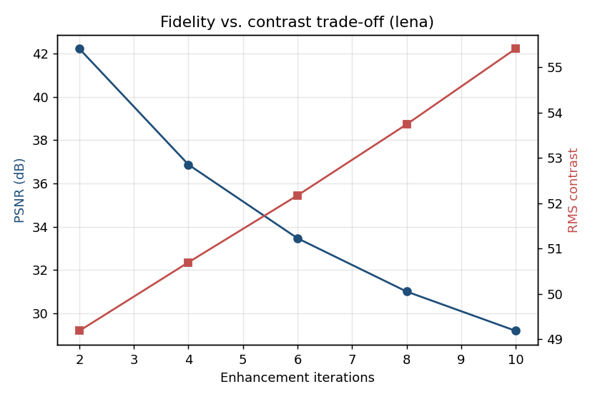
Results
• Contrast (RMS, entropy) rises with iterations.
• Payload grows with enhancement strength.
• All runs bit-exact reversible.

Slide 10
Advantages
• Enhancement and embedding in one pass.
• Automatic, brightness-aware stopping.
• Fully reversible, no external side channel needed.

Slide 11
Limitations
• Full-tonal-range images enhance less (boundary limit).
• Strong enhancement lowers PSNR.
• Contrast metric is global, not local.

Slide 12
Future Scope
• Local/ROI contrast enhancement.
• Perceptual quality-guided stopping.
• Extend to color and medical modalities.

Slide 13
Conclusion
• Reproduced automatic CE-RDH via histogram expansion.
• Confirmed the contrast-vs-fidelity trade-off and reversibility.
• Consistent with the paper's qualitative claims.

Slide 14
References
• Lyu, Yue, Yin. Automatic CE via Histogram Expansion. JVCIR 92, 2023.
• Wu, Dugelay, Shi. CE-RDH. IEEE SPL 22(1), 2015.
• Ni et al. Reversible Data Hiding. IEEE TCSVT 16(3), 2006.

