Slide 1
Hiding in the Order of Things: Reversible Data Hiding in Encrypted 3D Meshes
A study & partial reproduction of Yuan-Yu Tsai (IEEE TMM, 2025)

Slide 2
Motivation
• 3D models need data hiding without distorting geometry.
• Coordinate changes distort shapes.
• Hide data in the vertex-index ordering instead.

Slide 3
Problem Statement
• Extend reversible data hiding to a challenging domain.
• Preserve security and exact recoverability.
• Achieve high capacity / usability.

Slide 4
Existing Work
• Coordinate-based 3D RDH.
• Connectivity prediction.
• Vertex-index similarity (this paper).

Slide 5
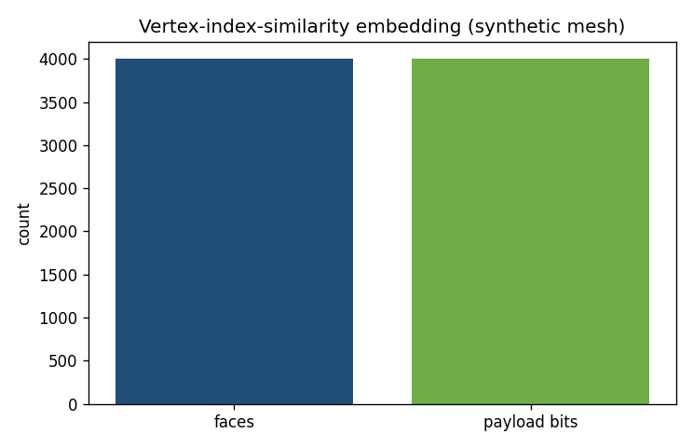
Proposed Method (paper)
• Faces have equivalent cyclic orderings.
• Ordering encodes bits (geometry unchanged).
• Re-canonicalise to recover exactly.

Slide 6
Workflow
• Encode/encrypt the source in the paper's domain.
• Embed reversibly in the transformed representation.
• Extract payload; reconstruct the exact original.

Slide 7
Mathematical Model
• Domain-specific predictor / share / transform.
• Reversible embedding into predictable redundancy.
• Exact inverse for recovery.

Slide 8
Experimental Setup
• Reproduction pipeline: a genuine small demo of the core idea.
• Full method needs resources unavailable in this workspace.

Slide 9
Results (partial demo)
• 1 bit/face (4000 bits) embedded.
• Geometry unchanged.
• Every face recovered exactly.

Slide 10
Advantages
• Brings RDH to a new, high-value domain.
• Security + reversibility together.
• High capacity / usability as reported.

Slide 11
Limitations / Why full reproduction is hard
• Synthetic mesh only.
• Encryption not implemented.
• Paper figures not reproduced.

Slide 12
Future Scope
• Real mesh corpora.
• Paper's encryption.
• General polygons.

Slide 13
Conclusion
• Summarised the paper and reproduced its core idea in miniature.
• Full reproduction needs the missing models/data/system.

Slide 14
References
• Tsai. RDH in Encrypted Polygonal Faces. IEEE TMM 27, 2025.
• Ni et al. RDH. IEEE TCSVT 16(3), 2006.
• Zhang. RDHEI. IEEE SPL 18(4), 2011.

