Slide 1
Local Focus: Reversible Superpixel-Block Contrast Enhancement for Medical Images
A reproduction of Gao, Yang, Hu, Xia & Shi (IEEE TCSVT, 2025)

Slide 2
Motivation
• Global enhancement flattens local detail.
• Medical detail is local.
• Enhance per superpixel block, reversibly.

Slide 3
Problem Statement
• Enhance diagnostic contrast of a region of interest (ROI).
• Embed clinical/annotation data during enhancement.
• Recover the exact original image (no diagnostic loss).

Slide 4
Existing Work
• Ni 2006 histogram shifting: high fidelity, low capacity.
• Wu-Huang 2015 CE-RDH: whole-image contrast enhancement.
• This paper: medical/ROI-focused reversible enhancement.

Slide 5
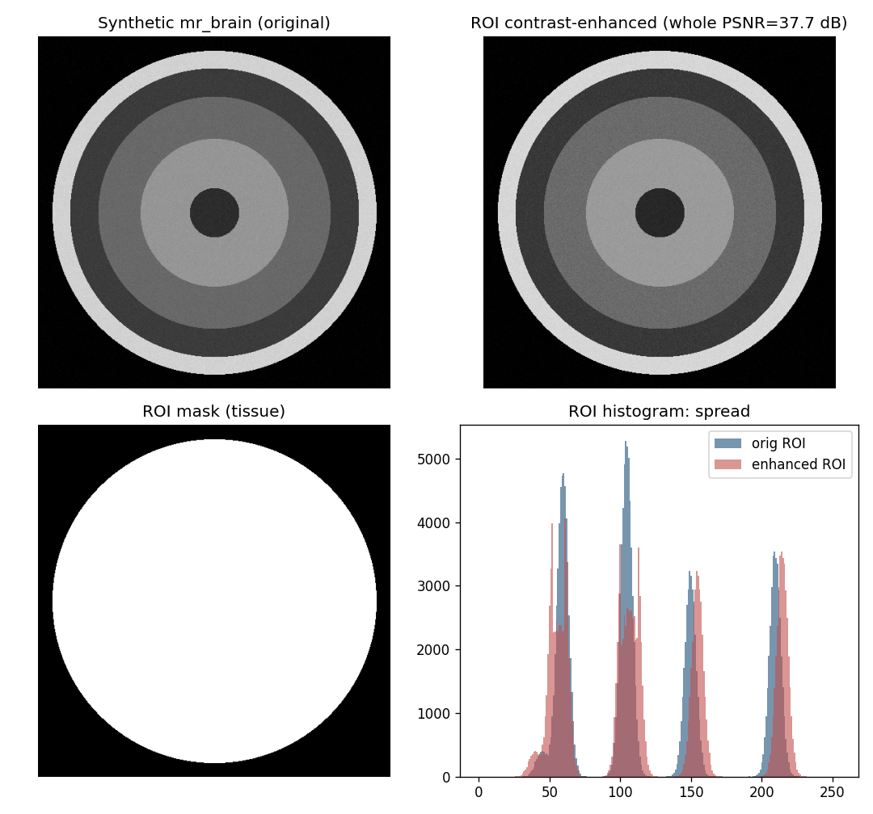
Proposed Method
• Segment ROI; partition into blocks.
• Enhance each block's local histogram.
• Embed bits per block.
• Exact recovery.

Slide 6
Workflow
• Segment ROI (tissue).
• Enhance ROI histogram + embed payload.
• Leave background untouched.
• Reverse -> exact original.

Slide 7
Mathematical Model
• ROI pixels expanded outward around peaks; 1 bit / peak pixel.
• ROI RMS contrast sigma rises; whole-image PSNR bounded.
• AMBE tracks ROI brightness stability.

Slide 8
Experimental Setup
• Synthetic MR/CT phantoms (no real patient data available).
• Tissue ROI via thresholding; iterations swept.
• Metrics: ROI payload, whole PSNR, ROI contrast/entropy, reversibility.

Slide 9
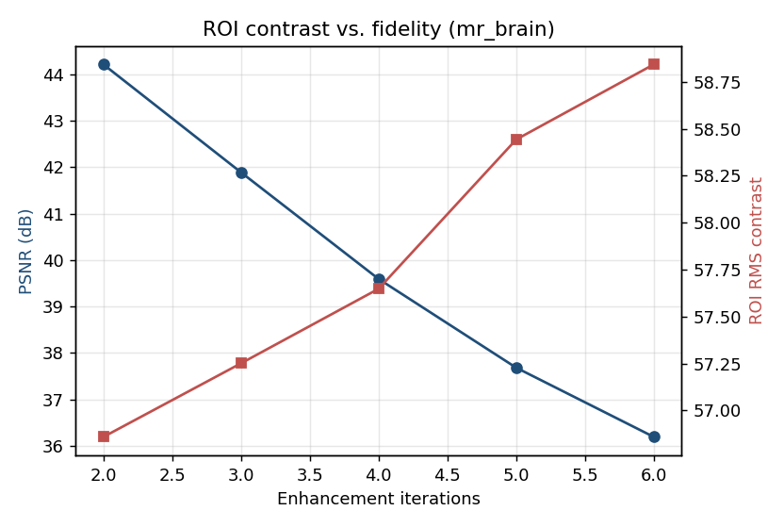
Results
• Local ROI contrast gain, sharper detail.
• Whole PSNR maintained.
• Bit-exact reversible.

Slide 10
Advantages
• Local detail preserved.
• Adaptive per region.
• Reversible.

Slide 11
Limitations
• Synthetic phantoms.
• Superpixels approximated by blocks.
• Per-block overhead.

Slide 12
Future Scope
• True SLIC superpixels.
• Real datasets.
• Adaptive block counts.

Slide 13
Conclusion
• Reproduced ROI-restricted reversible contrast enhancement.
• Confirmed ROI contrast gain with exact recovery on phantoms.

Slide 14
References
• Gao et al. Local CE Superpixel. IEEE TCSVT 35(2), 2025.
• Gao et al. Adaptive Interval. IEEE SPL 32, 2025.
• Wu, Dugelay, Shi. CE-RDH. IEEE SPL 22(1), 2015.

