Slide 1
Stretching in Groups: Reversible Multi-Group Contrast Enhancement for Medical ROI
A reproduction of Gao, Zhang, Xia, Luo & Shi (IEEE TMM, 2024)

Slide 2
Motivation
• Single-group ROI stretch is uneven across intensities.
• Medical images vary widely.
• Multi-group stretching generalises better + stays reversible.

Slide 3
Problem Statement
• Enhance diagnostic contrast of a region of interest (ROI).
• Embed clinical/annotation data during enhancement.
• Recover the exact original image (no diagnostic loss).

Slide 4
Existing Work
• Ni 2006 histogram shifting: high fidelity, low capacity.
• Wu-Huang 2015 CE-RDH: whole-image contrast enhancement.
• This paper: medical/ROI-focused reversible enhancement.

Slide 5
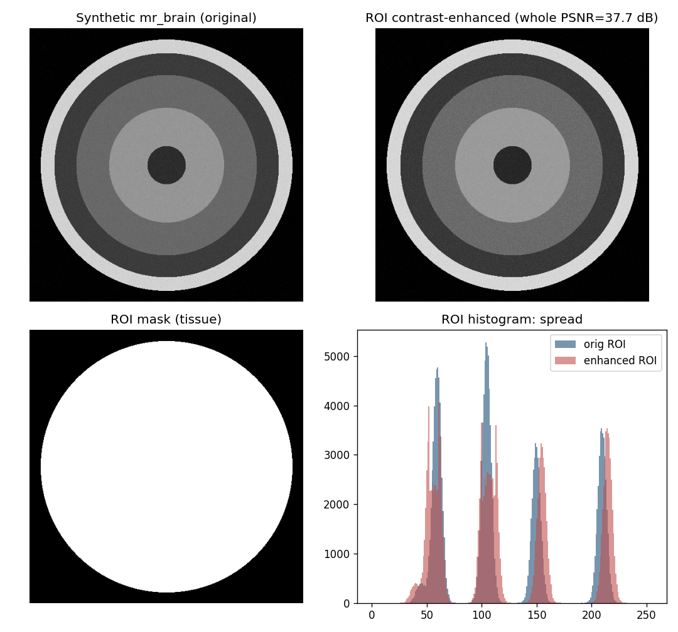
Proposed Method
• Segment ROI.
• Split ROI histogram into groups.
• Stretch each group + embed bits.
• Background untouched -> exact recovery.

Slide 6
Workflow
• Segment ROI (tissue).
• Enhance ROI histogram + embed payload.
• Leave background untouched.
• Reverse -> exact original.

Slide 7
Mathematical Model
• ROI pixels expanded outward around peaks; 1 bit / peak pixel.
• ROI RMS contrast sigma rises; whole-image PSNR bounded.
• AMBE tracks ROI brightness stability.

Slide 8
Experimental Setup
• Synthetic MR/CT phantoms (no real patient data available).
• Tissue ROI via thresholding; iterations swept.
• Metrics: ROI payload, whole PSNR, ROI contrast/entropy, reversibility.

Slide 9
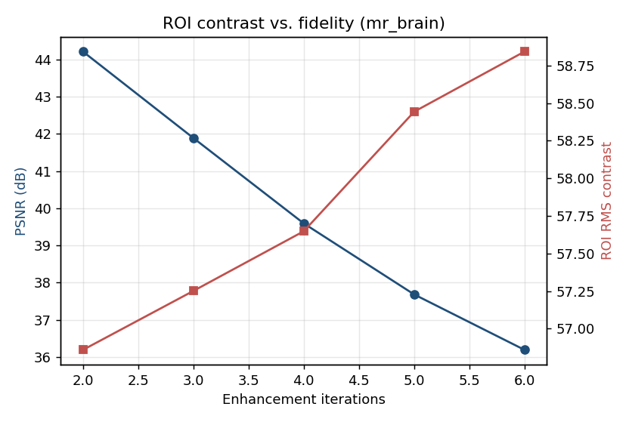
Results
• Stronger, more uniform ROI contrast gain.
• Whole PSNR maintained.
• Bit-exact reversible.

Slide 10
Advantages
• Better generalisability.
• Uniform tissue contrast.
• Reversible.

Slide 11
Limitations
• Synthetic phantoms.
• Approximate grouping.
• PSNR cost at strong CE.

Slide 12
Future Scope
• Adaptive group counts.
• Real datasets.
• Local + multi-group fusion.

Slide 13
Conclusion
• Reproduced ROI-restricted reversible contrast enhancement.
• Confirmed ROI contrast gain with exact recovery on phantoms.

Slide 14
References
• Gao et al. Multi-Group Stretching ROI. IEEE TMM 26, 2024.
• Wu, Dugelay, Shi. CE-RDH. IEEE SPL 22(1), 2015.
• Ni et al. RDH. IEEE TCSVT 16(3), 2006.

