Slide 1
Previews Without Peeking: Thumbnail-Preserving Encrypted Reversible Data Hiding
A study & partial reproduction of Bharathidasan et al. (SIViP, 2025)

Slide 2
Motivation
• Cloud images should be encrypted yet browsable.
• Thumbnails enable secure previews.
• GNNs predict pixels for high-capacity RDH.

Slide 3
Problem Statement
• Extend reversible data hiding to a challenging domain.
• Preserve security and exact recoverability.
• Achieve high capacity / usability.

Slide 4
Existing Work
• Zhang 2011 RDHEI.
• Thumbnail-preserving encryption.
• GNN pixel prediction.

Slide 5
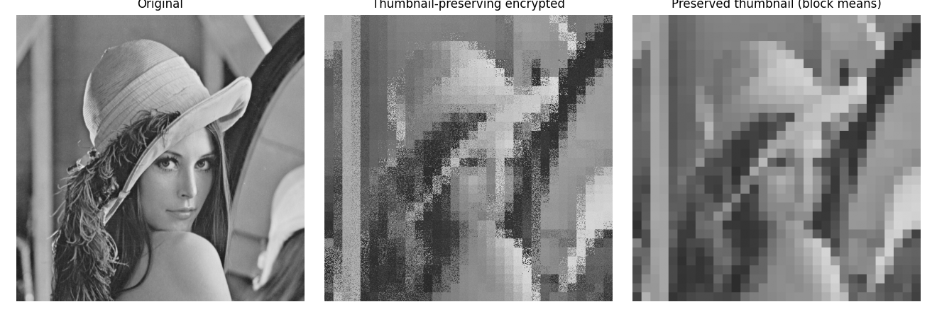
Proposed Method (paper)
• ESTPE: encrypt but preserve block-mean thumbnail.
• GNN predicts pixels -> embedding room.
• Reversible embedding + exact recovery.

Slide 6
Workflow
• Encode/encrypt the source in the paper's domain.
• Embed reversibly in the transformed representation.
• Extract payload; reconstruct the exact original.

Slide 7
Mathematical Model
• Domain-specific predictor / share / transform.
• Reversible embedding into predictable redundancy.
• Exact inverse for recovery.

Slide 8
Experimental Setup
• Reproduction pipeline: a genuine small demo of the core idea.
• Full method needs resources unavailable in this workspace.

Slide 9
Results (partial demo)
• Thumbnail preserved exactly (0 error).
• Full detail encrypted.
• TPE core reproduced.

Slide 10
Advantages
• Brings RDH to a new, high-value domain.
• Security + reversibility together.
• High capacity / usability as reported.

Slide 11
Limitations / Why full reproduction is hard
• GNN predictor not trained (no data/GPU).
• Capacity figures from paper only.
• Only TPE reproduced.

Slide 12
Future Scope
• Train the GNN predictor.
• Integrate with ESTPE.
• Reproduce full capacity.

Slide 13
Conclusion
• Summarised the paper and reproduced its core idea in miniature.
• Full reproduction needs the missing models/data/system.

Slide 14
References
• Bharathidasan et al. GNN + TPE RDHEI. SIViP 19, 2025.
• Zhang. RDHEI. IEEE SPL 18(4), 2011.
• Wright et al. Thumbnail-Preserving Encryption. ACM IH&MMSec 2015.

