Slide 1
Hiding Data Without a Trace: Histogram-Shifting Reversible Watermarking
A reproduction of Ni, Shi, Ansari & Su (IEEE TCSVT, 2006)

Slide 2
Motivation
• Medical / military / legal imaging cannot tolerate any permanent change to the cover image.
• We need to hide data AND restore the pixel-exact original after extraction.
• Goal: high fidelity + zero-loss recovery with a tiny key.

Slide 3
Problem Statement
• Embed a payload into an 8-bit grayscale image.
• Extract the payload later.
• Recover the original image with no distortion (bit-exact).
• Keep the marked image visually identical to the original.

Slide 4
Existing Work
• Lossless compression embedding (Fridrich 2002): low capacity, ~38 dB.
• Difference expansion (Tian 2003): higher capacity, needs a location map.
• This paper: histogram shifting — simple, high PSNR, no cover compression.

Slide 5
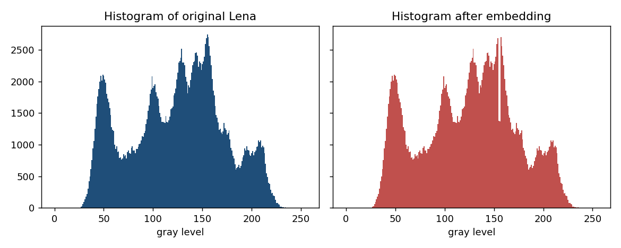
Proposed Method
• Find a peak bin P (most frequent gray value) and a zero bin Z (absent value).
• Shift the band between P and Z by one level to free the slot next to P.
• Embed bits into peak pixels: '1' -> move to slot, '0' -> stay.
• Capacity of one pair = height of the peak.

Slide 6
Workflow
• Compute histogram -> pick (peak, zero) pairs.
• Shift band -> embed payload into peaks.
• Transmit marked image + (P,Z) key.
• Receiver: read bits, collapse slot, un-shift band -> exact original.

Slide 7
Mathematical Model
• Direction d = +1 if Z>P else -1; slot s = P+d.
• Shift: v' = v + d for P < v < Z.
• Embed: peak pixel with bit b -> P + b*d.
• MSE <= 1 => PSNR >= 48.13 dB (theoretical bound).

Slide 8
Experimental Setup
• Eight 512x512 USC-SIPI grayscale images.
• Configurations: 1, 3 and 5 (peak,zero) pairs.
• Payload = full available capacity (pseudo-random bits).
• Metrics: capacity (bpp), PSNR, SSIM, exact-reversibility check.

Slide 9
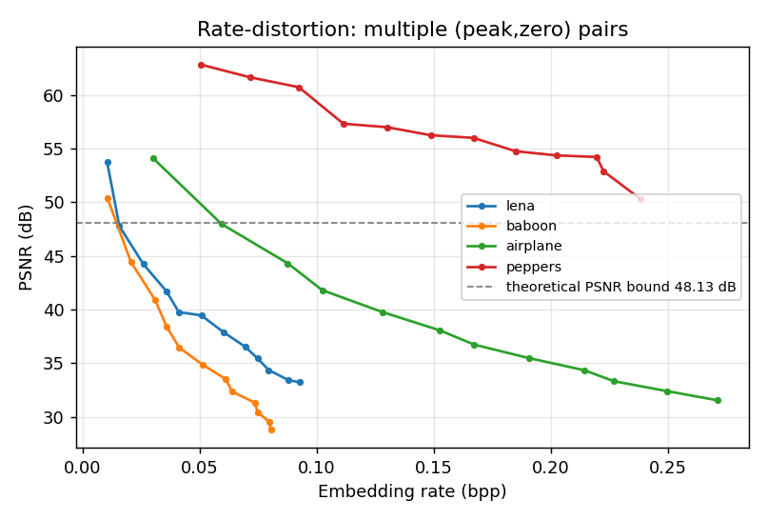
Results
• Bit-exact reversibility for every image and configuration.
• Single-pair PSNR ~50-55 dB, above the 48.13 dB bound.
• Capacity vs PSNR trades off cleanly as pairs increase.

Slide 10
Advantages
• Extremely simple and fast (integer arithmetic only).
• Very high image fidelity, guaranteed PSNR floor.
• No cover compression; negligible key size.

Slide 11
Limitations
• Capacity limited by peak height; poor for flat/textured histograms.
• Needs empty bins (or overhead) as zero points.
• Absolute numbers depend on the exact image variant.

Slide 12
Future Scope
• Prediction-error histograms for much higher capacity.
• Adaptive multi-pair selection.
• Extension to encrypted-domain RDH (RDHEI).

Slide 13
Conclusion
• Reproduced Ni et al. (2006) end to end.
• Confirmed exact reversibility and the 48.13 dB PSNR bound.
• Serves as the tested baseline for the other RDH papers in this project.

Slide 14
References
• Ni, Shi, Ansari, Su. Reversible Data Hiding. IEEE TCSVT 16(3), 2006.
• Tian. Difference Expansion. IEEE TCSVT 13(8), 2003.
• Fridrich et al. Lossless Data Embedding. SPIE 4675, 2002.
• Wang et al. SSIM. IEEE TIP 13(4), 2004.

