Slide 1
CHAT CONNECT APP

Slide 2
DESCRIPTION
ChatConnect is a native, real-time messaging application built with Kotlin, featuring the MVVM (Model-View-ViewModel) design pattern to provide a well-structured, scalable, and maintainable architecture. The app leverages Firebase Firestore for secure and efficient data storage, allowing users to exchange messages seamlessly and reliably.
To ensure users are always updated, Firebase Cloud Messaging is integrated for real-time notifications, even when the app is closed, keeping users informed about new messages instantly.
Background tasks and data flow are managed by Kotlin Coroutines, optimizing app responsiveness and enabling smooth multitasking without lag or delay. Dependency management is streamlined with Dagger Hilt, simplifying the code structure and making it easier to maintain and test.
Additionally, Jetpack components like ViewModel and LiveData are utilized to improve performance, responsiveness, and overall user experience. Together, these technologies make ChatConnect a robust, efficient, and engaging platform for real-time communication..

Slide 3
ChatAdapter.kt:
package com.arun.chatingapp.adapter
import android.graphics.Bitmap
import android.view.LayoutInflater
import android.view.View
import android.view.ViewGroup
import androidx.recyclerview.widget.RecyclerView
import com.arun.chatingapp.databinding.ItemReceivedMessageBinding
import com.arun.chatingapp.databinding.ItemSendMessageBinding
import com.arun.chatingapp.model.ChatMessage
import com.arun.chatingapp.utils.Constant.VIEW_TYPE_RECEIVED
import com.arun.chatingapp.utils.Constant.VIEW_TYPE_SEND
import java.util.*
class ChatAdapter(
private val senderId: String,
private val chatMessages: List<ChatMessage>
) :
RecyclerView.Adapter<RecyclerView.ViewHolder>() {

Slide 4
private var profileImage: Bitmap? = null
private var chatMessagesList = mutableListOf<ChatMessage>()
init {
chatMessagesList.addAll(chatMessages)
}
class SendMessageViewHolder(val binding: ItemSendMessageBinding) :
RecyclerView.ViewHolder(binding.root) {
fun setData(message: ChatMessage) {
binding.apply {
tvMessage.text = message.message
tvDateTime.text = message.dateTime
}
}
}
}

Slide 5
class ReceivedMessageViewHolder(private val binding: ItemReceivedMessageBinding) :
RecyclerView.ViewHolder(binding.root) {
fun setData(message: ChatMessage, profileImage: Bitmap?) {
binding.apply {
tvMessage.text = message.message
tvDateTime.text = message.dateTime profileImage?.let { ivProfile.setImageBitmap(profileImage) }
}
}
}
fun addMessage(newMessage: List<ChatMessage>, rvChat: RecyclerView) { chatMessagesList.addAll(newMessage)
chatMessagesList.sortBy { it.date }
if (chatMessagesList.isNotEmpty()) {
notifyItemRangeInserted(chatMessagesList.size, newMessage.size) rvChat.smoothScrollToPosition(chatMessagesList.size - 1)
}
rvChat.visibility = View.VISIBLE }

Slide 6
fun getMessageSize() = chatMessagesList.size
override fun onCreateViewHolder(parent: ViewGroup, viewType: Int): RecyclerView.ViewHolder {
return if (viewType == VIEW_TYPE_SEND) { SendMessageViewHolder(ItemSendMessageBinding.inflate(LayoutInflater.from(parent.context), parent, false)) }
else { ReceivedMessageViewHolder(ItemReceivedMessageBinding.inflate(LayoutInflater.from(parent.context), parent, false)) }
}
override fun onBindViewHolder(holder: RecyclerView.ViewHolder, position: Int) {
if (getItemViewType(position) == VIEW_TYPE_SEND) {
val sendHolder = holder as SendMessageViewHolder sendHolder.setData(chatMessagesList[position]) }
else {
val receivedHolder = holder as ReceivedMessageViewHolder receivedHolder.setData(chatMessagesList[position], profileImage)
} }

Slide 7
fun setProfileImage(profileImage: Bitmap) {
this.profileImage = profileImage
notifyDataSetChanged()
}
override fun getItemCount() = chatMessagesList.size
override fun getItemViewType(position: Int): Int {
return if (chatMessagesList[position].senderId == senderId)
VIEW_TYPE_SEND
else
VIEW_TYPE_RECEIVED
} }
RecentConversationsAdapter.kt:
package com.arun.chatingapp.adapter
import android.view.LayoutInflater
import android.view.ViewGroup
import androidx.recyclerview.widget.RecyclerView
import com.arun.chatingapp.databinding.ItemUserListBinding
import com.arun.chatingapp.databinding.ItemUserListRecentConversionBinding import com.arun.chatingapp.model.ChatMessage
import com.arun.chatingapp.model.User
import com.arun.chatingapp.utils.decodeToBitmap

Slide 8
class RecentConversationsAdapter : RecyclerView.Adapter<RecentConversationsAdapter.ConversationViewHolder>() {
private var recentConversationList = mutableListOf<ChatMessage>()
var onClickConversation: ((User) -> Unit)? = null
override fun onCreateViewHolder(parent: ViewGroup, viewType: Int) = ConversationViewHolder(ItemUserListRecentConversionBinding.inflate(LayoutInflater.from(parent.context), parent, false))
override fun onBindViewHolder(holder: ConversationViewHolder, position: Int) { holder.setData(recentConversationList[position])
}
override fun getItemCount() = recentConversationList.size
fun getRecentList() = recentConversationList
fun updateRecentConversion(conversation: List<ChatMessage>) {
recentConversationList.clear()
recentConversationList.addAll(conversation)
notifyDataSetChanged()
}

Slide 9
inner class ConversationViewHolder(private val binding: ItemUserListRecentConversionBinding) : RecyclerView.ViewHolder(binding.root) {
fun setData(chatMessage: ChatMessage) {
with(binding) {
tvName.text = chatMessage.conversionName
tvRecentMessage.text = chatMessage.message ivProfile.setImageBitmap(chatMessage.conversionImage?.decodeToBitmap())
root.setOnClickListener {
onClickConversation?.let { it1 ->
it1(User(
id = chatMessage.conversionId.toString(),
name = chatMessage.conversionName.toString(),
image = chatMessage.conversionImage.toString() ))
} }
} }
}
}

Slide 10
UsersAdapter.kt:
package com.arun.chatingapp.adapter
import android.view.LayoutInflater
import android.view.ViewGroup
import androidx.recyclerview.widget.DiffUtil
import androidx.recyclerview.widget.ListAdapter
import androidx.recyclerview.widget.RecyclerView
import com.arun.chatingapp.databinding.ItemUserListBinding
import com.arun.chatingapp.model.User
import com.arun.chatingapp.utils.decodeToBitmap
import javax.inject.Inject
class UsersAdapter @Inject constructor() : ListAdapter<User, UsersAdapter.UserViewHolder>(UserDiffer()) {
class UserViewHolder(val binding: ItemUserListBinding) : RecyclerView.ViewHolder(binding.root) {
fun onUserBind(user: User) {
binding.apply {
tvName.text = user.name
tvEmail.text = user.email
ivProfile.setImageBitmap(user.image?.decodeToBitmap())
}
}
}

Slide 11
class UserDiffer : DiffUtil.ItemCallback<User>() {
override fun areItemsTheSame(oldItem: User, newItem: User): Boolean {
return oldItem.token == newItem.token
}
override fun areContentsTheSame(oldItem: User, newItem: User): Boolean {
return oldItem.hashCode() == newItem.hashCode()
}
}
override fun onCreateViewHolder(parent: ViewGroup, viewType: Int) = UserViewHolder(ItemUserListBinding.inflate(LayoutInflater.from(parent.context), parent, false))
override fun onBindViewHolder(holder: UserViewHolder, position: Int) {
val user = currentList[position]
holder.onUserBind(user)
holder.binding.root.setOnClickListener {
onUserClick?.let { it1 -> it1(user) }
}
}
var onUserClick: ((User) -> Unit)? = null
}

Slide 12
ExampleInstrumentedTest.kt:
package com.arun.chatingapp
import androidx.test.platform.app.InstrumentationRegistry
import androidx.test.ext.junit.runners.AndroidJUnit4
import org.junit.Test
import org.junit.runner.RunWith
import org.junit.Assert.*
@RunWith(AndroidJUnit4::class)
class ExampleInstrumentedTest {
@Test
fun useAppContext() {
// Context of the app under test.
val appContext = InstrumentationRegistry.getInstrumentation().targetContext
assertEquals("com.arun.chatingapp", appContext.packageName)
}
}

Slide 13
ChatFragment.kt:
package com.arun.chatingapp.ui.chat
import android.content.SharedPreferences
import android.os.Bundle
import android.view.View
import androidx.core.view.isVisible
import androidx.fragment.app.Fragment
import androidx.fragment.app.viewModels
import androidx.navigation.fragment.findNavController
import androidx.recyclerview.widget.LinearLayoutManager
import com.arun.chatingapp.R
import com.arun.chatingapp.adapter.ChatAdapter
import com.arun.chatingapp.databinding.ChatFragmentBinding
import com.arun.chatingapp.model.ChatMessage
import com.arun.chatingapp.model.User
import com.arun.chatingapp.utils.Constant
import com.arun.chatingapp.utils.decodeToBitmap
import dagger.hilt.android.AndroidEntryPoint
import javax.inject.Inject

Slide 14
@AndroidEntryPoint
class ChatFragment : Fragment(R.layout.chat_fragment) {
private lateinit var binding: ChatFragmentBinding
private val viewModel: ChatViewModel by viewModels()
private lateinit var user: User
private lateinit var chatAdapter: ChatAdapter
@Inject
lateinit var pref: SharedPreferences
override fun onViewCreated(view: View, savedInstanceState: Bundle?) {
super.onViewCreated(view, savedInstanceState)
binding = ChatFragmentBinding.bind(view)
getArgument()
setClickListener()
setRecyclerview()
binding.tvName.text = user.name
binding.ivUserImage.setImageBitmap(user.image?.decodeToBitmap())

Slide 15
observeChat()
}
private fun getArgument() {
arguments?.let {
user = ChatFragmentArgs.fromBundle(it).user
}
}
private fun observeChat() {
viewModel.eventListener(user.id, object : ChatObserver {
override fun observeChat(newChat: List<ChatMessage>) {
if (newChat.isNotEmpty()) {
chatAdapter.addMessage(newChat, binding.rvChat)
}
binding.pb.visibility = View.GONE
viewModel.conversionId.isEmpty().let {
if (chatAdapter.getMessageSize() != 0) {
viewModel.checkForConversation(user.id)
}
}
}
})
}

Slide 16
private fun setClickListener() {
binding.ivBack.setOnClickListener { findNavController().popBackStack() }
binding.ivSend.setOnClickListener {
if (binding.etMessage.text.isNullOrBlank() && binding.etMessage.text.toString().trim().length < 0)
return@setOnClickListener
viewModel.sendMessage(binding.etMessage.text.trim().toString(), user)
binding.etMessage.text.clear()
}
}
private fun setRecyclerview() {
chatAdapter = ChatAdapter(pref.getString(Constant.KEY_USER_ID, null).toString(),
emptyList())
user.image?.let {
chatAdapter.setProfileImage(it.decodeToBitmap())
}
binding.rvChat.apply {
adapter = chatAdapter
layoutManager = LinearLayoutManager(requireContext())
}
}

Slide 17
interface ChatObserver {
fun observeChat(newChat: List<ChatMessage>)
}
override fun onResume() {
super.onResume()
viewModel.listenerAvailabilityOfReceiver(user.id) { availability, fcm, profileImage ->
binding.tvAvailability.isVisible = availability
user.token = fcm
if (user.image.isNullOrEmpty()) {
user.image = profileImage
binding.ivUserImage.setImageBitmap(user.image?.decodeToBitmap())
chatAdapter.setProfileImage(user.image?.decodeToBitmap()!!)
}
}
}
}

Slide 18
AndroidManifest.xml:
<?xml version="1.0" encoding="utf-8"?>
<manifest xmlns:android="http://schemas.android.com/apk/res/android"
package="com.arun.chatingapp">
<uses-permission android:name="android.permission.INTERNET"/>
<application
android:allowBackup="true"
android:icon="@mipmap/ic_launcher"
android:label="@string/app_name"
android:name=".ChatApplication"
android:roundIcon="@mipmap/ic_launcher_round"
android:supportsRtl="true"
android:theme="@style/Theme.ChatApp">
<activity
android:name=".ui.registration.RegistrationActivity"
android:windowSoftInputMode="adjustResize"
android:exported="true">
<intent-filter>
<action android:name="android.intent.action.MAIN" />

Slide 19
<category android:name="android.intent.category.LAUNCHER" />
</intent-filter>
</activity>
<activity
android:name=".ui.main.MainActivity"
android:windowSoftInputMode="adjustResize"
android:exported="true"/>
<service
android:name=".fcmservice.MessagingService"
android:exported="false">
<intent-filter>
<action android:name="com.google.firebase.MESSAGING_EVENT"/>
</intent-filter>
</service>
</application>
</manifest>

Slide 20
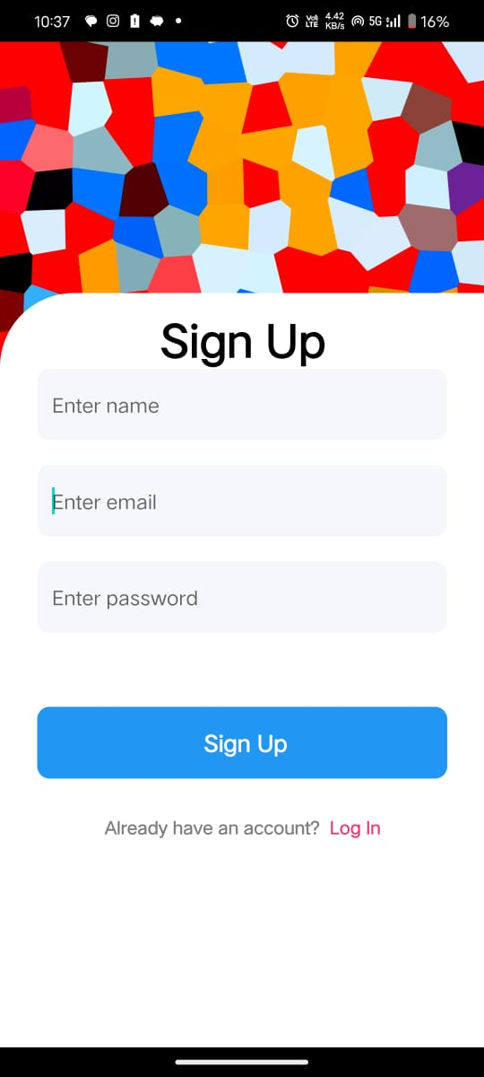
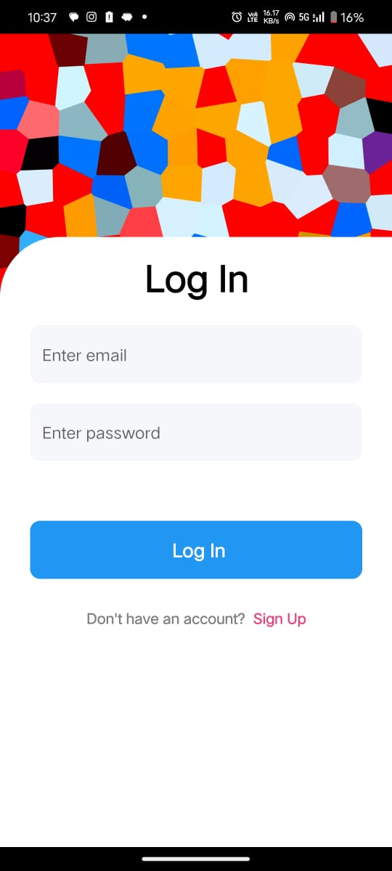
OUTPUT:

Slide 21
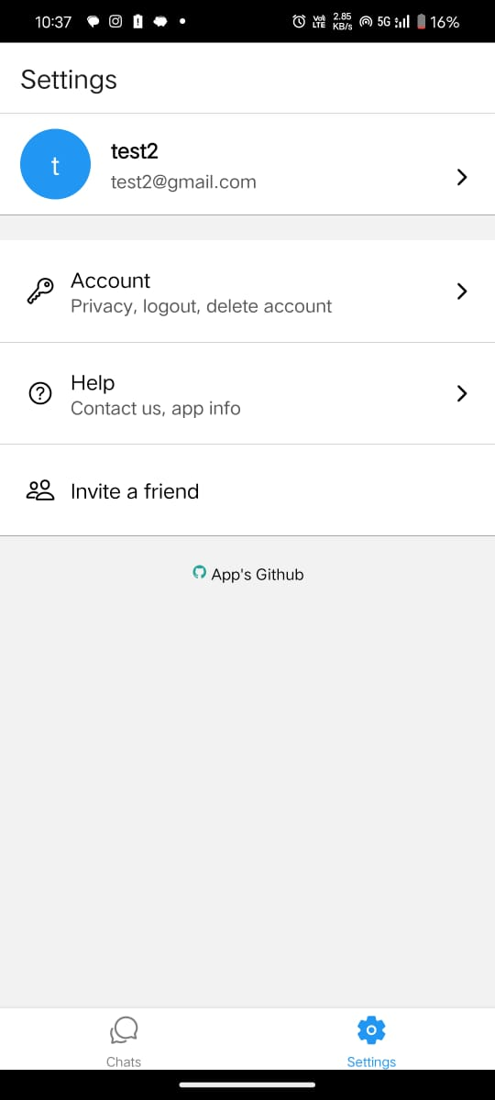
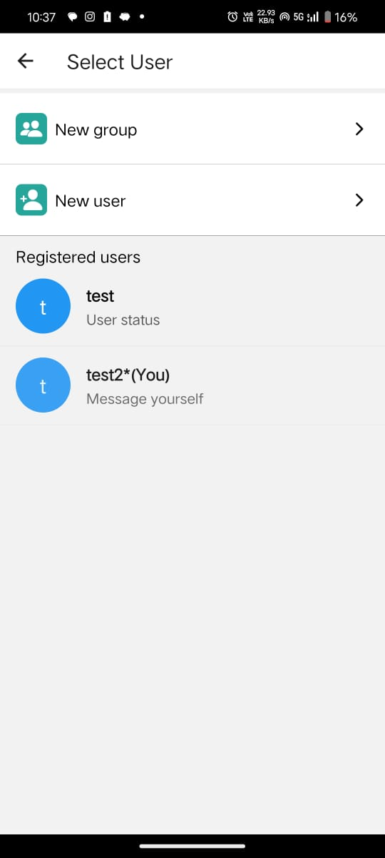

Slide 22
