Slide 1
ChatConnect App

Slide 2
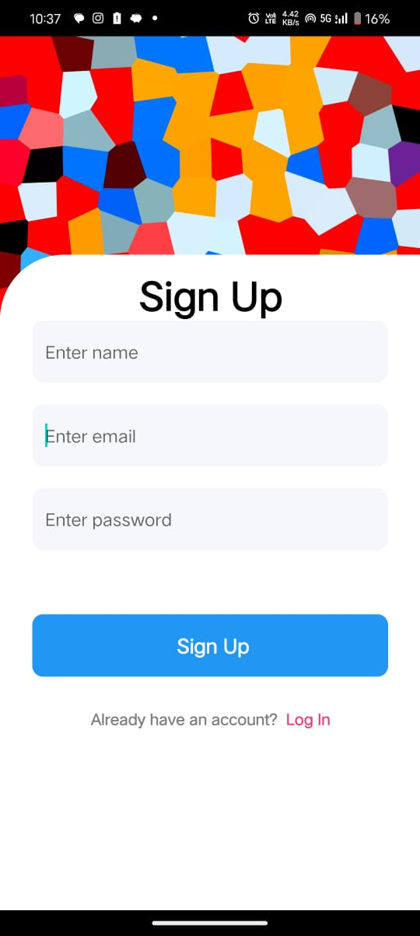
OUTPUT SCREENSHOTS
Fig 1: SignUp page

Slide 3
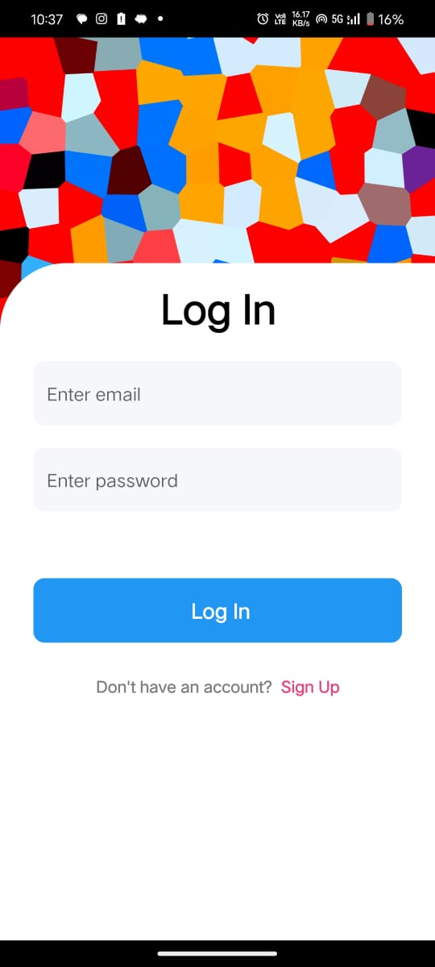
Fig 2: Login Page

Slide 4
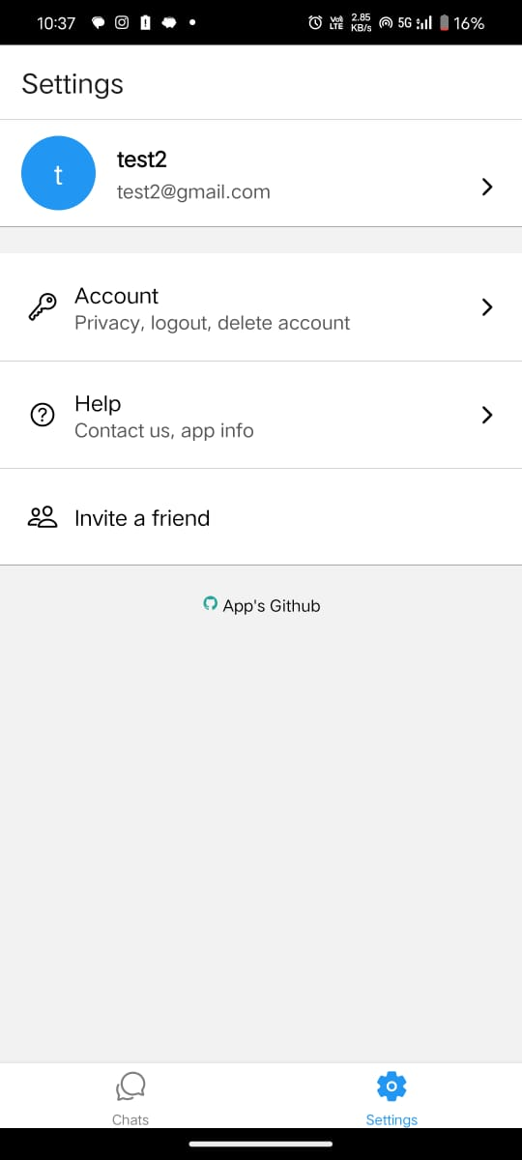
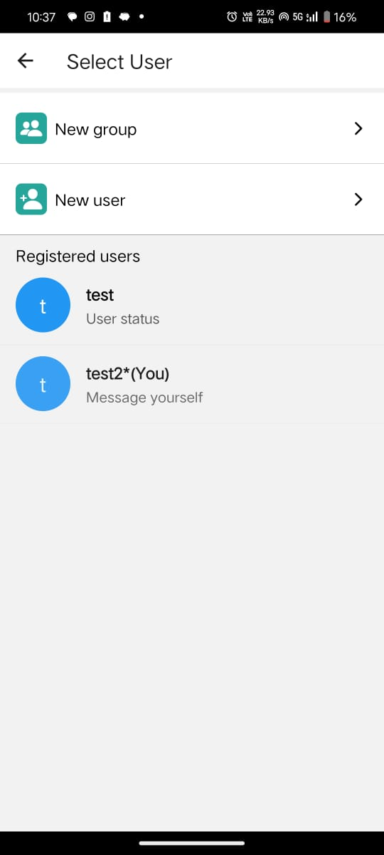
Fig 3: Sender’s side chat & settings

Slide 5
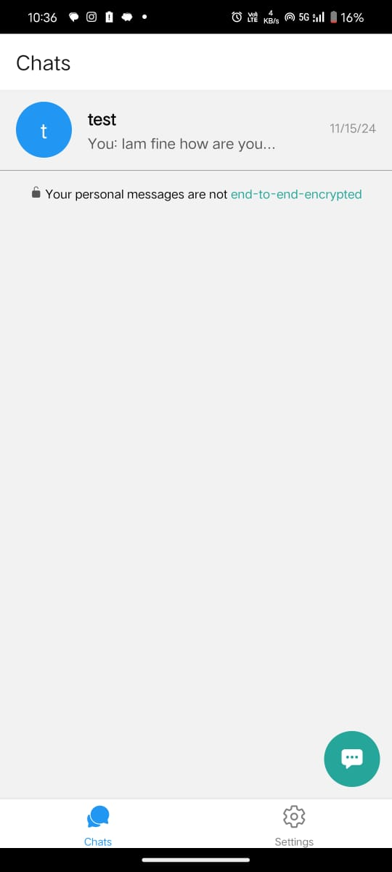
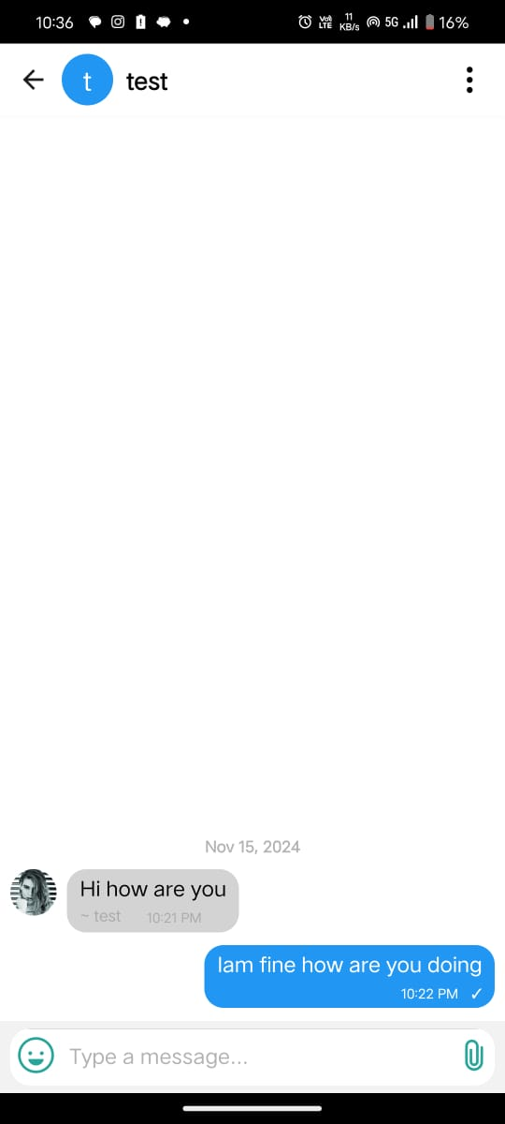
Fig 4 : Sender
Fig 5: Receiver

