Slide 1
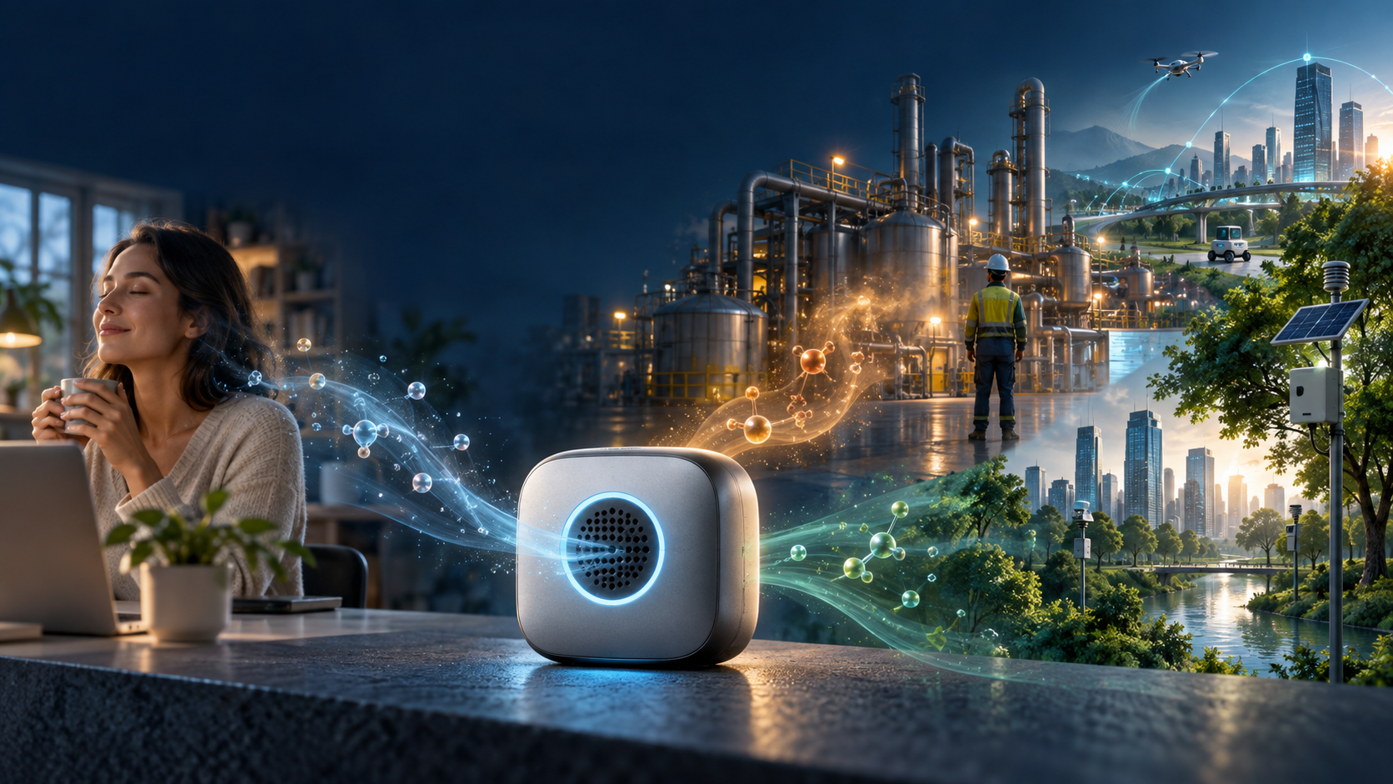
A Tiny Electronic Nose
for Safer Spaces
Keeping detection reliable as sensors change
Arun Kumar Gharami
Florida Atlantic University
PhD Student, Computer Engineering
Electrical Engineering and Computer Science
Notes:
3MT SPEAKER SCRIPT - TARGET 2:55
0:00-0:24
Imagine a nose that never sleeps. It could sit in a home, a factory, beside a highway, or inside a future smart city. But this nose is not biological. It is an electronic nose: chemical sensors connected to a tiny AI model.
DELIVERY CUE: Start slowly. Look at the audience after the first sentence.
0:24-0:43
The idea is simple. Air reaches the sensors. The sensors create a chemical fingerprint. The AI recognizes the pattern and can produce a warning.
DELIVERY CUE: Use one hand to trace the flow: air -> sensor -> AI -> warning.
0:43-1:13
But there is a hidden problem. Sensors change. As they age, heat, humidity, contamination, and time can slowly alter the signals they produce. Think of a piano drifting out of tune. The song has not changed, but the instrument has. An AI model trained on the old sound may still answer with confidence, even when its senses are no longer reliable.
DELIVERY CUE: Pause after “Sensors change.” Let the piano analogy breathe.
1:13-1:38
That is exactly what I see in my chronological experiments. One compact baseline model was about 81 percent accurate on an early test batch. On much later sensor data, the same frozen model fell to about 37 percent. The model did not forget its mathematics. Its world changed.
DELIVERY CUE: Describe the early and late batches while addressing the audience. Do not rush the final line.
1:38-2:00
My research asks a simple question: how can we build a small AI system that notices this change, explains what it is using, and remains trustworthy enough to run beside the sensor on a low-power device?
DELIVERY CUE: This is the center of the talk. Deliver it as one clear question.
2:00-2:30
Why does that matter? For people, an electronic nose could help monitor indoor air and flag unusual chemical exposure. In factories, it could support earlier detection of leaks or changes in process conditions. For the environment, networks of small sensors could watch for pollution or toxic releases close to where they happen. And in the future, the same idea could give smart buildings, robots, farms, and cities a dependable sense of smell.
DELIVERY CUE: Move through the four applications with energy, but keep the word “could.”
2:30-2:48
My goal is not simply to make a machine that can smell on day one. I want to build one that can recognize when its own sense of smell is changing - and tell us when we should no longer trust it.
DELIVERY CUE: Slow down. This is your contribution in plain language.
2:48-3:00
Because trustworthy AI is not just AI that gives an answer. It is AI that knows when the world has changed. And that is the future I am working toward: tiny, explainable intelligence that can keep watching over people and the environment, even as its sensors grow old.
DELIVERY CUE: Finish on “grow old.” Stop. Smile. Do not add another sentence.
EVIDENCE NOTE: The 81.4% -> 37.4% headline is MODEL-C1 under the fixed-origin Batch-1 protocol, comparing chronological test Batch 2 with Batch 10. Describe application examples as potential directions ("could"), not demonstrated deployments.
Research advisor: Prof. María Mercedes Larrondo-Petrie.
Research title: Drift-Robust Explainable TinyML for Electronic-Nose Sensing.
Project: https://drift-robust-tinyml-research.vercel.app/
Brand colors source: https://www.fau.edu/university-communications/branding/visual-standards/
Illustration: retained from the supplied presentation. Potential safety applications have not been represented as validated deployments.

