Slide 1



IPL MATCH WINNER PREDICTION USING MACHINE LEARNING
ARUNIMA K

Slide 2
Overview
This project focuses on predicting IPL match outcomes using advanced
machine learning algorithms and selecting the best-performing model through evaluation and hyperparameter tuning.

Slide 3

Dataset Overview
The dataset contains detailed match-level information such as teams, venue, toss outcomes, match results, and player performances across multiple IPL seasons.
Key features include win margins, toss decisions, and indicators like Duckworth-Lewis application, which are essential for predicting match outcomes.

Slide 4

Data Preprocessing
Standardize Data Types
Handle Missing Values
Remove Duplicates
Outlier Detection and Removal
Feature Engineering

Slide 5
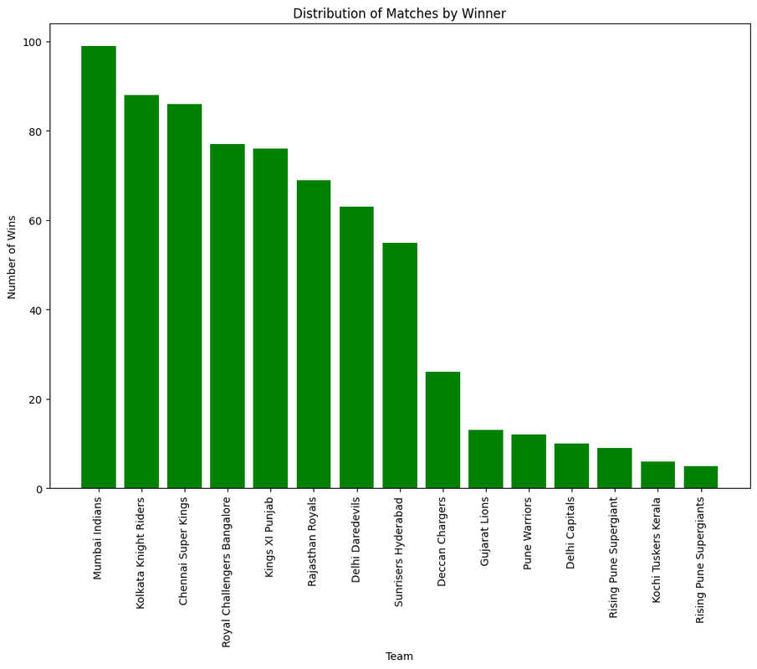
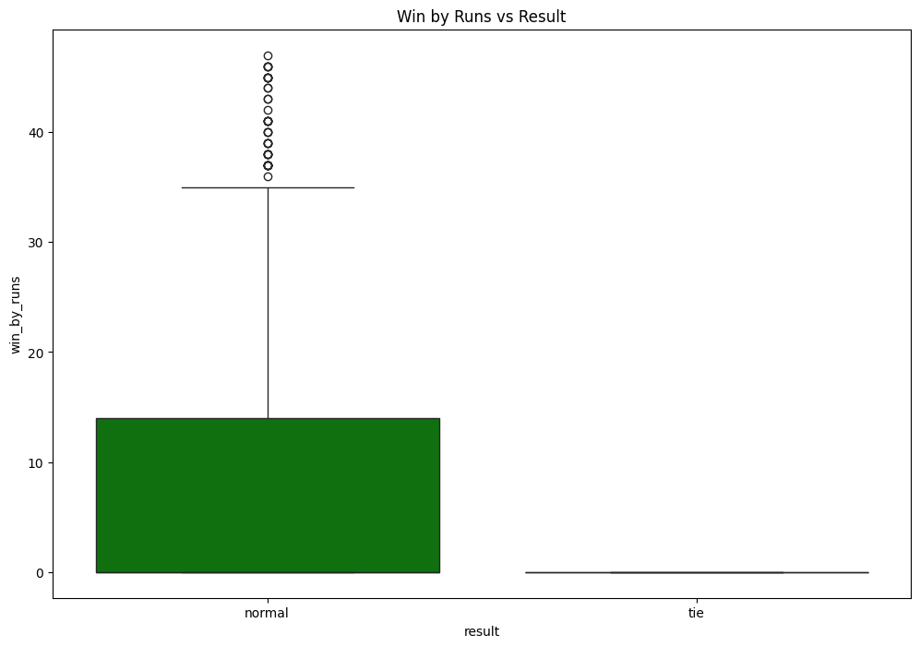
visualization

Slide 6
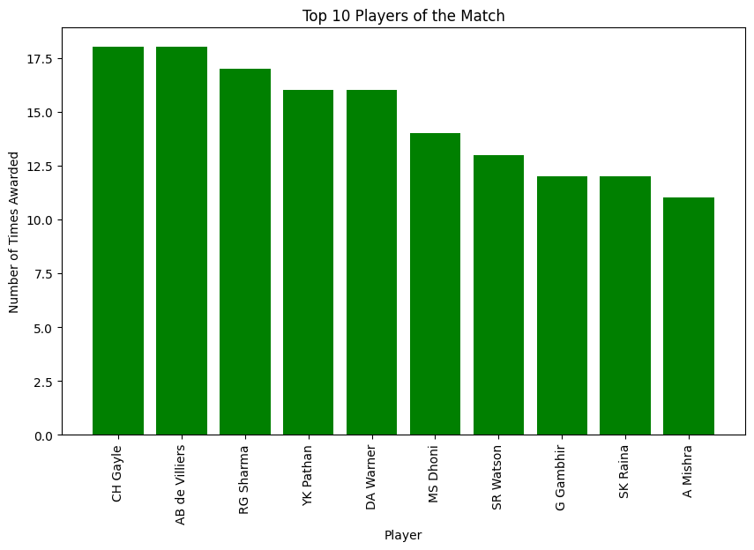
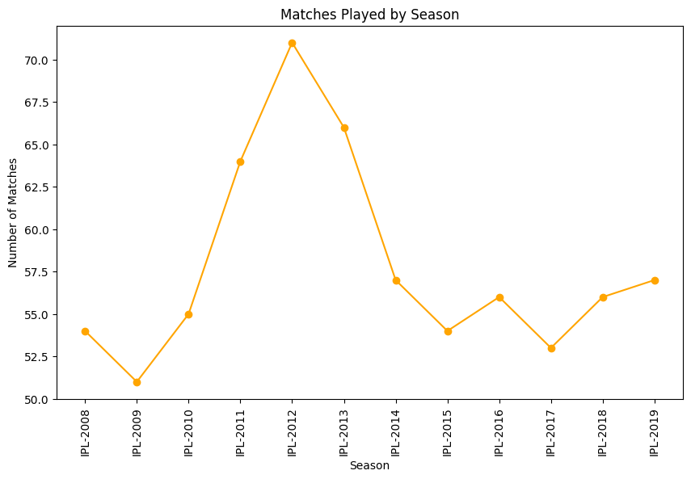
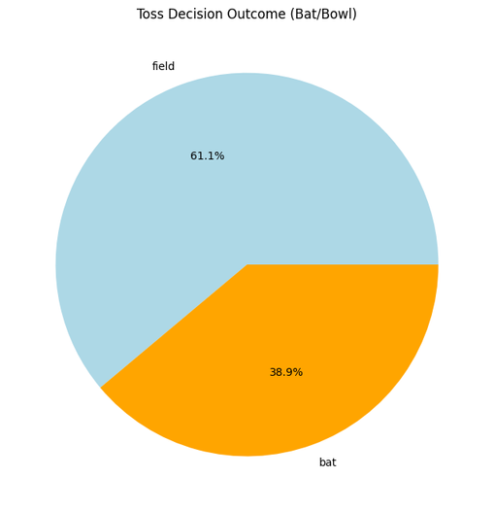

Slide 7
Supervised Machine Learning

Slide 8
Data Transformation for Supervised Machine Learning
Label Encoding: Converted categorical variables (e.g. Season, city,team1, team2, toss_winner,toss_decision, result,player_of_match, venue, umpire1,umpire2,winner) into numerical format using LabelEncoder to prepare the data for ML models.
Feature Scaling: Applied StandardScaler for normalization to standardize the feature values and improve model performance.

Slide 9
Model Training
Trained multiple supervised learning models:
Logistic Regression
K-Nearest Neighbors (KNN)
Support Vector Machine (SVM)
Decision Tree, Random Forest
XGBoost Classifier

Slide 10
Model | Accuracy
Logistic Regression | 28.7%
SVM | 44.6%
KNN | 41.7%
Decision Tree | 90.6%
Random Forest | 80.5%
XGBoost | 97.1%

Slide 11
Decision Tree – Hyperparameter Tuning
(GridSearchCV)
Applied GridSearchCV to improve model performance.
Best parameters identified:
Criterion = Entropy
Maximum _depth = 15
minimum _samples _leaf = 1
Through hyperparameter tuning, the Decision Tree model's performance improved from an initial accuracy of 90% to a cross-validation accuracy of 92% and a test accuracy of 96%.

Slide 12
Model Performance Improvement
Through hyperparameter tuning, the Decision Tree model's performance improved from an
initial accuracy of 90% to a cross-validation accuracy of 92% and a test accuracy of 96%.

Slide 13
Conclusion
XGBoost Classifier achieved the highest accuracy of 98%, outperforming all other models.
It also delivered the best precision and recall scores, making it the most reliable model for classification.
XGBoost is the most effective model for this dataset, offering both high accuracy and robustness in predictions.

Slide 14
Thank you

