Slide 1
LAPTOP PRICE PREDICTION AND CLUSTERING USING WEB SCRAPING AND MACHINE LEARNING
ARUNIMA K

Slide 2
WEB SCRAPING LAPTOP DATA FROM FLIPKART
LAPTOP DETAILS INCLUDING SPECIFICATIONS AND PRICES WERE SCRAPED FROM FLIPKART USING SELENIUM AND BEAUTIFULSOUP TO CREATE A STRUCTURED DATASET FOR ANALYSIS AND PREDICTION.

Slide 3
DATASET
Number Of Rows | 1176
Number Of Columns | 6
COLUMNS : TITLE, ORIGINAL PRICE, DISCOUNT PRICE, RATING, NUMBER OF REVIEWS, OFFERS

Slide 4
DATA PREPROCESSING
STANDARDIZE DATA TYPES
HANDLE MISSING VALUES
REMOVE DUPLICATES
OUTLIER DETECTION AND REMOVAL

Slide 5
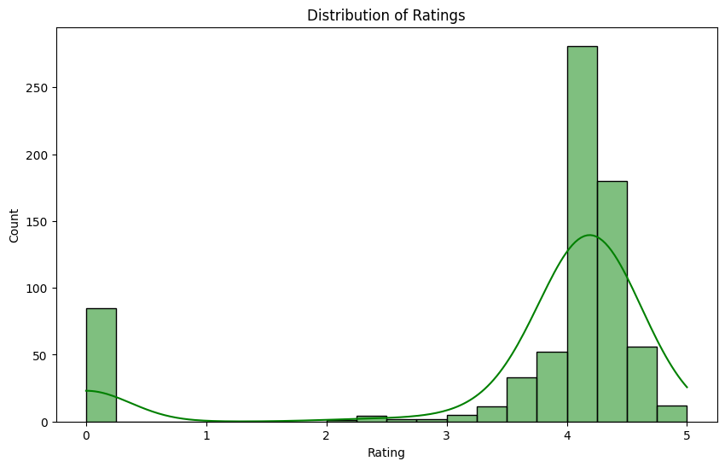
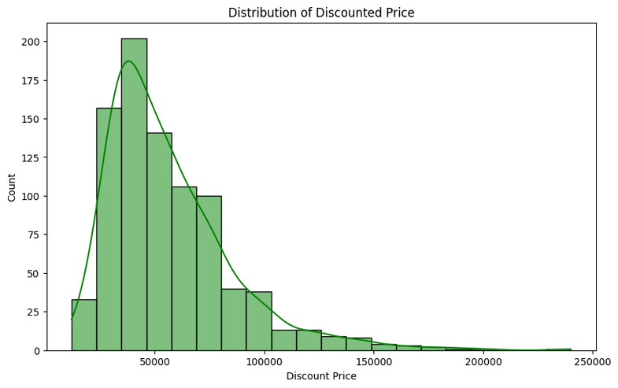
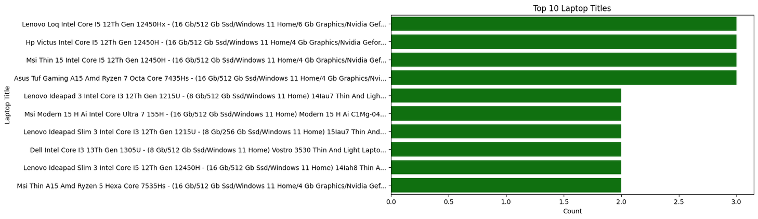
VISUALIZATION

Slide 6
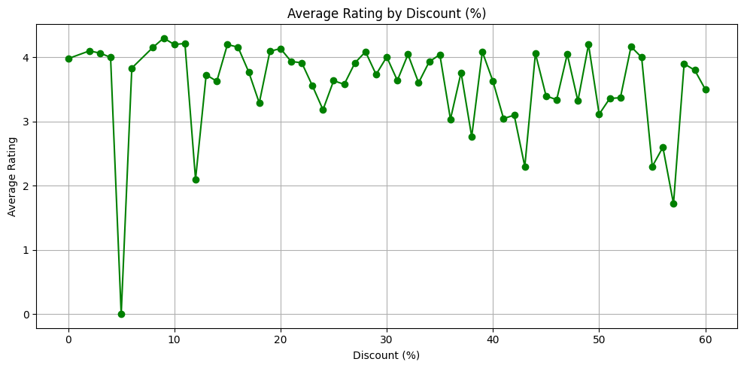
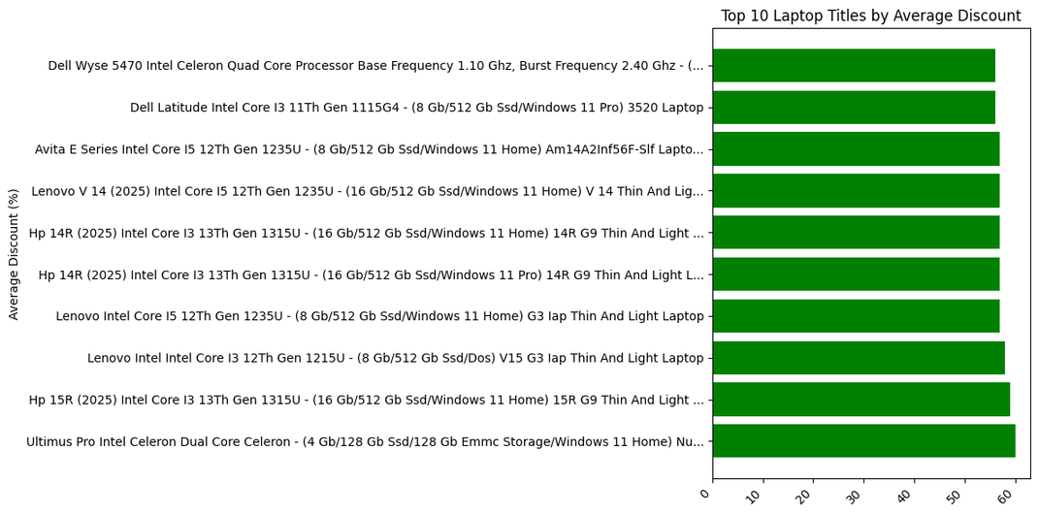
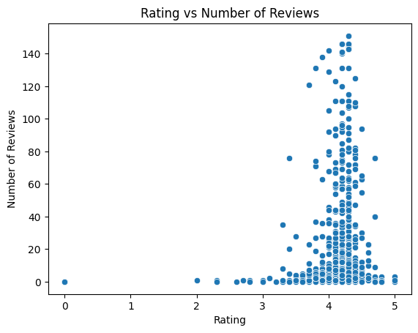
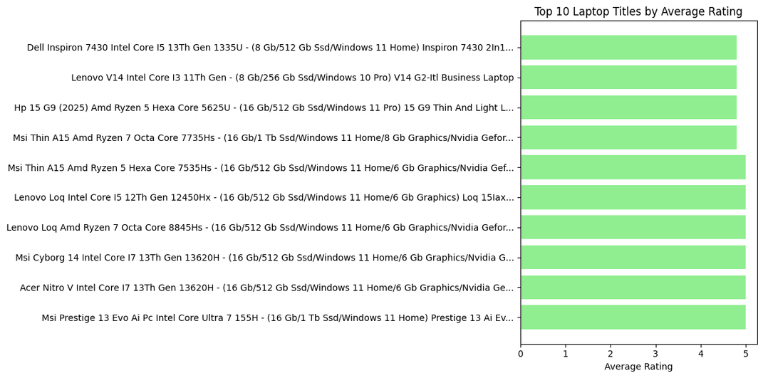

Slide 7
UNSUPERVISED MACHINE LEARNING

Slide 8
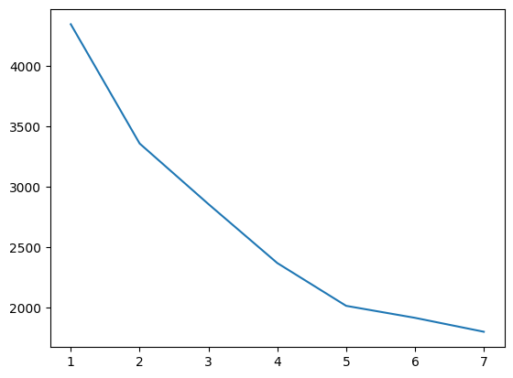
K-MEANS CLUSTERING

Slide 9
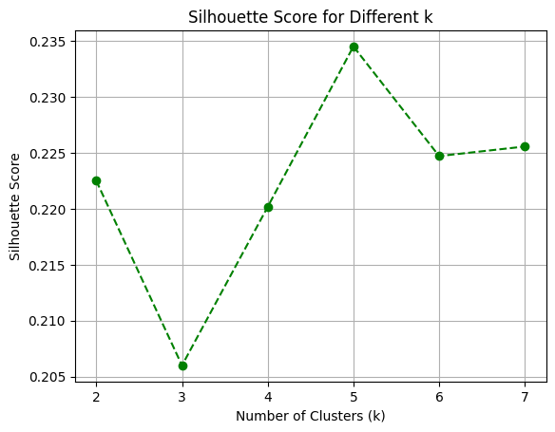
Silhouette Score

Slide 10
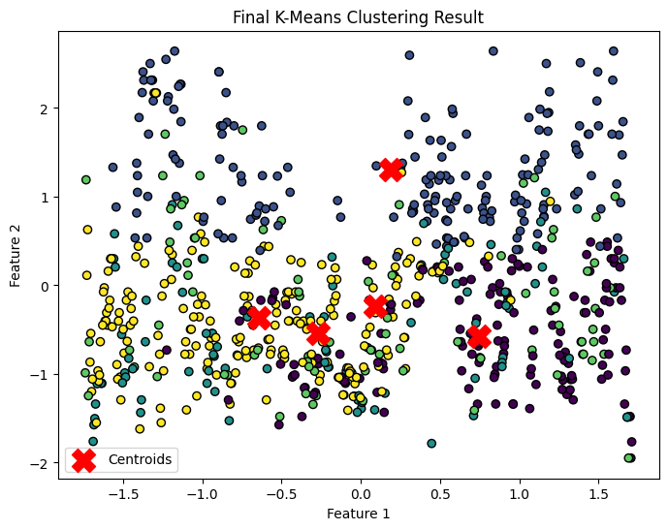
VISUALIZING CLUSTERS USING K-MEANS ALGORITHM (K = 5)

Slide 11
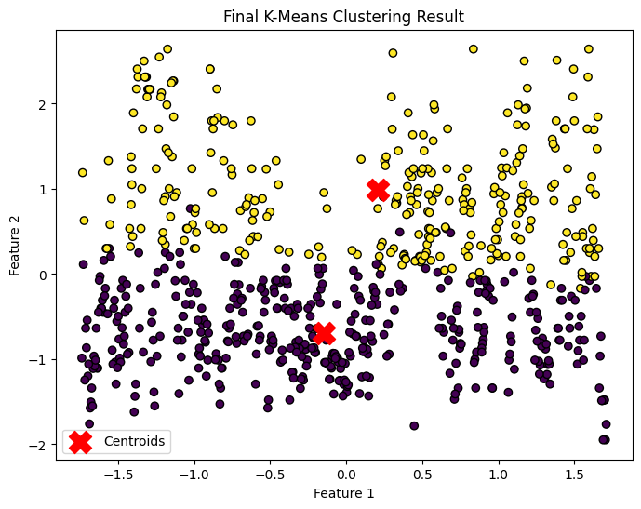
VISUALIZING CLUSTERS USING K-MEANS ALGORITHM (K = 2)

Slide 12
CLUSTER INSIGHTS VS DOMAIN KNOWLEDGE
KMeans identified 5 clusters based on data patterns, while domain knowledge indicates only 2 actual classes.
This suggests that the clustering captured sub-group variations within the main classes, supporting a semi-supervised learning approach.

Slide 13
SUPERVISED MACHINE LEARNING

Slide 14
MODEL TRAINING
Trained multiple supervised learning models:
Logistic Regression
K-Nearest Neighbors (KNN)
Support Vector Machine (SVM)
Decision Tree
Random Forest
XGBoost Classifier

Slide 15
Model | Accuracy
Logistic Regression | 98.29%
SVM | 96%
KNN | 96%
Decision Tree | 98.29%
Random Forest | 98.29%
XGBoost | 98.29%

Slide 16
HYPERPARAMETER TUNING
Initial SVM model achieved 96% accuracy before hyperparameter optimization.
GridSearchCV was used to systematically search for the best hyperparameters.
Best parameters found: C = 1, gamma = 1, kernel = 'linear'.
Final model achieved 100% accuracy with improved precision, recall, and F1-score after tuning.

Slide 17
CONCLUSION
Hyperparameter tuning using GridSearchCV enabled the SVM model to achieve 100% accuracy, demonstrating its effectiveness when optimally configured.

Slide 18
Thank you

